Slide 1
Speculative synchronization in StarSs, a task-based programming model
Rahulkumar Gayatri

Slide 2
Outline
StarSs (sequential parallel)
  Compiler directives (pragmas)
  Runtime features (Dependency Graph)
  Synchronization directives
Software Transactional Memory (STM) based concurrency control for critical memory updates
Speculative task generation
Moose Parallelization (current work)
  OpenMP and Pthread parallelization
  Optimizations

Slide 3
StarSs Programming Model
Implicit parallel programming model for widely used multi-core architectures
Single parallel application code for SMPs, Cell B.E, GPUs, cluster
Sequential application with pragmas
  Pragmas (compiler directives) to annotate a task
  Runtime schedules the tasks on the available resources
    Thread pool (Main and Worker threads)
    Task Dependency Graph (TDG)

Slide 4
Task pragma and its clauses
Application code is divided into fine grained tasks

Slide 5
Task pragma and its clauses
Application code is divided into fine grained tasks
#pragma css task clauses
void task (parameters)

Slide 6
Task pragma and its clauses
Application code is divided into fine grained tasks
#pragma css task clauses
void task (parameters)
input (list of parameters)
inout (list of parameters)
output (list of parameters)

Slide 7
StarSs: annotation of tasks
Sequential code
A
B
C
D
Time

Slide 8
StarSs: annotation of tasks
Sequential code
#pragma css task input(a) inout(b, c) \ output(d)
void A (a, b, c, d)
void B (e, f)
#pragma css task input(d) inout(b)
void C (d, b)
#pragma css task input(d) inout(c) output(e)
void D (d, c, e)
A
B
C
D
Time

Slide 9
StarSs: TDG
Sequential code
#pragma css task input(a) inout(b, c) \ output(d)
void A (a, b, c, d)
void B (e, f)
#pragma css task input(d) inout(b)
void C (d, b)
#pragma css task input(d) inout(c) output(e)
void D (d, c, e)
A
B
C
D
Time
TDG
t_{A}
t_{C}
t_{D}

Slide 10
StarSs: scheduling
Sequential code
#pragma css task input(a) inout(b, c) \ output(d)
void A (a, b, c, d)
void B (e, f)
#pragma css task input(d) inout(b)
void C (d, b)
#pragma css task input(d) inout(c) output(e)
void D (d, c, e)
A
B
C
D
Time
TDG
t_{A}
t_{C}
t_{D}
SMPSs scheduling
Main-thread
B
D
Worker-thread
A
C

Slide 11
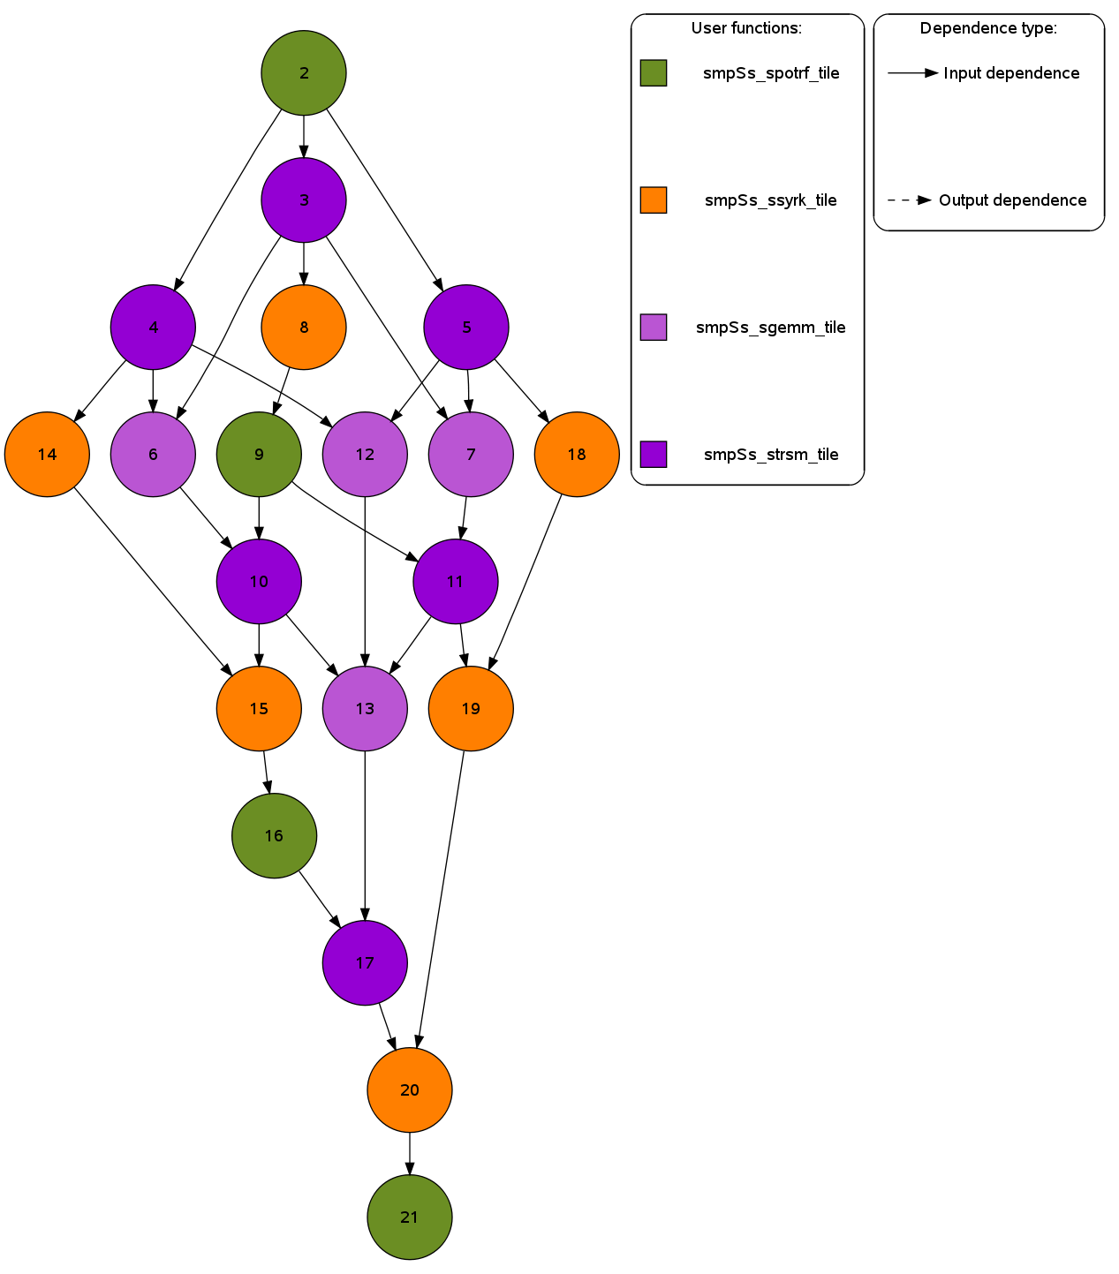
Cholesky TDG

Slide 12
StarSs: critical updates
Reduction clause
  does not create a dependency edge
Need synchronization to maintain correctness

Slide 13
StarSs: locks
# pragma css task input (n, j, a[n]) inout (results)\ reduction (results)
void nqueens_task (int n, int j, char* a, int* results)
{
...
# pragma css mutex lock (results)
*results = *results + local_sols;
# pragma css mutex unlock (results)
...
}

Slide 14
Drawbacks of lock-based synchronization
Deadlock – two concurrent threads wait for each other to release a resource, thus neither progress
Livelock – state of the threads change with regard to each other but neither progress
Priority inversion – Lower priority thread blocks the higher priority thread
Difficult to compose and debug
Not scalable

Slide 15
Software Transactional Memory
(STM)
Transaction
Series of read and writes to memory
Transaction 1
Transaction 2

Slide 16
STM: conflict detection
Transaction 1
Transaction 2
Read Memory
Location 0XA....
Read Memory
Location 0XF....
Conflict
detection
Update Memory
Location 0XA....
Critical Memory
Critical memory
Critical memory
Critical memory
Critical memory

Slide 17
STM: contention manager
Transaction 1
Transaction 2
Read Memory
Location 0XA....
Read Memory
Location 0XF....
Rollbaack and restart
Conflict
detection
Update Memory
Location 0XA....
Contention
manager
Successfull commit
And exit
Critical Memory
Critical memory
Critical memory
Critical memory
Critical memory

Slide 18
TinySTM
A light weight STM library
3 versions
  WRITE_BACK_ETL (check conflicts at encounter time)
  WRITE_BACK_CTL (check conflicts at commit time)
  WRITE_THROUGH (direcly update shared memory)

Slide 19
TinySTM in StarSs
Main and worker threads perform the necessary implementations
  Changes in configuration for the appropriate linking
Lock pragma starts a transaction and unlock pragma commits the transaction

Slide 20
Compiler vs runtime
Stack calls in TinySTM library make runtime implementation difficult
StarSs compiler replaces lock and unlock pragmas with TinySTM transaction calls.

Slide 21
Compiler transformations of lock and unlock
Start the transaction
Save the stack context
Load parameter into the transactional context
Application code
…
#pragma css mutex lock (results)
*results = *results + local_sols ;
#pragma css mutex unlock (results)
...
*results = *results + local_sols ;
Store the updated parameter to memory
Commit the transaction

Slide 22
Applications with reductions
Nqueens
BFS
Specfem3D
Gmeans
STM better than Locks
Locks better than STM

Slide 23
Locks vs Transactions performance
Both versions scale similarly
STM performed better in applications with high lock contention
More beneficial to update multiple memory locations in a single transaction

Slide 24
STM overhead
STM is notorious for high software overhead
  Setting up transaction environment
  Saving stack information
  Conflict detection
  Contention manager
Hybrid-TM is the way forward

Slide 25
2nd Phase of PhD
Speculative memory updates to speculative task execution

Slide 26
Necessary of task sychronization
Separation of task generation and execution makes synchronization a necessity
  #pragma css wait on (addr)
  #pragma css barrier

Slide 27
Usage of synchronization
while(!goal_achieved)
{
newBFD = pop_queue();
subst(refCFG, newBFD, newCFG);
dimemas(newCFG, trace, dimOUT);
extract(newBWD, dimOUT, finalOUT);
check(finalOUT, goal_achieved);
#pragma css wait on(goal_achieved)
}

Slide 28
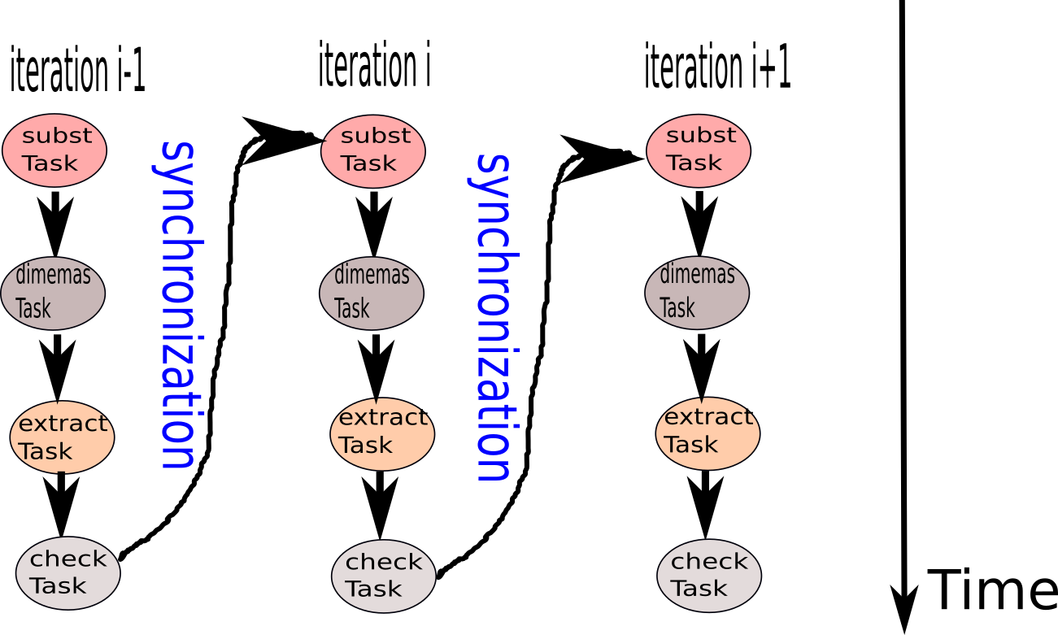
TDG

Slide 29
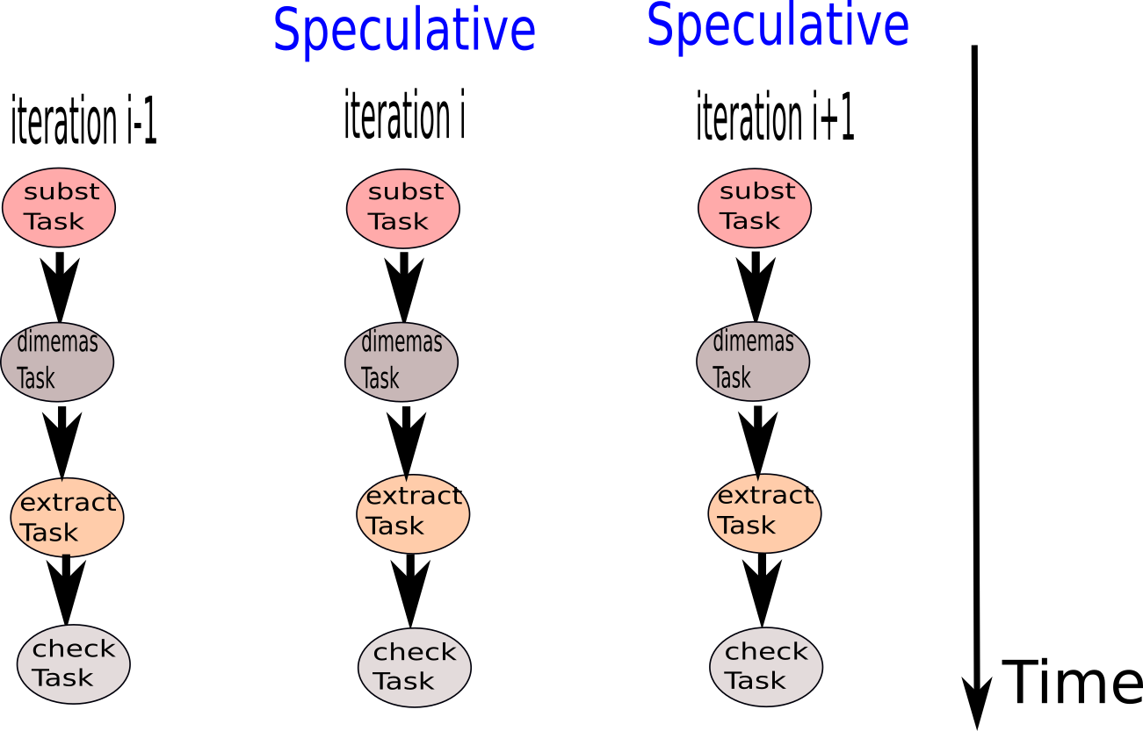
Speculative TDG (ideal)

Slide 30
Speculative directive: clauses
#pragma css speculate values(finalOUT) wait(goal_achieved)
while(!goal_achieved)
{
newBFD = pop_queue();
subst(refCFG, newBFD, newCFG);
dimemas(newCFG, trace, dimOUT);
extract(newBWD, dimOUT, finalOUT);
check(finalOUT, goal_achieved);
#pragma css wait on(goal_achieved)
}

Slide 31
Speculative directive: clauses
#pragma css speculate values(finalOUT) wait(goal_achieved)
values – protection in case of mis-speculation
wait – determines the progress of the loop
while(!goal_achieved)
{
newBFD = pop_queue();
subst(refCFG, newBFD, newCFG);
dimemas(newCFG, trace, dimOUT);
extract(newBWD, dimOUT, finalOUT);
check(finalOUT, goal_achieved);
}

Slide 32
Success of Speculation
Valid tasks – Successfull speculation
  Tasks generated even with the synchronization
Invalid tasks – Undo their results
  Loop predicate evaluated to false

Slide 33
Speculative directive: implementation
Speculative tasks - transactions
Parameters from values are loaded into the transactional context
Store values only if speculation is successful
Use of a guard function to evaluate the success of speculation

Slide 34
Guard function
Guard function
int guard (void *speculate_params[1])
{
return (!*(speculate_params[0]));
}
speculate_params[0] = &goal_achieved ;

Slide 35
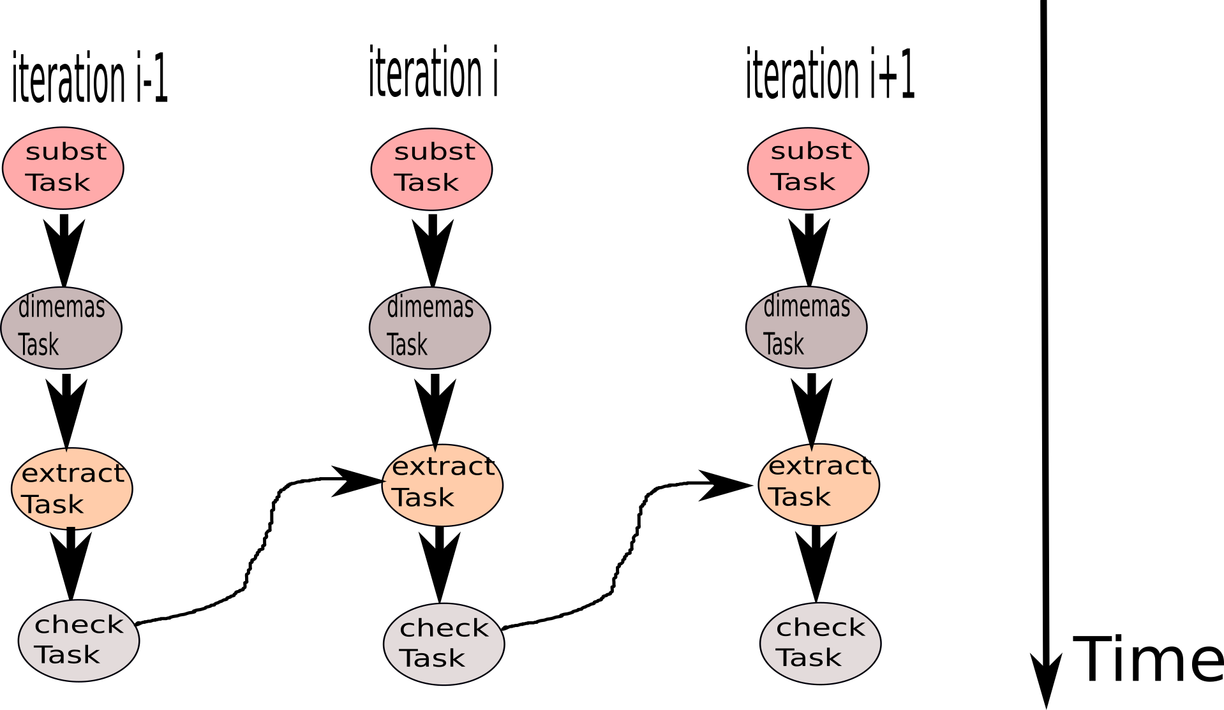
Speculative TDG

Slide 36
Types of Speculative tasks
Data-dependent speculative tasks
  Cross-iteration dependencies
  Tasks from iteration i consume values from tasks in i-1
  Overlap task generation with task execution
Control dependent speculative tasks
  Tasks from iteration i are independent of tasks from i-1
  Parallel execution of tasks

Slide 37
Applications for testing
Gauss – Seidel
Jacobi
Red-black
Kmeans

Slide 38
Observations
Non-speculative versions perform better
  Both versions scale similarly
Better performance with increasing number of threads
TinySTM overhead cannot be overcome with the additional parallelism obtained

Slide 39
TinySTM overhead
Less number of bigger transactions is beneficial
  Bigger tasks more beneficial than smaller tasks
  Longer rollbacks versus higher number of TinySTM calls
Increase task granularity
  Instead of increasing the number of tasks in the TDG, we reduce them to compensate for the overhead

Slide 40
Data-version based speculative task execution
TinySTM load and store a major overhead
Redundant conflict detection mechanisms
Data-versions to maintain correctness

Slide 41
Data-version based speculative task execution
TinySTM load and store a major overhead
Redundant conflict detection mechanisms
Data-versions to maintain correctness
Overhead
1) 1 copy for successful speculation
2) 2 copies for mis-speculation
3) Evaluation of the guard function

Slide 42
Observations
On average a 20% performance improvement over non-speculative application
  Significant since the improvement is over an already parallelized code
The benefits of speculation are better observed with increasing number of threads
With increasing problem sizes more number of threads are needed for performance benefits

Slide 43
Optimizations
Update original memory locations inside speculative tasks
Limit on the number of iterations to be speculated upon
  speculation_tasks, an environment variable

Slide 44
Current Work
Parallelization of Moose

Slide 45
Current Work
MOOSE, a Multiscale Object-Oriented Simulation Environment.

Slide 46
Cell/Neuron division
MOOSE, a Multiscale Object-Oriented Simulation Environment.
Molecules
Cell

Slide 47
Cell/Neuron division
MOOSE, a Multiscale Object-Oriented Simulation Environment.
Molecules
Voxel 1
Voxel i
Voxel j
Cell
A cell is subdivided into Voxels
Independent computations in each voxel at a given timestep

Slide 48
Single cell simulation
Chemical interactions on the molecules
Kinetic solver
  Large volume (deterministic behavior)
  Simulates the behavior of the molecule using linear transformation (rungekutta method of order 5)
Stochastic solver
  Small volume
  Simulation is performed over individual molecules
Diffusion solver
  Calculate the diffusion gradient

Slide 49
Programming Models used
OpenMP
  Parallel-for and task-based paralleization
  Ease of use
Pthreads
  More flexibility
  Optimized on thread creation-destruction by the use of semaphores

Slide 50
Optimization of pthreads using semaphores
Main-thread
Create Worker threads
Thread1
Thread i
Thread j
Wait for signal from the main thread
Send start signal to worker threads
Start parallel work
Over multiple time steps
Send work complete signal to main
thread
Exit thread
Send destroy signal

Slide 51
Optimizations
Memory alignment
Reduce the number of OpenMP parallel pragmas
Remove hyperthreading

Slide 52
Results of Parallelization on 8 threads
Kinetic solver
  OpenMP – 5X
  Pthreads – 4.5X
Stochastic Solver
  OpenMP – 5.5X
  Pthreads – 4.8X
Diffusion solver
  OpenMP – 3.8X
  Pthreads – 3.7X

Slide 53
Conclusion
PhD Thesis
  Compiler and runtime development
  Speculative synchronization (using STM)
Cell simulation
  Paralleization of solvers for chemical interactions

Slide 54
THANK YOU!!

