Slide 1
AI TRAVEL PLANNER FOR STUDENTS
CAPSTONE PROJECT
Presented By:
1. Rahul Trivedi – Graphic Era University Dehradun - CSE

Slide 2
OUTLINE
Problem Statement
System Development Approach
Algorithm & Deployment
Result
Conclusion
Future Scope
References

Slide 3
Problem Statement
Busy schedules, academic pressure, and limited opportunities for affordable leisure leave many students and young adults stressed and overwhelmed. Our AI Travel Planner helps you discover fun, budget-friendly, and personalized trips, making it easier to relax, explore, and recharge without the usual planning stress.
Problem: Planning trips is often time-consuming and expensive, especially for students with limited budgets. Current travel apps provide generic suggestions. A system that integrates maps, location data, and generative AI to create personalized, budget friendly itineraries would help students plan efficient and enjoyable trips.

Slide 4
System Approach
Frontend | Streamlit app for user interaction (chat UI, input/output display)
Backend | Python logic to handle chat flow, model inference, and session state
Model Engine | gemini-2.5-flash
Data Handling | Optional logging, feedback collection, or prompt templates

Slide 5
Algorithm & Deployment
1. Privacy & Security
User conversations must be confidential and not stored without consent.
No personally identifiable information (PII) should be collected or exposed.
Secure communication using HTTPS.
2. Availability
The chatbot should be accessible 24/7 to support users for their travel plan. .
Minimal downtime during updates or maintenance.
3. Performance
Response time should be under 30 seconds for typical queries.
Efficient memory usage to support low-resource devices (especially if using LLaMA locally).
4. Usability
Clean, intuitive interface with empathetic tone and easy navigation.
Mobile-responsive design for accessibility on phones and tablets.
Use of input text for user preferences (e.g. Source , destination etc.).
5. Scalability
Should support increasing user load without degradation in performance.
Modular architecture to allow future integration (e.g., journaling, voice input, multilingual support).

Slide 6
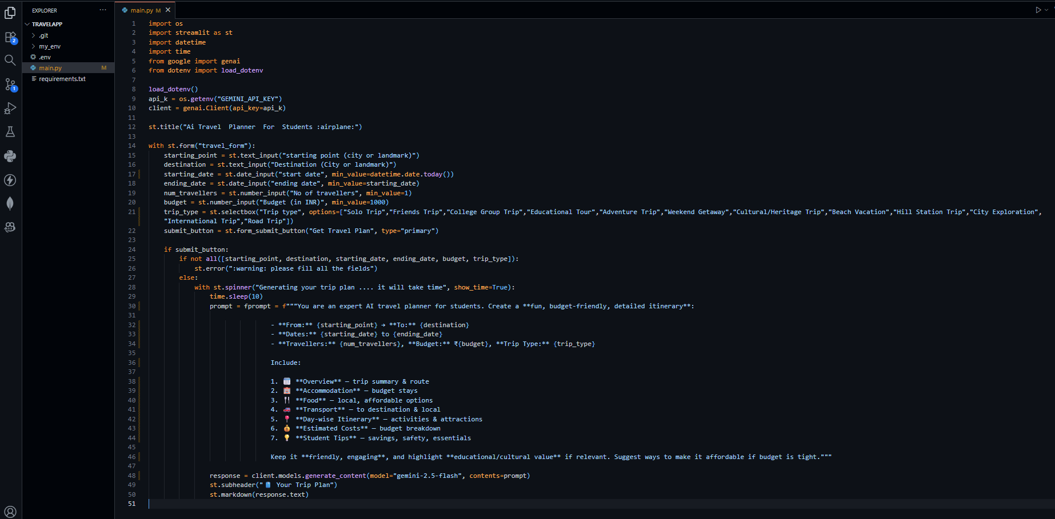
Result

Slide 7
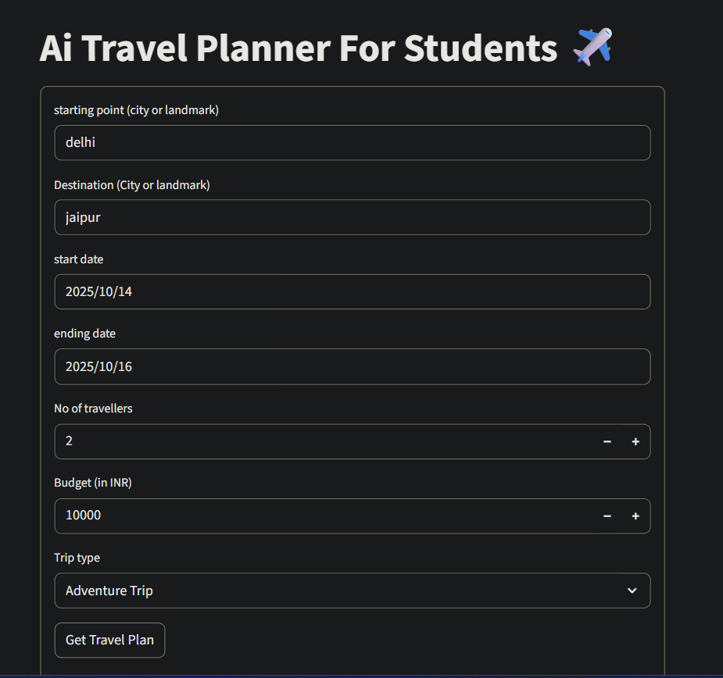
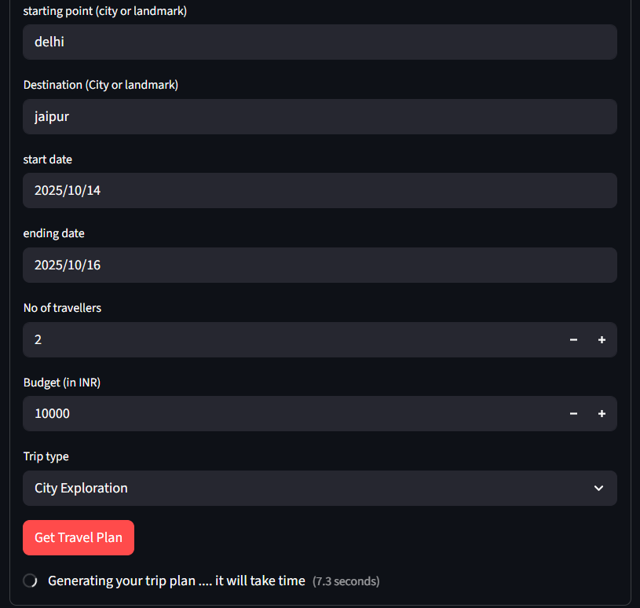
Result

Slide 8
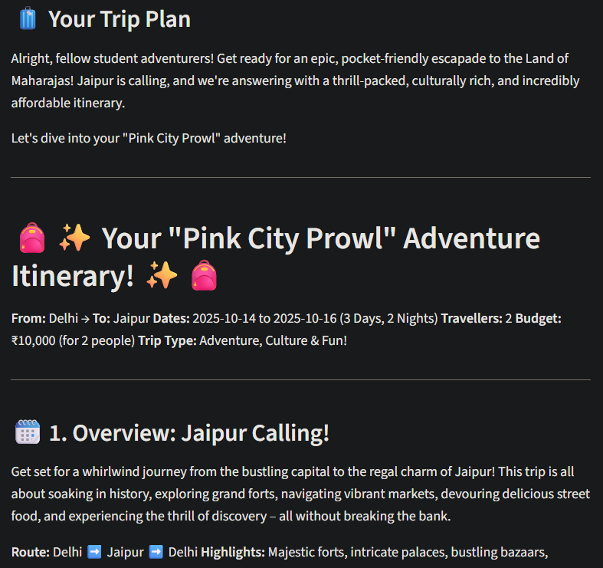
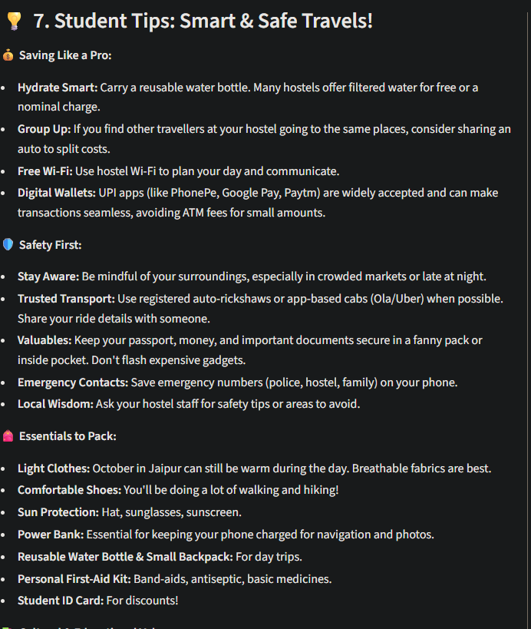
Result

Slide 9
GITHUB AND DEPLOYMNET LINK
GitHub Link :
https://github.com/rahulgihub8279/Travel-Planner
Deployment link:
https://travel-planner-wz4ovizwekvfjjgh9oqgcg.streamlit.app/

Slide 10
Conclusion
The AI Travel Planner app offers a smart, personalized, and budget-friendly solution for students and young adults seeking stress-free travel experiences. By leveraging AI, the app simplifies trip planning, recommends tailored itineraries, and adapts to real-time changes, making travel more accessible and enjoyable.

Slide 11
Future scope
Add Voice Support Users can talk to the chatbot and hear replies—great for accessibility.
Support More Languages Include Tamil and other local languages so more students can use it.
Work Without Internet Make it run offline using lightweight models like Llama for rural areas.
Track User Trips Track user trip and suggest more trips for future.
Integration with Other Services Flight bookings, hotels, food delivery, transport, events—all in one app.

Slide 12
References
https://streamlit.io/
https://docs.streamlit.io/
https://ai.google.dev/gemini-api/docs/quickstart

Slide 13
THANK YOU

