Slide 1
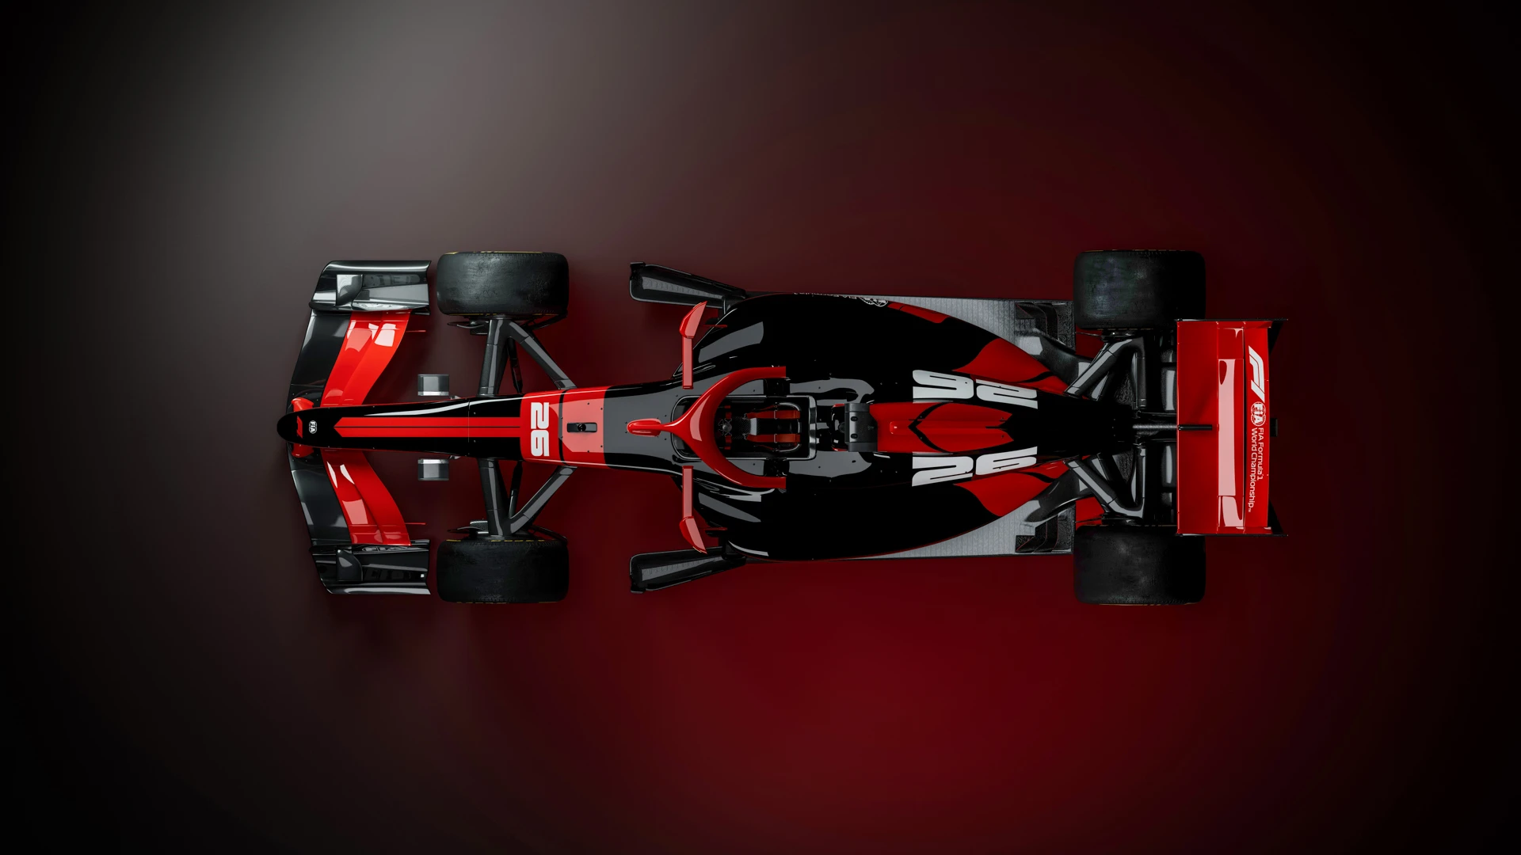

MARIANA MINERALS | F1 BRIEF

Slide 2

ABOUT MARIANA MINERALS
EIGHT QUESTIONS TO HELP US FIND THE RIGHT FIT
# | QUESTION | YOUR ANSWER (bullet points are perfect)
1 | OBJECTIVES What are the three most important things you want this partnership to achieve? e.g. investor visibility, attracting engineering talent, opening doors with operating partners
2 | AUDIENCE How would you rank your audiences, and roughly split your focus? You mentioned VC and talent first, then operating partners. Does that still hold?
3 | TARGET ACCOUNTS Which companies or investors would you most like to get in front of? We'll map these against each team's partners, owners and board members
4 | MARKETS Beyond the US, which markets matter most to you over the next few years? e.g. where your sites, operating partners, investors and future hires are
5 | COMPETITORS Which companies would you not want alongside you at a team? Teams lock out competitors in your category, so name direct rivals and any no-go brands
6 | STORY What story do you want to tell through F1? e.g. sustainability and electrification, engineering and AI, launching the new brand
7 | MEASURING SUCCESS What does success look like, and how will your founders judge it? e.g. investor meetings, hires made, partner deals, awareness after the rebrand
8 | VALUE & BUDGET You mentioned USD 6M with room to grow. What would justify going higher? e.g. stronger network access, more hospitality, a bigger talent programme
Rough thinking is all we need. We know the rebrand is still under way, so best guesses are fine.

Slide 3
WHAT YOU NEED FROM A PARTNERSHIP
MARK HOW IMPORTANT EACH ONE IS TO YOU
FOCUS AREA | WHAT YOU GET | NICE TO HAVE | IMPORTANT | MUST
Visibility | Official partner title in your category, with competitors locked out | ☐ | ☐ | ☐
 | Branding on the car, race suits and garage (price dependent) | ☐ | ☐ | ☐
 | Branding at the team factory and on team assets | ☐ | ☐ | ☐
Engagement | Access to drivers, team principal and engineers for content | ☐ | ☐ | ☐
 | Team engineers speaking at your panels and events | ☐ | ☐ | ☐
 | Deploying your AI in the team's operations, with a joint case study | ☐ | ☐ | ☐
Hosting & network | Race hospitality and money-can't-buy experiences (e.g. hot laps) | ☐ | ☐ | ☐
 | Off-track events (e.g. Davos, WEF, team golf days with leadership) | ☐ | ☐ | ☐
 | Introductions to the team's owners and partner network | ☐ | ☐ | ☐
Talent | Recruitment programmes using the team's engineering brand | ☐ | ☐ | ☐
One tick per row. Anything missing that you'd like us to consider? Add it in the margin.

Slide 4
HOW TEAMS DRIVE B2B RESULTS
EXAMPLARY CONCEPTS
"We work with your sales leads to develop a bespoke outreach programme that puts our network to work for your business development goals. For example, one of our partners recently secured a $130M new business deal as a direct result of our strategic approach."
(Tech company, Mclaren Racing, 2025)
"From race activations alone, we’ve accelerated over $300M in revenue opportunity."
(Tech company, Mercedes F1 Partner, 2025)
Ecosystem strategy
Quarterly review of your growth strategy with a dedicated team staff member, identifying opportunities from across our partner ecosystem, OEM relationships and extensive Senior Leadership and Advisory Team ‘black book’ contacts.
2. Introduction planning
Identifying the specific target contacts (e.g. CEO, CFO, CTO) and best method of introduction (e.g. direct meetings, invitations to scheduled events), with background and briefing materials provided in advance.
3. Contact made
Supporting introductions at:
Direct meetings
Dinners/ Receptions
Partner Summits
B2B networking events
Trackside hosting at races
HQ tours and experiences
4. Contact review
Checking in with your teams following each planned introduction to ensure all needs have been met, and setting up new introductions where required. Monthly status and progress reports can be provided.

