Slide 1

Test suite evaluation
For fun and profit
Rahul Gopinath, Carlos Jensen, Alex Groce
Code Coverage for Suite Evaluation by Developers
ICSE 2014
Notes:
Hello, I am Rahul Gopinath. I am here to present our research on approximating the mutation analysis for test-suite adequacy.
In a nutshell, we found that mutation analysis can be best approximated by statement coverage.

Slide 2

How do you know your tests are good enough?
M1
Notes:
One question that concerns developers and testers, is how to measure the quality of your test suite?
How do we know that our tests are good enough?

Slide 3
Test Adequacy Criteria
Why not inject a few bugs and see if we can catch them?
M2
Notes:
We use a variety of heuristics to measure the adequacy of a test suite.
One of the simplest things to do, is to inject a few bugs systematically, and see how many are caught by the test suite.

Slide 4

Here be mutants
Syntactically similar programs.
yes
If x = 0
yes
If x < 0
yes
If x > 0
yes
If x > 0
x ++
no
x ++
no
x ++
no
x ++
no
If y > 0
no
If y > 0
no
no
no
If y < 0
If y = 0
yes
yes
yes
yes
y ++
y ++
y ++
y ++
yes
If x > 0
yes
If x > 0
x --
no
no
x ++
If y > 0
no
no
If y > 0
yes
yes
y ++
y --
M3
Notes:
So we make a few changes in our program, and start our test run, and we see how many of the variants are detected
As we add more tests, we will see that more variants are detected

Slide 5
Here be mutants
Syntactically similar programs.
yes
If x = 0
yes
If x < 0
yes
If x > 0
yes
If x > 0
x ++
no
x ++
no
x ++
no
x ++
no
If y > 0
no
If y > 0
no
no
no
If y < 0
If y = 0
yes
yes
yes
yes
y ++
y ++
y ++
y ++
x=1,y=0 =>x=2,y=1
yes
If x > 0
yes
If x > 0
x --
no
no
x ++
If y > 0
no
no
If y > 0
yes
yes
y ++
y --
M3

Slide 6
Here be mutants
Syntactically similar programs.
yes
If x = 0
yes
If x < 0
yes
If x > 0
yes
If x > 0
x ++
no
x ++
no
x ++
no
x ++
no
If y > 0
no
If y > 0
no
no
no
If y < 0
If y = 0
yes
yes
yes
yes
y ++
y ++
y ++
y ++
x=1,y=0 =>x=2,y=1
x=1,y=1 =>x=2,y=1
yes
If x > 0
yes
If x > 0
x --
no
no
x ++
If y > 0
no
no
If y > 0
yes
yes
y ++
y --
M3

Slide 7
Here be mutants
Syntactically similar programs.
yes
If x = 0
yes
If x < 0
yes
If x > 0
yes
If x > 0
x ++
no
x ++
no
x ++
no
x ++
no
If y > 0
no
If y > 0
no
no
no
If y < 0
If y = 0
yes
yes
yes
yes
y ++
y ++
y ++
y ++
x=1,y=0 =>x=2,y=1
x=1,y=1 =>x=2,y=1
x=0,y=1 =>x=0,y=1
yes
If x > 0
yes
If x > 0
x --
no
no
x ++
If y > 0
no
no
If y > 0
yes
yes
y ++
y --
M3

Slide 8
Here be mutants
Syntactically similar programs.
yes
If x = 0
yes
If x < 0
yes
If x > 0
yes
If x > 0
x ++
no
x ++
no
x ++
no
x ++
no
If y > 0
no
If y > 0
no
no
no
If y < 0
If y = 0
yes
yes
yes
yes
y ++
y ++
y ++
y ++
x=1,y=0 =>x=2,y=1
x=1,y=1 =>x=2,y=1
x=0,y=1 =>x=0,y=1
x=0,y=0 =>x=0,y=1
yes
If x > 0
yes
If x > 0
x --
no
no
x ++
If y > 0
no
no
If y > 0
yes
yes
y ++
y --
M3
Notes:
Here the adequacy of the test suite is 5 variants detected out of 6, or about 83%
However, we have a small problem.

Slide 9
A mutant explosion
M4
Notes:
The number of such variants is astronomical
One way to resolve our predicament is to make a few plausible assumptions

Slide 10
Perhaps we don’t need as many?
Competent programmer hypothesis
Coupling effect
M5
Notes:
The first assumption is that, people make simple mistakes, that at least as far as the particular feature is concerned, fixes are going to be simple
The second is that a combination of faults can be detected by the testsuites capable of detecting the component faults
Using these assumptions, we can restrict our attention to only simple small syntactic changes

Slide 11
What is Mutation Analysis
Mutation analysis is a method of systematically introducing simple syntactic changes to the program, and measuring the capability of the test-suite in detecting these changes.
The mutation score is measured as
# mutants killed
# mutants produced
M6
Notes:
So what is mutation analysis? It is a method of systematically introducing simple syntactic changes to the program, and measuring the capability of test-suites to detect these changes.
It assumes that detecting first order mutants is sufficient to get a sense of the quality of the test suite.
However, even with this simplification, Mutation analysis is not cheap. So there has been a lot of research in this regard.

Slide 12
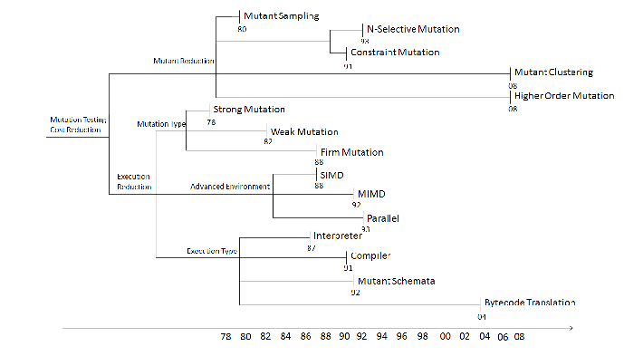
Traditional Strategies to counter mutant explosion
Lots of Research
Computation required for a single mutant
Time
Original
Fewer
(Reduce Mutants)
Faster
(Optimize mutation run)
Smarter
(Parallelize mutation analysis)
Computation
M7
Notes:
The research in reduction of computational requirements is traditionally classified into three orthogonal approaches.
Here, the gray box represents the analysis of a single mutant.
The first one is the do fewer method, which attempts to reduce the number of mutants analysed
Second one is the do faster method, which tries to optimize the mutation run so that the total mutation requires lesser resources
The third classification is do smarter, which tries to parallelize or memoize mutation analysis

Slide 13
Fewer
Summary
Faster
Smarter
Mutation testing is hard,
let us go shopping..
M8
Notes:
Our research chooses a different route, we wanted to see if there is a way to avoid having to spend so much effort, we want to avoid mutation analysis if possible.

Slide 14
So Cheat
Up, Right, A, B, A, Down, A, L, L
Do we have a way to predict mutation coverage? (without actually doing it)
We were not the first ones to attempt it.
Branch coverage can approximate mutation score [GroceISSTA13]
So what did we do different?
We changed the scale of sampling
Previous research looks at ~30 standard programs
Our research uses hundreds.
R1
Notes:
We were not the first to attempt it. For e.g Dr Groce, one of the co-authors found that branch coverage and path coverage can approximate mutation score very well
The difference in our analysis is the scale of sampling. While the previous research investigated about 30 programs, we investigated about 250.

Slide 15
We changed the scale of sampling
Github
1700 Java projects
The first 1700 Java projects that used Maven
We don’t expect Github ordering to affect our results
R2
Notes:
We started with about 1700 Java projects from Github. Unfortunately Github does not go beyond the first 1000 programs that matches your query, secondly it also orders the results according to its own algorithm
However, we believe that the ordering need not be a concern since our sample size is large enough.

Slide 16
Removed bad projects
Github
1700 Java projects
Removed problematic projects
Dependencies
Compilation Error
Timeouts
~550 projects successfully completed test runs
R3
Notes:
Next, we removed all projects that could not be compiled or that had dependency problems, or those that timed out

Slide 17
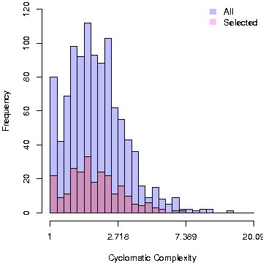
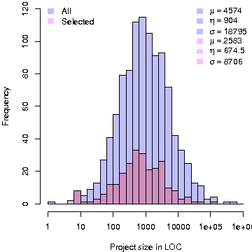
Checked for bias
Total Vs selected projects : Cyclomatic Complexity and LOC distribution
Look at the similarity of shapes between blue (all) and pink (selected)
Very similar => low bias
R4
Notes:
We checked for bias in the projects we thus discarded
In the figure, the first graph represents the cyclomatic complexity distribution of the original 1700 projects vs the selected 500 projects
The second graph is the histogram of project size for the original 1700 and the selected 500 projects.
Notice that the shapes of blue and pink graphs are very similar. This suggests that we have not skewed the results badly in at least these dimensions by removing all pathological projects.

Slide 18
Collected original and generated test-suites
Github
1700 Java projects
Removed problematic projects
Dependencies
Compilation Error
Timeouts
Original
Collected organic test-cases
(written by authors) ~250
Used Randoop to generate a separate set of test suites. ~250
Randoop
(Generated)
R5
Notes:
We then used randoop to generate random test cases and also collected the original test cases
We had two groups of programs, with the first group with original test suites, and second with randoop generated test suites, with some overlap

Slide 19
Collected coverage data
Github
Mutation Coverage
1700 Java projects
Path Coverage (AIMP)
Removed problematic projects
Branch Coverage
Dependencies
Compilation Error
Timeouts
Original
Statement Coverage
Randoop
(Generated)
R6
Notes:
Next we collected different test coverage metrics on these two groups, including Mutation Coverage, Path Coverage, Branch Coverage and Statement Coverage
We used multiple tools to make sure that we were not biased by bugs from any single tool

Slide 20
Applied statistical model selection
Github
Mutation Coverage
1700 Java projects
Path Coverage (AIMP)
Removed problematic projects
Branch Coverage
Dependencies
Compilation Error
Timeouts
Original
Statement Coverage
Randoop
(Generated)
lm(Ma ~ Complexity + log(LOC) + log(TLOC) + Coverage)
Ma: Mutation Score
LOC: Size in Lines Of Code
TLOC: Test suite size
Complexity: Cyclomatic Complexity
Coverage: (Path|Branch|Statement) coverage
R7
Notes:
Then we applied statistical analysis, first creating a regression model for mutation analysis containing all the variables like size complexity and coverage, and applied model selection on this full model

Slide 21
Found a simple model
Github
Mutation Coverage
1700 Java projects
Path Coverage (AIMP)
Removed problematic projects
Branch Coverage
Dependencies
Compilation Error
Timeouts
Original
Statement Coverage
Randoop
(Generated)
lm(Ma ~ Complexity + log(LOC) + log(TLOC) + Coverage)
Ma: Mutation Score
LOC: Size in Lines Of Code
TLOC: Test suite size
Complexity: Cyclomatic Complexity
Coverage: (Path|Branch|Statement) coverage
lm(Ma~Coverage)
R8
Notes:
We ended up a regression model associating mutation score with just coverage, able to predict 90% of the variance.

Slide 22
We now compare the correlations
Mutation Score and Path Coverage
lm(Ma~0 + PathCoverage)
Mutation Score and Branch Coverage
lm(Ma~0 + BranchCoverage)
Mutation Score and Statement Coverage
lm(Ma~0 + StmtCoverage)
R9
Notes:
We next compared our model using all different coverage criteria we had

Slide 23
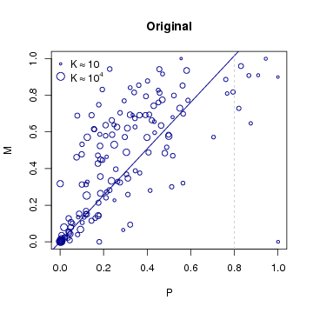
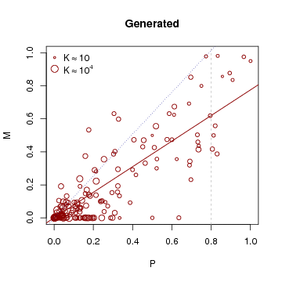
Comparing Mutation Score with Path Coverage
M : Mutation Coverage
P : Path Coverage (AIMP)
K : log(LOC) -- Size of dots indicate log(Size) of project
Mutation ~ Path Coverage : R²=0.75, 0.62
R10
Notes:
In this figure, Y axis is the mutation coverage, and X axis is the structural coverage. In this coverage it is Path
K is the size of the project, and it is also indicated in the size of the bubbles
On the left side, the blue graph shows organic test suites, while the right side red graph shows results from randoop generated test suites
Path coverage accounted for 75% of the variation in mutation score for organic test suites.

Slide 24
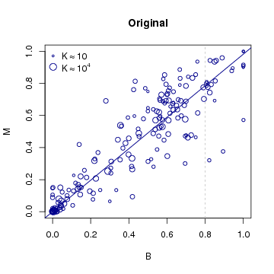
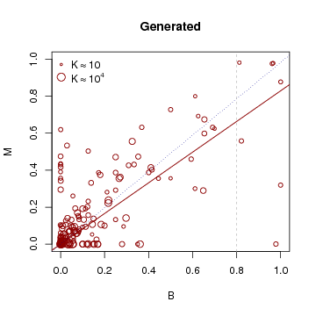
Comparing Mutation Score with Branch Coverage
M : Mutation Coverage
B : Branch Coverage
K : log(LOC) -- Size of dots follow the size of project
Mutation ~ Branch Coverage : R²=0.92, 0.65
R11
Notes:
Branch coverage did much better with accounting for 92% of the variation

Slide 25
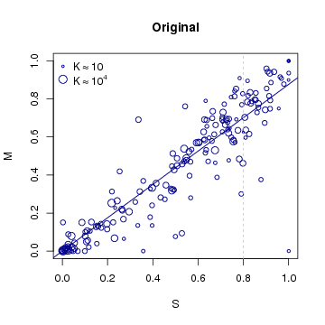
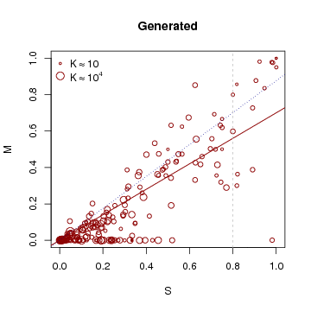
Comparing Mutation Score with Line Coverage
M : Mutation Coverage
S : Statement Coverage
K : log(LOC) -- Size of dots follow the size of project
Mutation ~ Statement Coverage : R²=0.94, 0.72
R12
Notes:
The surprise was statement coverage, which did better than branch or path coverage, accounting for 94% variation of mutation score for organic test suites

Slide 26
Correlations
 | R² |  | T_{b}
Formula | Organic | Generated | Organic | Generated
lm(Ma~0 + Path) | 0.75 | 0.62 | 0.67 | 0.49
lm(Ma~0 + Branch) | 0.92 | 0.65 | 0.77 | 0.52
lm(Ma~0 + Statement) | 0.94 | 0.72 | 0.82 | 0.54
Takeaway (for approximating Mutation Score):
Statement > Branch > Path
R13
Notes:
So in summary, these were our results
We utilized both pearson coefficient of correlation and Kendall’s Tau beta
Using both measures, and for both randoop and generated test suites, we see that statement coverage is better followed by branch and lastly path coverage.
The takeaway here is that statement coverage is better at approximating mutation coverage than branch or path.

Slide 27
yes
If x > 0
If x > 0
If x > 0
x ++
no
x ++
x ++
no
If y > 0
If y > 0
If y > 0
yes
y --
y --
y --
Possibilities:
Simple faults have large semantic impact
Reachability is sufficient to identify faults in a majority of cases.
R14
Notes:
So, why does this happen?
We think that this is due to two reasons
- First is that most mutants produced are rather easy to kill
- At least to such an extent that covering them is sufficient to detect the mutant

Slide 28
New Research: Role of Test Suite Size
Statement Coverage and log(TLOC) is highly correlated
S ~ log(TLOC) = 72%
So were we just seeing the effects of test suite size?
M~ log(TLOC) = 69%
R15
Notes:
In a follow up research, we investigated the role of test suite size in detail.
We found that size captures about 70% of the variation, which is not surprising since it is highly correlated with statement coverage

Slide 29
So what does statement coverage get us?
Removed effect of test suite size statistically
residuals(M~0+TLOC)~S = 60%
We find a substantial relationship (60%) for statement coverage with mutation score after discounting effects of test suite size.
R16
Notes:
So next, we statistically removed the effect of test suite size from our model
We found that, after discounting the effect of size, the coverage still accounted for about 60% variance in the model, which is substantial.

Slide 30
But, The story does not end there.
R17
Notes:
But the story does not end yet

Slide 31
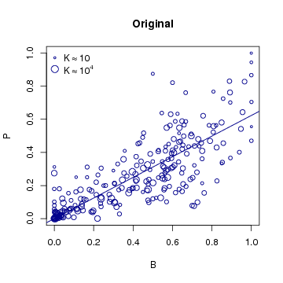
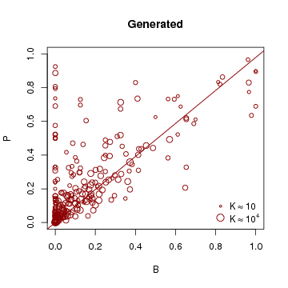
Path ~ Branch Coverage : R²=0.80, 0.59
R18
Notes:
We found that while branch was highly correlated with path coverage

Slide 32
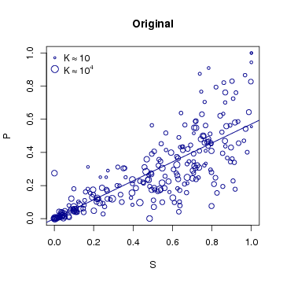
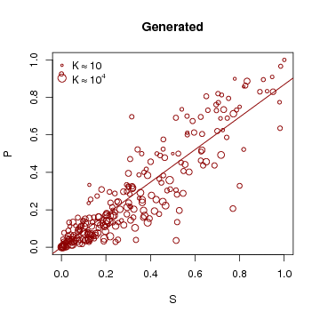
Path ~ Statement Coverage : R²=0.81, 0.84
R19
Notes:
Statement coverage was even more correlated with path coverage

Slide 33
Why?
we don’t know (yet)
R20
Notes:
Why? We dont know yet

Slide 34
Dear Developers,
Keep writing tests
more tests == better quality
Pay attention to your statement coverage
Statement coverage > Branch coverage > Path coverage
Your mutation score is approximately
0.87 times statement coverage stddev: 0.01
0.98 times branch coverage stddev: 0.02
1.27 times path coverage stddev: 0.05
Takeaway
X1
Notes:
So the message for developers is two fold,
1) Keep writing the tests since more tests is correlated with better mutation score
2) Pay attention to statement coverage
In summary, statement coverage is better than branch or path coverage in approximating the mutation analysis score.

Slide 35
Food for thought
For Researchers
Faults from mutation analysis seems really easy to detect
Are they representative of real faults?
X2
Notes:
For the researchers,
It seems that the faults from mutation analysis are really easy to detect
So are they really representative of real faults?

Slide 36

Fini.

Slide 37
Research by inozemtseva et al claims very little correlation of normalized mutation score with coverage (covering mutation score).
However: Their raw score (App. T(raw)) seems to indicate that after removing outlier Jodatime, they have a T_b = 0.48, which is substantial.
i.e T_b 0.48 => 0.74 probability of predicting correctly or an odds ratio of approximately 3:1 for correct prediction.
Comparison of Covering (Normalized) mutation score ~ Full Line coverage is wrong.
Mutation score using total mutants only from the covered lines
That is a new program. In that case, you should be comparing 100% coverage to mutation score. i.e coverage ratio is a constant here.
Is Covering mutation score actually useful to the developers?
Not so sure.
What about normalized mutation coverage?
Notes:
odds ratio Pc/Pd = (1+ Tau )/(1- Tau )

Slide 38
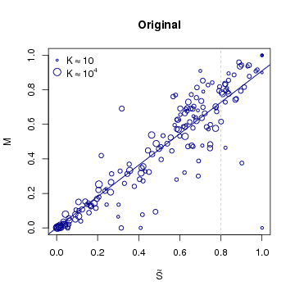
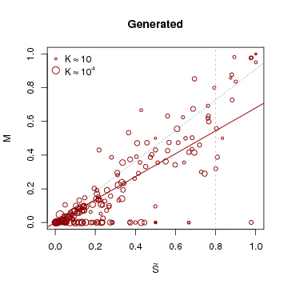
M : Mutation Coverage
S : Block Coverage
K : log(LOC) -- Size of dots follow the size of project
Mutation ~ Block Coverage : R²=0.93, 0.69
R13

