Slide 1
Mutations: How close are they to real faults? ISSRE’14
Rahul Gopinath, Carlos Jensen, Alex Groce
Oregon State University
Notes:
Hello, I am Rahul Gopinath
A PhD candidate from Oregon State University.
I am here to talk about our investigations into Competent Programmer Hypothesis, one of its central tenets of Mutation Analysis

Slide 2

What is mutation analysis? and why is it important?
Generates fake bugs that looks like the real thing.
The primary technique used to evaluate test suites
Used in the industry as a stopping criteria for test suites
Used by researchers to generate real looking faults, and hence judge the effectiveness of testing techniques.
?
Notes:
Mutation analysis is a technique used to compare test suites, and testing tools.
Researchers also use mutation analysis to evaluate how good their techniques
are in creating or modifying test suites.
The best way to judge the effectiveness of a test suite is to start with a known
set of faults, and see how many of the faults were caught by the suite. However,
this technique is rather hard to use in practice, as the programs we are concerned
with often do not have a known set of real faults, mostly because they have not
been caught yet.
Mutation analysis comes closest to this gold standard by providing an artificial set
of bugs against which the test suit is evaluated, and hence provides a metric
that can be used to evaluate a suite or a tool even in the absence of real faults.

Slide 3

How does it work?
Programs corresponding to Test suites rarely have all bugs known.
Deterministically inserts faults against which test suites can be judged.
Notes:
Because we rarely know how many bugs there are in the program before testing, it is hard to benchmark tools in the abstract.
So our best option is to introduce bugs in the code, and evaluate test suites on finding these.
It creates a variant of the program with known defects that we can then use as metric.
(However, there is an issue here, when we insert bugs, how do we know where to insert bugs? Mutation analysis takes the approach that the bug proneness of a piece of code is equivalent to the lexical complexity of the code – that is, it introduces all possible first order bugs into code)

Slide 4

Motivation or how useful is it?
Not the only option to evaluate test suites, but provides the closest alternative to real bugs.
Mutation analysis is useful only if the bugs generated are similar to real faults.
Notes:
(problem statement)
Mutation analysis is not the only option for judging the effectiveness of a test suite,
however, practitioners like this technique because they believe that it provides the closest alternative.
However, there is an elephant in the room here,
That is, are mutants really that similar to real faults?,
and on this front, there is little or inconclusive evidence.
this is what motivated our research

Slide 5
Basic Assumptions
Competent Programmer Hypothesis
Coupling Effect
Notes:
To evaluate how closely good mutation analysis matches to real faults, we have to look at two fundamental assumptions that we are making about programmers and the nature of bugs when we use mutation analysis.
The first is the so called the competent programmer hypothesis and second is the coupling effect

Slide 6

Competent Programmer Hypothesis
Notes:
When we talk about competent programmer hypothesis, we don’t mean whether people are good at their job or not.

Slide 7
Competent Programmer Hypothesis: An Example
d = b^2 + 4 * a * c;
Notes:
What this says is that, most bugs will be simple bugs. When programmers make mistakes, they will typically be small detail mistakes associated with one token. This is what we call simple fault.
In this case, the programmer meant to say - but he made a simple easy to make mistake, of using + instead.
When we talk about CPH, we don’t mean in relation to the entire program, but with respect to the fault in question.
(15 seconds – point to the screen, )

Slide 8
Competent Programmer Hypothesis: An Example
d = b^2 + 4 * a * c;
A plausible mistake,
Notes:
What this says is that, most bugs will be simple bugs. When programmers make mistakes, they will typically be small detail mistakes associated with one token. This is what we call simple fault.
In this case, the programmer meant to say - but he made a simple easy to make mistake, of using + instead.
When we talk about CPH, we don’t mean in relation to the entire program, but with respect to the fault in question.
(15 seconds – point to the screen, )

Slide 9
Competent Programmer Hypothesis: An Example
d = b^2 + 4 * a * c;
A plausible mistake, The programmer meant
d = b^2 - 4 * a * c;
Notes:
What this says is that, most bugs will be simple bugs. When programmers make mistakes, they will typically be small detail mistakes associated with one token. This is what we call simple fault.
In this case, the programmer meant to say - but he made a simple easy to make mistake, of using + instead.
When we talk about CPH, we don’t mean in relation to the entire program, but with respect to the fault in question.
(15 seconds – point to the screen, )

Slide 10
Coupling Effect
Faults rarely interact with each other
If they interact, they become easier to detect than original faults.
Notes:
The coupling effect states that a test case able to detect a fault in isolation will continue to detect it even when the fault appears in combination with other faults.
However, this is not critical to our study.

Slide 11
So what is a simple fault?
We have no formal definitions
But intuitively..
An atomic fault that cant contain smaller faults
Examples from mutation theory and practice use one token mutants.
Notes:
A simple fault is intuitively a fault that cant contain smaller faults.
Unfortunately we have no formal definitions of what a simple fault is, but we have lots of examples from mutation theory and mutation tools
These tools overwhelmingly use single token mutants.
A token here is a sequence of characters that is translated as a single meaningful symbol in the underlying language.

Slide 12
A simple fault
-
d = b^2 + 4 * a * c;
A simple fault (a single token mutation).
Notes:
So here is an example

Slide 13
So what is a simple fault?
We have no formal definitions.. But intuitively..
An atomic fault that cant contain smaller faults
Examples from mutation theory and practice use one token mutants.
A token is a sequence of characters that is translated as a single meaningful symbol in the underlying language.
Notes:
A simple fault is intuitively a fault that cant contain smaller faults.
Unfortunately we have no formal definitions of what a simple fault is, but we have lots of examples from mutation theory and mutation tools
These tools overwhelmingly use single token mutants.
A token here is a sequence of characters that is translated as a single meaningful symbol in the underlying language.

Slide 14
Mutation Analysis: A recap
Generate fake bugs
Run test-suites on generated mutants
Effectiveness determined by number of mutants killed
Notes:
When we do mutation analysis, we feed a program into to the mutation generator, which generate a deterministic number of mutants, and we test our test suite against this known number of faults,
The test suite that detects the most number of mutants is deemed to be the best one.

Slide 15
The Problem
Do mutations resemble real faults?
Notes:
(stop)
Mutation analysis is used a lot. It is a very popular technique, it can be very valuable because it is an easy bench mark to use
However, its validity hinges on how close mutants are to real bugs. And unfortunately, that is some thing we haven’t actually tested,
And in this study we investigate whether competent programmer hypothesis holds true
Whether the bugs that we see in real world programs are simple bugs.
Or do we generate realistic faults?

Slide 16
So what did we do?
A large sample of opensource projects in different languages
1850 C, 1128 Java, 1000 Python, 1393 Haskell
Classified 4x1200 commits as bugs/features manually
Used this to train ML classifier on bugs and features (78.87% correct)
Used ML Classifier to classify the complete set.
Notes:
We collected a set of opensource projects from Github using a nil criteria.
To avoid bias, we collected more than 1000 projects each in C, Java, Python and Haskell.
We chose these four languages as representatives of different domains.
C is a premier systems language, and Java the most popular enterprise language.
Python is an upcoming dynamic language with a rather different niche.
Finally, Haskell is a very well know strictly typed functional academic language.
Because we were interested in finding faults, we wanted to sample just the patches that
addressed the bug, to accomplish this, we went through the following steps.
First, we classified a set of patches manually as bugs and features, then we used this set to
Train our ML classifier, which we then used to classify the remaining patches.
These patches were then normalized, and the size of change, and mutation operator being used was identified.

Slide 17
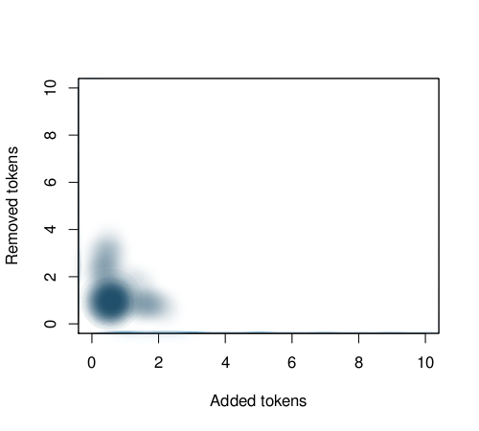
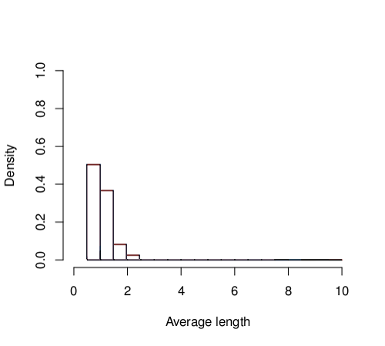
Do real faults look like simple faults?
What we expect
Density plot of the length of addition (X) and removal (Y)
Histogram of change length
Majority of changes are expected to be single token replacements
Notes:
So what did we expect to find?
If competent programmer hypothesis is correct, we would expect to find a distribution as the graphs given.
The first graph is a density plot of the length of addition and removal in X and Y axes.
The second graph is a histogram of the same data, where the histogram of average length of change is given.
We would expect that in the first graph, there is a large concentration of one token additions, one token removals, and one token changes.
We would expect the single token changes to predominate with the density falling rapidly for larger changes.

Slide 18
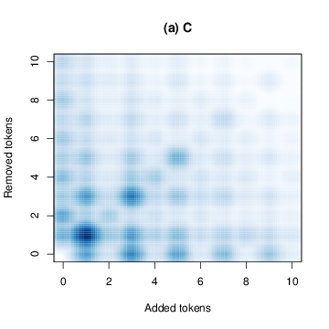
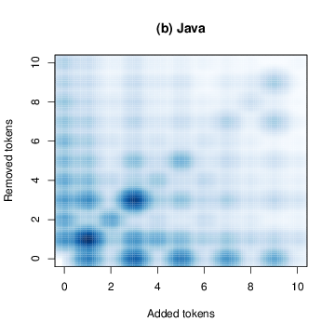
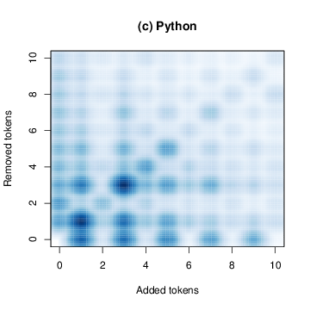
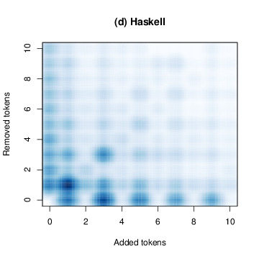
Do real faults look like simple faults?
It does not look like single token changes predominate
Density plot of the length of addition (X axis) and removal (Y axis) for sampled commits
R3
Notes:
However, we see a rather different distribution from the data.
The density plot that we get looks like this, where real faults seem to be more complex than the single token changes we expected.
That is, we see that the changes predominantly involve more than one token.
We note that there is an objection that developers, when they added commits, may have fixed more than one bug at once. To counter this objection, we also identified those commits that did not involve more than one single location in a file.
If a developer was fixing bugs, the chances of non related bugs being present at the exact same location is low. So we believe that these bugs that was fixed in a single location, that we called localized bugs provides a sort of validation to our experiment.

Slide 19
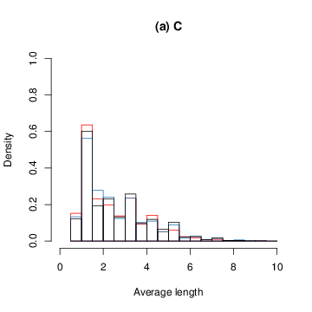
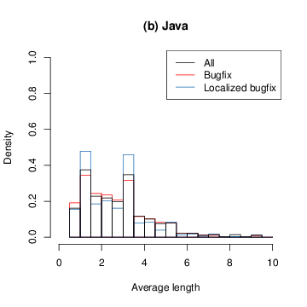
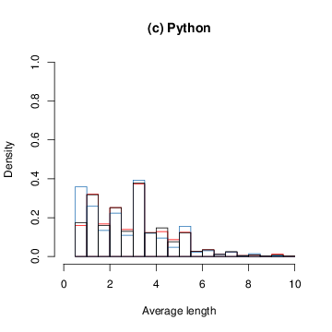
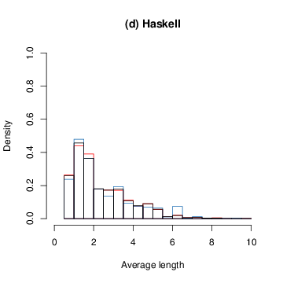
Average Tokens Changed
Histogram of change length in each language
Notes:
So here is the same data, but plotted as the average change length in a histogram. The thin blue line indicates the median.
Notice that the change length of all commits, that of the bugs and also that of localized bugs are noted separately.
As in the previous graph, we see that multi token changes predominate, even in the case of localized bugs.

Slide 20
Summary
Generated faults are dissimilar to real faults
in the dimensions examined.
Notes:
So in summary, we found that the average real fault differs from the kind of faults we generate using mutation analysis in terms of the size of the fault.
Since we had the data available, we also wondered about the distribution of mutation operators.

Slide 21
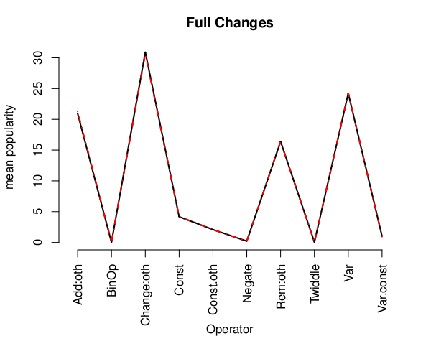
We also found that our current tools are incomplete
Add:oth Added tokens
Change:Oth Replaced tokens
Rem:oth Removed tokens
Twiddle Addition or removal of +/-1
Const Change in constant value
Var:Const Variable to constant or reverse
Var A variable to another
BinaryOp One binary operator to another
Negation Negation of a value
Frequency of mutation operators
Notes:
In our data, we found that some of the mutation operators are much more prevalent than others, even more than their lexical incidence seems to suggest.

Slide 22
We also found that our current tools are incomplete
Add:oth Added tokens
Change:Oth Replaced tokens
Rem:oth Removed tokens
Twiddle Addition or removal of +/-1
Const Change in constant value
Var:Const Variable to constant or reverse
Var A variable to another
BinaryOp One binary operator to another
Negation Negation of a value
Frequency of mutation operators
Notes:
More importantly, a large set of mutations are under uncategorized, which means that current tools do not produce these mutants.

Slide 23
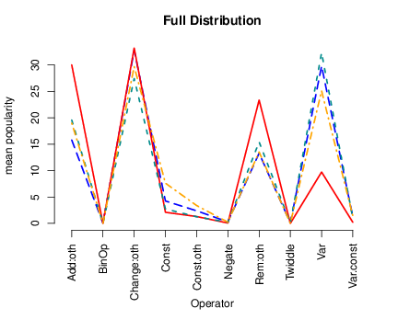
And that language matters
O C
O Python
O Java
O Haskell
Add:oth Added tokens
Change:Oth Replaced tokens
Rem:oth Removed tokens
Twiddle Addition or removal of +/-1
Const Change in constant value
Var:Const Variable to constant or reverse
Var A variable to another
BinaryOp One binary operator to another
Negation Negation of a value
Interaction between Mutation Operator and Language
Notes:
A further question we had, was whether we can reuse the results in previous studies especially in older programming languages using different paradigms. This assumes importance if you remember that quite a large number of mutation studies have been done in Fortran, and in the late 20th century, Further, we ourselves were trying to see if the older research could be reused for Haskell in our paper in ISSTA.
We found that different languages have different mutation distributions, with C and Java seemingly having similar mutation distributions, and Haskell very different from the rest. Even though python was similar to C and Java than to Haskell, it was the closest language to Haskell. We wonder if this is perchance due to the incidence of functional programming techniques in python.

Slide 24
TL;DR
Competent programmer hypothesis seems suspect
Notes:
However, this research does not suggest that mutation analysis is incorrect.
Mutation analysis is still useful if we can show that either
Mutations are similar to real faults in other dimensions
Or at least that mutation score actually follows test suite effectiveness.
For this, we need stronger research, using a large number of real projects, with real faults.

Slide 25
Finito

