Slide 1
On The Limits of Mutation Reduction Strategies
Rahul Gopinath
Amin Alipour
Iftekhar Ahmed
Carlos Jensen
Alex Groce
Notes:
Hello, I am Rahul Gopinath, PhD Candidate at Oregon State University.
This talk is about evaluating test suites, using a technique called mutation analysis.
It is a very useful technique but it can be computationally expensive.
This paper is an examination of how to keep the computational expenses in check and some of the pitfalls involved in doing so.

Slide 2
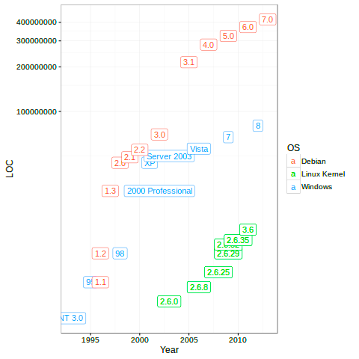

Complexity of software increasing exponentially
[ogheneovo2014jcc]
Google is now 2 billion lines of code
Notes:
Software, which is a critical part of our life now has a habit of increasing in complexity and size every few years.

Slide 3

And so is the number of bugs
Hitomi : Lost in space because of a bug
The number of vulnerabilities per year (1999 - 2016) [cvedetails.com]
Notes:
And along with it, so does bugs and their impact.
The only way we can hope to manage the explosion in bugs is through comprehensive testing.

Slide 4

We rely on testing. But…
Can we really trust our tests?
Notes:
However, that is just shifting the problem to another level.
If we use testing as a means of ensuring reliability of software, how do we ensure the correctness of software test suites?

Slide 5

We rely on testing. But…
Tests are written mostly manually [lam2014beyond]
Tests may have complex control flow, and may use external resources [lam2014beyond].
Subject to similar problems of correctness as programs.
Notes:
The question is important because tests are still written manually, and subject to the same errors that programs face. Tests themselves are quite similar to the programs they test, and can often be complex.
That is, how do we ensure that the tests are good enough, and testing what they are supposed to be testing?

Slide 6
We rely on testing. But…
Graph coverage criteria are often used. But are they useful?
Depends on how good your assertions are [zhang-fse15]
Assertions have a tendency to be inadequate:
Up to 65% unit tests in OSS Projects sampled have inadequate asserts [zhi-issta13].
class SimpleName
def initialize(num)
@x = num
end
def add(y)
@x + y
end
def multiply(y)
@x * y
end
end
class TestSimpleNumber < Test::Unit::TestCase
def setup
@num = SimpleNumber.new(2)
end
def test_simple_add
assert(@num.add(2) != 0)
end
def test_simple_multiply
assert(@num.multiply(2) != @num)
end
end
Notes:
The commonly used criteria, coverage of program elements is at best a useful heuristic because it relies on good assertions,
[click]
which is part of what we want to know.
To actually get a good idea of the quality of test suite, the most direct way is to apply mutation analysis on the test suite.

Slide 7

What is mutation analysis?
Generates fake bugs that look like the real things
Used in the industry as a stopping criteria for test suite development
Used by researchers to generate real looking faults, and then judge the effectiveness of testing techniques.
Researchers have shown that mutants are similar to bugs [just2014], and their detectability is similar to real faults [andrews2005] and tests with high mutation score is better able to detect hand seeded faults [le2009] than other test coverage metrics.
?
Notes:
Mutation analysis is a technique used to compare test suites, and testing tools.
Researchers also use mutation analysis to evaluate how good their techniques
are in creating or modifying test suites.
The best way to judge the effectiveness of a test suite is to start with a known
set of faults, and see how many of the faults were caught by the suite. However,
this technique is rather hard to use in practice, as the programs we are concerned
with often do not have a known set of real faults, mostly because they have not
been caught yet.
Mutation analysis comes closest to this gold standard by providing an artificial set
of bugs against which the test suit is evaluated, and hence provides a metric
that can be used to evaluate a suite or a tool even in the absence of real faults.
Researchers have shown that the faults produced by mutation analysis are similar
enough to real bugs that a test suite’s performance against the mutants is a reliable
proxy of its performance against real faults.

Slide 8
Mutation Analysis
Deterministically insert exhaustive first order faults against which test suites can be judged.
Notes:
Mutation analysis works by deterministically and exhaustively creating all possible simple mutations of a program.

Slide 9
Mutation Analysis
Deterministically insert exhaustive first order faults against which test suites can be judged.
Δ=b² – 4ac
d = b^2 + 4 * a * c; d = b^2 * 4 * a * c; d = b^2 / 4 * a * c; d = b^2 ^ 4 * a * c; d = b^2 % 4 * a * c;
d = b^2 << 4 * a * c;
d = b^2 >> 4 * a * c;
d = b^2 * 4 + a * c; d = b^2 * 4 - a * c; d = b^2 * 4 / a * c; d = b^2 * 4 ^ a * c; d = b^2 * 4 % a * c;
d = b^2 * 4 << a * c;
d = b^2 * 4 >> a * c;
d = b^2 * 4 * a + c; d = b^2 * 4 * a - c; d = b^2 * 4 * a / c; d = b^2 * 4 * a ^ c; d = b^2 * 4 * a % c;
d = b^2 * 4 * a << c;
d = b^2 * 4 * a >> c;
d = b + 2 - 4 * a * c; d = b - 2 - 4 * a * c; d = b * 2 - 4 * a * c; d = b / 2 - 4 * a * c; d = b % 2 - 4 * a * c; d = b << 2 - 4 * a * c; d = b >> 2 - 4 * a * c;
d = b^0 - 4 * a * c; d = b^1 - 4 * a * c;
d = b^-1 - 4 * a * c;
d = b^MAX - 4 * a * c;
d = b^MIN - 4 * a * c;
d = b - 4 * a * c; d = b ^ 4 * a * c;
d = b^2 - 0 * a * c; d = b^2 - 1 * a * c; d = b^2 – (-1) * a * c; d = b^2 - MAX * a * c; d = b^2 - MIN * a * c; d = b^2 * a * c; d = b^2 - a * c;
The # of mutants produced for even small programs is huge.
Each mutant requires a potential full test suite run.
Notes:
[pause]
Essentially, each lexical token becomes a site for one or possibly more mutants.
Since each mutant has to be verified independently, possibly by running the full
test suite against it, the runtime requirements of mutant analysis can increase
very fast corresponding to the size of programs tested.
[pause]

Slide 10
Mutation Analysis
Time
Original
Faster
(Optimizing)
Smarter
(Parallelizing)
Fewer
(Selective)
[harman2011,offutt2000]
Many approaches to reduce the computational time requirements of mutation analysis
Notes:
In order to tame this huge number of mutants, different strategies have been proposed
These are divided into Do faster smarter and fewer.
[click]
The Do faster approach concentrates on optimizing individual mutation execution,
[click]
the do smarter on better parallelization,
[click]
and the do fewer on reducing the number of mutants that need to be executed.
[click]
The do fewer is more important for the simple reason that regardless of improvements in other dimensions, we are still dealing with an exponential number of mutants for large programs.
[pause]
Hence, our focus here is on the do fewer strategy, or the selective mutation.
The reason why selective mutation can work is because of the so-called redundant and equivalent mutants.
Equivalent mutants are those mutants which are semantically equivalent to the original program, and hence can not be distinguished.
Similarly redundant mutants are those mutants which are essentially duplicates.
Both these groups of mutants do not provide any benefit to the mutation analysis.
The main aim of selective mutation is to remove the equivalent and redundant mutants so that we end up with a set of mutants that are unique.
In effect, the idea is to identify a way to group the mutants together and select a representative set of mutants.
[pause]

Slide 11
Mutation Analysis : Mutation Selection
Do fewer strategies:
Operator Selection:
Constrained Mutation [mathur91]
Selective Mutation [offutt93]
Program Element Strata:
Sampling by Program Element [gligoric2013]
Clustering:
Static [patrick2014]
Dynamic [offutt2014]
Domain [hussain2008]
Notes:
[pause]
The simplest and naive way of doing fewer is random selection, which can, in theory, produce a representative set of mutants.
Researchers have investigated whether we can arrive at a better set of representative mutants using a number of different techniques.

Slide 12
Do Fewer: Improvement from intelligent selection.
What is the maximum improvement that we can hope for
over random sampling?
Utility = % improvement in unique mutants over random sampling same number of mutants..
Notes:
With these different strategies for reduction of mutants, one may ask,
How much can one gain by using these intelligent strategies?
That is, what is the maximum utility from using one of these strategies over just reducing the mutants by random sampling.
This is the question that we tried to answer.
The utility is the improvement in unique mutants over random sampling same number of mutants.
When there is a positive utility, we call it a gain, and when it is negative, we call it a loss.

Slide 13
Do Fewer: Improvement from intelligent selection.
What is the maximum utility for a given strategy?
Empirical analysis
Theoretical analysis
Notes:
It is important to look at this from both empirical and theoretical perspectives.
The empirical analysis provides the assurance that the behavior exists in the real world. Further it serves to validate the theoretical model.
The theoretical analysis can provide us with insights as to how the system can behave, and its limits.
Hence, it is important to do both, and hold them up against each other.

Slide 14
Visual notation
4 different tests
A mutant
A mutant killed by two tests:
Notes:
Before we go further, here is an explanation of the visual notation. [click]
The rounded rectangles represent tests,[click]
the large circles represent mutants,[click]
and the filled dots represents tests killing mutants.

Slide 15


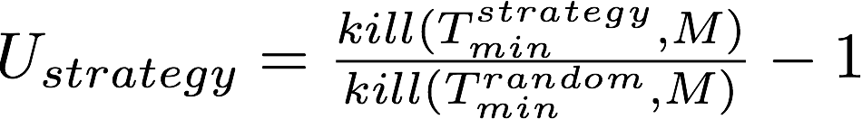
Comparison:
Strategy
Random
=
Notes:
To determine the utility from any given strategy, we followed the traditional steps.
[click]
First, we apply the reduction strategy against the full set of mutants, producing a smaller set of selected mutants.
[click]
Next, we produce the minimum test suite that is necessary to kill these reduced mutants.
[click]
Then, apply the minimal test suite against the full set of mutants,
[click]
and find how many of the original mutants were killed by this minimal test suite.
Finally, randomly select the same number of mutants as that of the reduction technique,
[click]
find its minimal test suite, and find the mutants killed.
The utility
[click]
is expressed as the percentage difference in final killed mutants between reduction strategy and random sample.

Slide 16
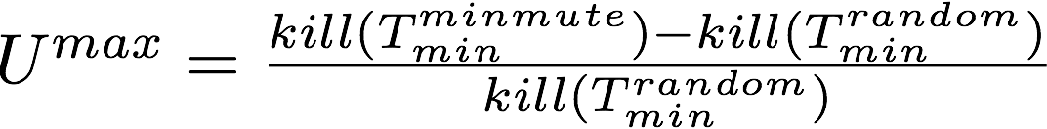
Finding maximum utility: Compare with minimal mutants
The best reduction strategy is minimal mutant (you already know which mutant is killed by which test).
We compared the best N mutants with oracular knowledge (minimal set) with N randomly sampled mutants
Notes:
To determine the maximum utility from any given strategy, we used minimal mutants
Minimal mutants are a smaller subset of mutants that can completely represent the full mutants in terms of the faults it represents.
We traditionally judge any reduction strategy by how close to minimal mutants it came when reducing the mutants.
In essence, minimal mutants are the perfect set of non-redundant mutants that we can have.
So once we have the minimal mutants, we used that in place of the reduced set of mutants, and compared with the mutants from random sample.
This gives us the maximum utility we can achieve.

Slide 17
Empirical analysis : Pipeline
Github & Apache Libraries
1,800
Has test suite
796
Compiles
326
|T| > 100
39
Notes:
So, this was our pipeline for empirical analysis.
[click]We started with 1800 Java projects using Maven from Github and Apache.
[click]From these, for ease of analysis, we removed aggregate projects, and projects with no test suites, yielding 796 projects.
[click]This was further reduced to 326 projects after removing projects that did not compile and run.
[click]Finally, we chose 39 out of these that had at least 100 tests.

Slide 18
Comparison of perfect and random sampling : Empirical
Found the minimal set of mutants from each project (rerun 100 times)
Generated random comparison mutant set of same size.
Computed the utility using minimal mutants.
Notes:
As we explained previously, we computed the minimal mutant set, and computed the maximum utility in comparison to random sampling.

Slide 19
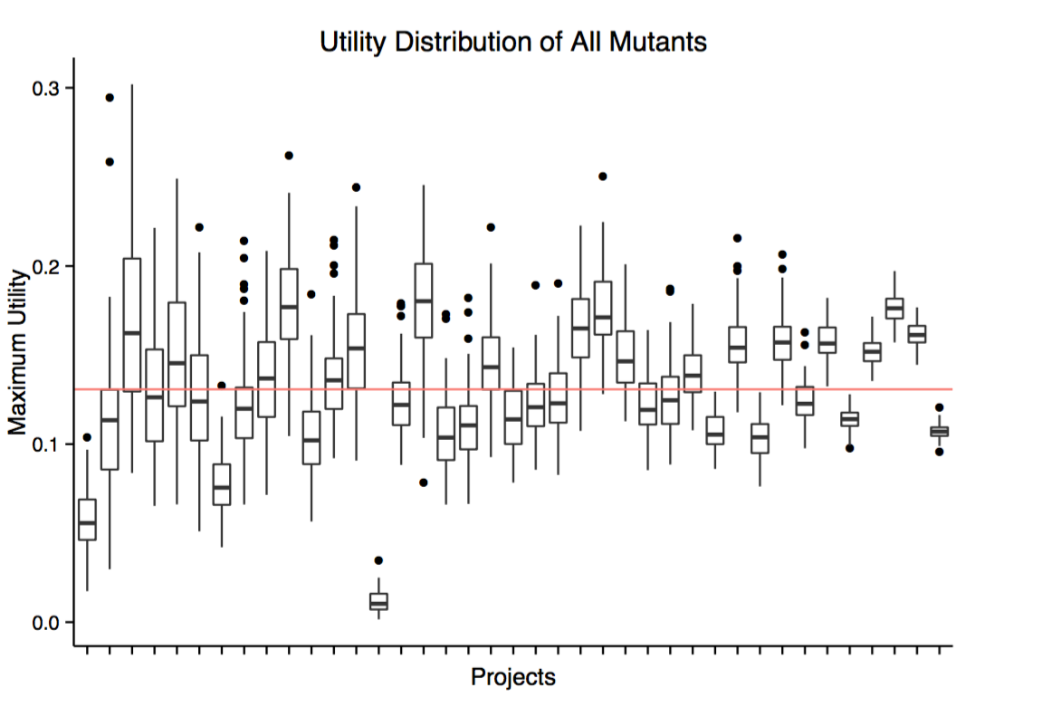
The distribution of utility
Mean utility 13.1%
95% projects have maximum utility between {12.23, 14.26} (u-test p<0.01)
Notes:
We plot the improvement seen by our perfect selection strategy using minimal mutants here.
A utility of zero mean no better than random sampling.
What we find is that on average, using perfect strategy in a project, we see a gain of 13.1% from random sampling.
For 95% projects the utility of perfect strategy lies between 12% and 14%.
That is, the 14% that we see is essentially the upper-bound on what we can hope to achieve using any mutation reduction strategy.
The gain we see here is for a perfect reduction strategy. If we were actually using one of the actual reduction strategies, we could expect the
utility to even be negative.
[pause]

Slide 20
Is this the best that we can do?
Theoretical Analysis:
We start with a few simplifications:
Every non-redundant mutant can be killed uniquely by some test case.
Equal number of redundant mutants for each mutant.
These are simplifications that help us to derive a theory for limits.
Notes:
Is this the best that we can do? In other words is there an upper bound?
To find out, we analyze the problem theoretically.
To make the analysis simple, we start with a few simplifications.
For starters, we assume that there exist a test case that can kill a non-redundant mutant uniquely. This allows us to model the system as a simple set of objects from where elements are sampled.
The distribution of redundant mutants in real world is hard to model, and may differ for different projects.
To make things simple, we assume a uniform distribution of redundant mutants.

Slide 21
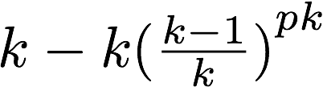
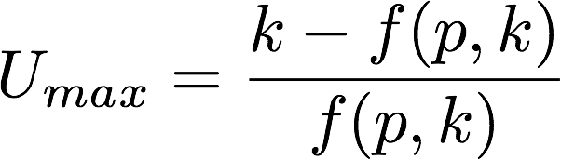
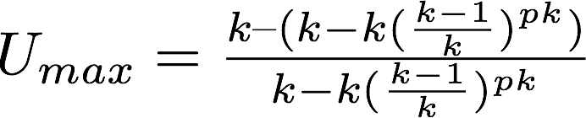


Comparison of perfect strategy and random sampling
N mutants
Perfect set of s mutants k unique with p each
Randomly sampled s mutants
p
k
Unique mutants : k
Unique mutants :
k unique mutants
<
~ 58.2%
Notes:
We are trying to find a theoretical expression of the gain of a perfect strategy over random sampling.
[click]
We start with k unique mutants, out of a set of N mutants.
From this, we select s mutants. [click]
If it is a perfect set, we know that we will have k unique mutants.
[click]
If it is a random sampling, then we compute the expected number of unique mutants by the given formula.
We expect the unique mutants in the random sample to be fewer than the perfect selection.
Next we find the expected utility of the perfect strategy over random sampling.
[click]
Interestingly, we find that the utility is given by 1/e^p-1, which has the maximum value when p = 1, approximately 58.2%
[pause]
This means that there is a theoretical bound on how much better a strategy can perform on average. 58.2%

Slide 22
Summary
We empirically computed the utility of a perfect strategy for picking minimal mutants over random sampling, finding it to be less than 15%.
We theoretically computed the utility of a perfect strategy over random sampling, assuming uniform distribution of redundancy, finding a maximum of 58%.
The assumptions made, such as a unique test case for each unique mutant, may not be available in a given test site. Hence the difference between theory and empirical analysis.
The take-home point is that there is a hard limit to the amount of improvement one can expect from any intelligent mutation reduction over random sampling.
Notes:
So in summary, we theoretically computed the utility of perfect strategy over random sampling, assuming uniform distribution of redundancy and found a maximum of 58%.
We empirically computed the utility of perfect strategy that can pick the minimal mutants over random sampling, and found a maximum of 15%.
The difference between theory and empirical value is due to the assumptions made in theory, such as a unique test case killing each mutant. This may not be possible in a given test suite. However, it serves as a kind of maximum limit.
The most important point here is that there is a hard limit to how much one can improve compared to random sampling.

Slide 23
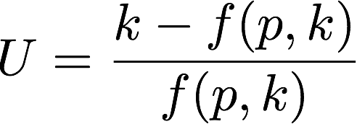
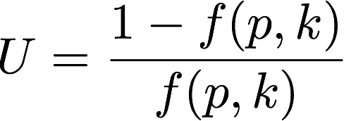
However....
The utility for perfect strategy
What happens when the heuristic of reduction technique fails?
Worst case: duplicates of a single mutant.
U is no longer bounded.
Caveat: Under the conditions of uniform distribution of mutants.
Notes:
Of course the strategy can go horribly wrong as well.
The interesting question is what happens when the heuristic of reduction technique fails, and it fails to pick the unique mutants.
In the worst case, it may pick duplicates of the same mutant over and over again. In which case, the utility becomes negative, and there is no lower bound.

Slide 24
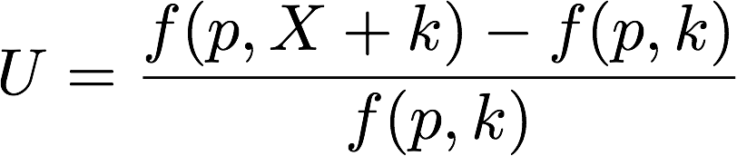
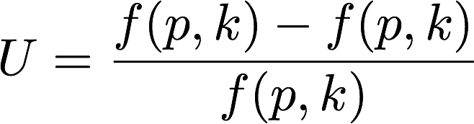
However....
Instead of reduction, add new operators, and reduce by sampling.
New formulation: X : new unique mutants.
In the best case, X increases with new mutagens (unbounded).
Worst case: Same as random sampling.
Entire mutant population
(before sampling)
Entire mutant population
(before sampling)
Caveat: Under the conditions of uniform distribution of mutants.
Notes:
Let us compare an alternate strategy. Instead of reducing the mutants using a heuristic, let us use new mutants.
In the best case, as we introduce new mutation operators
[click],
the number of unique mutants increases correspondingly, with no bound to the maximum utility that can be gained thus.
In the worst case, new mutation operators does not contribute any new mutants
[click],
if so, we are no worse than the original random sample, with zero, utility.

Slide 25
Conclusions
Mutation reduction strategies:
Very little potential gain
High potential for harm
New mutation operators:
High potential for gain
Little potential for harm
Want better mutants?
Avoid mutation reduction strategies
Investigate newer mutation operators
Notes:
In summary, if we are using selective mutation reduction strategies, such strategies have a fixed limit for any advantage over random sampling. However, if they fail to work, there is no limit to the disadvantage.
On the other hand, if one implements new operators and randomly sample them to reduce the number of mutants, there is no bound on the maximum advantage that can be gained. But in the worst case, we are no worse than random sampling.
That is, the least dangerous way of increasing the utility of mutants is to use new mutant operators.

Slide 26
Minimal mutants
All tests
All mutants
Minimal tests
Minimal mutants
May 12, 2016

Slide 27
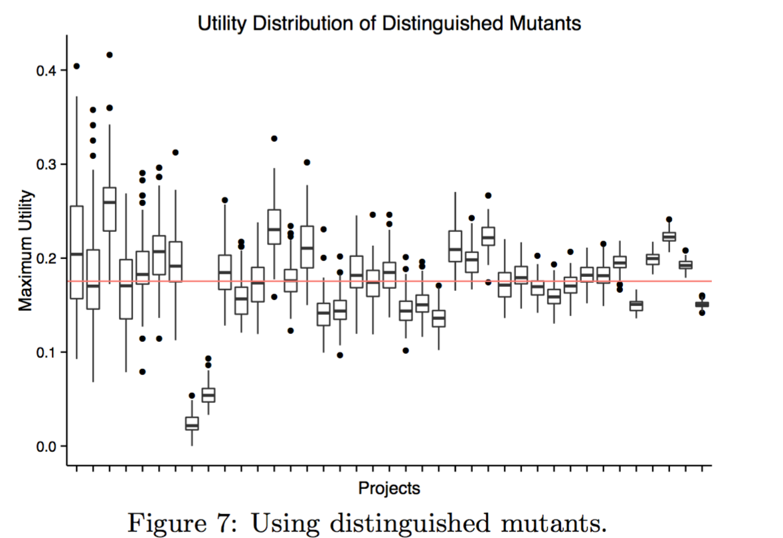
What if we used only distinguished mutants?
Recomputed Utility using distinguished mutants.
Mean utility 17.54%
95% projects have maximum utility between {16.91, 18.87} (u-test p<0.01)
May 12, 2016
Notes:
Since PIT has a larger number of mutant operators than other tools, and is known to produce a larger number of redundant mutants, we tried to simulate the mutants from a better tool that could produce less redundant mutants by using only distinguished mutants.
We found that the mean utility increased to 17.54%, and 95% projects have between 17 and 19% utility.

Slide 28







We rely on our programs
May 12, 2016
Notes:
Software is now a critical part of our life. It guides and enhances almost everything we do.

Slide 29
Mutation Analysis
Original
Faster
(Optimizing)
Smarter
(Parallelizing)
Fewer
(Selective)
[harman2011,offutt2000]
Many approaches to reduce the computational time requirements of mutation analysis
May 12, 2016
Notes:
Hence, our focus here is on the do fewer strategy, or the selective mutation.
The reason why selective mutation can work is because of the so-called redundant and equivalent mutants.
Equivalent mutants are those mutants which are semantically equivalent to the original program, and hence can not be distinguished.
Similarly redundant mutants are those mutants which are essentially duplicates.
Both these groups of mutants do not provide any benefit to the mutation analysis.
The main aim of selective mutation is to remove the equivalent and redundant mutants so that we end up with a set of mutants that are unique.
In effect, the idea is to identify a way to group the mutants together and select a representative set of mutants.
[pause]

Slide 30

How does it work?
We rarely know about all bugs in a code base.
Deterministically insert exhaustive first order faults against which test suites can be judged.
Δ=b² – 4ac
d = b^2 + 4 * a * c;
d = b^2 * 4 * a * c;
... etc.
May 12, 2016
Notes:
Because we rarely know how many bugs there are in the program before testing, it is hard to benchmark tools in the abstract.
So our best option is to introduce bugs in the code, and evaluate test suites on finding these.
That is, we use variants of the program with known defects that we can then use as metric.
However, there is an issue here, when we insert bugs, how do we know where to insert bugs?
Mutation analysis tackles this issue by introducing all first order faults into the code.

Slide 31

Do Fewer: Improvement from intelligent selection.
What is the maximum utility for a given strategy?
Procedure for evaluation of a reduction technique:
Apply intelligent reduction strategy to mutant set M
Determine the minimum test suite that can kill all mutants
Apply the same minimum test suite against full set M
We compared the best N mutants with oracular knowledge (minimal set) with N randomly sampled mutants
May 12, 2016
Notes:
To determine the utility from any given strategy, we followed the traditional steps.
First, we apply the reduction strategy against the full set of mutants, producing a smaller set of selected mutants.
Next, we produce the minimum test suite that is necessary to kill these reduced mutants.
Then, apply the minimal test suite against the full set of mutants, and find how many of the original mutants were killed by this minimal test suite.
Finally, randomly select the same number of mutants as that of the reduction technique, find its minimal test suite, and find the mutants killed.
The utility is expressed as the percentage difference in final killed mutants between heuristic and random sample.

Slide 32
Conclusions
No limit on how much disadvantage (negative utility) a reduction strategy can have, if it fails to predict correctly.
There is a fixed limit to maximum advantage (positive utility) from using a reduction strategy when it works.
The other side is that one may implement new operators instead, and use random sampling to get a representative set of mutants.
Using this strategy has a maximum limit on the disadvantage, but no limit on the maximum advantage.
May 12, 2016
Notes:
In summary, if we are using selective mutation reduction strategies, such strategies have a fixed limit for any advantage over random sampling. However, if they fail to work, there is no limit to the disadvantage.
On the other hand, if one implements new operators and randomly sample them to reduce the number of mutants, there is no bound on the maximum advantage that can be gained. But in the worst case, we are no worse than random sampling.
That is, the least dangerous way of increasing the utility of mutants is to use new mutant operators.

Slide 33
Empirical analysis : Pipeline
Subjects:
Java projects using Maven from Github and Apache : 1,800
Removed aggregate projects, and projects with no test suites : 796
Compiles with some hacking : 326
With non trivial test suites (>= 100 tests) : 39
Used PIT – An industry standard mutation tool
May 12, 2016
Notes:
So, this was our pipeline for empirical analysis.
We started with 1800 Java projects using Maven from Github and Apache.
From these, for ease of analysis, we removed aggregate projects, and projects with no test suites, yielding 796 projects.
This was further reduced to 326 projects after removing projects that did not compile and run.
Finally, we chose 39 out of these that had at least 100 tests.

Slide 34

But our programs are still buggy and unreliable.
The Japanese Hitomi X Ray Satellite : Lost in space due to a bug Cost: ¥31 billion
May 12, 2016
Notes:
Unfortunately, our programs are still buggy and unreliable, and we have no simple way to reduce the amount of bugs or vulnerabilities in our programs.
Here is a graph of the vulnerabilities in software systems which are severe bugs that can be attacked.
While techniques like static analysis and formal analysis show promise, it is often hard to apply them in large programs.

Slide 35
Conclusion
There is limited advantage to reduction of mutants by selection.
There is no limitation to possible advantage from adding new mutants.
Any set of mutants can be reduced using random sampling with little impact in its effectiveness.
Hence new research should be focused on finding new operators, not in selective mutation.
May 12, 2016
Notes:
Our take home point is just this: Be careful when using mutation reduction operators. Instead concentrate on finding new mutation operators that can increase the variety of mutant pool.

Slide 36

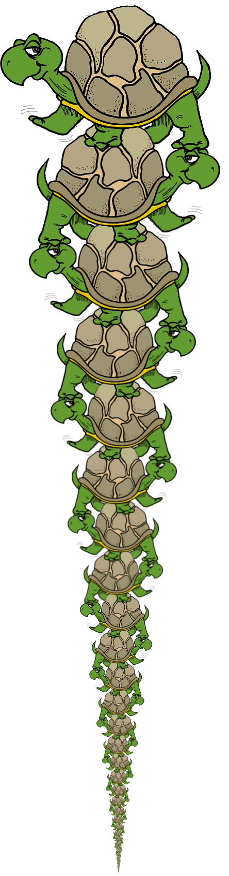
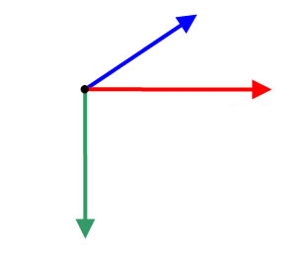

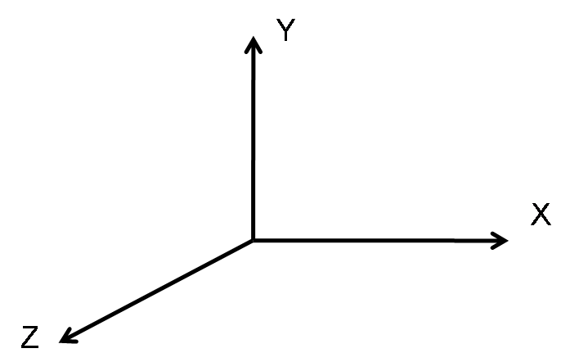
Pics
Smarter (parallelize)
Faster (single)
Fewer (reduce)
May 12, 2016

Slide 37
We rely on our programs
May 12, 2016
Notes:
Software is now a critical part of our life. It guides and enhances almost everything we do.
Hence, it is important that our programs are reliable and bug free.

Slide 38
We rely on our programs
May 12, 2016
Notes:
Software is now a critical part of our life. It guides and enhances almost everything we do.
Hence, it is important that our programs are reliable and bug free.

Slide 39
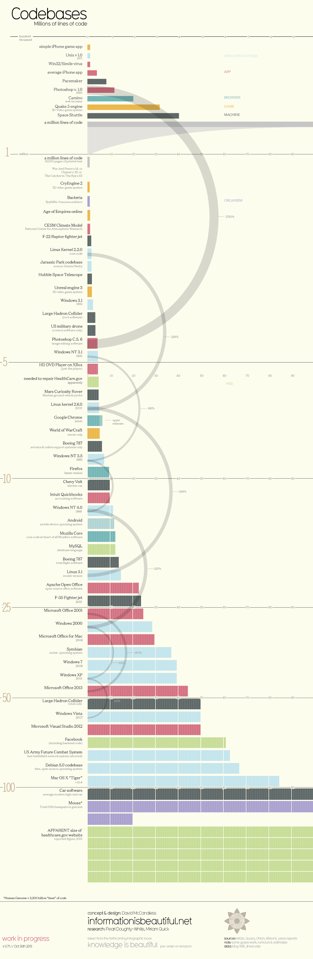
Unix 1.0 < 10000 lines
A million lines (zoomed)
Size of software systems has a nasty habit of doubling every few years
[dataisbeautiful.net]
Debian 5 ~ 70 million lines
Smart Cars
100 million lines
Notes:
Which is rather painful, because software has a nasty habit of doubling every few years.
While formal methods may deliver us from this mess at some point in future, we are left with software testing to ensure reliability of our systems.

Slide 40

Comparison of perfect strategy and random sampling
Let there be k unique mutants, in a set of N mutants.
We sample s mutants, where we have p samples of each.
Perfect sampling:
p * k= s
Expected unique mutants = k
Random sampling:
random(k) : total mutants = s
Expected unique mutants =
Hence
Converges to
This has a maximum value when p equals 1 of 58.2%
May 12, 2016
Notes:
We are trying to find a theoretical expression of the gain of a perfect strategy over random sampling.
We start with k unique mutants, out of a set of N mutants.
From this, we sample s mutants. If it is a perfect sampling, we know that we will have k unique mutants.
If it is a random sampling, then we compute the expected number of unique mutants by the given formula.
We expect the unique mutants in the random sample to be fewer than the perfect selection.
Next we find the expected utility of the perfect strategy over random sampling.
Interestingly, we find that the utility is given by 1/e^p-1, which has the maximum value when p = 1, approximately 58.2%
[pause]
This means that there is a theoretical bound on how much better a strategy can perform on average. 58.2%

