Slide 1
Topsy-Turvy
A Smarter and Faster Parallelization of Mutation Analysis
Rahul Gopinath
Carlos Jensen
Alex Groce
Notes:
Hello, I am Rahul Gopinath, PhD Candidate at Oregon State University.
My talk is about a faster algorithm for mutation analysis.
Mutation analysis is the best technique for evaluating test suites, but it is very computationally expensive.
A large reason for this expense is the redundancy in execution of common parts in mutants.
Our algorithm reduces the redundancy in mutant executions by using cheap forking.

Slide 2

Mutation Analysis : A birds eye view
Requirement: Find how good your tests are
Graph coverage metrics have well known faults
They do not take into account quality of oracles.
class SimpleName
def initialize(num)
@x = num
end
def add(y)
@x + y
end
def multiply(y)
@x * y
end
end
class TestSimpleNumber < Test::Unit::TestCase
def setup
@num = SimpleNumber.new(2)
end
def test_simple_add
assert(@num.add(2) != 0)
end
def test_simple_multiply
assert(@num.multiply(2) != @num)
end
end
May 15, 2016
Notes:
One of the major questions in software testing is to know when to stop testing.
That is, how do we know our tests are comprehensive, and strict enough to prevent possible bugs?
We use graph coverage metrics such as statement, branch and path coverage criteria, and assume that a good coverage equates to a good test suite.
[click]
Unfortunately, even if one has good coverage, it is possible that the assertions are not sufficient.
Which is a common occurrence in an average project.

Slide 3
Mutation Analysis : A birds eye view
Instead:
Seed a large number of faults (mutants).
Run test suite against each.
The effectiveness is the % of faults detected (killed).
Δ=b² – 4ac
d = b^2 + 4 * a * c; d = b^2 * 4 * a * c; d = b^2 / 4 * a * c; d = b^2 ^ 4 * a * c; d = b^2 % 4 * a * c;
d = b^2 << 4 * a * c;
d = b^2 >> 4 * a * c;
d = b^2 * 4 + a * c; d = b^2 * 4 - a * c; d = b^2 * 4 / a * c; d = b^2 * 4 ^ a * c; d = b^2 * 4 % a * c;
d = b^2 * 4 << a * c;
d = b^2 * 4 >> a * c;
d = b^2 * 4 * a + c; d = b^2 * 4 * a - c; d = b^2 * 4 * a / c; d = b^2 * 4 * a ^ c; d = b^2 * 4 * a % c;
d = b^2 * 4 * a << c;
d = b^2 * 4 * a >> c;
d = b + 2 - 4 * a * c; d = b - 2 - 4 * a * c; d = b * 2 - 4 * a * c; d = b / 2 - 4 * a * c; d = b % 2 - 4 * a * c; d = b << 2 - 4 * a * c; d = b >> 2 - 4 * a * c;
d = b^0 - 4 * a * c; d = b^1 - 4 * a * c;
d = b^-1 - 4 * a * c;
d = b^MAX - 4 * a * c;
d = b^MIN - 4 * a * c;
d = b - 4 * a * c; d = b ^ 4 * a * c;
d = b^2 - 0 * a * c; d = b^2 - 1 * a * c; d = b^2 – (-1) * a * c; d = b^2 - MAX * a * c; d = b^2 - MIN * a * c; d = b^2 * a * c; d = b^2 - a * c;
May 15, 2016
Notes:
Mutation analysis takes a different approach.
It starts by mutating the program with small changes.
If the test suite is good enough, it should be able to identify that the program was changed.
The effectiveness or the mutation score is essentially the percentage of such changes detected.
[click]
Of course, the number of such mutants are really huge even for small programs.

Slide 4
Mutation Analysis : The problem
Each seeded test requires a full test suite run
The number of mutants are huge for even small programs.
Observation: Assertions often happen after a fairly long execution.
class SimpleX
def initialize()
....
end
def check(y)
....
....
x = ...
z = x > y
return z
end
end
class TestSimpleX < Test::Unit::TestCase
def setup
@x = SimpleX.new()
end
def test_check
assert (@x.check(1000) )
end
end
mutation point
May 15, 2016
Notes:
We also potentially need to run the full test suite to evaluate each mutant.
However, an interesting observation is that assertions often happen at the end of long execution threads, to make sure that the result conforms to expectations.

Slide 5
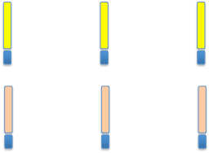
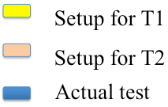
Observation: Two test cases on three mutants
m1
m2
m3
Mutants executed
in parallel
May 15, 2016
Example: Two test cases on three mutants
Example: Two test cases on three mutants
Traditional parallelization (Setup executed redundantly)
Traditional parallelization (Setup executed redundantly)
Setup for T1
Setup for T2
Setup for T1
Setup for T2
Actual test
Actual test
Topsy-turvy Parallelization (Setup executed only once)
Topsy-turvy Parallelization (Setup executed only once)
Notes:
Here is what happens when we run multiple mutants in the traditional way.
The traditional parallelization strategy is to parallelize the mutant execution, with tests serialized.
Each mutant independently executes the initial portion even though there is no difference in the code path or values.

Slide 6
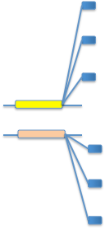
We Propose: Topsy Turvy
Tests are executed
in parallel
Fork off mutants as they are encountered
t1
t2
May 15, 2016
Notes:
What we propose is to instead execute the tests in parallel, and each time a possible mutation point is encountered, fork off a new mutant.

Slide 7
We Propose: Topsy Turvy
Original:
def avg(a,b)
return (a+b) / 2
end
Fork off mutants
as they are encountered
Mutant id (:b)
Transformed:
def avg(a,b)
return μ(:a, μ(:b, x, y, +), 2, /)
end
The library function: μ()
def μ(id, a, b, op)
if parent?
return op(a,b) if has?(id)
mutations(op).each do |o|
fork
if child?
set(id, o)
return o(a,b)
end
end
set(id, op)
return op(a, b)
else
o = get(id) || op
return o(a,b)
end
end
Library call (μ)
May 15, 2016
Notes:
So here is our algorithm that decides when to fork a mutant.
[click]
Given any function with a mutation point such as an operator, transform it to a library call with a mutation id. The mu is the library call here, which takes the mutating point along with mutation id.
[click]
The library implementation is simple.
[click]
It first checks if any mutation is currently active. If none is active, it forks, and mutates the current point in the child. If another mutation is currently active, it executes the original function. So essentially, each mutation point becomes a site for forking, and each child gets a single mutation.
With this algorithm, we have a few important benefits. The first is of course the shared execution, which cuts down on the runtime costs.
Secondly, notice that this is just a simple library call. It does not need a large framework to support mutation analysis, and can be implemented by a source transformation for any language.
Another interesting part is that only those mutants that are actually covered by a given test case is actually executed. This is something that is lacking even in more recent mutation analysis frameworks.

Slide 8
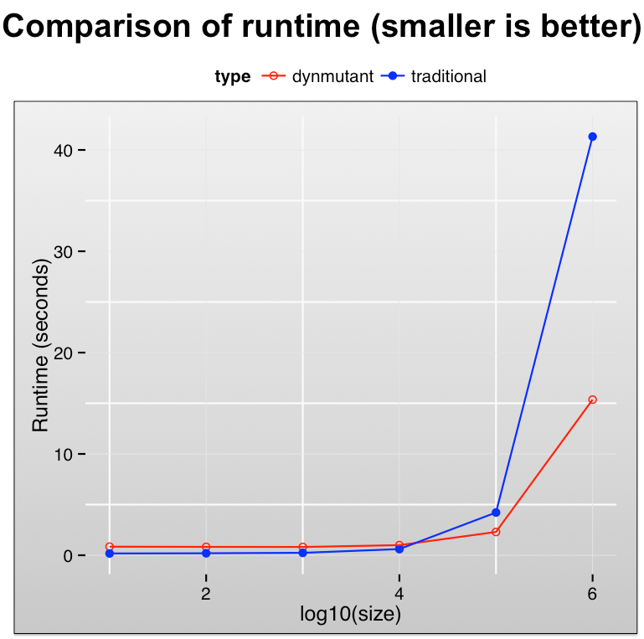
Total runtime
(not wall-clock time.)
May 15, 2016
Notes:
We applied our algorithm to a very simple program that computes prime numbers, and its test cases.
The X axis corresponds to the input size of the program, and Y axis corresponds to the total runtime.
You can see that there is a significant amount of savings in execution as the setup time increases.

Slide 9
Related ideas
Topsy Turvy (dynamic mutants): Applied as source transformation, and applicable in any environment and language with cheap forking.
Related ideas:
Split Stream Execution – King et al. 1991 Difference: Interpreter only technique – Interpreter manages the forking.
MuVM – Tokumoto et al. (ICST) 2016 Difference: Similar idea, but Virtual Machine based. The tests are still serial
May 15, 2016
Notes:
Ours is not the only proposal for sharing state and execution between mutants.
The first was proposed in 1991, where the mutation interpreter managed the state, and forked the execution
The second was proposed very recently at ICST 2016 called MuVM which is a virtual machine based technique for C.

Slide 10
Conclusion
Original:
def avg(a,b)
return (a+b) / 2
end
Transformed:
def avg(a,b)
return μ(:a, μ(:b, x, y, +), 2, /)
end
The library function: μ()
def μ(id, a, b, op)
if parent?
return op(a,b) if has?(id)
mutations(op).each do |o|
fork
if child?
set(id, o)
return o(a,b)
end
end
set(id, op)
return op(a, b)
else
o = get(id) || op
return o(a,b)
end
end
Advantages:
Applicable for any language
Simple source transformation (can do it in AWK)
Involves just a library call
Only executes mutants relevant to test cases
Obtains significant runtime improvement
Caveats:
Requires cheap forking (such as Unix)
Assumes test cases are parallelizable
Assumes reusable state
May 15, 2016
Notes:
So in conclusion, our technique has the following advantages.
It is applicable in any language, and can be implemented with a simple source transformation.
It requires no complicated framework. All it needs is a simple library call to be executed at the place of operators.
It only executes mutants that are hit during the test case execution. Hence we avoid executing test cases that do not cover a mutant.
It obtains significant runtime savings.

