Slide 1

Currency Analysis
Presentation of Findings
Rahul Goraksha

Slide 2

INDEX
01
ASSESSMENT-1
02
ASSESSMENT-2 INTRODUCTION
03
GOALS AND OBJECTIVES
04
OUTPUTS
05
TECHNICAL ANALYSIS
06
CONCLUSION
07
GRATITUDE

Slide 3


ASSESSMENT-1
Alphashots.Ai uses to find comparable historical patterns in stock charts, AI probably use machine learning models and pattern recognition algorithms like Convolutional Neural Networks (CNNs) or Dynamic Time Warping (DTW).
These algorithms can identify matches based on visual or shape-based similarities between historical data and current stock price trends.
Understanding sequential patterns throughout time can include time series models such as LSTM (Long Short-Term Memory) networks.
This enables the AI to make predictions about future stock price movements based on historical patterns.

Slide 4


ASSESSMENT-2 INTRODUCTION
Currencies:
Euro (EUR): Official currency of the European Union.
Indian Rupee (INR): Official currency of India.
Project Goal:
Analyze EUR/INR exchange rate.
Use technical indicators: Simple Moving Average (MA20), Bollinger Bands, Commodity Channel Index (CCI).
Key Considerations:
Data Source: Yahoo Finance.
Time Frame: January 1, 2023 to September 30, 2024.

Slide 5





GOALS AND OBJECTIVES
Data Collection
Signal Generation
Data Visualization
Fetch and analyze historical data for the EUR/INR pair to understand market trends.
Calculate technical indicators to identify trends and generate trading signals that guide investment decisions.
Visualize the data and provide a summary of the analysis to facilitate easy interpretation of results.

Slide 6

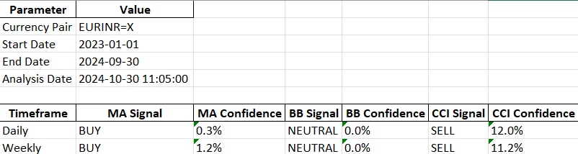
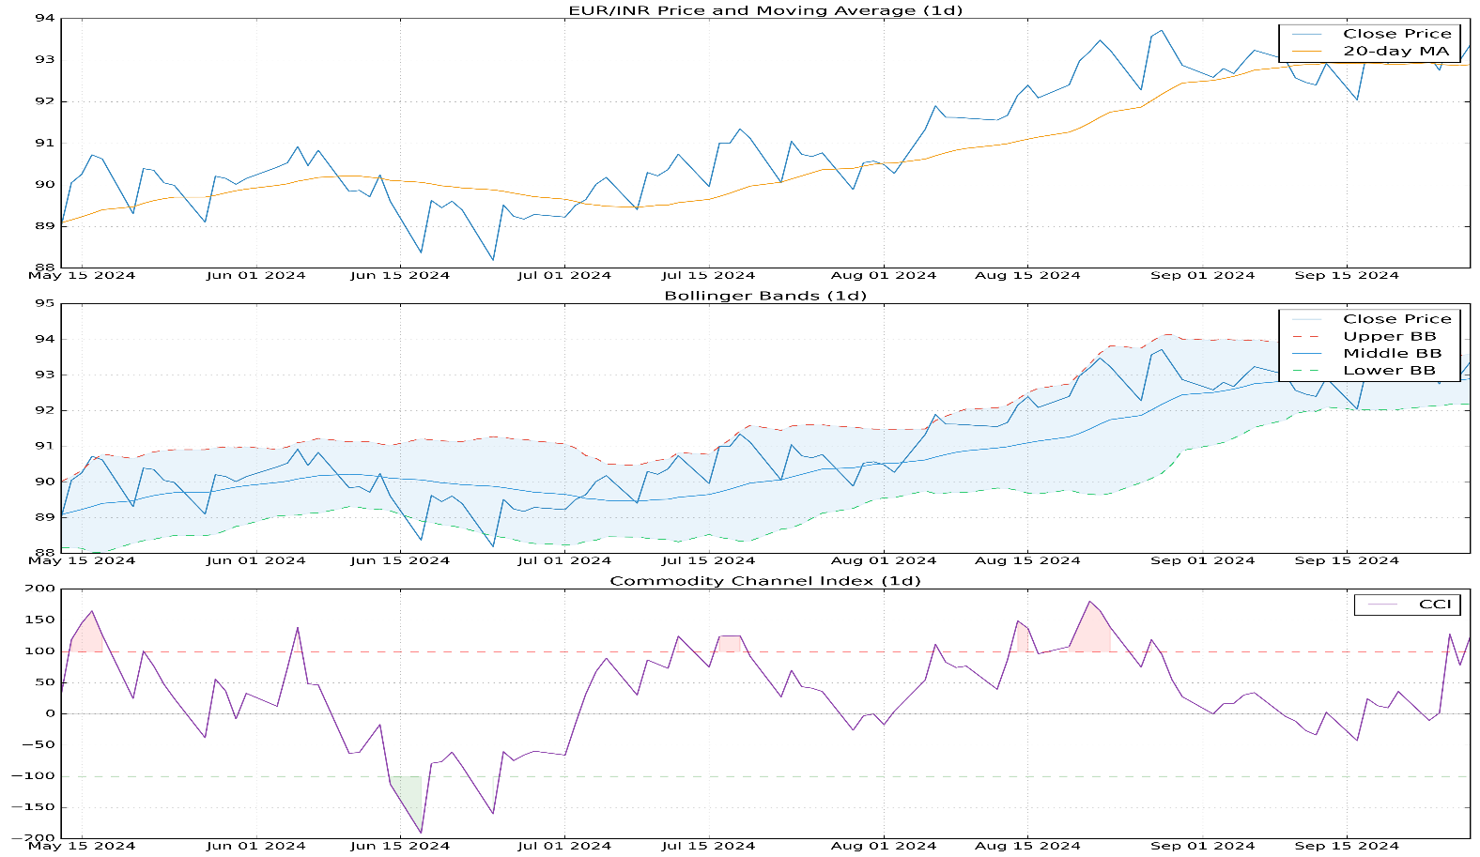
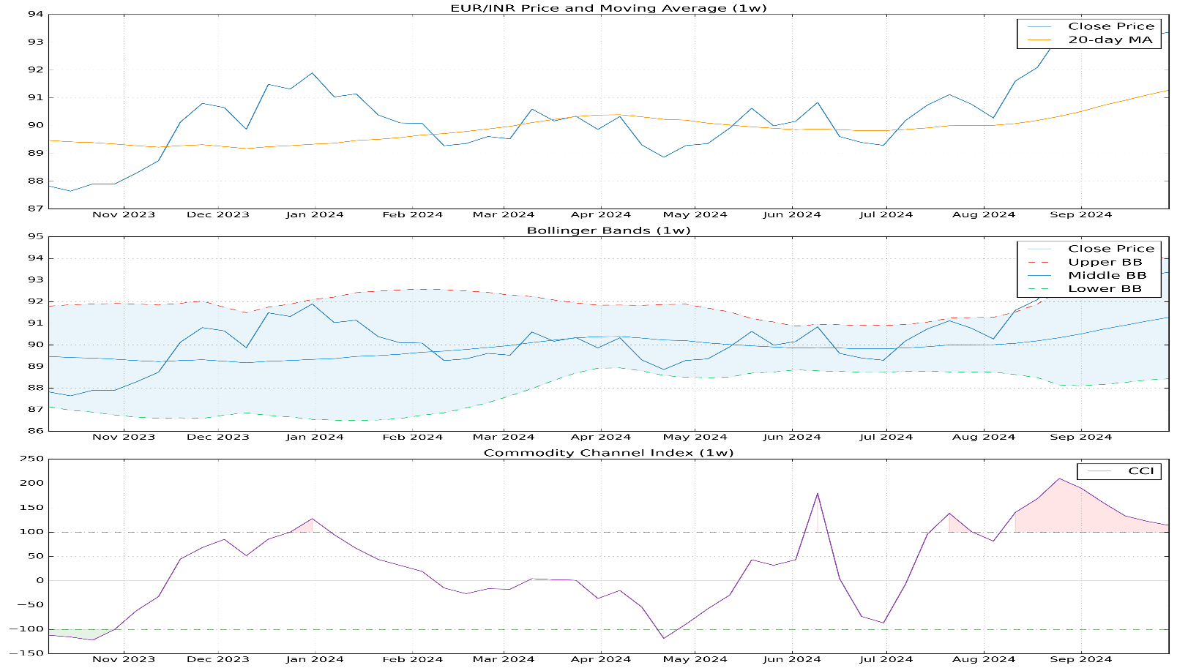
Outputs
Tabular Output
Graphical Output

Slide 7

Technical Anlysis
Shows the CCI values over time, with the +100 and -100 levels marking overbought and oversold regions.
Plots the EUR/INR closing price and the 20-day simple moving average, highlighting the relationship between the two.
Displays the upper, middle, and lower Bollinger Bands, indicating overbought and oversold market conditions.
Commodity Channel Index (CCI)
Price and Moving Average
Bollinger Bands

Slide 8




CONCLUSION
Summarize the most significant signals from the daily and weekly technical indicator analysis.
Highlight any notable trends or patterns observed in the EUR/INR exchange rate.
Discuss the potential implications of the findings for traders and investors.
Provide a short-term projection for the EUR/INR pair based on the technical analysis.
Suggest potential improvements and the integration of fundamental analysis for more comprehensive results.
Future Considerations
Implications & Outlook
Key Findings

Slide 9
THANK YOU

