Slide 1
Automated Report Generation
Development of a customized application to support team-specific reporting needs through automated report generation using Power Automate.

Slide 2
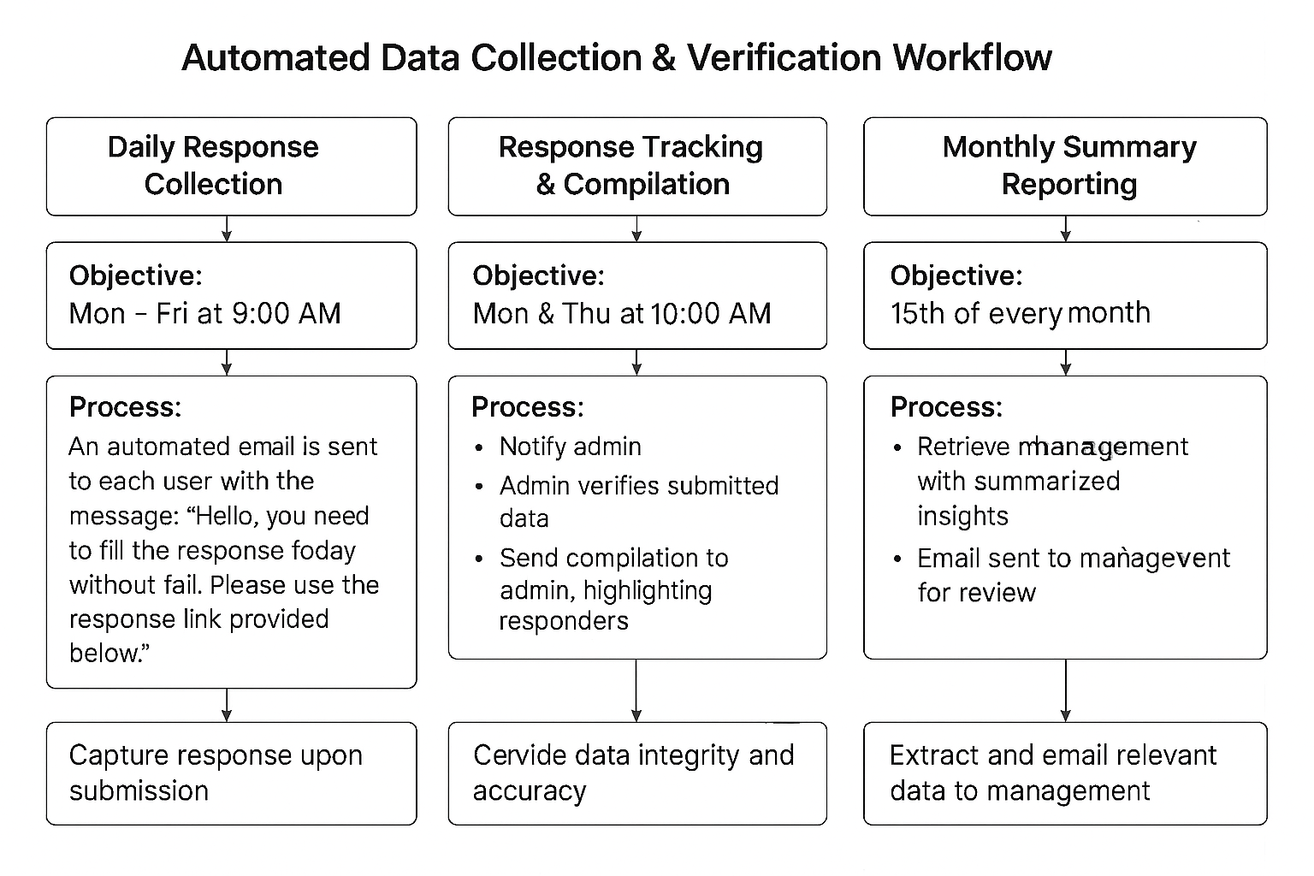

Slide 3
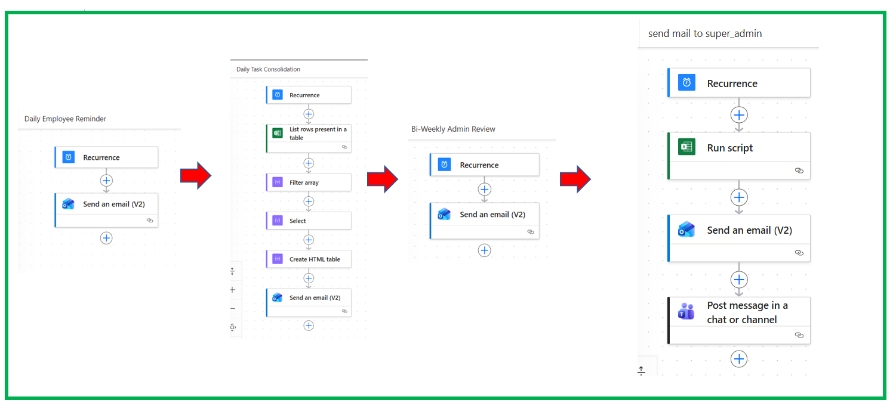
Workflow Process Map

Slide 4
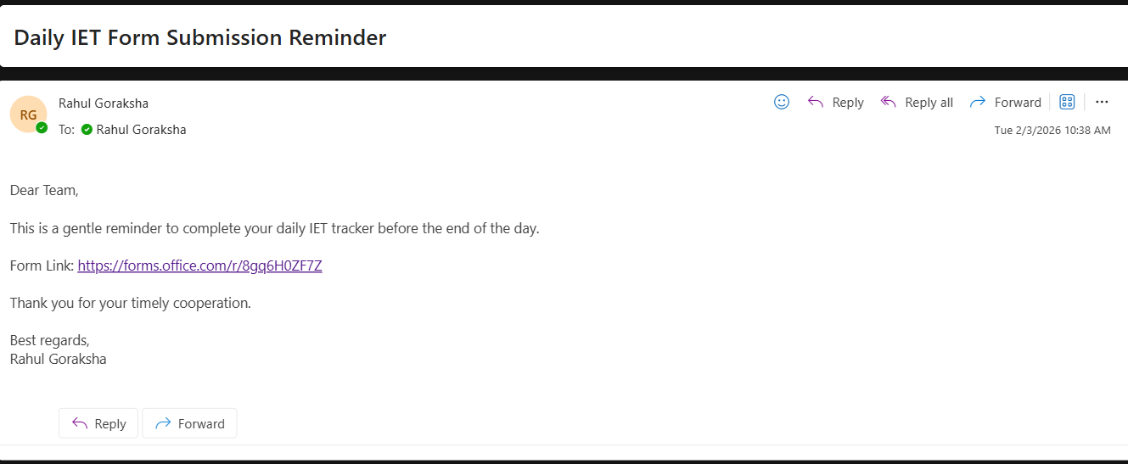
Test Result
Form filling Reminder

Slide 5
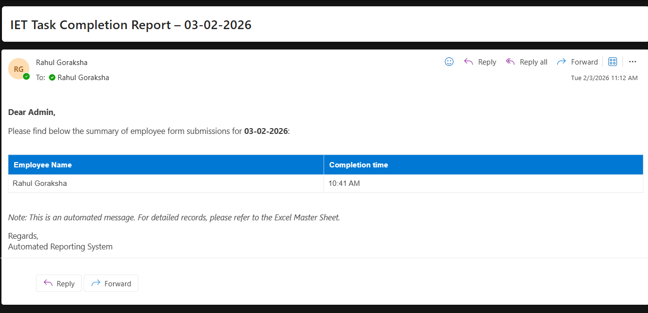
Test Result​
User Task Completion Summary to Admin

Slide 6
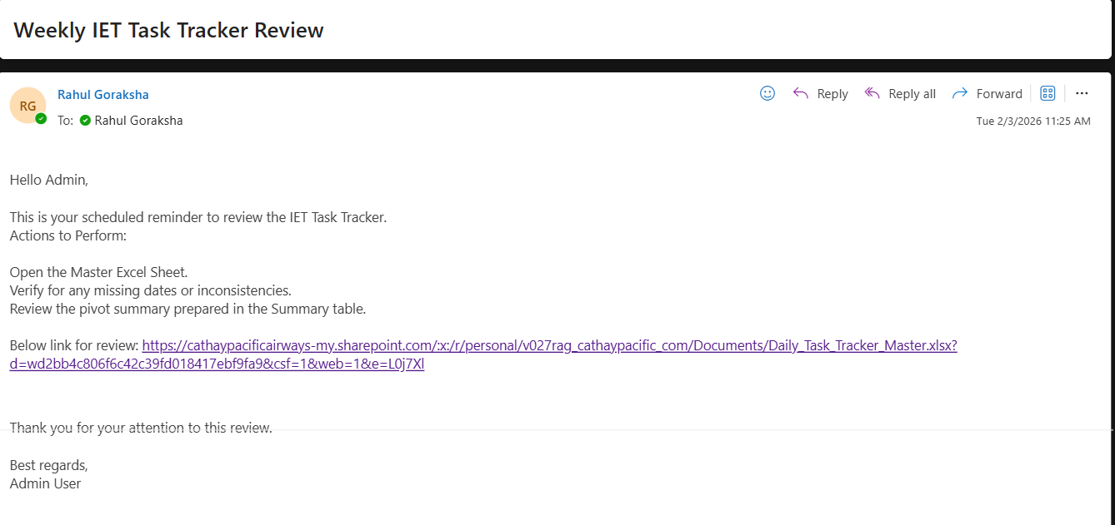
Test Result​
Weekly Review for Admin

Slide 7
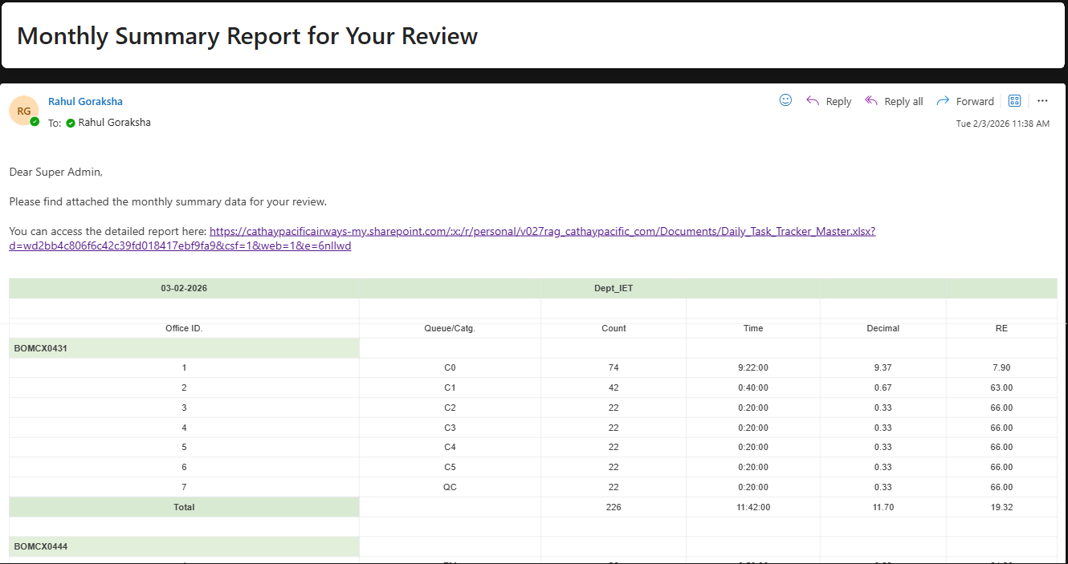
Test Result​
Monthly Summary to Supervisor

Slide 8
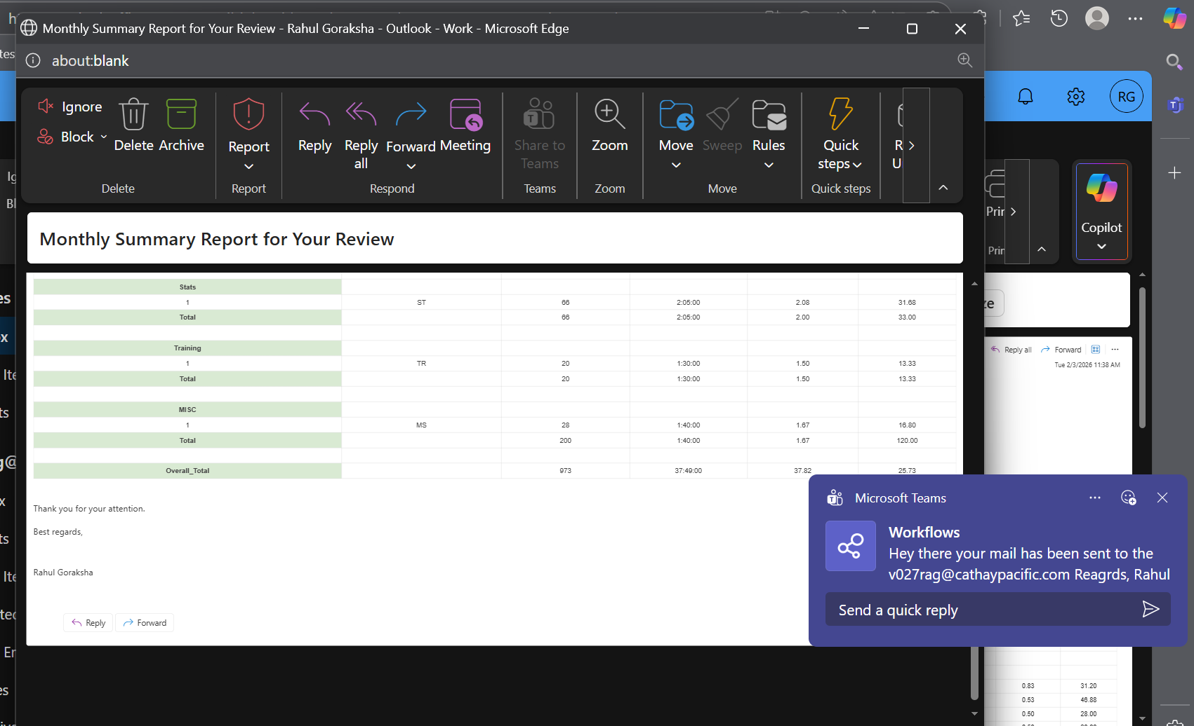
Test Result​
Teams Pop-up to Admin on successful triggering mail to Supervisor

Slide 9
Goals and Benefits
The automation workflow achieves the following objectives:
Dynamic Data Management:
> The workflow maintains data dynamically, similar to previous Excel-based approaches, without manual updates.
Elimination of Sub sheet Maintenance:
> No need to create multiple sub sheets based on dates.
Employee Changes Handled Automatically:
> Addition or removal of employees is automatically handled; column headers do not need to be updated manually.
Automated Calculations:
> Individual totals or summaries are calculated automatically; no separate manual calculation is required.
Fully Autonomous Reporting:
> Daily and monthly reports are generated automatically, eliminating the need to maintain separate report files.

