Slide 1

How to Create Branching in Microsoft Forms
Step-by-step guide to setting customized form paths
Notes:
AI-generated content may be incorrect. ---

Slide 2
Understanding and Implementing Branching in Microsoft Forms
Notes:
Introduction to Branching in Microsoft Forms, Accessing Branching Settings in Microsoft Forms, Setting Up Branching for Questions, Applying Branch Logic to Create a Personalized Flow, Practical Example of Branching in Use, Previewing and Testing Branching Logic, Finalizing, Saving, and Sharing the Branched Form

Slide 3
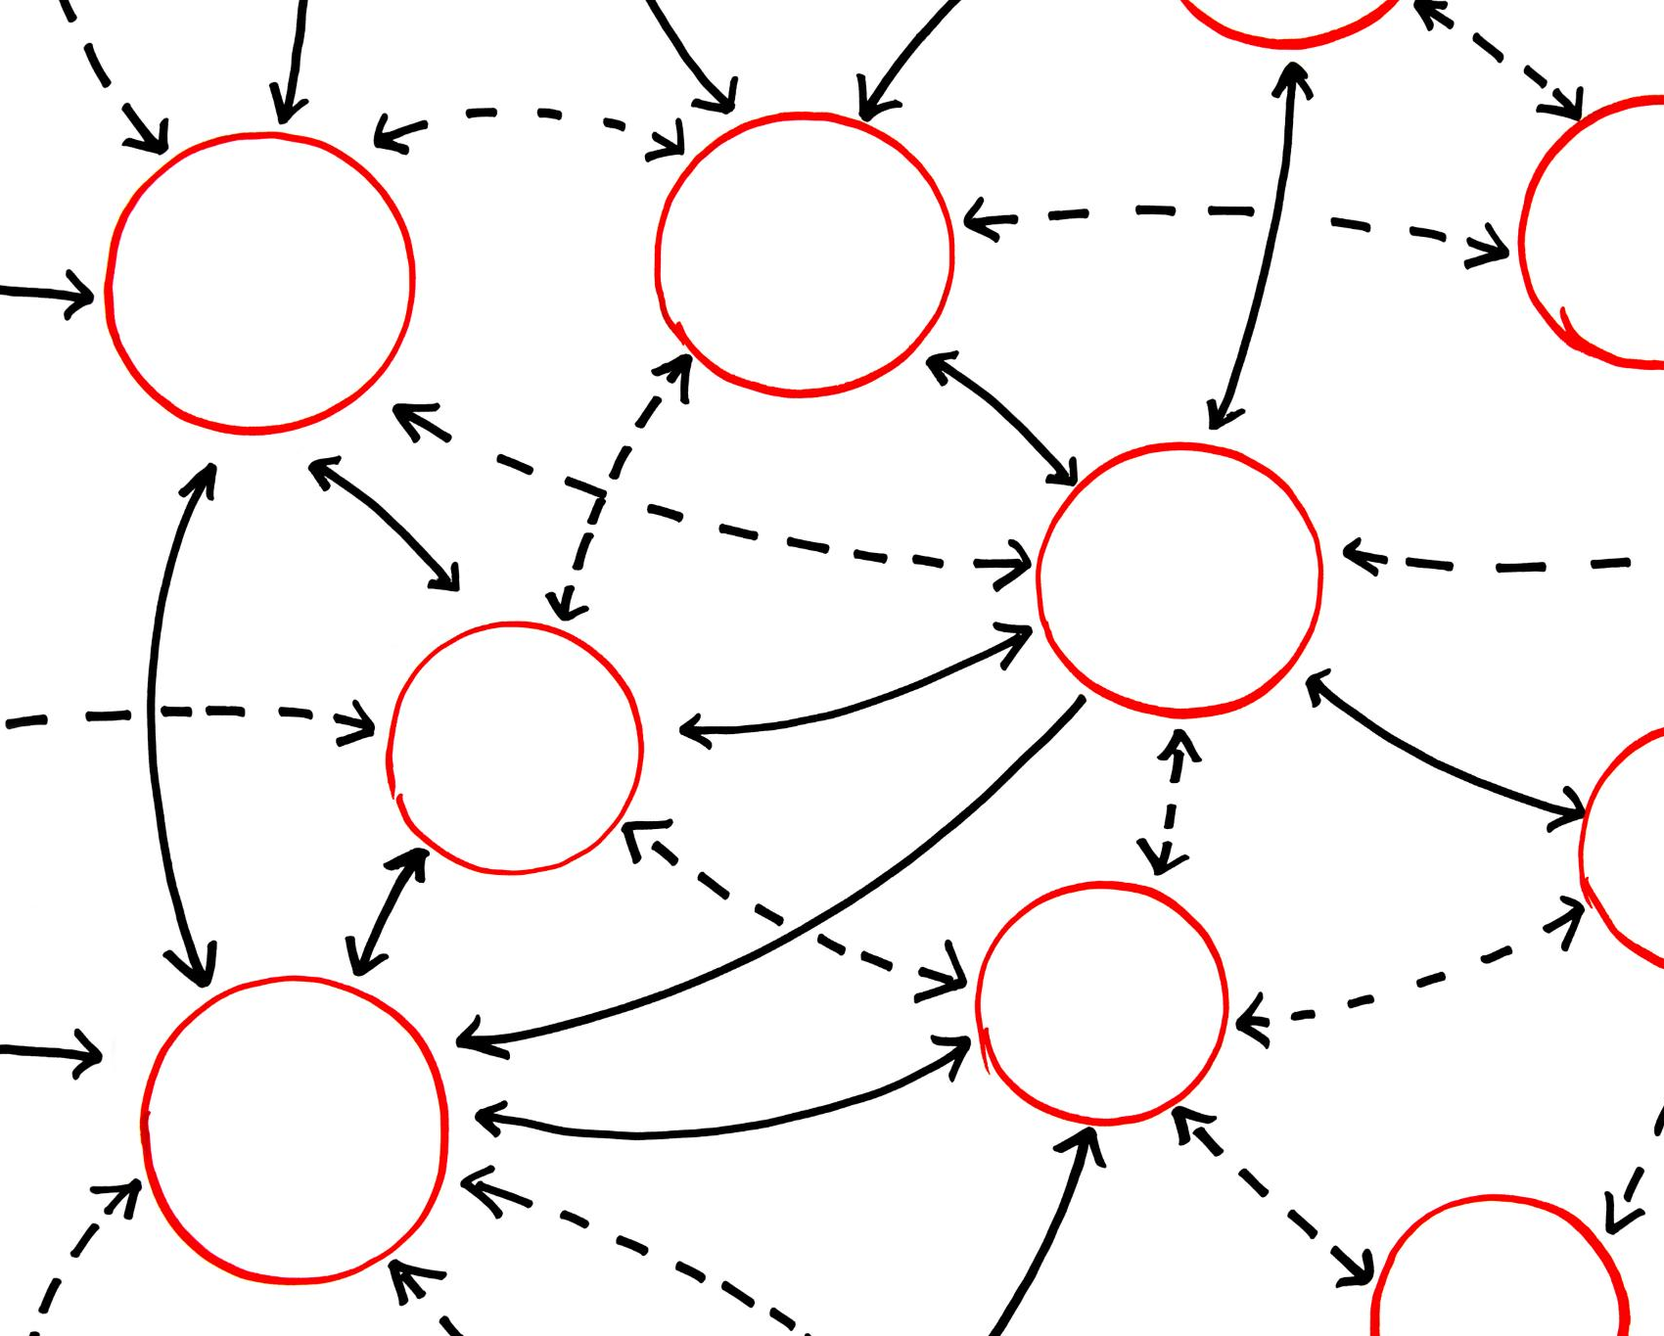
Introduction to Branching in Microsoft Forms
Personalized Question Flow
Branching customizes the form by showing questions relevant to respondents based on their previous answers.
Improved Data Accuracy
Branching reduces irrelevant responses, enhancing data clarity and minimizing respondent fatigue.
Visual Implementation
Branching is designed visually in Microsoft Forms, allowing easy setup without programming skills.
Strategic Planning Required
Effective branching demands careful planning of form structure and logical decision-making paths.
Notes:
Branching in Microsoft Forms is a powerful feature that allows form creators to build dynamic and interactive forms by controlling the flow of questions based on a respondent’s answers. Instead of presenting every user with the same fixed set of questions, branching enables a personalized experience where only relevant questions are shown. This is especially useful in scenarios such as surveys, training assessments, feedback forms, and application forms, where different respondents may need to answer different questions depending on their choices. For example, in a training feedback form, a user who selects that they attended a particular module can be directed to questions specific to that module, while others skip those questions entirely. This improves clarity, reduces respondent fatigue, and increases the accuracy of collected data. Branching also helps organizations maintain cleaner datasets by avoiding irrelevant or empty responses. In Microsoft Forms, branching is implemented visually, making it accessible even to users without technical or programming backgrounds. The feature works by assigning a “next step” for each answer option in a question, which could be another question or the end of the form. Understanding the purpose of branching is the first step before implementing it, as effective branching requires careful planning of the form structure, question order, and logical decision paths. When used correctly, branching transforms a simple form into a smart, responsive questionnaire that adapts to user input in real time. This introductory understanding sets the foundation for learning how to access, configure, test, and finalize branching logic in Microsoft Forms, which will be covered in the subsequent slides.

Slide 4
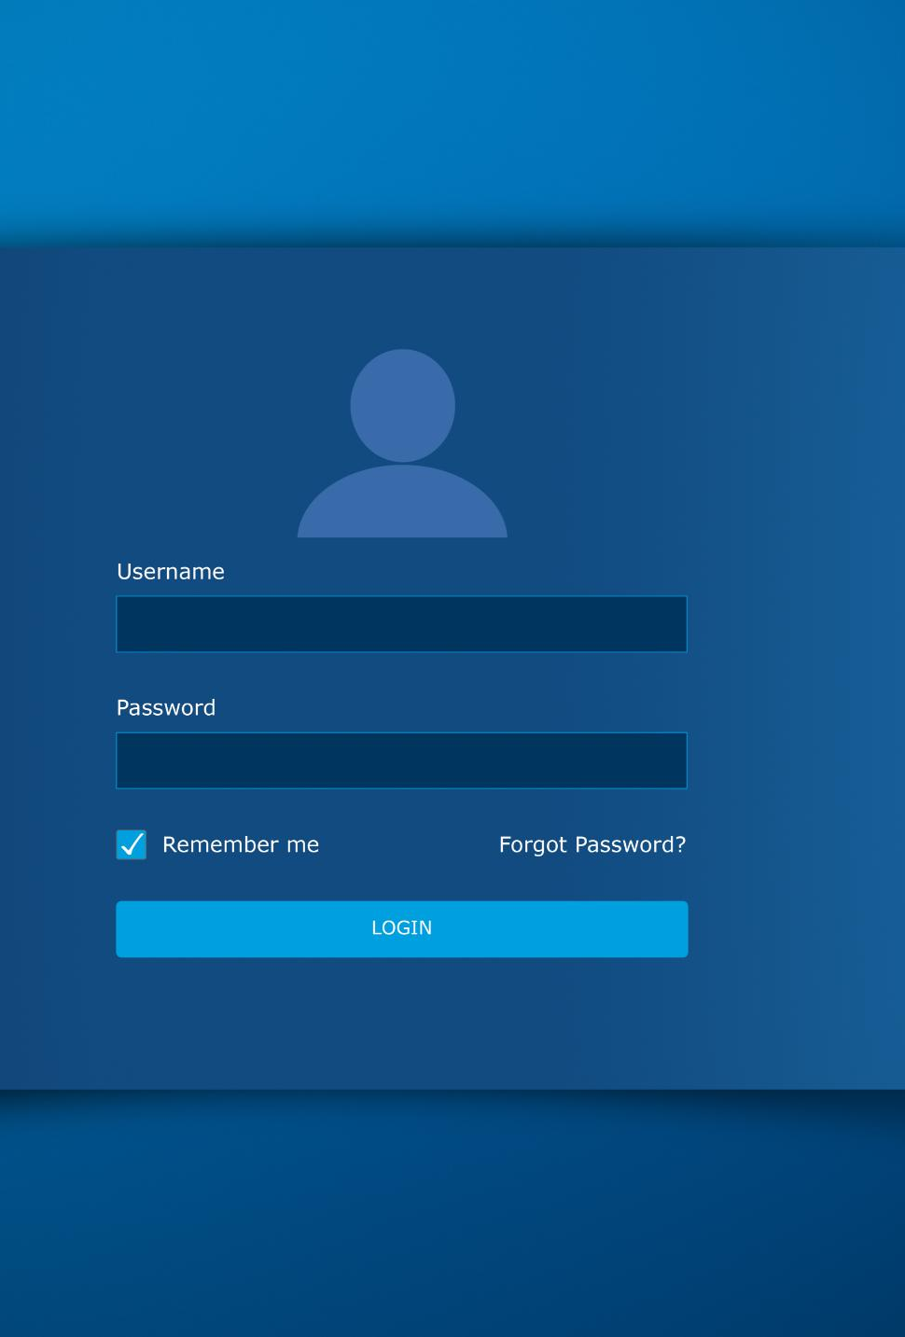
Accessing Branching Settings in Microsoft Forms
Opening Form Editor
Start by creating or opening a form in Microsoft Forms dashboard to access editing features.
Locating Branching Option
Click the three-dot 'More options' menu in the top-right corner to find the branching setting.
Using Branching View
Branching view displays questions sequentially with dropdown controls to set navigation based on answers.
Question Type Considerations
Branching is supported mainly for choice-based questions; select question types accordingly.
Notes:
To begin using branching in Microsoft Forms, it is essential to know where and how to access the branching settings within the form interface. First, you need to create a new form or open an existing one from the Microsoft Forms dashboard. Once the form is open in edit mode, ensure that all the primary questions you want to include are already added, as branching works best when the overall structure of the form is visible. In the top-right corner of the form editor, you will find the three-dot menu labeled as “More options.” Clicking on this menu reveals several advanced features, one of which is “Branching.” Selecting the branching option switches the form into branching view, where you can see your questions laid out in sequence. In this view, each question displays dropdown controls that allow you to choose what happens next based on each possible answer. For choice-based questions, such as multiple-choice or dropdown questions, you can define a different branch for each answer option. For other question types, you can define a single next step. Understanding how to access this mode is critical, as all branching logic is configured from this interface. It is also important to note that branching is not available for every question type, so selecting appropriate question formats during form design is essential. Accessing branching settings correctly ensures you can move smoothly into configuring logic without disrupting the existing flow of your form.

Slide 5

Setting Up Branching for Questions
Branching Rule Setup
Set up branching rules by selecting destinations for respondents after answering each question using dropdown menus.
Customizable Decision Paths
Each answer option can lead to different questions, allowing creation of simple or complex decision trees.
Logical Flow Importance
Ensure logical respondent flow to avoid dead ends or confusing loops and enhance user experience.
Visual Flow Updates
Visual updates in the interface reflect branching changes, helping to understand the overall question structure.
Notes:
Once branching mode is enabled, the next step is setting up branching rules for individual questions. This process involves deciding where respondents should be directed after answering a particular question. In branching view, each question has an option labeled “Go to” or a similar dropdown that allows you to select the next destination. For choice-based questions, each answer option will have its own branching dropdown, enabling highly customized paths. You can choose to send respondents to the next question in sequence, jump to a specific question elsewhere in the form, or end the form altogether. This flexibility allows you to design both simple and complex decision trees. For example, if a respondent answers “No” to a qualifying question, you may want to skip several detailed questions and move them directly to a conclusion or submission page. While setting up branching, it is important to think logically about the respondent’s journey and ensure there are no dead ends or confusing loops. Microsoft Forms visually updates the flow as you assign branches, making it easier to understand the overall structure. Proper setup at this stage is crucial, as it directly impacts user experience, data quality, and the effectiveness of the form’s purpose. Careful configuration ensures that every respondent sees only the questions that are relevant to them.

Slide 6

Applying Branch Logic to Create a Personalized Flow
Transforming Forms with Branch Logic
Branch logic personalizes forms by guiding users based on their specific answers, enhancing engagement.
Consistency and Clarity
Consistent branching ensures similar responses lead to similar outcomes, reducing user confusion.
Visual Flow Review
Visual tools help trace branches to confirm all paths lead to appropriate endpoints.
Improved User Experience
Thoughtful branch logic guides respondents smoothly, improving completion rates and satisfaction.
Notes:
Applying branch logic effectively is what transforms a standard form into a personalized and intelligent experience. After setting individual branching rules, it is important to review how these rules work together across the entire form. Branch logic should follow a clear and intuitive path that aligns with the form’s objective. For instance, in a training registration form, an initial question might ask the user’s role, and based on their selection, they are directed to role-specific questions. This approach reduces unnecessary complexity for the respondent and keeps them engaged. When applying branch logic, consistency is key; similar answer types should lead to similar outcomes to avoid confusion. It is also advisable to limit overly complex branching in a single form, as too many conditional paths can make maintenance difficult. Microsoft Forms allows you to visually trace the flow, helping you confirm that all branches eventually lead to an appropriate endpoint. Applying thoughtful branch logic ensures that respondents feel guided rather than tested, which can significantly improve completion rates. This step is where planning and design come together, resulting in a smooth, logical, and user-friendly form flow.

Slide 7
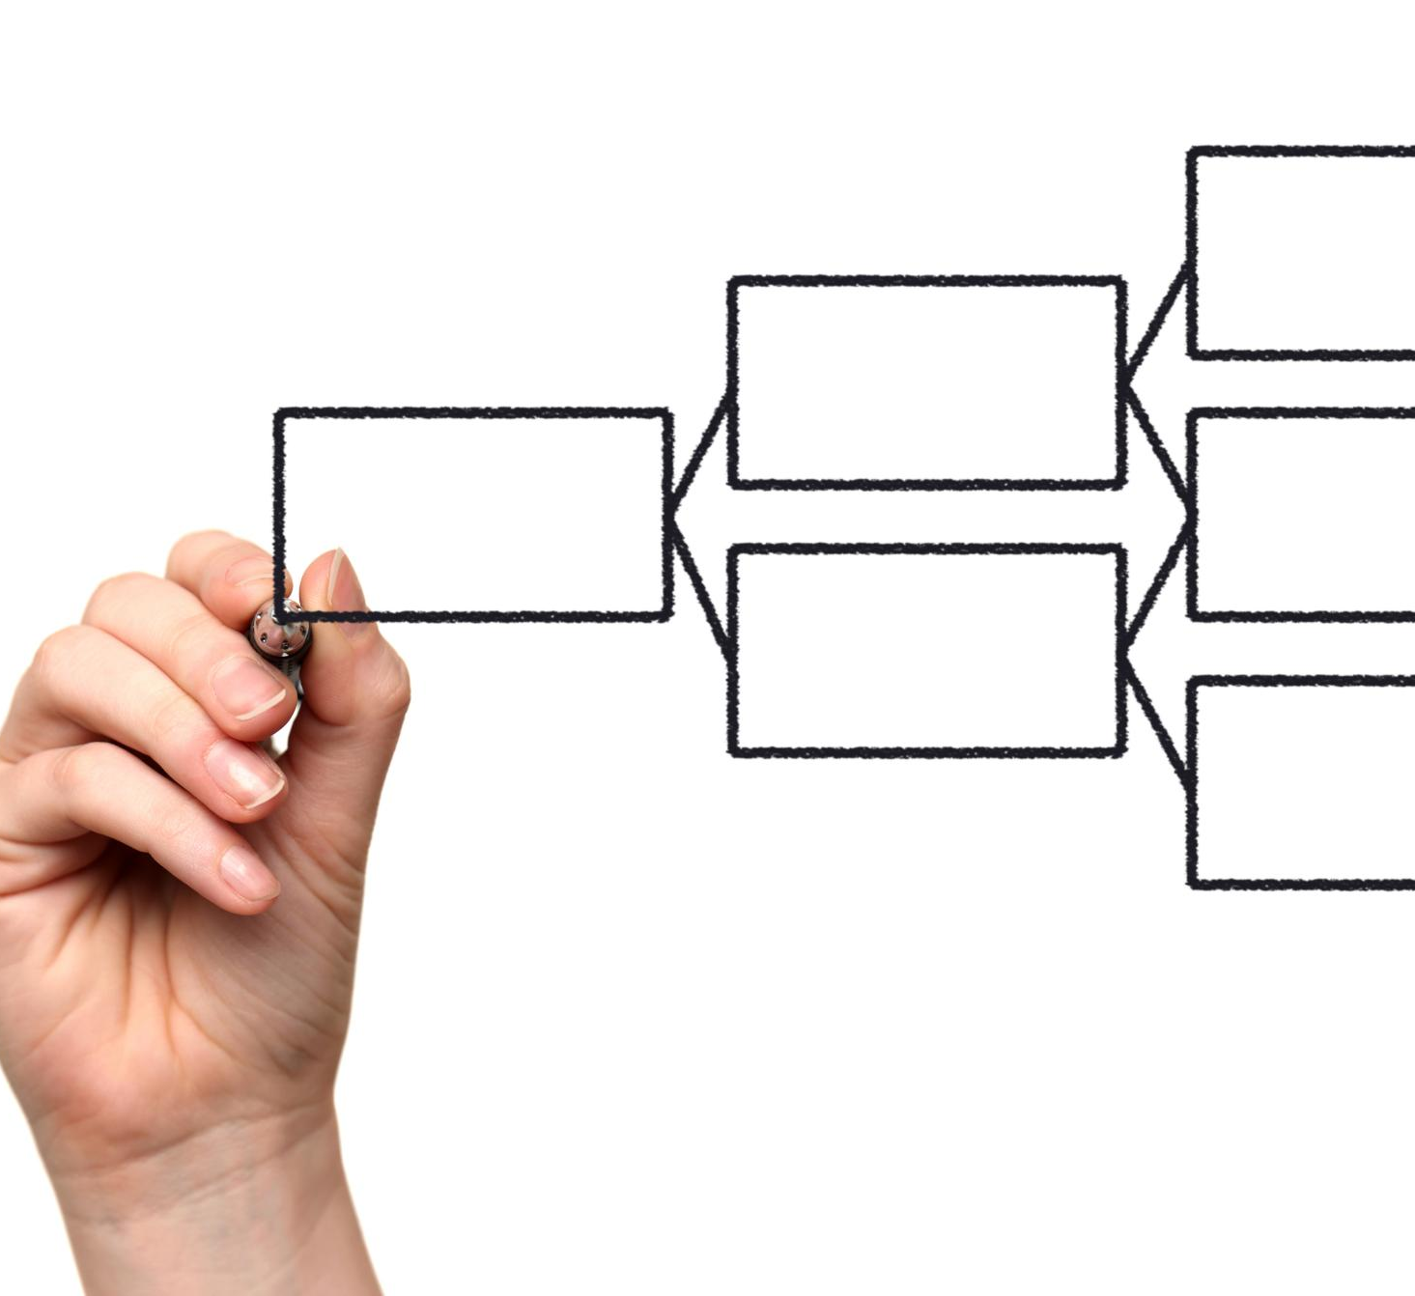
Practical Example of Branching in Use
Branching in Feedback Forms
Branching directs respondents to relevant questions based on their attendance, improving form relevance and user experience.
Branching in IT Support Requests
Branching guides users to specific diagnostic questions based on issue type, enhancing problem resolution efficiency.
Benefits of Branching
Branching shortens completion time, increases accuracy, and helps collect targeted, meaningful data.
Notes:
A practical example helps clarify how branching works in real-world scenarios. Consider a feedback form for a training program. The first question asks whether the respondent attended the training session. If the answer is “Yes,” the form branches to a set of detailed questions about content quality, trainer effectiveness, and learning outcomes. If the answer is “No,” the respondent is directed to a different question asking for the reason they did not attend, followed by the end of the form. This ensures that attendees and non-attendees are not presented with irrelevant questions. Another example could be an IT support request form, where users select the type of issue they are facing. Depending on whether they choose hardware, software, or access-related issues, the form branches to specific diagnostic questions. These examples show how branching improves efficiency for both respondents and administrators. It shortens completion time, increases response accuracy, and makes data analysis more meaningful. By applying branching thoughtfully, organizations can collect targeted information without overwhelming users, making the form more effective and professional.

Slide 8

Previewing and Testing Branching Logic
Previewing the Form
Use the preview option to see the form as a respondent on desktop and mobile devices.
Testing All Branches
Test every possible answer path to ensure branching logic works correctly and no questions are skipped.
Quality Assurance
Testing helps identify logic gaps and ensures smooth user experience before form sharing.
Peer Review
Having a colleague test the form can reveal overlooked issues and improve quality.
Notes:
After configuring branching rules, previewing and testing the form is a critical step that should never be skipped. Microsoft Forms provides a preview option that allows you to experience the form exactly as a respondent would, both on desktop and mobile views. During testing, you should select every possible answer path to ensure that each branch behaves as expected. This helps identify issues such as incorrect question jumps, skipped mandatory questions, or unintended form endings. Testing also allows you to verify that the wording of questions makes sense in context, especially when certain questions are only visible based on prior answers. It is good practice to ask a colleague to test the form as well, as a fresh perspective can uncover logic gaps you may have missed. Thorough testing ensures a smooth respondent experience and prevents data collection errors after the form is shared. This step acts as quality assurance, confirming that the branching logic supports the form’s goals without creating confusion or frustration.

Slide 9

Finalizing, Saving, and Sharing the Branched Form
Review Branching Logic
Conduct a final review of the form's branching logic to ensure all paths lead to logical conclusions.
Save and Auto-Save
Microsoft Forms automatically saves changes, but verify and finalize your form before sharing.
Share Form Options
Distribute the form via link, QR code, email, webpage embed, or Microsoft Teams channel.
Set Permissions
Decide whether the form is accessible publicly or restricted within your organization.
Notes:
Once testing is complete and you are satisfied with the branching logic, the final step is to save and share the form. Microsoft Forms automatically saves changes, but it is still important to do a final review of the entire structure in branching view. Ensure that all paths lead to a logical conclusion and that the form aligns with its intended purpose. After finalization, you can use the Share option to distribute the form via a link, QR code, email invitation, or embed it in a webpage or Microsoft Teams channel. At this stage, consider permissions, such as whether the form should be accessible only within your organization or publicly. A well-designed branched form reflects professionalism and thoughtful planning. Finalizing and sharing marks the transition from design to real-world use, where respondents interact with the dynamic flow you have created. Proper completion of this step ensures that the form is ready for effective data collection and successful outcomes.

