Slide 1
Python Programming
Unit -1 : Introduction to Python and Jupyter Notebook
Topics : Introduction to Python Programming Language, Features of Python and its origin, Introduction to Jupyter Notebook, Basic Datatype – Integers, Boolean, Floats, Strings, type() function, typecasting, Declaring and using variables, Comments, Reading input from users, printing output, Operator in python (Arithmetic Operators, Logical Operators, Membership Operators, Assignment Operators, Comparison Operators, Ternary Operators)Operator precedence
Basic Programming Style of Python, Memory Management scheme adopted in Python.

Slide 2
Python Introduction
Python is a dynamic, interpreted (bytecode-compiled) language. There are no type declarations of variables, parameters, functions, or methods in source code. This makes the code short and flexible, and you lose the compile-time type checking of the source code. Python tracks the types of all values at runtime and flags code that does not make sense as it runs.
Python is a popular programming language. It was created by Guido van Rossum, and released in 1991.
It is used for web development (server-side), software development, mathematics, system scripting.

Slide 3
Why Python?
Python works on different platforms (Windows, Mac, Linux, Raspberry Pi, etc).
Python has a simple syntax similar to the English language.
Python has syntax that allows developers to write programs with fewer lines than some other programming languages.
Python runs on an interpreter system, meaning that code can be executed as soon as it is written. This means that prototyping can be very quick.
Python can be treated in a procedural way, an object-oriented way or a functional way.
In python, Interpreter is use to interpret and run our programs.

Slide 4
Advantages Of Python
Extensive Libraries - Python downloads with an extensive library and contains code for various purposes like regular expressions, documentation-generation, unit-testing, web browsers, threading, databases, CGI, email, image manipulation, and more.
Extensible - Python can be extended to other languages. You can write some of your code in languages like C++ or C.
Simple and Easy - It is quite easy to learn, understand, and code.

Slide 5
Advantages Of Python
Embeddable - Complimentary to extensibility, Python is embeddable as well. You can put your Python code in your source code of a different language, like C++.
Improved Productivity - The language’s simplicity and extensive libraries render programmers more productive than languages like Java and C++ do. You need to write less and get more things done.
IOT Opportunities - Since Python forms the basis of new platforms like Raspberry Pi, it finds the future bright for the Internet Of Things.

Slide 6
Advantages Of Python
Readable - Because it is not such a verbose language, reading Python is much like reading English. This is the reason why it is so easy to learn, understand, and code. It also does not need curly braces to define blocks, and indentation is mandatory.
Object Oriented - This language supports both the procedural and object-oriented programming paradigms. While functions help us with code reusability, classes and objects let us model the real world. A class allows the encapsulation of data and functions into one.
Free and Open Source - Python is freely available. But not only can you download Python for free, but you can also download its source code, make changes to it, and even distribute it. It downloads with an extensive collection of libraries to help you with your tasks.

Slide 7
Advantages Of Python
Portable - Here, you need to code only once, and you can run it anywhere. This is called Write Once Run Anywhere (WORA). However, you need to be careful enough not to include any system-dependent features.
Interpreted - It is an interpreted language. Since statements are executed one by one, debugging is easier than in compiled languages.

Slide 8
Uses Of Python
Python can be used on a server to create web applications.
Python can be used alongside software to create workflows.
Python can connect to database systems. It can also read and modify files.
Python can be used to handle big data and perform complex mathematics.
Python can be used for rapid prototyping, or for production-ready software development.
Example - print(“Hello World”)
Hello World

Slide 9
Introduction to Jupyter
The Jupyter Notebook is an open source web application that you can use to create and share documents that contain live code, equations, visualizations, and text.
The next most popular distribution of Python is Anaconda. Anaconda has its own installer tool called conda that you could use for installing a third-party package. However, Anaconda comes with many scientific libraries preinstalled, including the Jupyter Notebook, so you don’t actually need to do anything other than install Anaconda

Slide 10
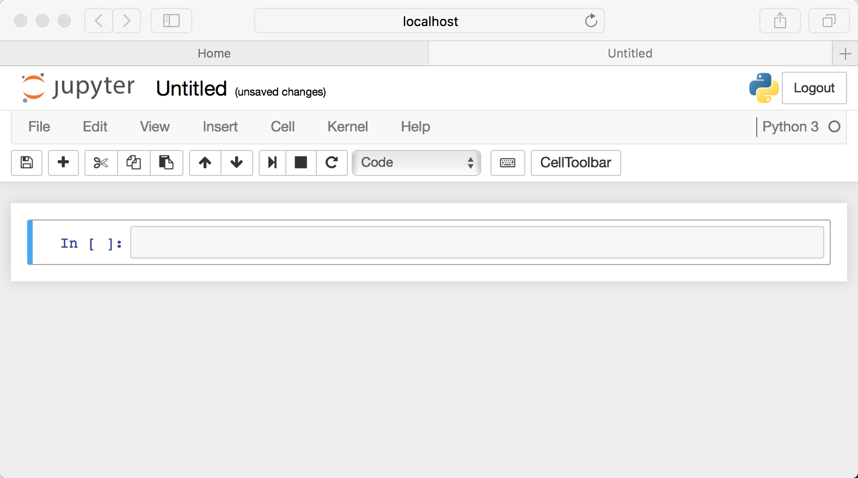
Introduction to Jupyter

Slide 11
Introduction to Jupyter
A Notebook’s cell defaults to using code whenever you first create one, and that cell uses the kernel that you chose when you started your Notebook.
In this case, you started yours with Python 3 as your kernel, so that means you can write Python code in your code cells. Since your initial Notebook has only one empty cell in it, the Notebook can’t really do anything.
Thus, to verify that everything is working as it should, you can add some Python code to the cell and try running its contents.

Slide 12
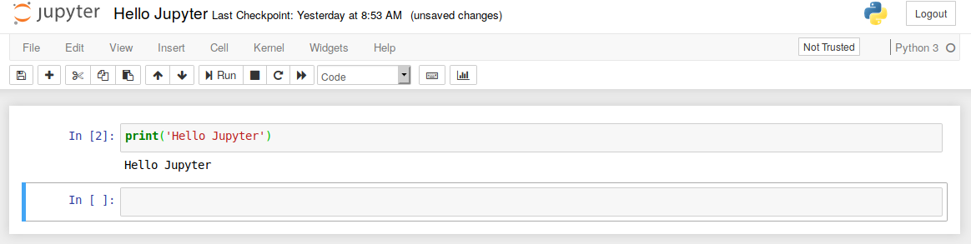
Introduction to Jupyter

Slide 13
Basic Datatypes
Data types are the classification or categorization of data items. It represents the kind of value that tells what operations can be performed on a particular data. Since everything is an object in Python programming, data types are actually classes and variables are instance (object) of these classes.
Basic datatypes in python:
Numeric
Dictionary
Set
Boolean
Sequence Type

Slide 14
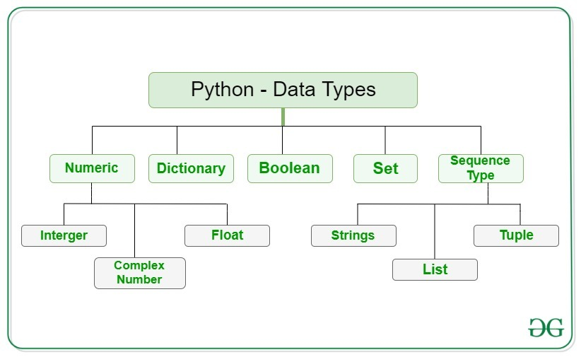
Basic Datatypes

Slide 15
Integer
In Python, there is effectively no limit to how long an integer value can be. Of course, it is constrained by the amount of memory your system has, as are all things, but beyond that an integer can be as long as you need it to be. Example-
print(4)
Output: 4
print(123123123123123123123123123123 + 1) Output: 123123123123123123123123123124

Slide 16
Float
The float type in Python designates a floating-point number. float values are specified with a decimal point. Optionally, the character e or E followed by a positive or negative integer may be appended to specify scientific notation. Example -
print(4.2)
Output: 4.2
print(5.68 – 1.21)
Output: 4.47

Slide 17
String
In Python, Strings are arrays of bytes representing Unicode characters. A string is a collection of one or more characters put in a single quote, double-quote or triple quote. In python there is no character data type, a character is a string of length one. It is represented by str class.
Strings in Python can be created using single quotes or double quotes or even triple quotes. Ex –
String1 = ‘Python Programming’
print(String1)
Output – Python Programming

Slide 18
Type Function
type() function is used to determine the type of data type.Ex –
a = 5
print("Type of a: ", type(a))
Output - Type of a: <class 'int'>
b = 5.0
print("\nType of b: ", type(b))
Output - Type of a: <class 'float'>
c = 2 + 4j
print("\nType of c: ", type(c))
Output - Type of a: <class 'complex'>

Slide 19
Boolean
Python provides a Boolean datatype. Objects of Boolean type may have one of two values, True or False. Example –
print(type(True) / print(type(False))
Output - <class 'bool'>

Slide 20
Type Casting
Type Casting is the method to convert the variable data type into a certain data type in order to the operation required to be performed by users. In this article, we will see the various technique for typecasting.
There can be two types of Type Casting in Python:
Implicit Type Casting
Explicit Type Casting

Slide 21
Implicit Type Casting
Python converts data type into another data type automatically. In this process, users don’t have to involve in this process. Ex -
a = 7
b = 3.0
c = a+b
print(c)
print(type(c))
Output - 10.0
<class 'float'>

Slide 22
Explicit Type Casting
In this method, Python need user involvement to convert the variable data type into certain data type in order to the operation required. Mainly in type casting can be done with these data type function:
int() : int() function take float or string as an argument and return int type object.
float() : float() function take int or string as an argument and return float type object.
str() : str() function take float or int as an argument and return string type object.

Slide 23
Type Casting Int To Float
Here, we are casting integer object to float object with float() function. Ex -
A = 5
N = float(A)
print(N)
print(type(N))
Output – 5.0
<class 'float'>

Slide 24
Type Casting Float To Int
Here, we are casting float data type into integer data type with int() function. Ex -
A = 3.7
N = int(A)
print(N)
print(type(N))
Output – 3
<class ‘int’>

Slide 25
Type Casting Int To String
Here, we are casting int data type into string data type with str() function. Ex -
A = 5
N = str(A)
print(N)
print(type(N))
Output – 5
<class ‘str’>

Slide 26
Type Casting String To Int
Here, we are casting string data type into integer data type with int() function. Ex -
A = “5”
N = int(A)
print(N)
print(type(N))
Output – 5
<class ‘int’>

Slide 27
Type Casting String To Float
Here, we are casting string data type into float data type with float() function. Ex -
A = “5.9”
N = float(A)
print(N)
print(type(N))
Output – 5.9
<class ‘float’>

Slide 28
Arithmetic Operator
Arithmetic operators are used with numeric values to perform common mathematical operations:
Operator | Name | Example
+ | Addition | x+y
- | Subtraction | x-y
* | Multiplication | x*y
/ | Division | x/y
% | Modulus | x%y
** | Exponentiation | x**y
// | Floor division | x//y

Slide 29
Assignment Operator
Assignment operators are used to assign values to variables:
Operator | Example | Same As
= | x = 5 | x = 5
+= | x += 3 | x = x + 3
–= | x –= 3 | x = x – 3
*= | x *= 3 | x = x * 3
/= | x /= 3 | x = x / 3
%= | x %= 3 | x = x % 3
//= | x //= 3 | x = x // 3
**= | x **= 3 | x = x ** 3

Slide 30
Assignment Operator
Operator | Example | Same As
&= | x &= 3 | x = x & 3
|= | x |= 3 | x = x | 3
^= | x ^= 3 | x = x ^ 3
>>= | x >>= 3 | x = x >> 3
<<= | x <<= 3 | x = x << 3

Slide 31
Comparison Operator
Comparison operators are used to compare two values:
Operator | Name | Example
== | Equal | x == y
!= | Not equal | x != y
> | Greater than | x > y
< | Less than | x < y
>= | Greater than or equal to | x >= y
<= | Less than or equal to | x <= y

Slide 32
Logical Operator
Logical operators are used to combine conditional statements:
Operator | Description | Example
and | Returns True if both statements are true | x < 5 and x < 10
or | Returns True if one of the statements is true | x < 5 or x < 10
not | Reverse the result, returns False if the result is true | not(x < 5 and x < 10)

Slide 33
Identity Operator
Identity operators are used to compare the objects, not if they are equal, but if they are actually the same object, with the same memory location:
Operator | Description | Example
is | Returns True if both variables are the same object | x is y
is not | Returns True if both variables are not the same object | x is not y

Slide 34
Membership Operator
Membership operators are used to test if a sequence is presented in an object:
Operator | Description | Example
in | Returns True if a sequence with the specified value is present in the object | x in y
not in | Returns True if a sequence with the specified value is not present in the object | x not in y

Slide 35
Bitwise Operator
Bitwise operators are used to compare (binary) numbers:
Operator | Name | Description
& | AND | Sets each bit to 1 if both bits are 1
| | OR | Sets each bit to 1 if one of two bits is 1
^ | XOR | Sets each bit to 1 if only one of two bits is 1
~ | NOT | Inverts all the bits
<< | Zero fill left shift | Shift left by pushing zeros in from the right and let the leftmost bits fall off
>> | Signed right shift | Shift right by pushing copies of the leftmost bit in from the left, and let the rightmost bits fall off

Slide 36
Ternary Operator
Ternary operators are also known as conditional expressions are operators that evaluate something based on a condition being true or false.
It simply allows testing a condition in a single line replacing the multiline if-else making the code compact.
Syntax : [on_true] if [expression] else [on_false]
Example : a,b = 10,20
min = a if a<b else b
print(min)
Output - 10

Slide 37
Operator Precedence
Operator | Description | Associativity
( ) | Parentheses | left-to-right
** | Exponent | right-to-left
* / % | Multiplication / Division / modulus | left-to-right
+ – | Addition / Subtraction | left-to-right
<< >> | Bitwise shift left / Bitwise shift right | left-to-right
< <= > >= | Relational less than / less than equal to, Relational greater than / greater than equal to, | left-to-right
== != | Relational is equal to / is not equal to | left-to-right
is, is not in, not in | Identity Membership operators | left-to-right
& | Bitwise AND | left-to-right

Slide 38
Operator Precedence
Operator | Description | Associativity
^ | Bitwise exclusive OR | left-to-right
| | Bitwise inclusive OR | left-to-right
not | Logical NOT | right-to-left
and | Logical AND | left-to-right
or | Logical OR | left-to-right
= += -= *= /= %= &= ^= |= <<= >>= | Assignment Addition/subtraction assignment Multiplication/division assignment Modulus/bitwise AND assignment Bitwise exclusive/inclusive OR assignment Bitwise shift left/right assignment | right-to-left

Slide 39
Basic Programming Style
Functional: Every statement is treated as a mathematical equation and any forms of state or mutable data are avoided. The main advantage of this approach is that it lends itself well to parallel processing because there is no state to consider. Many developers prefer this coding style for recursion and for lambda calculus.
Imperative: Computation is performed as a direct change to program state. This style is especially useful when manipulating data structures and produces elegant yet simple code. Python fully implements this paradigm.

Slide 40
Basic Programming Style
Object-oriented: Relies on data fields that are treated as objects and manipulated only through prescribed methods. Python doesn’t fully support this paradigm because it can’t implement features such as data hiding (encapsulation), which many believe is a primary requirement of the object-oriented programming paradigm. This coding style also favors code reuse.
Procedural: Tasks are treated as step-by-step iterations where common tasks are placed in functions that are called as needed. This coding style favors iteration, sequencing, selection, and modularization. Python excels in implementing this particular paradigm.

Slide 41
Memory Allocation in Python
There are two parts of memory:
Stack memory
Heap memory
The methods/method calls and the references are stored in stack memory and all the values objects are stored in a private heap.

Slide 42
Stack Memory
The allocation happens on contiguous blocks of memory. We call it stack memory allocation because the allocation happens in the function call stack.
The size of memory to be allocated is known to the compiler and whenever a function is called, its variables get memory allocated on the stack.
It is the memory that is only needed inside a particular function or method call. When a function is called, it is added onto the program’s call stack.

Slide 43
Stack Memory
Any local memory assignments such as variable initializations inside the particular functions are stored temporarily on the function call stack, where it is deleted once the function returns, and the call stack moves on to the next task.
This allocation onto a contiguous block of memory is handled by the compiler using predefined routines, and developers do not need to worry about it.
Example:
def func():
# All these variables get memory
# allocated on stack
a = 20
b = []
c = ""

Slide 44
Heap Memory
The memory is allocated during the execution of instructions written by programmers.
Note that the name heap has nothing to do with the heap data structure.
It is called heap because it is a pile of memory space available to programmers to allocated and de-allocate.

Slide 45
Heap Memory
The variables are needed outside of method or function calls or are shared within multiple functions globally are stored in Heap memory.
Example:
# This memory for 10 integers
# is allocated on heap.
a = [0]*10

Slide 46
Identation
Python relies on indentation (whitespace at the beginning of a line) to define scope in the code. Other programming languages often use curly-brackets for this purpose.
Example:
a = 33
b = 200
if b > a:
print("b is greater than a") # you will get an error

Slide 47
Simple If Statement
An if statement is written by using the if keyword.
Example:
a = 33
b = 200
if b > a:
print("b is greater than a")

Slide 48
If Else Statement
An if statement is written by using the if keyword.
The else keyword catches anything which isn't caught by the preceding conditions.
Example:
a = 200
b = 33
if b > a:
print("b is greater than a")
else:
print("b is not greater than a")

Slide 49
If Elif Else Statement
The elif keyword is pythons way of saying "if the previous conditions were not true, then try this condition".
Example:
a = 33
b = 33
if b > a:
print("b is greater than a")
elif a == b:
print("a and b are equal")

Slide 50
Nested If
You can have if statements inside if statements, this is called nested if statements.
Example:
x = 41
if x > 10:
print("Above ten,")
if x > 20:
print("and also above 20!")
else:
print("but not above 20.")

Slide 51
Short Hand If
You can have if statements inside if statements, this is called nested if statements.
Example:
if a > b: print("a is greater than b")

Slide 52
Short Hand If Else
If you have only one statement to execute, one for if, and one for else, you can put it all on the same line.
This technique is known as Ternary Operators, or Conditional Expressions.
Example:1
a = 2
b = 330
print("A") if a > b else print("B")

Slide 53
Short Hand If Else
Example:2
a = 330
b = 330
print("A") if a > b else print("=") if a == b else print("B")

Slide 54
Some Examples of If Else Statement
Example:1
a = 200
b = 33
c = 500
if a > b and c > a:
print("Both conditions are True")
Example:2
a = 200
b = 33
c = 500
if a > b or a > c:
print("At least one of the conditions is True")

Slide 55
For Loop
Python's for loop is designed to repeatedly execute a code block while iterating through a list, tuple, dictionary, or other iterable objects of Python. The process of traversing a sequence is known as iteration.
Syntax:
for value in sequence:
{ code block }

Slide 56
For Loop
Example:
fruits = ["apple", "banana", "cherry"]
for x in fruits:
print(x)
Output: apple
banana
cherry

Slide 57
Using else Statement with for Loop
As already said, a for loop executes the code block until the sequence element is reached. The statement is written right after the for loop is executed after the execution of the for loop is complete.
Only if the execution is complete does the else statement comes into play. It won't be executed if we exit the loop or if an error is thrown.

Slide 58
Using else Statement with for Loop
Example:1 [Without Break]
for i in range(1, 4):
print(i)
else: # Executed because no break in for
print("No Break")
-Output: 1
2
3
No Break
-Example:2 [With Break]
for i in range(1, 4):
print(i)
break
else: # Not executed as there is a break
print("No Break")
-Output: 1

Slide 59
While Loop
While loops are used in Python to iterate until a specified condition is met. However, the statement in the program that follows the while loop is executed once the condition changes to false.
Syntax:
while <condition>:
{ code block }

Slide 60
While Loop
Example:
i = 1
while i < 6:
print(i)
i += 1
Output:
1
2
3
4
5

Slide 61
Using else Statement with while Loops
As discussed earlier in the for loop section, we can use the else statement with the while loop also. It has the same syntax.
Example:
i = 1
while i < 6:
print(i)
i += 1
else:
print("i is no longer less than 6")

Slide 62
Using else Statement with while Loops
Output:
1
2
3
4
5
i is no longer less than 6

Slide 63
Single statement while Block
The loop can be declared in a single statement, as seen below. This is similar to the if-else block, where we can write the code block in a single line.
Example:
counter = 0
while (counter < 3): counter+=1; print("Python Loops")
Output:
Python Loops
Python Loops
Python Loops

Slide 64
The range() Function
With the help of the range() function, we may produce a series of numbers. range(10) will produce values between 0 and 9. (10 numbers).
We can give specific start, stop, and step size values in the manner range(start, stop, step size). If the step size is not specified, it defaults to 1.
The range object can be characterized as being "slow“.
Example: print(range(15))
Output: range(0, 15)

Slide 65
The range() Function
Example: print(list(range(15)))
Output: [0, 1, 2, 3, 4, 5, 6, 7, 8, 9, 10, 11, 12, 13, 14]
Example: print(list(range(4, 9)))
Output: [4, 5, 6, 7, 8]
Example: print(list(range(5, 25, 4)))
Output: [5, 9, 13, 17, 21]

Slide 66
For loop using range() function
Example:
# print first 5 integers
# using python range() function
for i in range(5):
print(i, end=" ")
print()
Output:
0 1 2 3 4

Slide 67
Continue Statement
It returns the control to the beginning of the loop.
Syntax:
while True / For x in range():
...
if x == 10:
continue
print(x)

Slide 68
Continue Statement
Example:
# loop from 1 to 10
for i in range(1, 11):
# If i is equals to 6,
# continue to next iteration
# without printing
if i == 6:
continue
else:
# otherwise print the value
# of i
print(i, end=" ")
Output:1 2 3 4 5 7 8 9 10

Slide 69
Break Statement
It stops the execution of the loop when the break statement is reached.
Syntax:
Loop{
Condition:
break
}
Example:
for i in range(10):
print(i)
if i == 2:
break
Output: 0 1 2

Slide 70
Pass Statement
Pass statements are used to create empty loops. Pass statement is also employed for classes, functions, and empty control statements.
Example:
a = 10
b = 20
if(a<b):
pass
else:
print("b<a")

