Slide 1
Exceptions
Chapter – 16
Book: 2

Slide 2
Errors in Python Program
Compile-time errors
Syntactical errors found in code
Program fails to compile
Detected by Python compiler
Runtime errors
Occurs when PVM cannot executes the byte code
PVM not able to execute some statement due to insufficient memory
Logical errors
Flaws in the logic of the program
Not detected either by Python compiler or PVM

Slide 3
Exceptions
Runtime error which can be handled by the programmer
Means if he guesses the error and do something to eliminate the problem then it is called an exception
All exceptions are presented as classes in Python
Already available Exceptions in Python are called built-in exception.
The base class for all built-in exceptions is ‘BaseException’ class

Slide 4
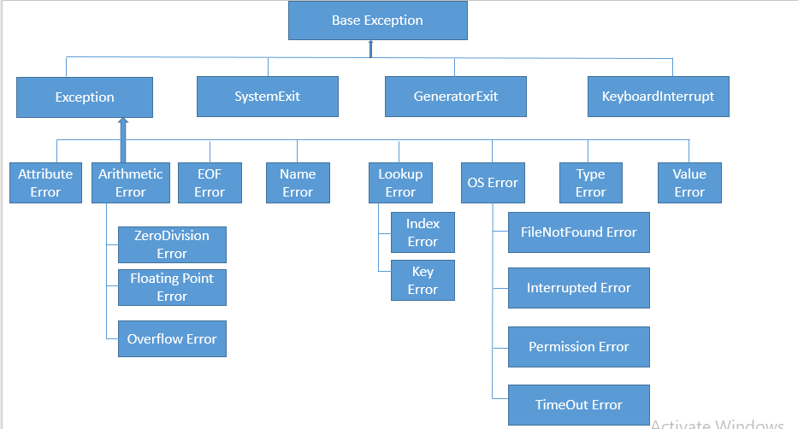
Important Exception classes in Python

Slide 5
Exception Handling
To handle exceptions following 3 steps must be followed:
Step1: statements in the program where there may be possibility of exception, should be written inside a ‘try’ block. When PVM understands that there is an exception, it jumps into ‘except’ block
Step2: write the ‘except’ block where mention the exception details to be shown to the users.
Step3: can write ‘finally’ block to perform cleanup operations like closing the file or terminating any other processes.
‘Finally’ block is executed irrespective of whether there is an exception or not

Slide 6
Points to Remember
A single ‘try’ block can be followed by several except blocks
Multiple ‘except’ blocks can be use to handle multiple exception
Can not write ‘except’ block without ‘try’ block But can write ‘try’ block without any ‘except’ block
‘else’ and ‘finally’ blocks are not compulsory
When there is no exception ‘else’ block is executed after ‘try’ block
‘finally’ block is always executed

Slide 7
Few examples of Exceptions
ArithmeticError
AssertionError
ImportError
IndexError
KeyError
NameError
TypeError
UnboundLocalError
ValueError
ZeroDivisionError

Slide 8
Exception | Description
AssertionError | Raised when the assert statement fails.
AttributeError | Raised on the attribute assignment or reference fails.
EOFError | Raised when the input() function hits the end-of-file condition.
FloatingPointError | Raised when a floating point operation fails.
GeneratorExit | Raised when a generator's close() method is called.
ImportError | Raised when the imported module is not found.
IndexError | Raised when the index of a sequence is out of range.
KeyError | Raised when a key is not found in a dictionary.
KeyboardInterrupt | Raised when the user hits the interrupt key (Ctrl+c or delete).
MemoryError | Raised when an operation runs out of memory.
NameError | Raised when a variable is not found in the local or global scope.
NotImplementedError | Raised by abstract methods.
OSError | Raised when a system operation causes a system-related error.
OverflowError | Raised when the result of an arithmetic operation is too large to be represented.
ReferenceError | Raised when a weak reference proxy is used to access a garbage collected referent.
RuntimeError | Raised when an error does not fall under any other category.

Slide 9
StopIteration | Raised by the next() function to indicate that there is no further item to be returned by the iterator.
SyntaxError | Raised by the parser when a syntax error is encountered.
IndentationError | Raised when there is an incorrect indentation.
TabError | Raised when the indentation consists of inconsistent tabs and spaces.
SystemError | Raised when the interpreter detects internal error.
SystemExit | Raised by the sys.exit() function.
TypeError | Raised when a function or operation is applied to an object of an incorrect type.
UnboundLocalError | Raised when a reference is made to a local variable in a function or method, but no value has been bound to that variable.
UnicodeError | Raised when a Unicode-related encoding or decoding error occurs.
UnicodeEncodeError | Raised when a Unicode-related error occurs during encoding.
UnicodeDecodeError | Raised when a Unicode-related error occurs during decoding.
UnicodeTranslateError | Raised when a Unicode-related error occurs during translation.
ValueError | Raised when a function gets an argument of correct type but improper value.
ZeroDivisionError | Raised when the second operand of a division or module operation is zero.

Slide 10
The Except Block
Useful to catch an exception that is raised in the try block.
It is written in various formats as follow:
Block with the exception class name
except ExceptionClass:
Exception as an object that contains some description about the exception
except ExceptionClass as obj:
Single exception block to catch multiple exceptions (as a tuple inside parenthesis)
except (ExceptionClass1, Exceptionclass2, ….):
Catch any type of exception without bothering its type.
except:

Slide 11
The assert statement
The assert statement is useful to ensure that a given condition is True. If it is not true, it raises AssertionError
Syntax : assert condition, message
If the condition is False, then the exception by the name AssertionError is raised along with the ‘message’ written in the assert statement.
example

Slide 12
User-Defined Exceptions
Programmer creates his own exception is called user-defined exception or Custom exception
When none of the in-built Python exceptions are useful then need to create own exception and raise it.
Since all exceptions are classes, create own exception as a class as follow:
class MyException(Exception):
def __init__(self, arg):
self.msg = arg

Slide 13
Cont…
‘MyException’ class is the sub class for ‘Exception’ class. This class has a constructor where a variable ‘msg’ is defined. It receives a message passed from outside through arguments
When the programmer suspects the possibility of exception, he raise his own exception using ‘raise’ statement
raise MyException(‘message’)
raise statement is raising MyException class object that contains the given message
The programmer can insert the code inside a try block and catch the exception using except block as:
try:
code
exception MyException as ex:
print(ex)

Slide 14
Logging the Exception
The file which stores the messages, especially of errors or exceptions is called a ‘log’ file and this technique is called logging
Logging helps in debugging the program
Python provides a module ‘logging’ that is useful to create a log file that can store all error messages that may occur while executing a program.
There may be different levels of error messages, an error that crashes the system must be given more importance than compare to an error that gives warning messages.
So depending on the seriousness of the error, they are classified into 6 levels in ‘logging’ module

Slide 15
Logging Error Level and their predefined numerical values
CRITICAL - 50
ERROR - 40
Warning - 30
INFO - 20
DEBUG - 10
NOTSET - 0

Slide 16
Logging the Exception steps
Import logging module
Create a file for logging/ storing messages using basicConfig() method as:
Logging.basicConfig(‘filename’,level)
Add the messages to the specified file as:
logging.methodname(‘message’)
You can see the logs in the file, mentioned with basicConfig method.

Slide 17
datetime module in Python
A date in Python is not a data type of its own, but we can import a module named datetime to work with dates as date objects.
Example
from datetime import datetime
dt = datetime.strptime(userInput, "%d/%m/%y")
dObj = datetime
print(dObj.now())
print(dObj.now().year)
print(dObj.now().month)
print(dObj.now().day)
print(datetime.strftime(dObj.now(),"%a"))

Slide 18
A reference of all the legal format codes:
Directive Description Example
%a Weekday, short version Wed
%A Weekday, full version Wednesday
%w Weekday as a number 0-6, 0 is Sunday 3
%d Day of month 01-31 31
%b Month name, short version Dec
%B Month name, full version December
%m Month as a number 01-12 12
%y Year, short version, without century 18
%Y Year, full version 2018
%H Hour 00-23 17
%I Hour 00-12 05
%p AM/PM PM
%M Minute 00-59 41
%S Second 00-59 08
%f Microsecond 000000-999999 548513
%Z Timezone CST
%j Day number of year 001-366 365
%U Week number of year, Sunday as the first day of week, 00-53 52
%W Week number of year, Monday as the first day of week, 00-53 52
%c Local version of date and time Mon Dec 31 17:41:00 2018
%x Local version of date 12/31/18
%X Local version of time 17:41:00

