Slide 1
Unit - 4
Plotting, Data Science and Data Visualization

Slide 2
Plotting using PyLab
PyLab is a Python standard library module
Provides many functionality of MATLAB
It is a high level technical computing language and interactive environment for algorithm development, data visualization, data analysis and numeric computation.
Complete user’s guide to the plotting capabilities of PyLab is at:
matplotlib.sourceforge.net/users/index.html

Slide 3
Plotting Steps
import pylab or can write import pylab as p1
Can give the name of the figure by defining figure property like pylab.figure(1) or p1.figure(‘result’)
pylab.plot() is used to generate the plot.
Plot() has many parameters like
(*args, scalex=True, scaley=True, data=None, **kwargs)
Calling signatures:
plot([x], y, [fmt], *, data=None, **kwargs)
plot([x], y, [fmt], [x2], y2, [fmt2], ..., **kwargs)
pylab.show() causes the window to appear on the computer screen
pylab.savefig() save the figure in a file with the mentioned filename and default .png extention

Slide 4
Parameters
Returns - Lines
x, y : array-like or scalar
fmt : str, optional
data : indexable object, optional
scalex, scaley : bool, optional, default: True
**kwargs : Line2D properties, optional
kwargs are used to specify properties like a line label (for auto legends), linewidth, antialiasing, marker face color etc.
Format Strings:
fmt = '[marker][line][color]'

Slide 5
Markers
Character Description
'.' point marker
',' pixel marker
'o' circle marker
'v' triangle_down marker
'^' triangle_up marker
'<' triangle_left marker
'>' triangle_right marker
'1' tri_down marker
'2' tri_up marker
'3' tri_left marker
'4' tri_right marker
's' square marker
'p' pentagon marker
'*' star marker
'h' hexagon1 marker
'H' hexagon2 marker
'+' plus marker
'x' x marker
'D' diamond marker
'd' thin_diamond marker
'|' vline marker
'_' hline marker

Slide 6
Line Styles
character Description
'-' solid line style
'--' dashed line style
'-.' dash-dot line style
':' dotted line style
Colors
character colour
'b' blue
'g' green
'r' red
'c' cyan
'm' magenta
'y' yellow
'k' black
'w' white

Slide 7
Examples
plot(x, y) # plot x and y using default line style and colour
plot(x, y, 'bo') # plot x and y using blue circle markers
plot(y) # plot y using x as index array 0..N-1
plot(y, 'r+') # ditto, but with red plusses
plot(x, y, 'go--', linewidth=2, markersize=12)
plot(x, y, color='green', marker='o', linestyle='dashed', linewidth=2, markersize=12)
plot('xlabel', 'ylabel', data=obj) ->Plotting labelled data
Plotting multiple sets of data
plot(x1, y1, 'bo')
plot(x2, y2, 'go')
plot(a[0], a[1:])
plot(x1, y1, 'g^', x2, y2, 'g-')

Slide 8
rcParams Settings
It is also possible to change the default values, which are known as “rc settings”
These values are stored in a dictionary like variable that can be accessed via the name pylab.rcParams
eg. Set the default line width to 6 points:
pylab.rcParams[lines.linewidth’] = 6
A complete list can be found at
http://matplotlib.org/users/customizing.html
http://matplotlib.org/users/style_sheets.html#style-sheets

Slide 9
Most useful rcParams settings
Set Line Width
pylab.rcParams['lines.linewidth']=5
Set Font Size for title
pylab.rcParams['axes.titlesize']=25
Set Font Size of Labels on axes
pylab.rcParams['axes.labelsize']=20
Set Size of Numbers on x-axis
pylab.rcParams['xtick.labelsize'] = 16
Set Size of Numbers on y-axis
pylab.rcParams['ytick.labelsize'] = 16
Set Size of ticks on x- axis
pylab.rcParams['xtick.major.size'] = 7
Set Size of ticks on y- axis
pylab.rcParams['ytick.major.size'] = 7
Set Size of Markers
pylab.rcParams['lines.markersize'] = 10
Set no. of times markers are shown with legend
pylab.rcParams['legend.numpoints'] = 3

Slide 10
Data Frame
Data frame is an object that is useful in representing data in the form of rows and columns
Data may come from an excel file(spreadsheet), a .csv file, a Python sequence like a dictionary, list or tuple
Python contains pandas which is a useful package for data analysis and manipulation
To create a dataframe, import pandas and then use its methods like: pandas.read_excel(), pandas.read_csv(), pandas.dataframe()
Example.

Slide 11
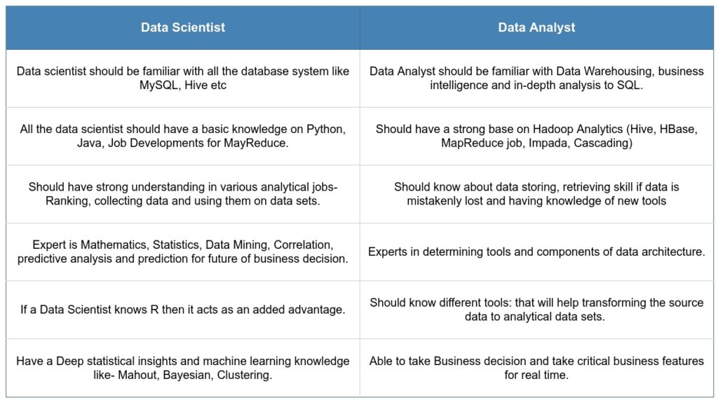

Slide 12
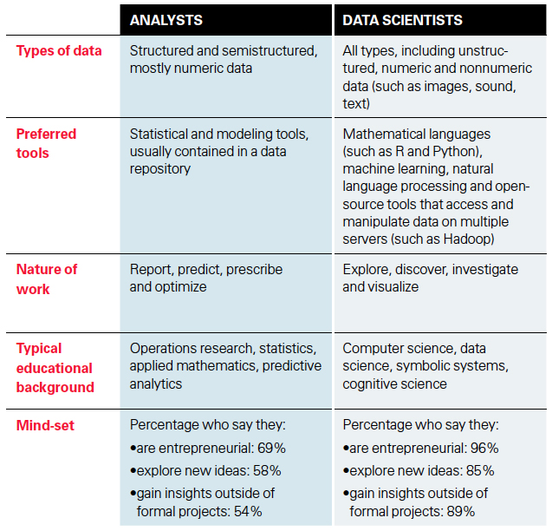

Slide 13
Operations on Data Frames
Knowing number of Rows and Columns:
df.shape -> will return a tuple of rows and columns
eg. Print(df.shape) will print (5,4) means 5 rows and 4 columns
r, c = df.shape and print(r) will just print no. of rows
Retrieving Rows from Data Frame
head() method returns 1st 5 and tail() returns last 5 rows by default
If we provide an integer parameter in it will return that many rows
Retrieving a Range of Rows
Can treat data frame as an object and rows can be retrieved using slicing
df[2:5] -> will return rows 2 to 5 (will use row id- starting from 0)
df[1::3] ->will return 1st row and 3rd row after 1st row i.e. 4th row, then 7th row and so on…
df[5:0:-1]

Slide 14
Operations on Data Frames
Retrieve Column Names:
df.columns will return list of columns with their index name.
Output: Index(['Emp ID', 'EmpName', 'Salary', 'Joining Date'], dtype='object')
Retrieve column Data
To retrieve column data, use column name as subscript
eg. print(df.EmpName) will give o/p as list of all Employee Names
2 ways: df.empid OR df[‘empid’]
Retrieving data from Multiple Columns
Provide the list of column names as a subscript to dataframe object
eg. df [[’empid’ , ’empname’]]
Finding Maximum and Minimum Values
Use max() and min() method on columns containing numerical data
eg. df [‘sal’].max()

Slide 15
Operations on Data Frames
Displaying Statistical Information
describe() method displays information like: no. of values, average, standard deviation, minimum, maximum, 25%, 50% and 75% of total value.
It is highly useful for statistical analysis. eg. df.describe()
Performing Queries on Data
We can retrieve rows based on a query
Query should be given as subscript in the data frame object
To show data from some columns based on a query, mention the list of columns and then the query
eg. 1 df[df.sal>1000]] eg2: df[[ ‘id’, ’name’]] [df.sal>1000]
Knowing the Index Range
df.index will return for eg. RangeIndex(start=0, stop=5, step=1)
Setting Column as Index
eg. df1 = df.set_index(‘empid’) OR df.set_index(‘empid’,inplace=True)
Using df.loc[1004] can access a specific row with the defined index value
Resetting the Index
df.reset_index(inplace=True)
Sorting the Data
df.sort_values(‘doj’) OR df.sort_values(‘sal’, ascending=False)
Handling Missing Data
df1 = df.fillna(0) or df1 = df.dropna()

Slide 16
Data Visualization
import matplotlib.pyplot as plt
import pandas as pd
Bar Graph:
Eg. plt.bar(x, y, label=‘Bar Graph ’, color = ‘red’)
Histogram:
Shows distribution of values.
Similar to bar graph but useful to show values grouped in bins or intervals
eg. EmpAge = [33,25,34,26,28,35,23,24,32,26,23,35,25]
bins = [0, 10, 20, 30, 40]
Plt.hist(EmpAge, bins, histtype=‘bar’,rwidth=0.8,color=‘cyan’)
Histtype can be ‘bar’,‘barstacked’, ‘step’, ‘stepfilled’
rwidth indicates that the bar width is 80% so 10% gap before and after 2 bars

Slide 17
Data Visualization
Pie Chart
Shows a circle, divided into sectors, represents a portion of the whole
pie() function is used, having parameters like:
slices
startangle
explode (indicate whether the slices in the pie chart should stand out or not)
shadow
autopct (indicates how to display the percentages on the slices)

