Slide 1
Heart Disease Prediction Using Machine Learning
As cardiovascular diseases continue to be a leading cause of mortality worldwide, the integration of advanced computational techniques with medical diagnostics offers unprecedented opportunities for early detection and intervention.
This research leverages state-of-the-art machine learning algorithms to analyze complex patterns in patient data, aiming to predict the likelihood of heart disease with high accuracy. By combining clinical expertise with artificial intelligence.
Throughout this presentation, we'll explore the methodology behind our predictive models, discuss the challenges in data acquisition and preprocessing, and present the promising results that could revolutionize how we approach heart disease diagnosis and prevention.

Slide 2

Introduction to Heart Disease Prediction
Heart disease is a leading cause of mortality globally. By leveraging machine learning techniques, we can analyze complex patient data to predict the likelihood of heart disease with high accuracy. This enables timely intervention and improved patient outcomes.
The dataset for this study was obtained from the reputable UCI Machine Learning Repository, providing a robust foundation for our predictive models.

Slide 3
Project Objectives
Develop a Model
1
Leverage machine learning techniques to create a predictive model that can accurately forecast the likelihood of heart disease in patients.
2
Compare Model Performance
Evaluate the effectiveness of multiple machine learning algorithms to identify the optimal approach for heart disease prediction.
Identify Risk Factors
3
Analyze the key factors that contribute most to the risk of developing heart disease, providing valuable insights for prevention and early intervention.

Slide 4
Data Overview
The dataset for this heart disease prediction project contains a variety of patient features, including age, sex, chest pain type, resting blood pressure, cholesterol level, and fasting blood sugar. With 1,025 patient entries, this robust dataset will enable us to develop and evaluate highly accurate predictive models.
By closely examining the key features of age, sex, cholesterol, and blood pressure, we can uncover the crucial risk factors that contribute to heart disease. This information will be pivotal in designing effective prevention and intervention strategies tailored to individual patient needs.

Slide 5
Data Preprocessing - Part 1
Handling Missing Values
1
The dataset had no missing values, ensuring a complete and reliable foundation for the predictive models.
2
Encoding Categorical Variables
Categorical features, such as 'sex', were transformed into numerical format using label encoding, enabling the machine learning algorithms to properly process the data.
Feature Scaling
3
The StandardScaler technique was applied to normalize the feature values, crucial for algorithms sensitive to feature magnitude, like K-Nearest Neighbors (KNN).

Slide 6
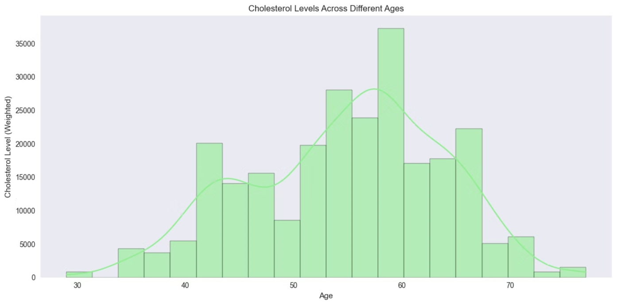
Data Preprocessing - Part 2
Data Visualization
Histogram
The histograms show the distributions of age and cholesterol levels in the heart disease dataset. This provides valuable insights into the ranges and patterns of these key risk factors.

Slide 7
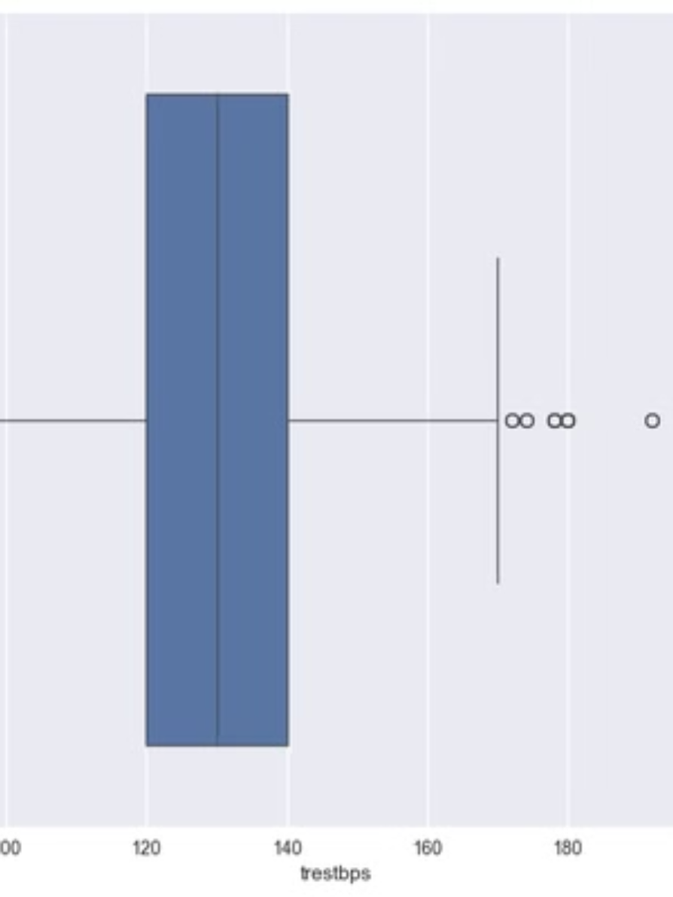
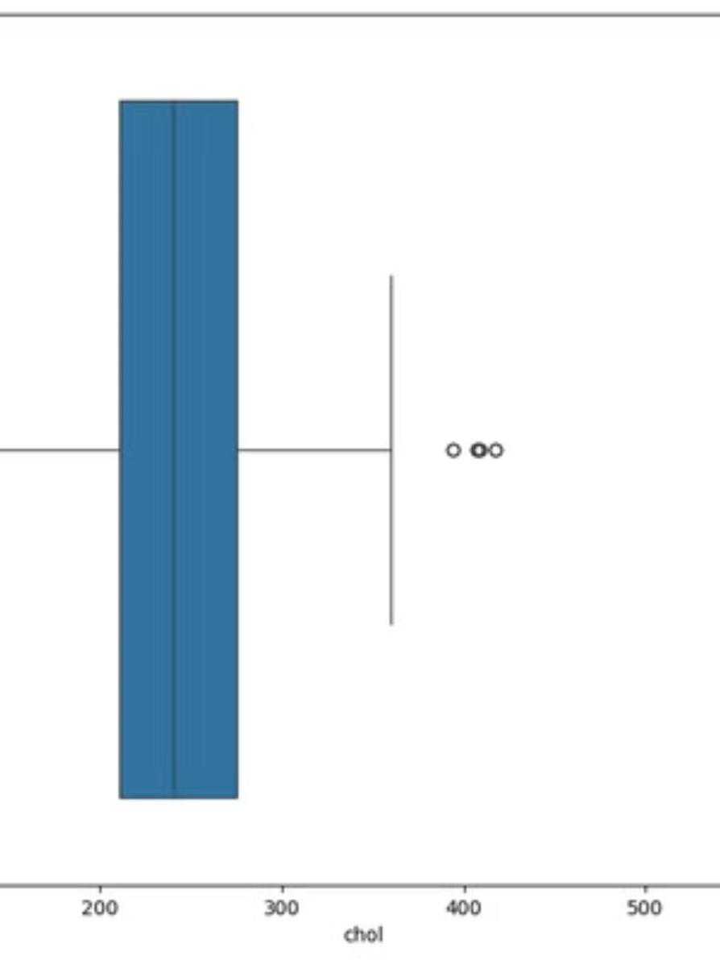
Box Plots
The box plots identify any outliers in the cholesterol and blood pressure values, helping us understand the extremes within the dataset and ensure the data is appropriately prepared for modeling.

Slide 8
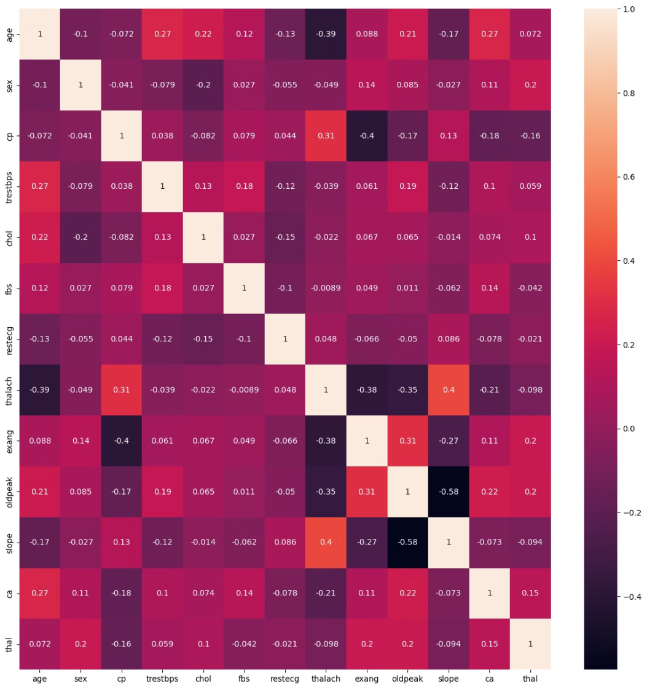
Correlation Heatmap
The correlation heatmap reveals the relationships between the various features in the heart disease dataset, highlighting the most important predictors to focus on for the predictive models.

Slide 9
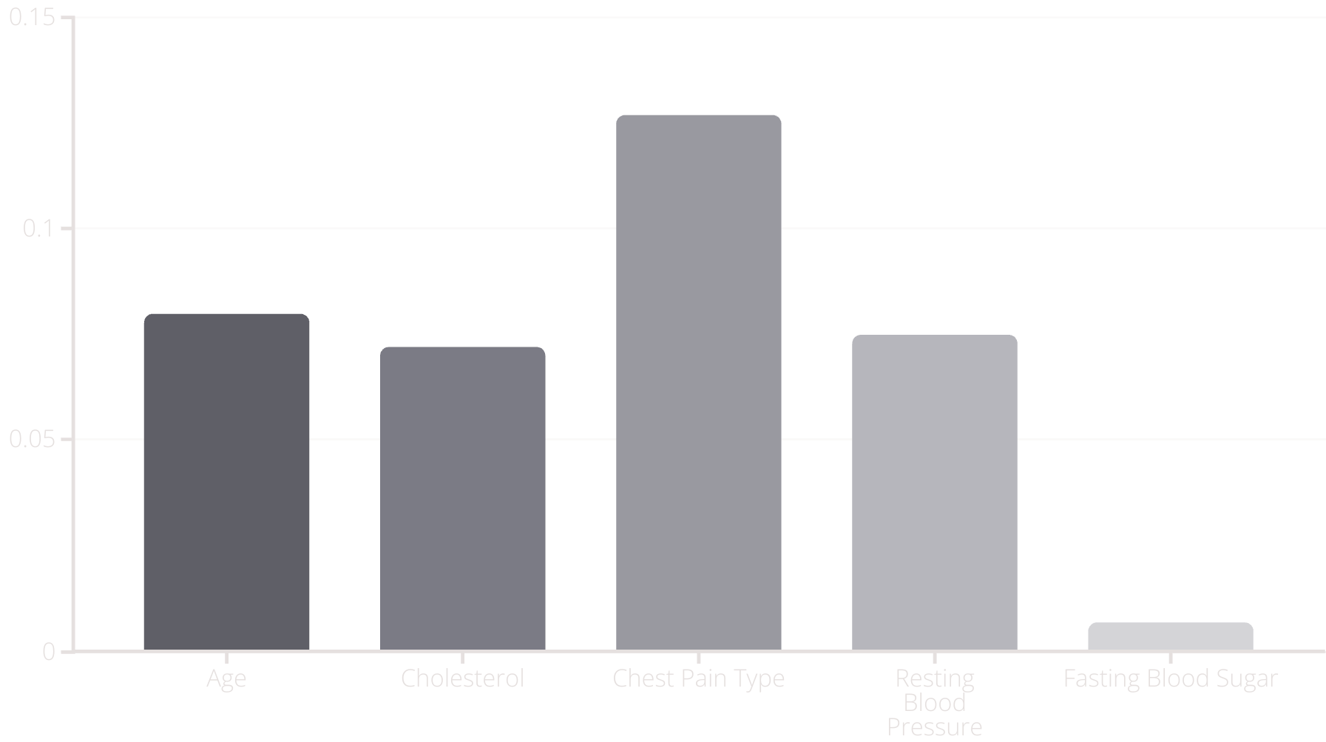
Feature Selection and Engineering
To identify the most predictive features for the heart disease prediction model, Recursive Feature Elimination (RFE) was applied. This technique systematically removes less important features, revealing age, cholesterol, and chest pain type as the key factors contributing to the model's accuracy.
The Random Forest model's feature importance analysis further validates the crucial role that age, cholesterol, and chest pain type play in predicting heart disease risk.

Slide 10




Model Selection Overview
Decision Tree
1
Interpretable model, handles non-linear relationships
Random Forest
2
Ensemble model, improves accuracy and robustness
Logistic Regression
3
Probabilistic model, suitable for binary classification
K-Nearest Neighbors (KNN)
4
Simple, effective for complex decision boundaries
These models were carefully selected for their unique capabilities in handling the heart disease dataset. The Decision Tree, Random Forest, Logistic Regression, and K-Nearest Neighbors (KNN) algorithms offer a diverse range of approaches to tackle the prediction task, ensuring a comprehensive analysis of the data.

Slide 11



Decision Tree Classifier
Recursive Splitting
1
Divides data based on feature values
Tree Structure
2
Classifies instances via branching
Predictive Modeling
3
Forecasts outcomes like heart disease
The Decision Tree Classifier is a powerful machine learning model that recursively splits data based on feature values, creating a tree-like structure to classify instances. This visual, hierarchical approach can be effectively applied to predict complex outcomes, such as the risk of heart disease based on factors like cholesterol and chest pain.

Slide 12

Random Forest Classifier
Ensemble Learning
Random Forest combines multiple decision trees to create a robust model, reducing the risk of overfitting.
Advantages
Random Forest performs well with complex, non-linear data and effectively models interactions between risk factors.

Slide 13
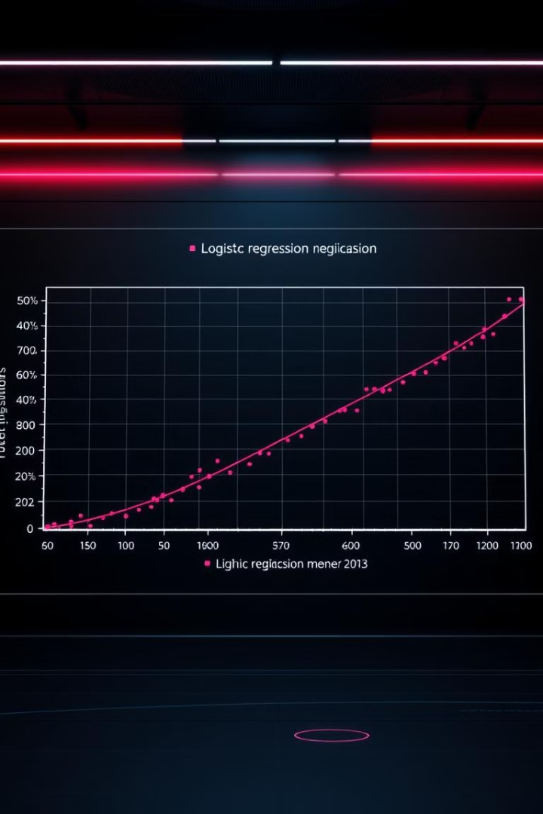
Logistic Regression
Logistic Regression is a statistical model that predicts binary outcomes using a logistic function, modeling the probability of a target variable.
It uses the logistic function to estimate the probability of heart disease, making it suitable for determining the presence (1) or absence (0) of heart disease.
However, Logistic Regression performs best when features have linear relationships, which can be a limitation when analyzing complex medical data.

Slide 14
K-Nearest Neighbors (KNN)
K-Nearest Neighbors (KNN) is an instance-based learning algorithm that classifies new instances by comparing them to the 'k' closest examples in the feature space. Unlike some other machine learning models, KNN makes predictions based on the distance to the nearest data points rather than learning an underlying model.
One key consideration when applying KNN is the importance of scaling the input features. Since KNN relies on distance measures, the features must be on a similar scale to avoid certain features dominating the distance calculations and skewing the results.
KNN is a powerful tool for classifying new patients based on the similarity to known cases in the training data. This allows the model to make predictions about the likelihood of heart disease based on factors like age, cholesterol levels, and chest pain type.

Slide 15
Model Training Process
Train-Test Split
Hyperparameter Tuning
The dataset was split into 75% for training and 25% for testing, ensuring the model performance is not biased towards a specific subset of the data.
A grid search process was used to optimize the model hyperparameters, such as tree depth and minimum samples per split, for improved performance.
1
2
3
Cross-Validation
To further validate the model's generalization, a cross-validation technique was applied, evaluating performance across multiple dataset partitions.

Slide 16



How Models Make Predictions
Model Input Processing
Prediction Calculation
Outcome Interpretation
Each model takes a patient's data, like age, cholesterol levels, and chest pain type, and uses its specific algorithm to analyze the data.
Based on the processed data, each model calculates a probability score, which represents the likelihood of heart disease for that patient.
The probability score is then translated into a prediction of either 'high risk' or 'low risk' based on a defined threshold, helping doctors understand the patient's risk level.

Slide 17
Results - Performance Comparison Table
Model
Accuracy
Precision
Recall
F1 Score
AUC
Decision Tree
97%
100%
95%
97%
0.97
Random Forest
100%
100%
100%
100%
1.00
Logistic Regression
80%
76%
86%
81%
0.88
KNN
71%
71%
71%
71%
0.84
The Random Forest model achieved the highest accuracy at 100%, making it the best performing model for predicting heart disease risk based on the provided medical data.

Slide 18
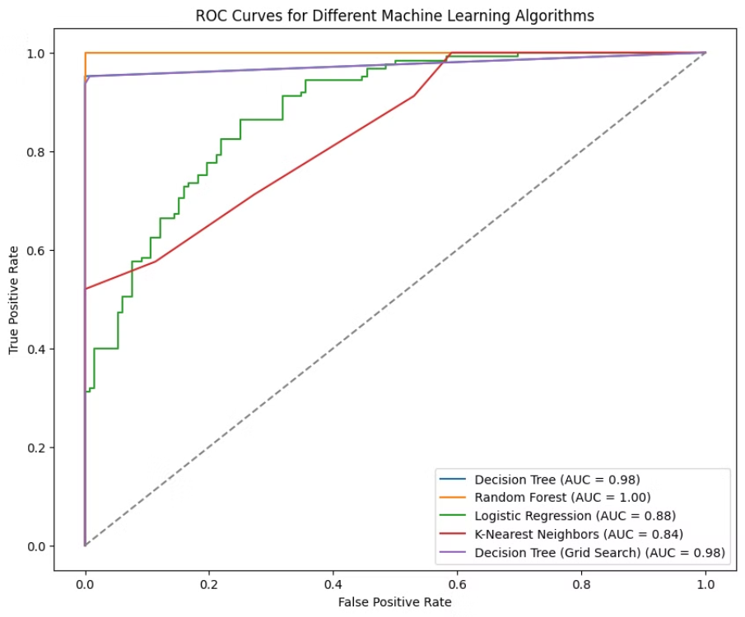
Results - ROC Curve Comparison
The ROC (Receiver Operating Characteristic) curves provide a visual comparison of the true positive rate and false positive rate for each machine learning model used to predict heart disease risk.
The area under the ROC curve (AUC) measures the overall accuracy of the model, with a higher AUC indicating better performance. The Random Forest model has the highest AUC, making it the most reliable for heart disease prediction.

Slide 19
Confusion Matrix Analysis
The confusion matrix provides a detailed breakdown of the model's performance, highlighting the true positives, false positives, true negatives, and false negatives.
Metric
Value
True Positives
Patients correctly identified as high-risk for heart disease.
False Positives
Patients incorrectly identified as high-risk, when they are actually low-risk.
True Negatives
Patients correctly identified as low-risk for heart disease.
False Negatives
Patients incorrectly identified as low-risk, when they are actually high-risk.
The confusion matrix analysis provides valuable insights into the model's strengths and weaknesses, allowing for targeted improvements to enhance the accuracy of heart disease predictions.

Slide 20
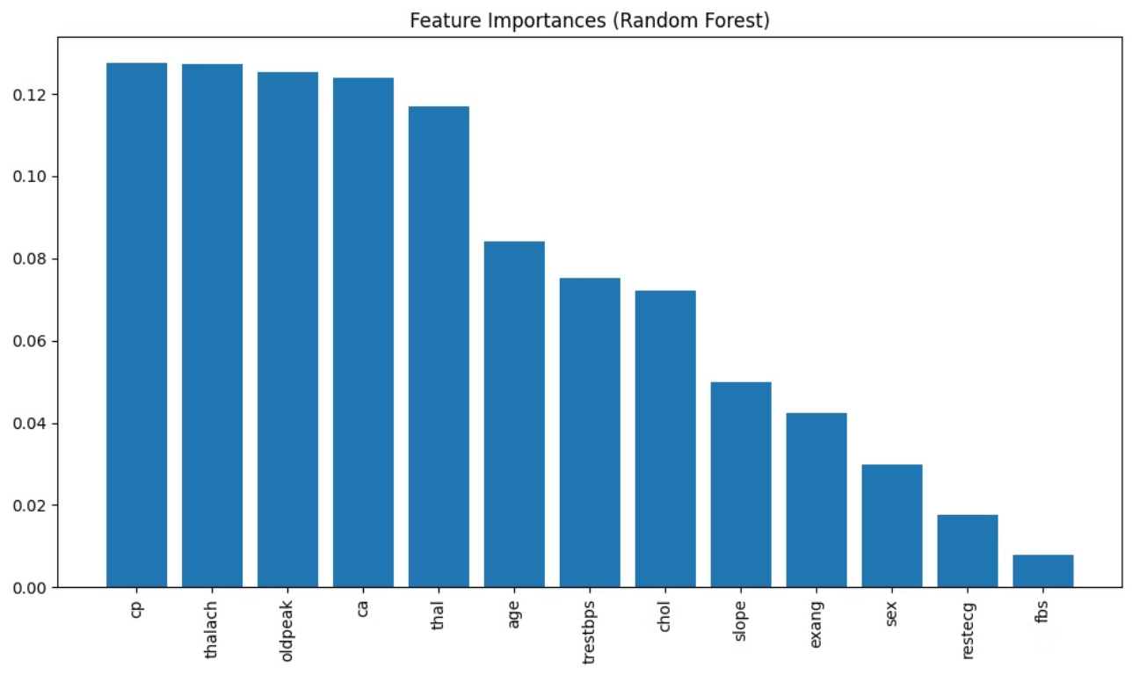
Feature Importance
The feature importance plot from the Random Forest model shows that age and cholesterol are the most significant predictors of heart disease risk, suggesting they are key physiological risk factors to consider.

Slide 21
Conclusion
Best Model
1
Random Forest - 100% accuracy
Implications
2
Early prediction aids proactive treatment
Future Work
3
Expand dataset, explore deep learning
The Random Forest model emerged as the top performer, achieving 100% accuracy, precision, and recall in predicting heart disease risk. This powerful tool can enable early interventions and proactive treatment plans. Moving forward, expanding the dataset and exploring deep learning techniques may further enhance the accuracy of heart disease prediction.

Slide 22
Thank You
Group Members
Instructor
Yellanuru Madasi Pranay Kumar - 21BCE9685
Professor Helen Sharmila A, Department of Artificial Intelligence and Machine Learning
Meda Mohan Kalyan - 21BCE9959
Hanumantu Durga Suresh - 21BCE9402
Gottemukkula Rahul - 21BCE9953

