Slide 1

Credit Card Customer Segmentation (Unsupervised Learning)
Presented by: Rahul Gottemukkula

Slide 2
Dataset Features
Feature | Definition
CUST_ID | Unique identifier assigned to each credit card customer.
BALANCE | Total outstanding balance available on the customer's credit card account.
BALANCE_FREQUENCY | Frequency at which the account balance is updated (0 to 1).
PURCHASES | Total amount spent by the customer using the credit card.
ONEOFF_PURCHASES | Total value of one-time purchases made by the customer.
INSTALLMENTS_PURCHASES | Total amount spent through installment (EMI) purchases.
CASH_ADVANCE | Total cash withdrawn using the credit card.
PURCHASES_FREQUENCY | Frequency of making purchases with the credit card (0 to 1).
ONEOFF_PURCHASES_FREQUENCY | Frequency of one-time purchase transactions.
PURCHASES_INSTALLMENTS_FREQUENCY | Frequency of purchases made through installment payments.

Slide 3
CASH_ADVANCE_FREQUENCY | Frequency of cash advance transactions (0 to 1).
CASH_ADVANCE_TRX | Total number of cash advance transactions performed.
PURCHASES_TRX | Total number of purchase transactions made by the customer.
CREDIT_LIMIT | Maximum credit amount approved for the customer's card.
PAYMENTS | Total amount paid by the customer towards the credit card bill.
MINIMUM_PAYMENTS | Minimum payment required from the customer each billing cycle.
PRC_FULL_PAYMENT | Percentage of times the customer paid the full outstanding balance.
TENURE | Total number of months the customer has held the credit card account.

Slide 4
app.py Structure
Home ↓ Dataset Analysis ↓ Dynamic Clustering ↓ Cluster Visualization ↓ Predict Cluster Implemented using if / elif navigation.

Slide 5
Project Workflow
Load Dataset EDA Missing Values Feature Scaling K-Means Hierarchical Clustering DBSCAN Evaluation PCA Save Model

Slide 6
EDA
Dataset Preview Statistics Correlation Heatmap Histogram Boxplot Outlier Detection

Slide 7
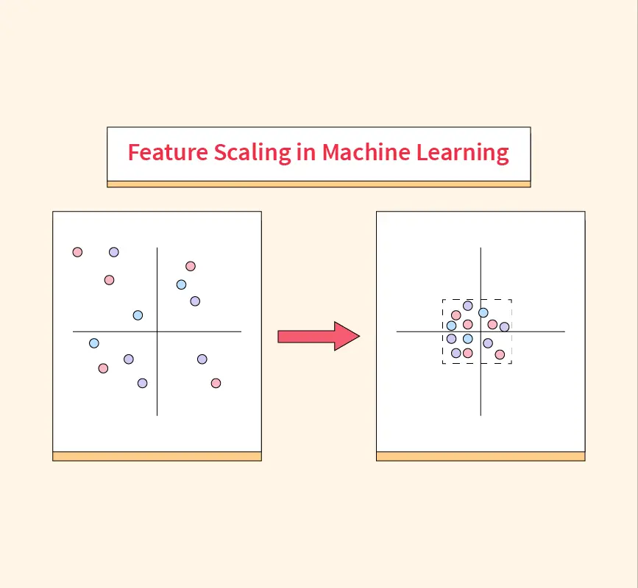
Feature Scaling
StandardScaler applied before clustering.

Slide 8
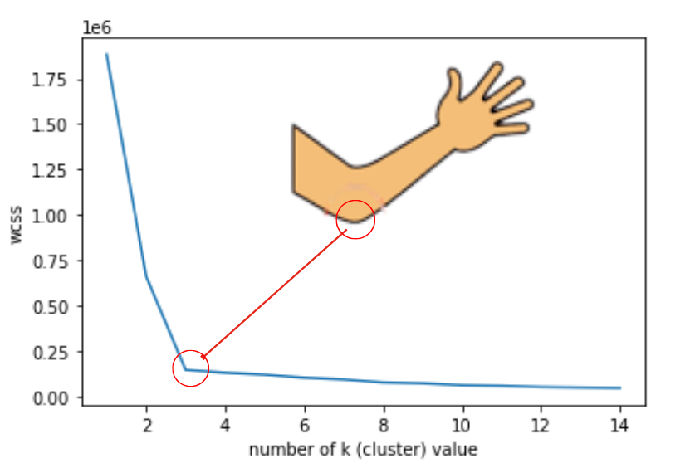
K-Means
Automatic & Manual K Cluster Creation

Slide 9
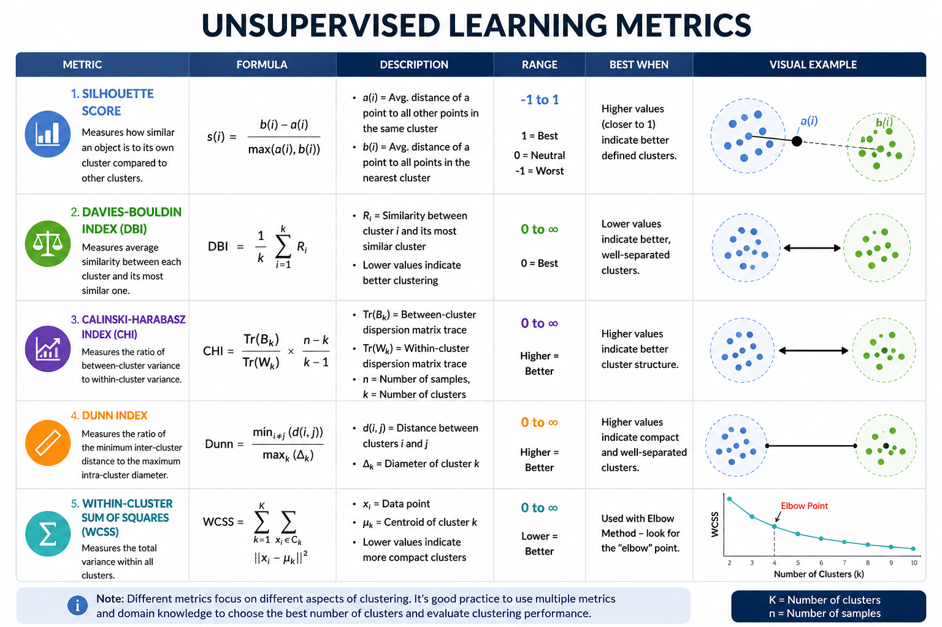

Slide 10
Visualizations
Elbow Curve Silhouette Curve PCA Plot Cluster Distribution Cluster Centers

Slide 11
Frontend
Streamlit Dashboard Interactive Widgets Dynamic Clustering Prediction Module

Slide 12
Prediction
Load scaler.pkl Load kmeans_model.pkl Predict Cluster Display Interpretation

Slide 13
Conclusion
Customer Segmentation Completed Successfully.

Slide 14

Thank You
Questions?

