Slide 1


NATIONAL INSTITUTE OF TECHNOLOGY KARNATAKA ,SURATHKAL
COMPUTER APPLICATION
PROJECT
SUBMITTED BY
NAYAN GUPTA 204CA033
NITESH MALVIYA 204CA035
PRATHVI SONI 204CA037
SUBMITTED TO
Dr. SONALI CHAKRABORTY

Slide 2
RURAL EMPLOYMENT

Slide 3

1
CONTENT
INTRODUCTION
USECASE
ER DIAGRAM
DATA FLOW DIAGRAM
DATABASE TABLES
OUTPUT FORMS
TECHNOLOGY USED
FUTURE SCOPE
CONCLUSION

Slide 4
2
INTRODUCTION
The main motive behind the project Rural Employment is to enhance one’s business or to help one’s start-up altogether it is kind helpful to Rural workers.
It is basically two interface platform other than the admin panel one interface is for rural employers and other interface is for company or start-up.
The platform behaves as an intermediary between the two(Rural supplier and Company).

Slide 5
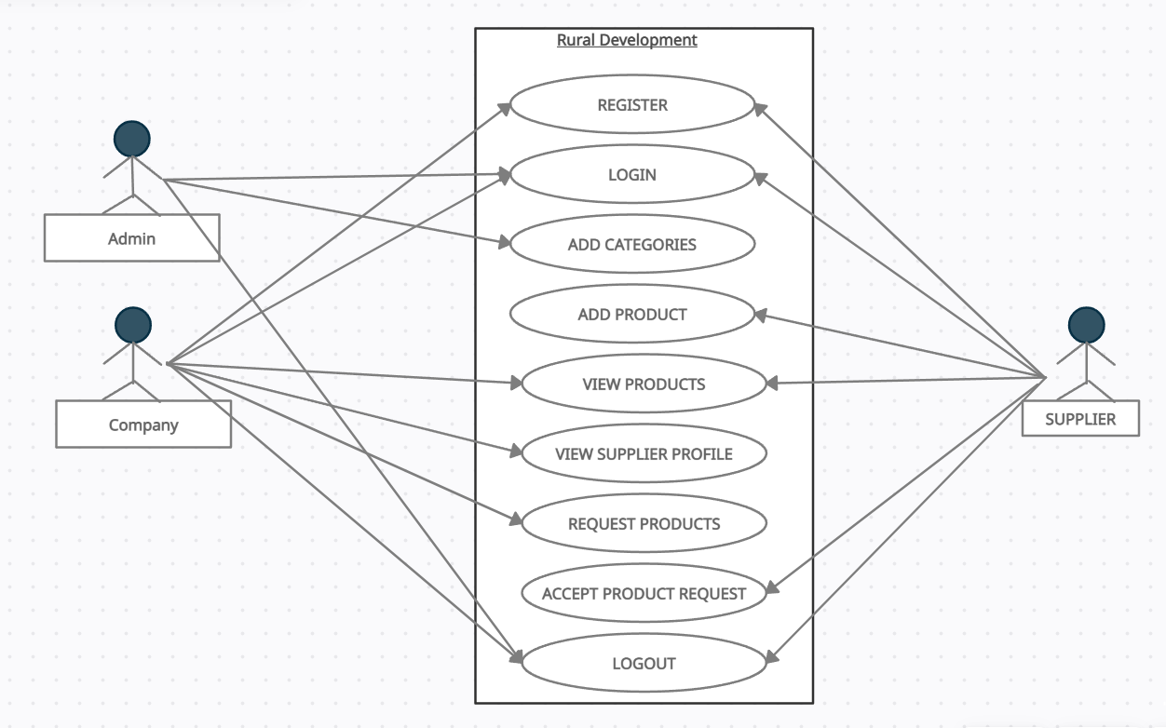
3
USECASE

Slide 6
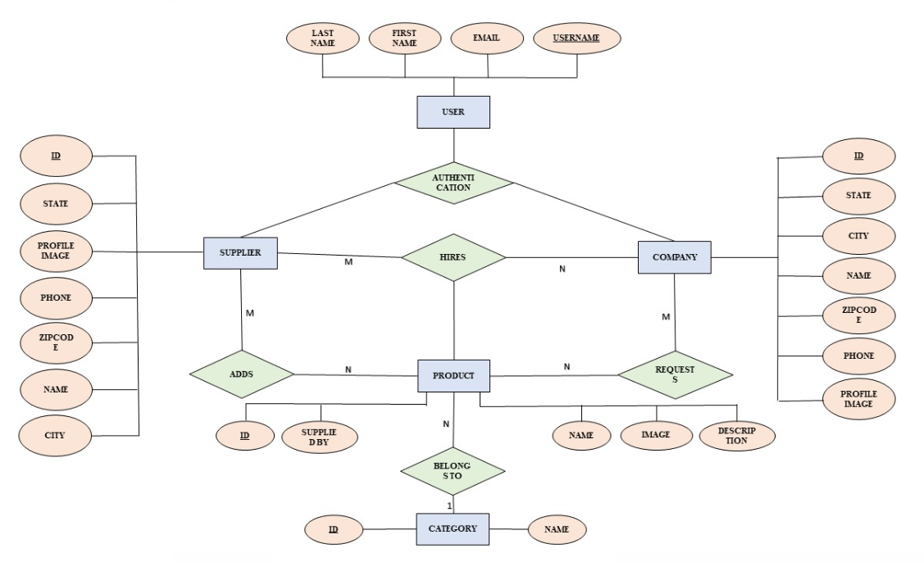
4
ER DIAGRAM

Slide 7
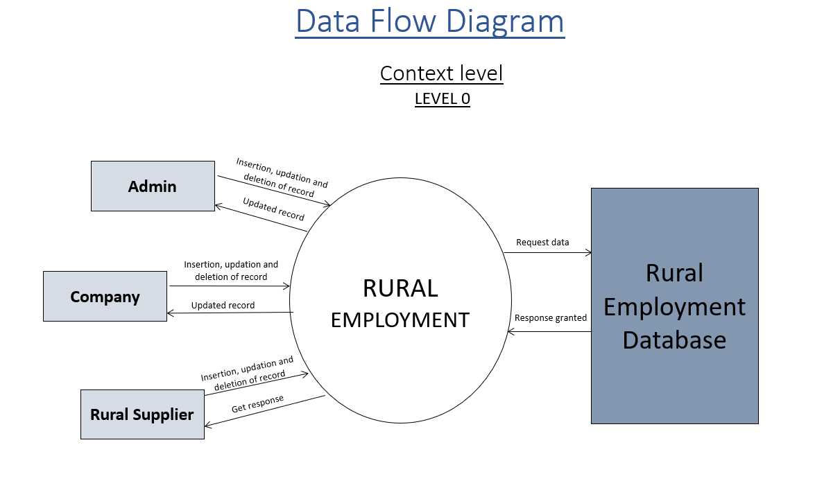
5
DATA FLOW DIAGRAM

Slide 8
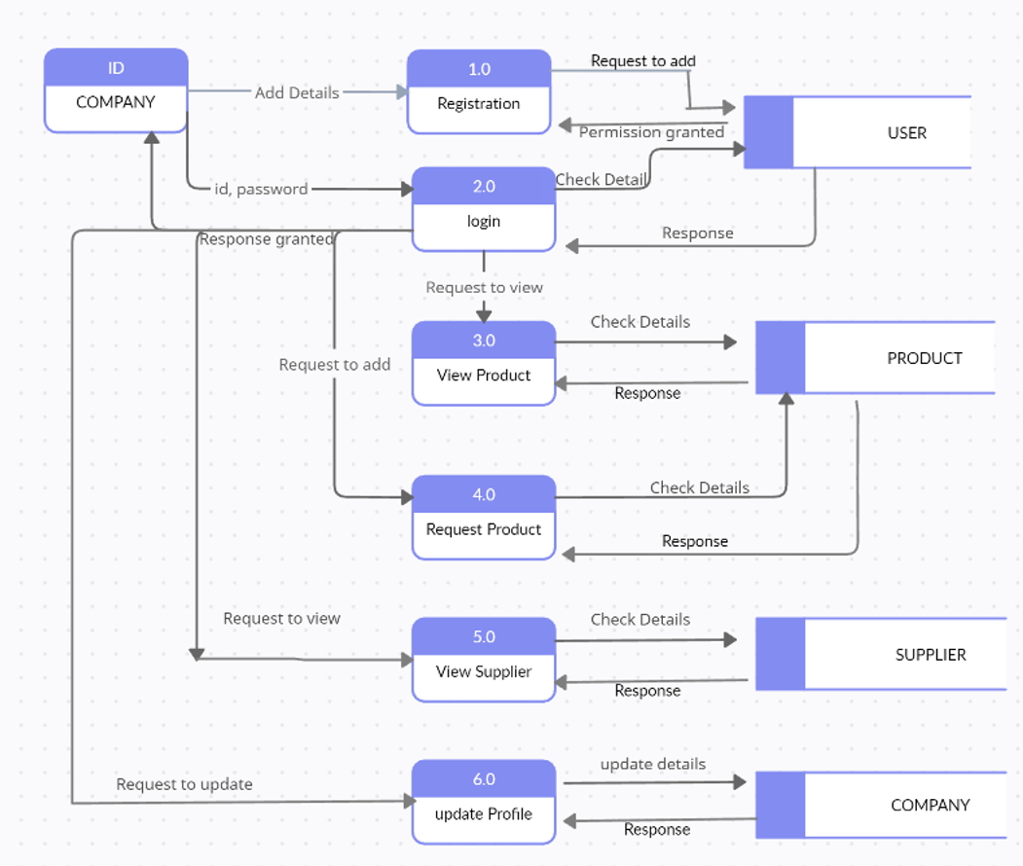
6
DATA FLOW DIAGRAM
COMPANY LEVEL 1 DFD:

Slide 9
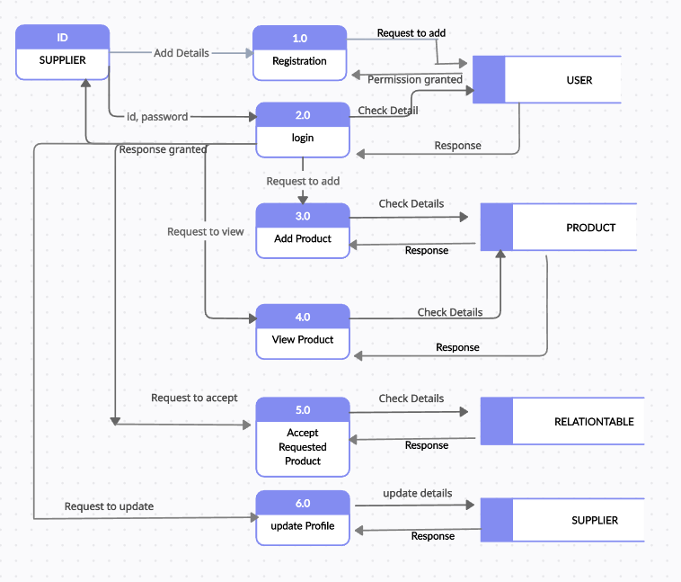
7
SUPPLIER LEVEL 1 DFD:
DATA FLOW DIAGRAM

Slide 10
8
DATABASE
USER TABLE
USERNAME | EMAIL | FIRST NAME | LAST NAME | STAFF STATUS
SUPPLIER TABLE
ID | NAME | CITY | STATE | ZIPCODE
COMPANY TABLE
ID | NAME | CITY | STATE | ZIPCODE
CATEGORY TABLE
ID | NAME
PRODUCT TABLE
ID | NAME | IMAGE | DESCRIPTION | SUPPLIED BY
RELATION TABLE
SUPPLIED BY | PRODUCT SUPPLIED | SUPPLIED TO | APPROVAL

Slide 11
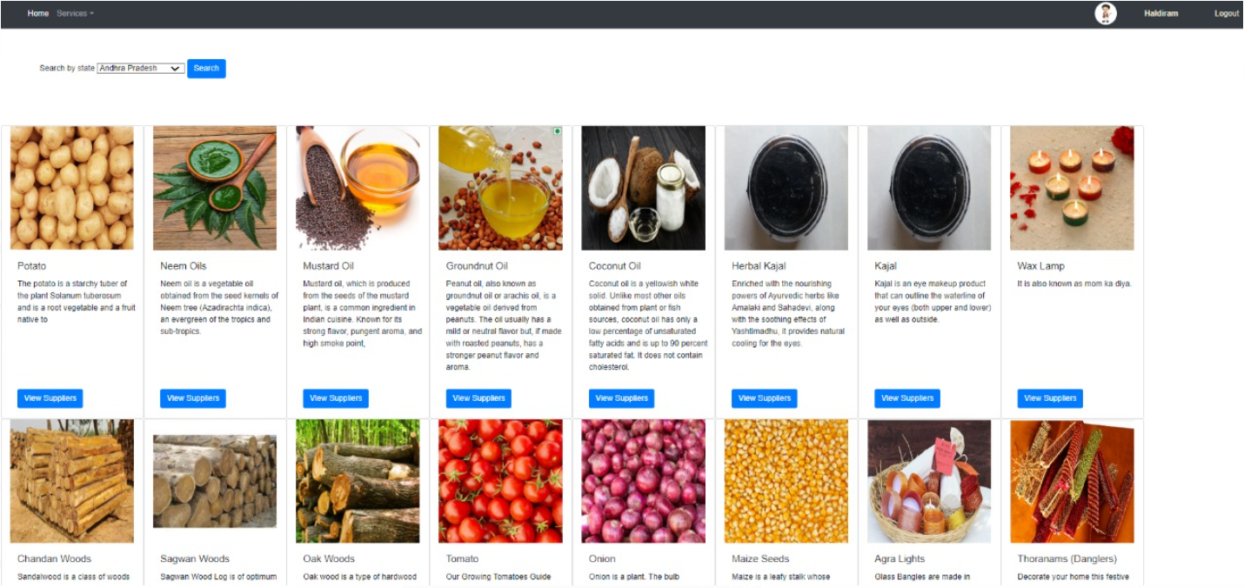
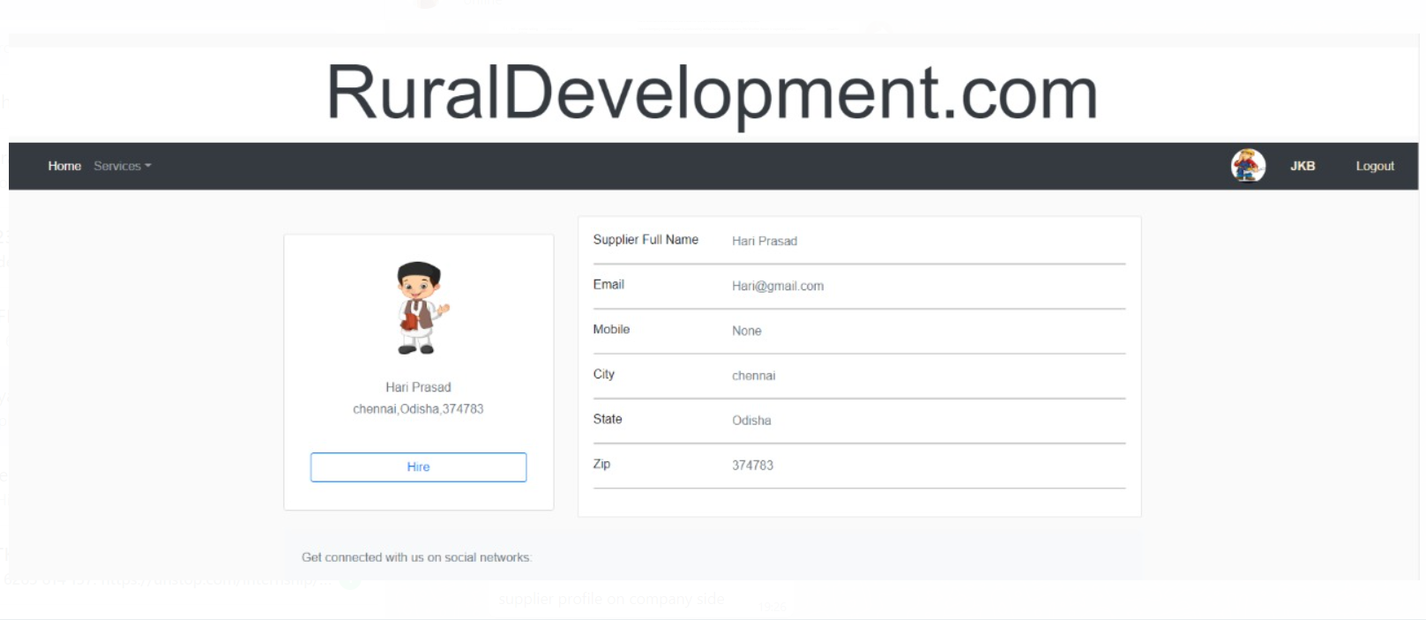
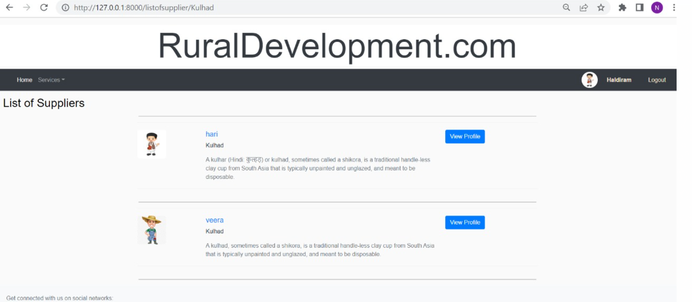
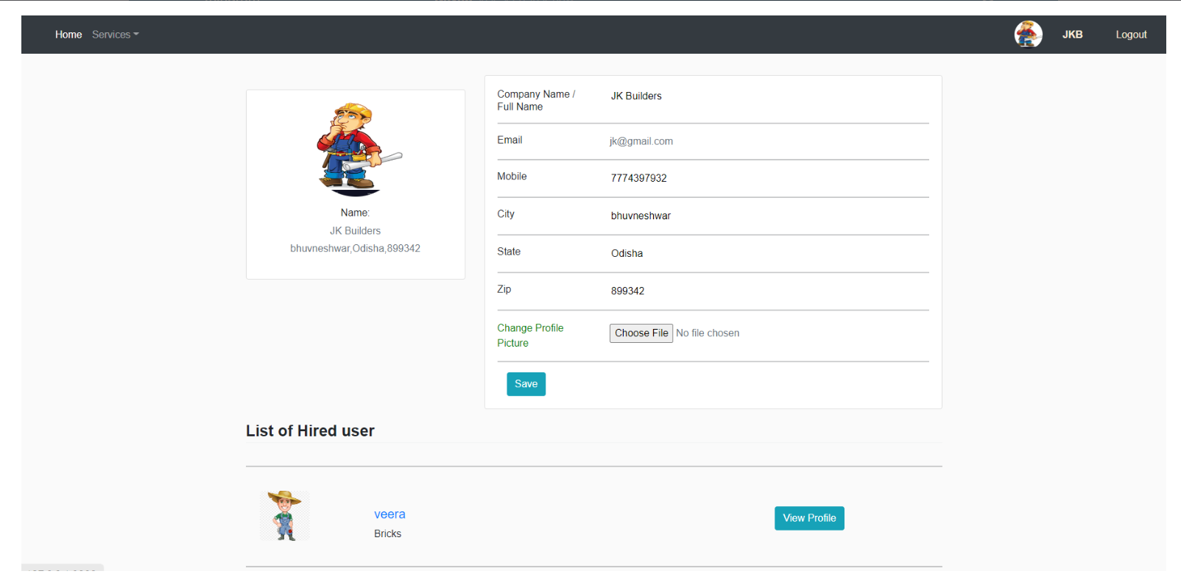
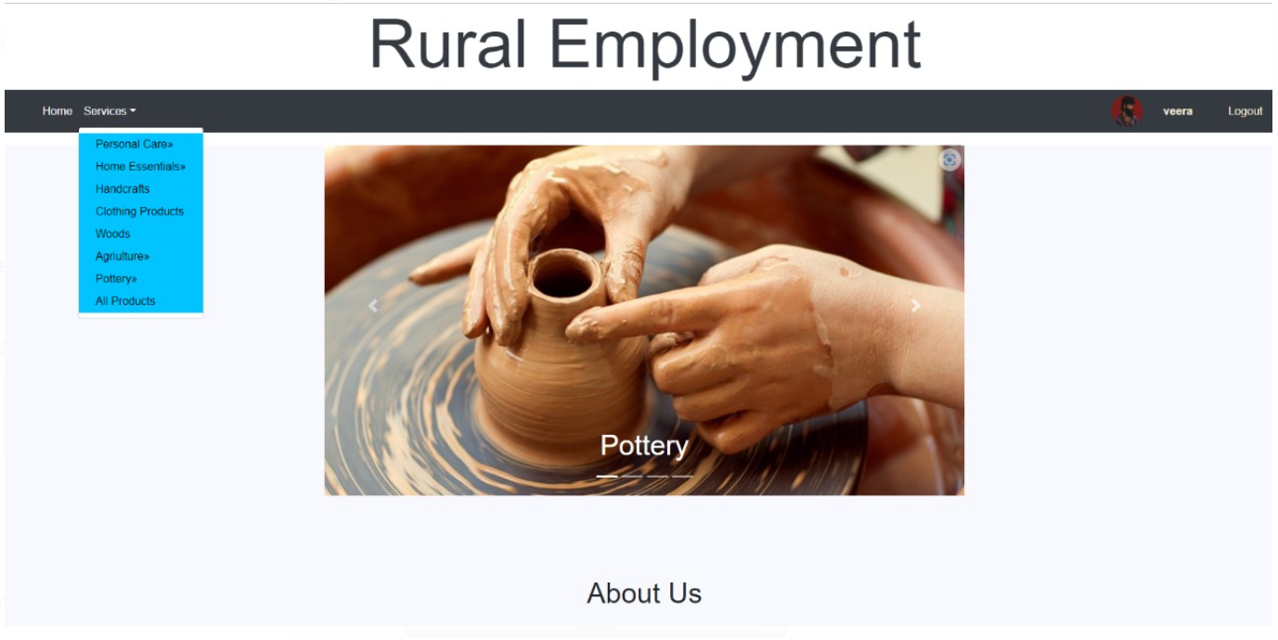
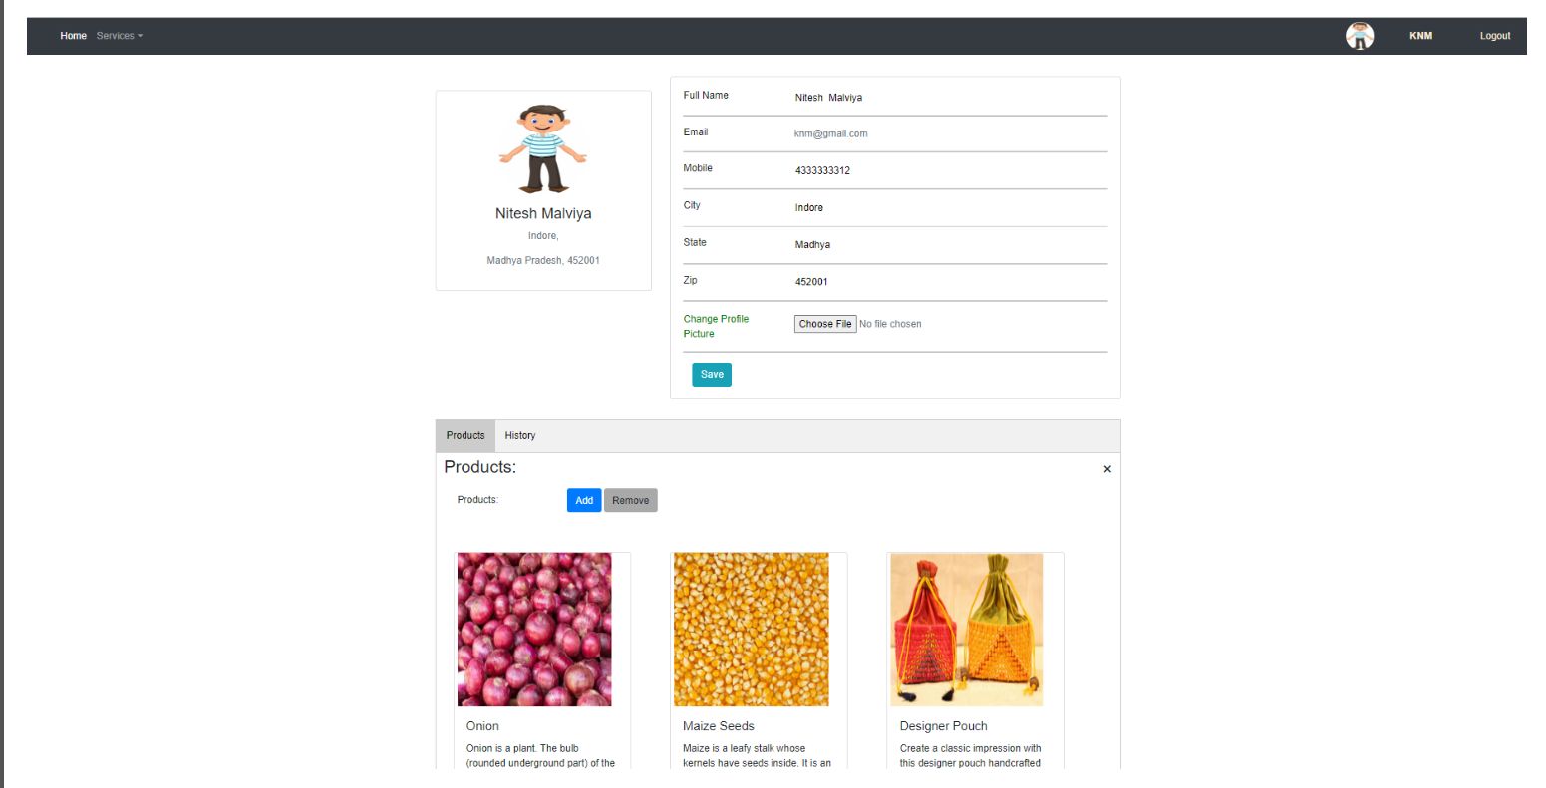
9
Output Forms

Slide 12
10
TECHNOLOGY USED
Software Requirements:
Technology: Python Django
IDE: Visual studio
Client-Side Technologies: HTML, CSS, Bootstrap
Server-Side Technologies: Python
Data Base Server: SQLite
Operating System: Microsoft Windows/Linux

Slide 13
11
FUTURE SCOPE
We can add rating system according to supplied product Quality.
Generate Bond Agreement from the side of supplier.
List out particular product supplier at a requested distance entered by the Company.

Slide 14
12
CONCLUSION
To start a new business or to enhance a business people hit into many needs. So this platform makes the beginning easy.
Saves effort and time.
One will be more focused on growth of business other than searching supporting stuffs.
A rural worker get employment at his own pace other than working under someone else.

Slide 15










