Slide 1

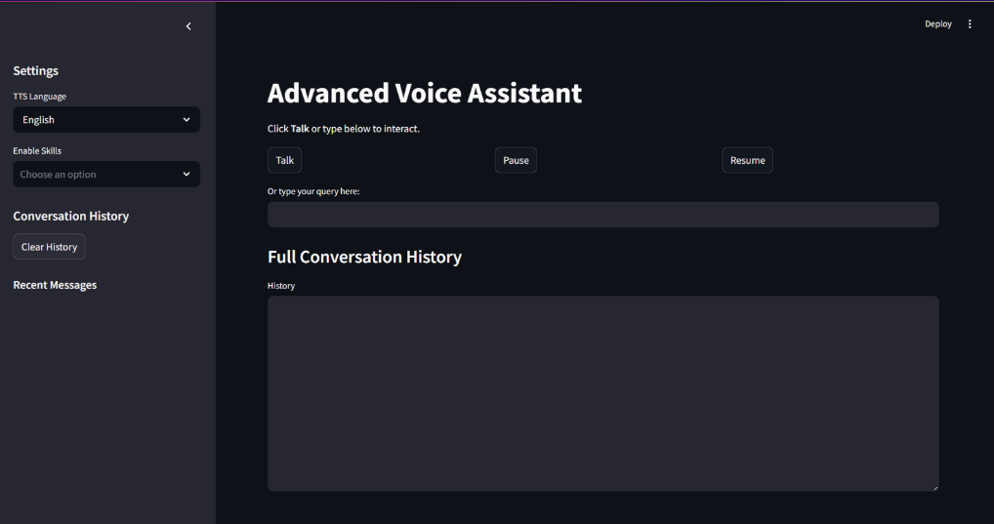
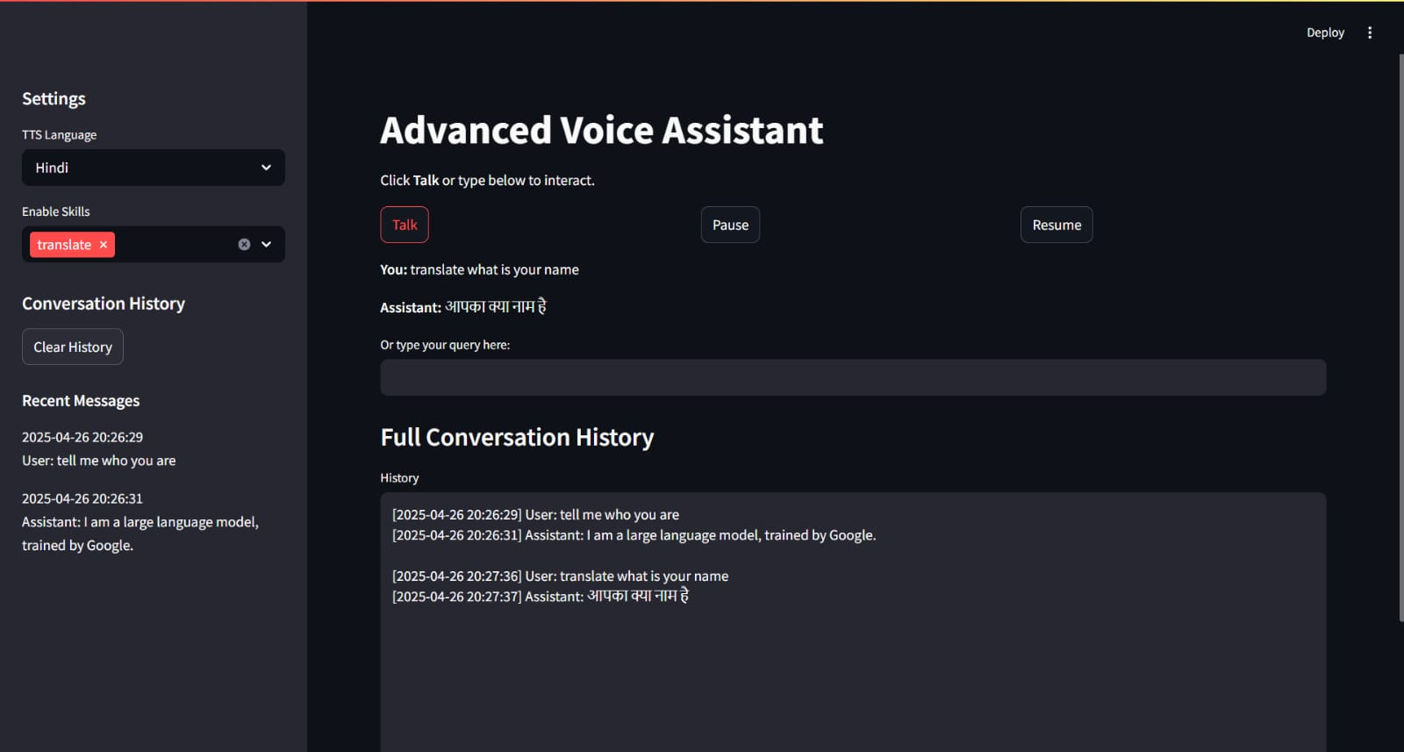
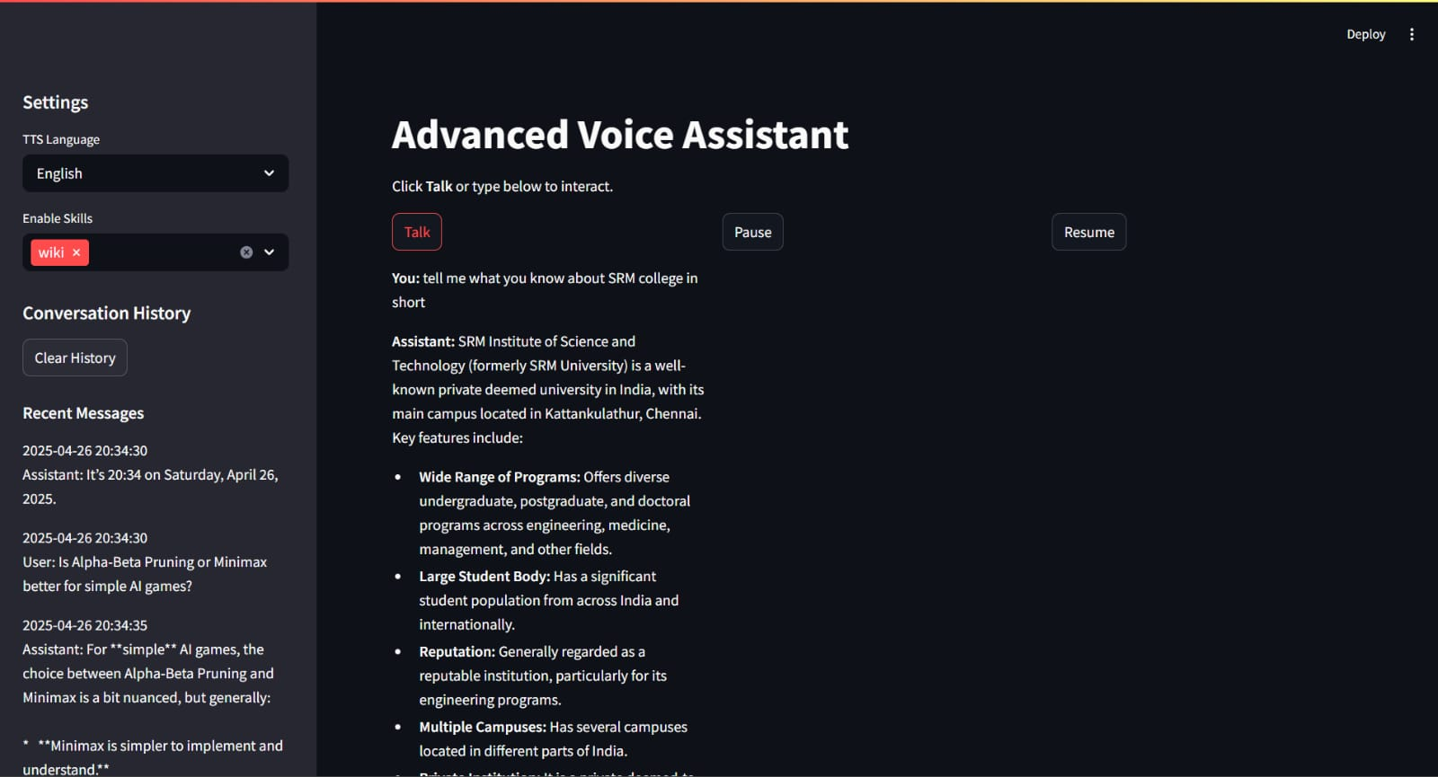
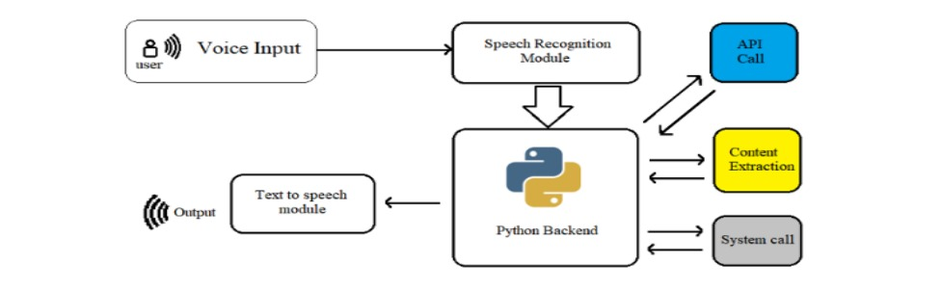
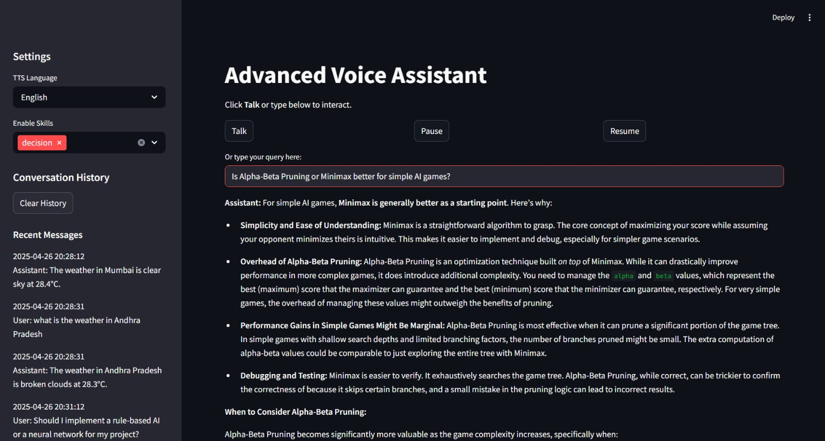
AI VOICE ASSISTANT
INTRODUCTION
METHODOLOGY
RESULTS
CONCLUSION
Our project, "Advanced Voice Assistant System," is a smart and interactive platform designed to assist users seamlessly in real-time. It combines advanced technologies like Speech Recognition, Natural Language Processing, and Smart Decision-Making. By integrating AI algorithms such as A* Search, Alpha-Beta Pruning, and Backtracking, the assistant delivers faster and more intelligent responses. The system can understand voice input, translate languages, fetch Wikipedia summaries, provide weather updates, and assist in decision-making. It features text-to-speech output, creating a natural conversation flow. Voice input ensures hands-free convenience for users. Language translation breaks communication barriers effortlessly. Wikipedia search offers quick, summarized information retrieval. Weather updates are provided instantly based on city names. Decision support helps users choose between multiple options wisely. Conversation history is maintained for context-aware responses. Together, these features showcase the power of AI to enrich everyday human-computer interactions.
The project follows a modular development approach, making it easy to manage and expand. The core skills integrated into the assistant include:
Weather Reporting: Fetches real-time weather information using OpenWeather API.
Translation: Uses backtracking for robust translation between languages.
Wikipedia Search: Utilizes the A* search algorithm to provide the most relevant Wikipedia page.
Time Display: Provides current time information with localization.
Decision Making: Implements Alpha-Beta pruning for optimized decision-making.
Each skill is built with specific algorithms that handle complex tasks effectively. For example, Alpha-Beta Pruning makes smart decisions between multiple options, and Backtracking ensures translations succeed even when direct methods fail. The A * Search algorithm enhances the Wikipedia search experience by finding the most relevant articles.
The assistant integrates APIs like Google Translate and OpenWeather for real-time external data fetching. The design is modular and scalable, allowing easy integration of new skills or features in the future. This ensures the assistant remains flexible and can grow with additional capabilities as needed.
The Advanced Voice Assistant System successfully delivers fast, accurate, and intelligent responses by integrating multiple AI techniques and real-time user interaction features.
The "Advanced Voice Assistant System" successfully integrates multiple AI techniques to enhance user interactions. It provides efficient, real-time assistance using speech recognition, NLP, and decision-making algorithms. The system effectively processes both voice and text inputs to generate accurate, context-aware responses. Natural Language Processing techniques ensure seamless understanding of user queries in multiple languages. Text-to-Speech (TTS) technology delivers human-like voice responses, creating an engaging user experience. The system's modular structure allows for easy upgrades and additional features in the future. It incorporates valuable skills, such as weather updates, Wikipedia search, and language translation. Alpha-Beta Pruning optimizes decision-making processes, improving speed and accuracy. Real-time interaction history is tracked, offering personalized and context-aware responses. The assistant is designed to be accessible, making it easy for users to interact through voice or text. The performance of the system has been validated through extensive testing to ensure reliability. User feedback has shown satisfaction with the assistant's ease of use and functionality. The assistant simplifies daily tasks, saving time and boosting user productivity. The project demonstrates the potential of AI to create smarter, more intuitive voice assistants. In the future, the system can be expanded to support more languages and new skills. This project highlights the role of AI in revolutionizing human-computer interaction. It marks a significant step toward developing more advanced, intelligent virtual assistants.
Backtracking enhanced the translation accuracy by dynamically retrying multiple approaches until the best output was achieved.
PROBLEM STATEMENT
As the demand for intelligent and interactive systems grows, there is a need for a versatile and efficient Voice Assistant capable of handling multiple tasks seamlessly. Existing voice assistants may be limited in terms of flexibility, adaptability, and user personalization. The problem lies in developing a multi-functional voice assistant that not only performs basic tasks like weather reporting, time tracking, and translation but also incorporates advanced decision-making algorithms, contextual search capabilities, and real-time interaction with the user. This project aims to bridge this gap by creating a modular voice assistant that leverages natural language processing, algorithmic decision-making, and external APIs to provide a comprehensive, intuitive, and scalable solution for personal and professional use.
IMPLEMENTATION DETAILS
A* Search optimized the Wikipedia search process by efficiently finding the most relevant articles based on user queries.
1. Project Setup:
Built using Python as the core language.
Environment variables (API keys, etc.) are managed securely with python-dotenv.
Streamlit is used for the web interface, enabling real-time interaction.
2. Voice Interaction:
Voice commands are captured through a voice input module.
Responses are spoken out using a Text-to-Speech (TTS) system.
3. Skill Modules:
Weather Skill: Fetches live weather data via OpenWeather API.
Translation Skill: Translates text with a backtracking mechanism to improve accuracy.
Wikipedia Skill: Searches and summarizes Wikipedia articles with intelligent A* fallback for ambiguous queries.
Decision-Making Skill: Smartly selects between options using Alpha-Beta Pruning.
Time Skill: Provides current time and day information in a human-readable format.
4. Core Components:
AI Engine: Manages user conversations and skill routing through an AI agent (Gemini API).
History Manager: Saves and displays conversation history for context and easy review.
5. Application Logic:
A main routing system processes user input and directs it to the correct skill or fallback AI response.
REFERENCES
1. https://openweathermap.org/api - Provides real-time and forecasted weather data for locations worldwide, enabling dynamic weather updates in the system.
2. https://www.wikipedia.org/ - Serves as a vast source of human knowledge, supplying detailed summaries and information for user queries.
3. https://aistudio.google.com/welcome - Offers powerful AI models and tools for building, fine-tuning, and deploying advanced conversational agents.
4. https://openai.com/index/chatgpt/ - Powers natural language understanding and generation, enabling human-like conversations and intelligent responses.
ARCHITECTURE DIAGRAM
Alpha-Beta Pruning significantly reduced decision-making time by eliminating unnecessary evaluations, enabling quicker and smarter choices.
ACKNOWLEDGEMENT
RA2311027010191-PVSK.ROHIT
RA2311027010201-RAHUL GOVARDHAN

