Slide 1
Most popular components in syncfusion
By Rahul R

Slide 2

List of components
Data grid
Chats
List View
Scheduler
Diagram
PDF Viewer
Excel Library

Slide 3
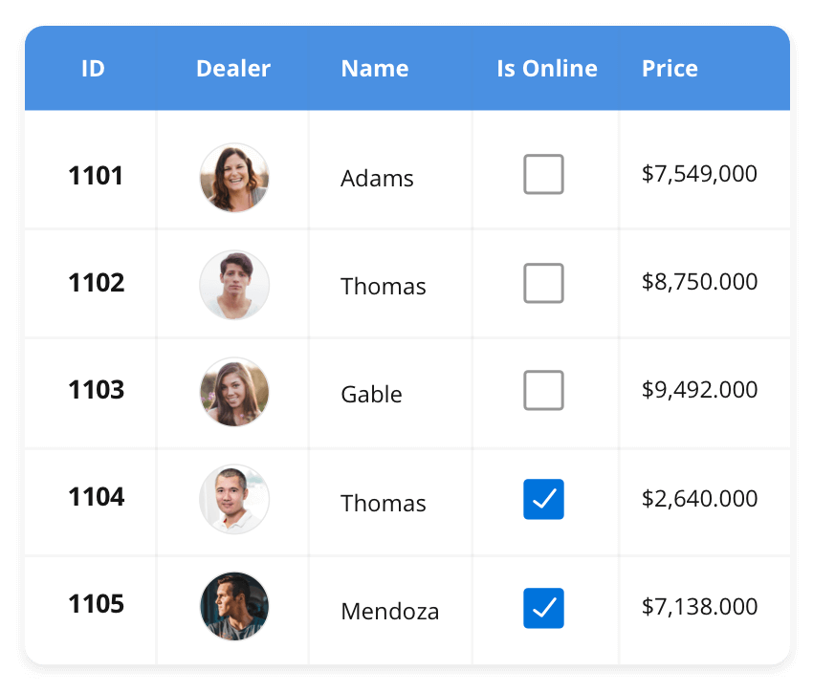
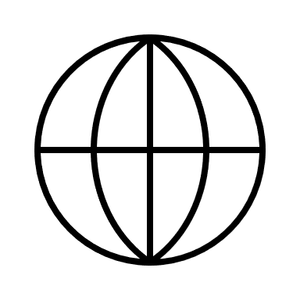



DataGrid
The DataGrid control is a high-performance grid component that helps display and manipulate large amounts of data in a tabular format. Its rich feature set includes functionalities like data binding, sorting, grouping, editing, filtering, swiping, dragging, resizing, loading more items, pull-to-refresh, and exporting to Excel and PDF file formats.
SUPPORTED PLATFORMS
JavaScript Angular React Vue Blazor
Flutter ASP.NET MVC ASP.NET core
Winforms WPF WinUI Flutter Xamarin
UWP .NET MAUI
Xamarin Flutter UWP JavaScript .NET MAUI

Slide 4
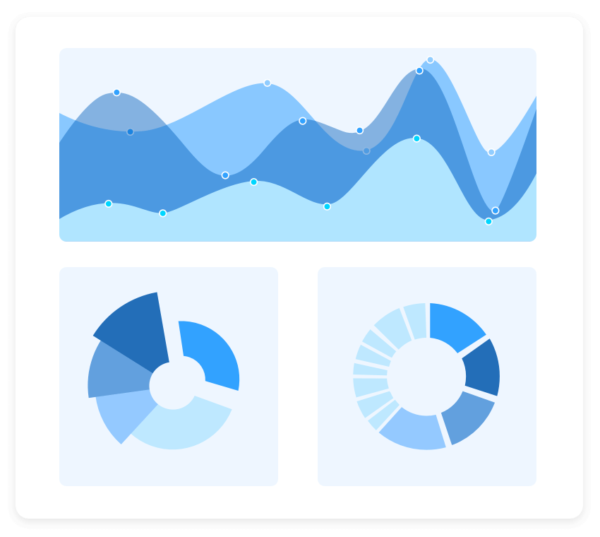
Charts
The Charts control can plot a wide range of chart types, ranging from line charts to specialized financial charts. Its rich feature set includes functionalities like data binding, multiple axes, legends, animation, data labels, annotations, trackballs, tooltips, and zooming.
SUPPORTED PLATFORMS
JavaScript Angular React Vue Blazor
Flutter ASP.NET MVC ASP.NET core
Winforms WPF WinUI Flutter Xamarin
UWP .NET MAUI
Xamarin Flutter UWP JavaScript .NET MAUI

Slide 5
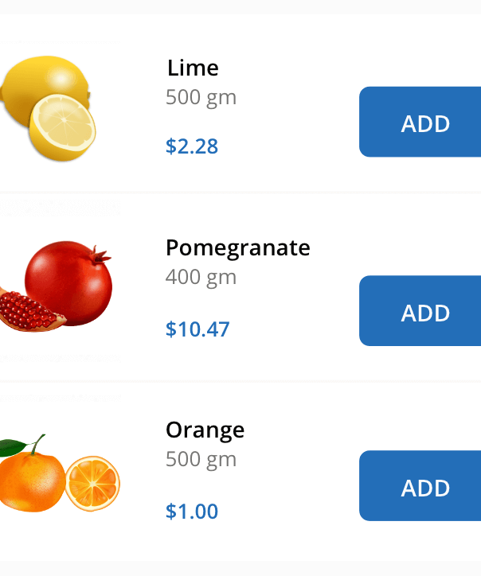



Listview
The List View renders a set of data items with UI views or custom templates. It has many features like grouping, sorting, filtering, paging, swiping, multiple selection, drag and drop, and different layout types. The List View control has been optimized to work with large amounts of data.
SUPPORTED PLATFORMS
JavaScript Angular React Vue Blazor
Flutter ASP.NET MVC ASP.NET core
Winforms WPF WinUI Flutter Xamarin
UWP .NET MAUI
Xamarin Flutter UWP JavaScript .NET MAUI

