Slide 1


Air Quality Health Risk
Prediction System

Slide 2

Learning Objectives
To analyze and visualize a real-world air quality dataset to uncover key trends and relationships between pollutants.
To preprocess and clean data, addressing issues like negative values to prepare it for machine learning.
To build and evaluate multiple classification models (Logistic Regression, Decision Tree, Random Forest) to solve a multi-class prediction problem.
To optimize model performance through hyperparameter tuning using GridSearchCV.
To develop and deploy a user-friendly, interactive web application with Streamlit that brings the predictive model to life..
GOAL
Source :
www.freepik.com/

Slide 3
Tools and Technology used
Python: The core programming language used for the entire project.
Pandas: For data manipulation, cleaning, and analysis.
NumPy: For numerical operations and handling arrays.
Matplotlib & Seaborn: For data visualization and creating informative plots.
Scikit-learn: For building, training, and evaluating machine learning models.
Jupyter Notebook: For interactive data exploration, analysis, and model development.
Streamlit: For creating and deploying the interactive web application.
Joblib: For saving and loading the trained machine learning model and other objects.

Slide 4
Methodology
Data Loading and Initial Exploration: The Indian air quality dataset was loaded into a Pandas DataFrame for analysis.
Exploratory Data Analysis (EDA): Visualizations were generated to understand pollutant distributions, correlations, and trends.
Data Cleaning: Illogical negative values in pollutant and AQI columns were corrected by clipping them to zero.
Feature Engineering: A Health_Risk target variable was created, and categorical city data was converted to a numerical format.
Model Preparation: The dataset was split into training/testing sets, and features were standardized for uniform scale.
Model Training & Comparison: Logistic Regression, Decision Tree, and Random Forest models were trained and evaluated on key performance metrics.
Interactive Scenario Planner: A "what-if" analysis feature was implemented, allowing users to adjust pollutant values with sliders to see how the health risk might change.
Deployment: The final, optimized model was saved and integrated into an interactive Streamlit web application.

Slide 5
Problem Statement:
The Challenge: Air pollution in India is a critical public health issue, with various pollutants like PM2.5, NO2, and CO posing significant risks to respiratory health. While raw data on these pollutants is available, it is not easily interpretable for the general public in terms of immediate health impact.
The Goal: The primary objective of this project is to develop an accurate and reliable machine learning model that can translate complex air quality data into a simple, understandable health risk classification (Low, Medium, or High).
The Impact: By building this predictive model, we aim to empower individuals and communities across various Indian cities to make informed, data-driven decisions about their health, such as whether to limit outdoor activities on days with poor air quality. This transforms raw scientific data into actionable public health guidance.

Slide 6
Solution:
An Interactive Web Dashboard: The core solution is a web application built with Streamlit, designed with a modern, futuristic UI for an engaging user experience. It serves as a public-facing tool to make the model's insights accessible to anyone.
Real-Time Predictive Forecasting: The application allows users to input current pollutant levels and AQI data for a specific city. Upon submission, it uses the saved Random Forest model to provide an instant, easy-to-understand health risk prediction (Low, Medium, or High).
Actionable Health Guidance: Beyond just a prediction, the app provides personalized and actionable health precautions based on the forecast. It also calculates and displays the model's confidence score, showing the probability for each risk category, which adds a layer of transparency to the results.
What-If Scenario Planner: A dedicated "Scenario Planner" tab allows users to adjust key pollutant levels with sliders and instantly see how these changes would impact the health risk, providing a powerful tool for understanding pollutant sensitivity

Slide 7
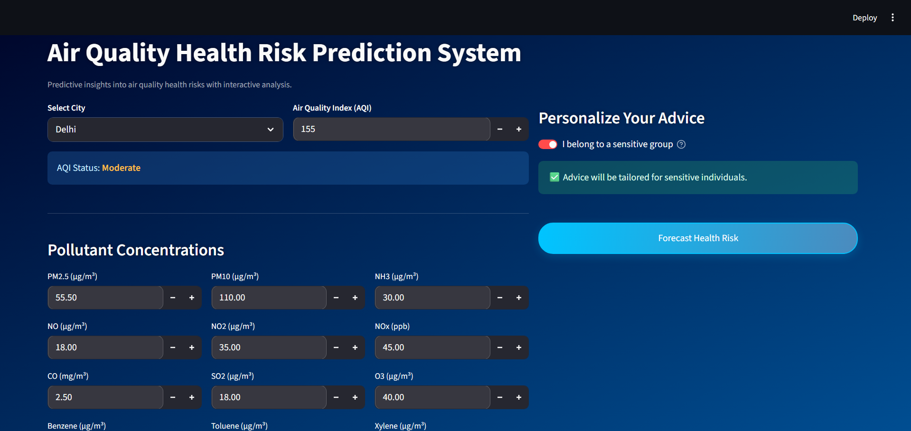
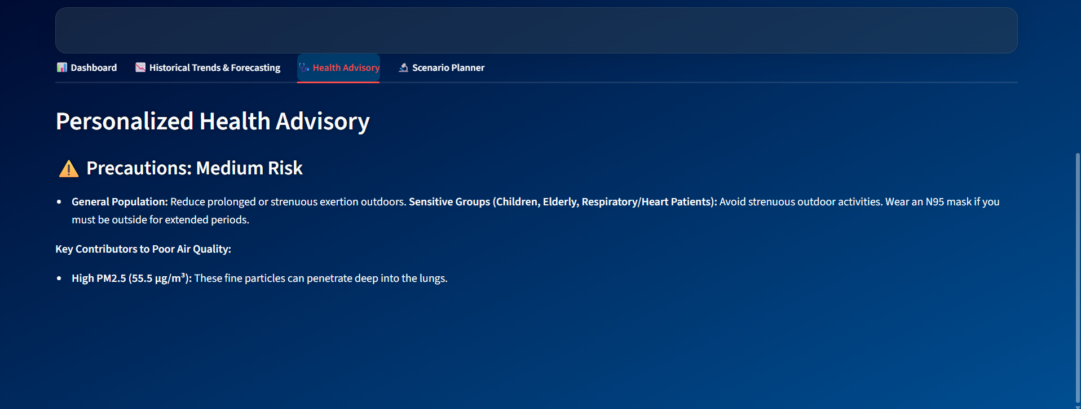
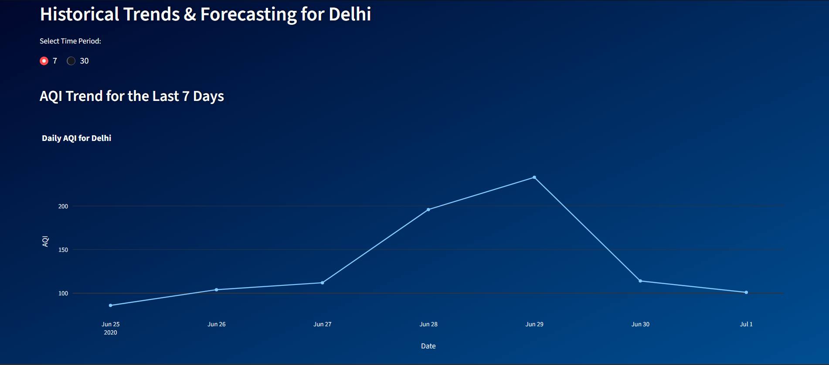
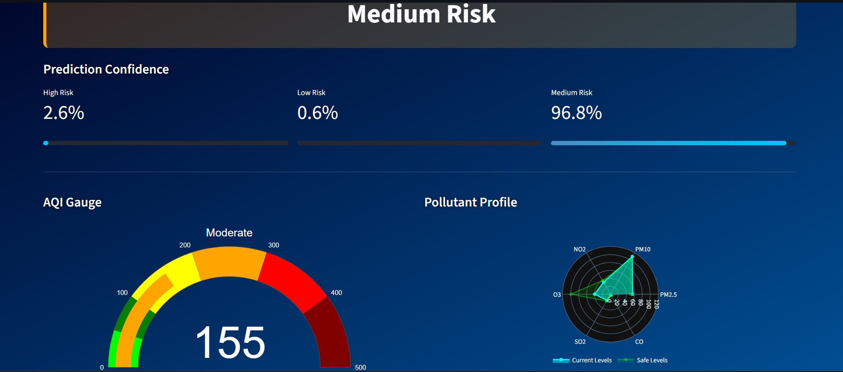
Screenshot of Output:

Slide 8
Conclusion:
High Model Accuracy: The final, tuned Random Forest model proved to be highly effective, achieving a 98% accuracy on the test dataset, confirming its reliability.
From Prediction to Insight: The project successfully evolved from a simple predictive tool into a comprehensive decision-support dashboard. By integrating interactive visualizations and "what-if" analysis, the application now provides deep, contextual insights, not just predictions.
A Practical Tool for Public Health: The Streamlit application effectively translates a complex machine learning model into a practical and accessible tool that empowers users to make data-driven decisions to protect their health.

