Slide 1

Social Media Toxic Content Detection & Moderation System
Leveraging Natural Language Processing and Machine Learning to automate content moderation, protect users, and foster healthier online communities at scale.
FINAL YEAR ENGINEERING PROJECT
NLP · MACHINE LEARNING · CONTENT SAFETY

Slide 2

The Moderation Crisis
Social media platforms generate billions of posts daily. Manual moderation cannot keep pace — harmful content spreads unchecked, causing real-world harm.
Delayed Detection
Manual review takes hours or days, allowing toxic content to spread virally before action is taken.
Human Bias
Inconsistent judgments across moderators lead to unfair enforcement and eroded trust.
Scalability Gap
Content volumes far exceed human capacity, leaving most harmful posts undetected.
Policy Inconsistency
Without automation, enforcing community guidelines uniformly across platforms is nearly impossible.

Slide 3


Project Objectives
This system automates toxic content detection and moderation using NLP and ML, delivering a secure, scalable platform for safe digital communities.
Detect
Flag & Filter
Identify hate speech, cyberbullying, threats, and offensive language in real time.
Automatically surface suspicious content and filter inappropriate material before it reaches users.
Alert & Report
Enforce Policy
Generate real-time alerts and comprehensive moderation reports for administrators.
Support consistent, bias-free enforcement of community guidelines across all content types.

Slide 4
Existing Systems vs. Proposed Solution
Traditional Moderation
Proposed NLP-Powered System
Manual review only — slow and error-prone
Keyword-based filters easily bypassed
No contextual understanding of language
High moderator burnout and inconsistency
Reactive rather than proactive enforcement
Real-time automated detection using ML models
Context-aware NLP with sentiment analysis
Multi-class classification of toxic content types
Centralized dashboard with analytics and alerts
Proactive, scalable, and consistently enforced

Slide 5
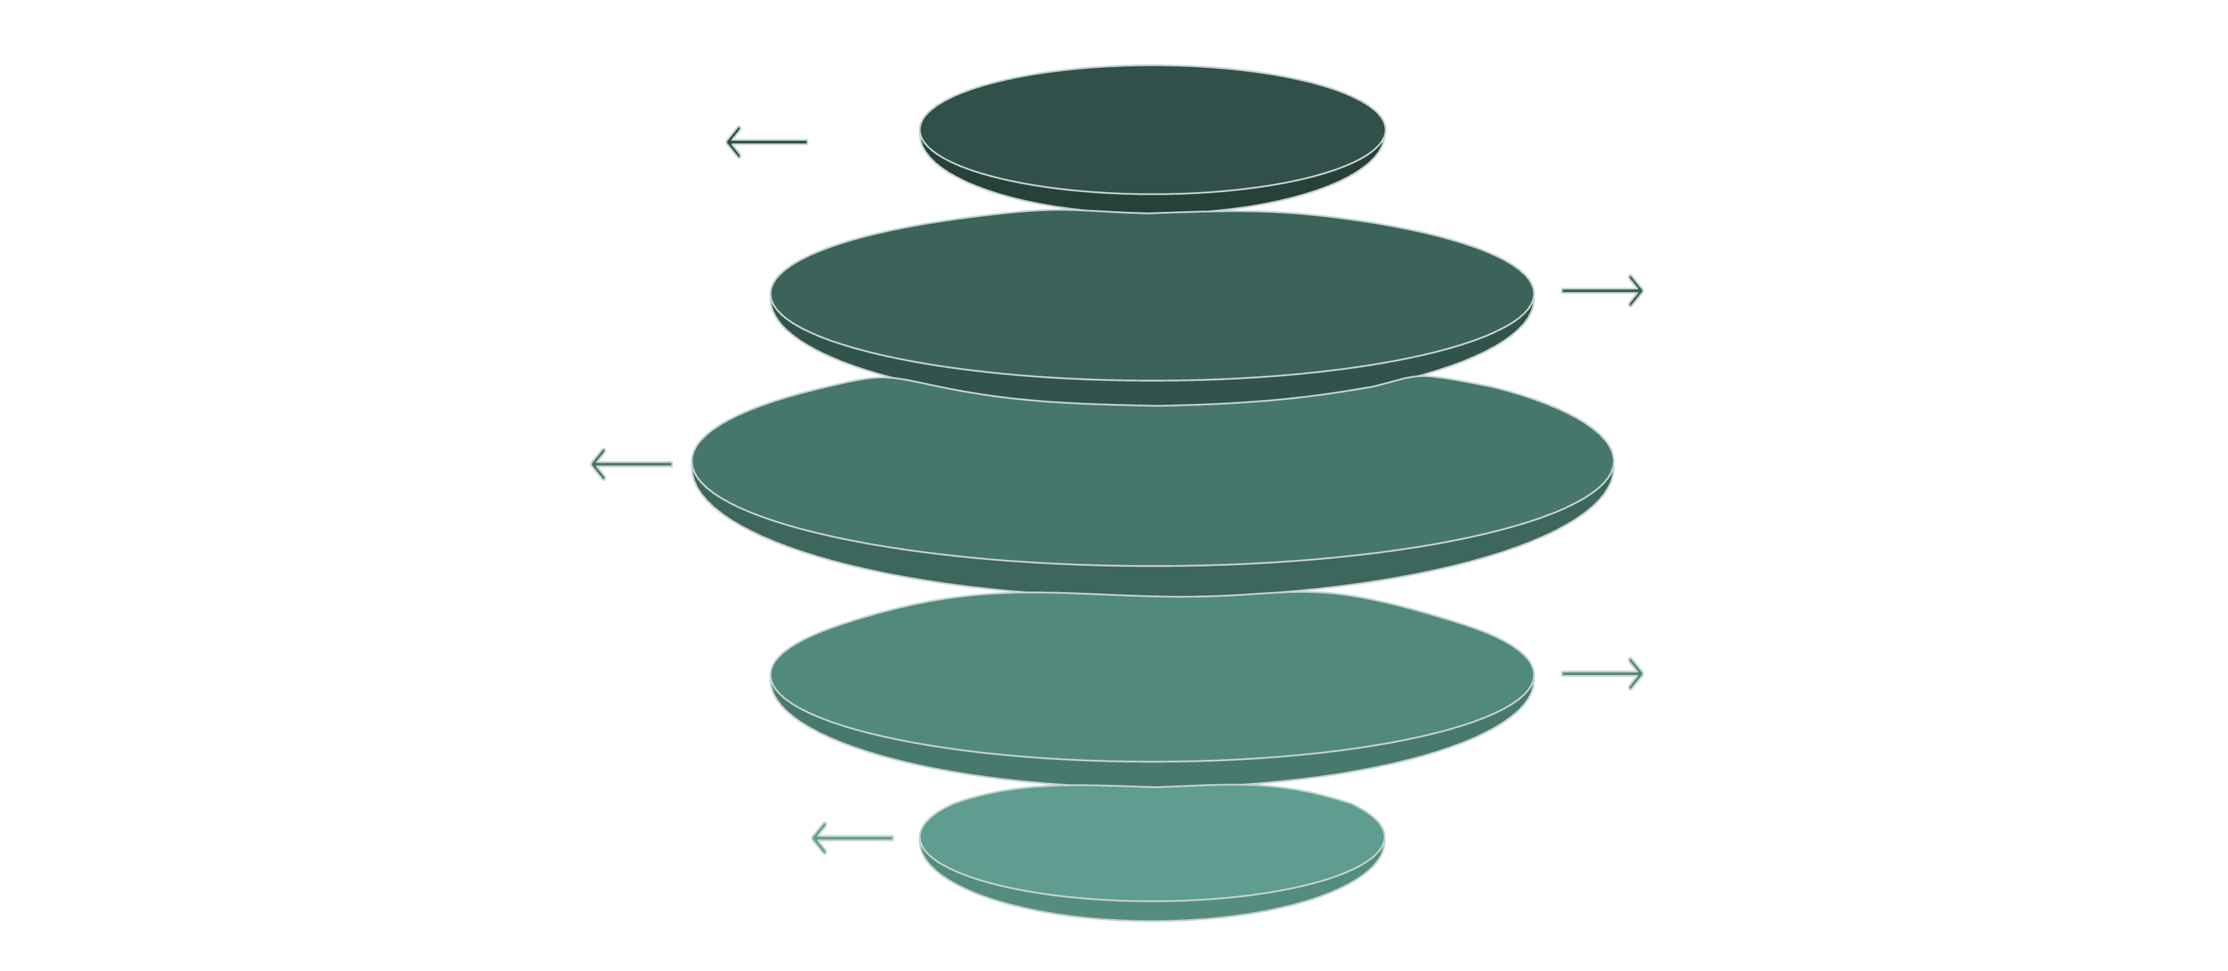
System Architecture
Content Sources
Social APIs, posts, messages
NLP Processing
Preprocessing, tokenization, features
ML Classification
Toxicity, sentiment, hate speech
Moderation Engine
Flagging, filtering, enforcement
Admin Dashboard
Alerts, reports, analytics
The system ingests content from multiple social media sources, processes text through an NLP pipeline, classifies toxicity using trained ML models, and delivers actionable moderation outputs to administrators via a centralized dashboard.

Slide 6
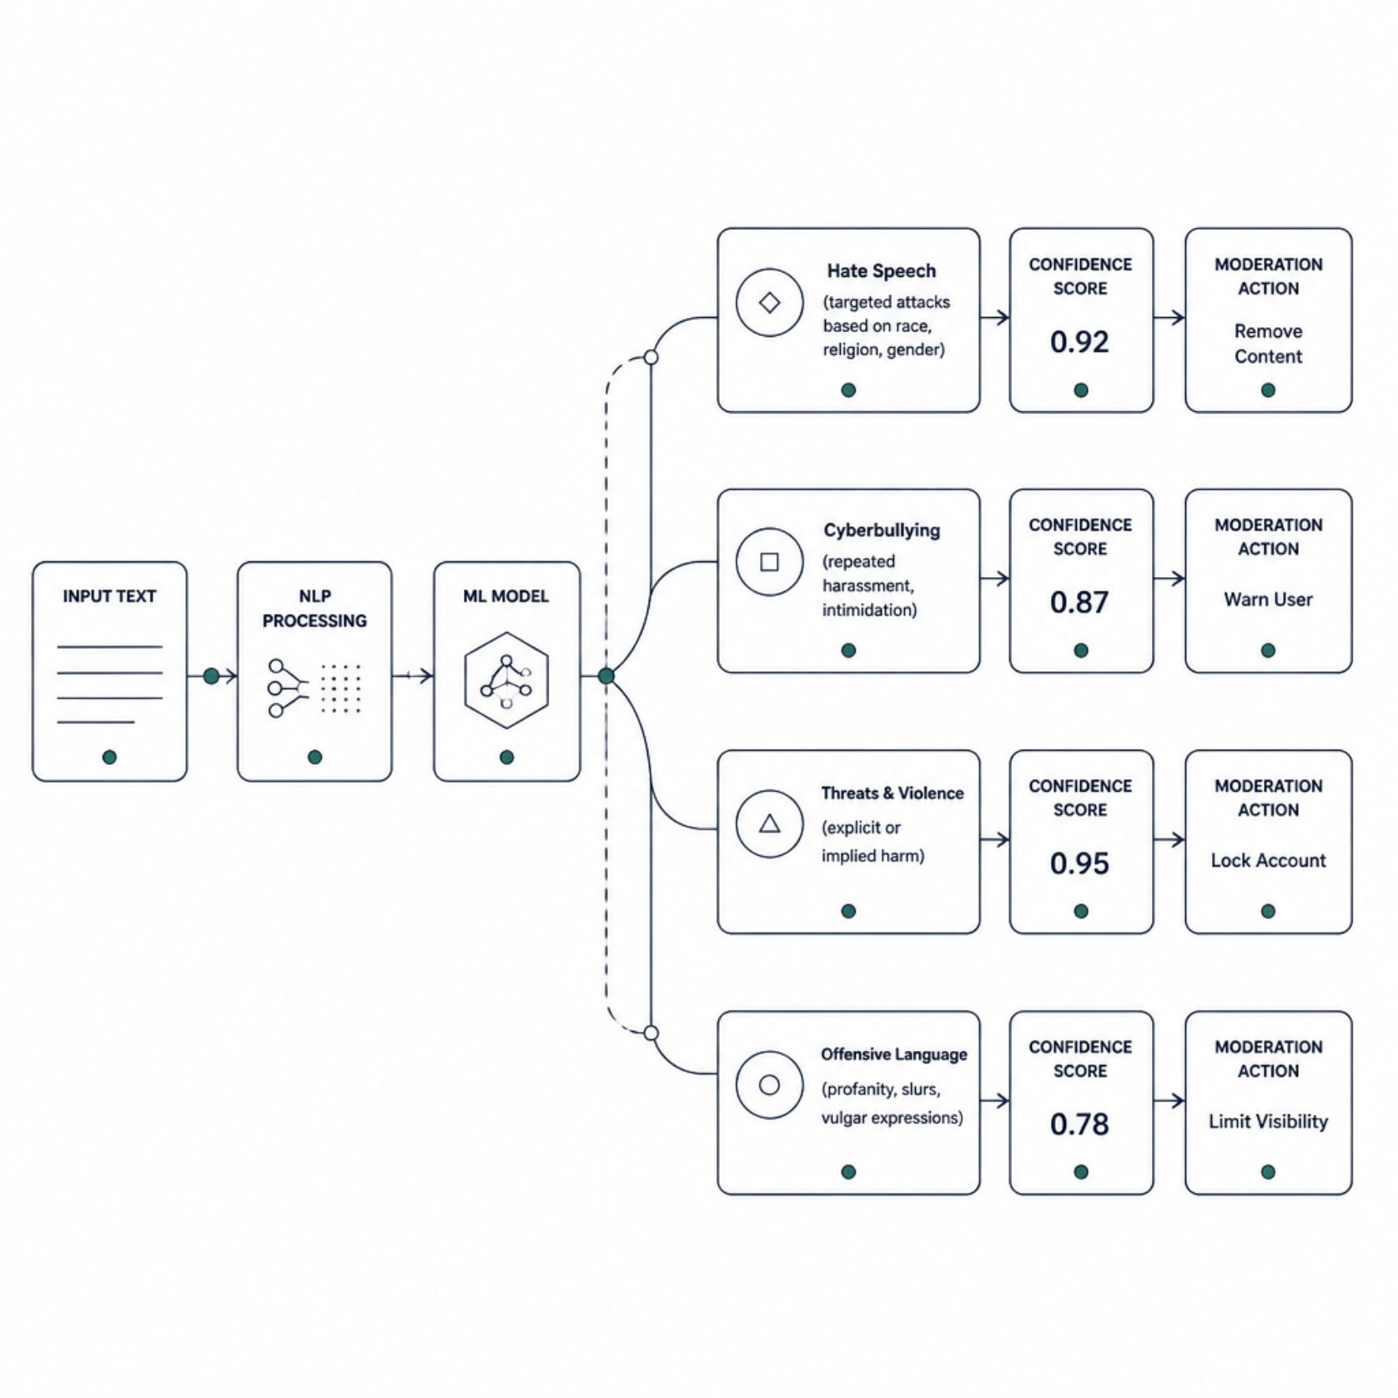
NLP Pipeline & ML Classification
How Detection Works
Raw text passes through a structured NLP pipeline before classification. Each stage refines understanding of context, sentiment, and intent.
01
02
Text Preprocessing
Feature Extraction
Tokenization, stop-word removal, lemmatization, and normalization.
TF-IDF, word embeddings (Word2Vec, GloVe), and n-gram features.
03
04
Sentiment Analysis
ML Classification
Detects emotional tone — negative sentiment often correlates with toxicity.
Models (SVM, LSTM, BERT) classify content into hate speech, bullying, threats, or safe.

Slide 7
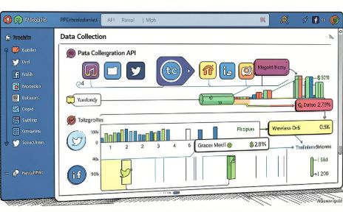
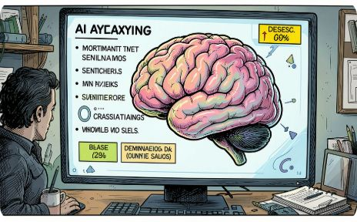
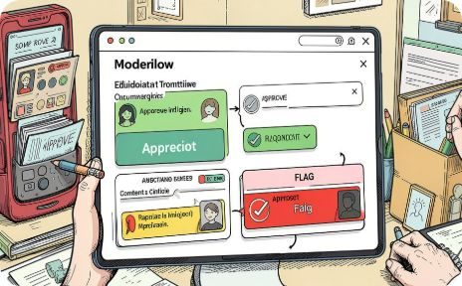

Core Modules & User Roles
Content Collection
Toxicity Classifier
Moderation Workflow
Dashboard & Alerts
APIs ingest posts, comments, and messages from multiple platforms in real time.
ML models detect hate speech, cyberbullying, threats, and offensive language with confidence scores.
Automated flagging, filtering, and human review queue with audit trails.
Real-time alerts, trend visualizations, user behavior analytics, and policy reports.
User Roles: Administrators manage policies and system settings. Moderators review flagged content and enforce guidelines. Analysts monitor trends and generate reports. End Users interact with the platform under automated content protection.

Slide 8
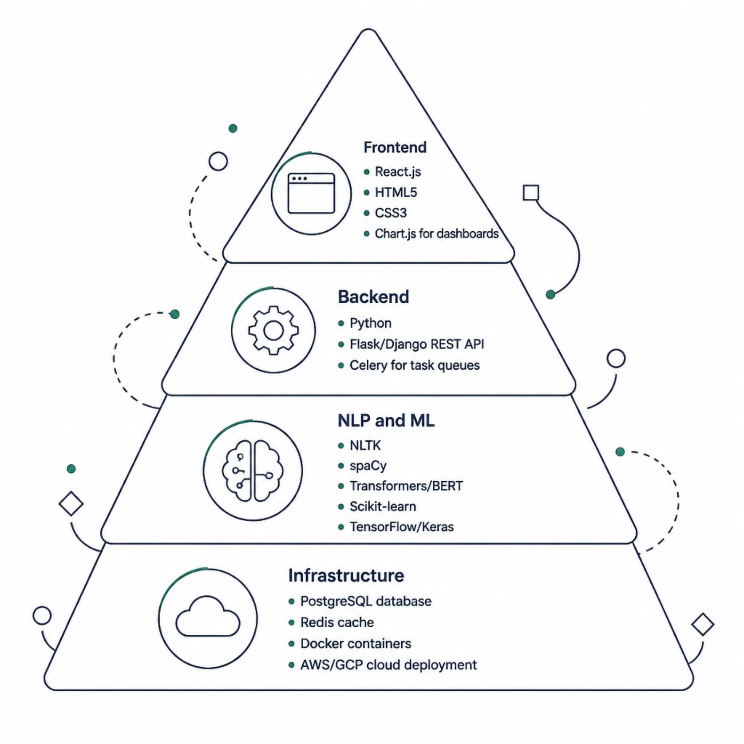
Technology Stack & Development
Development Approach
The system follows an Agile methodology with iterative sprints, enabling continuous integration of NLP models and user feedback. Security is embedded at every layer — data encryption, role-based access control, and GDPR-compliant data handling ensure user privacy and ethical AI deployment.
Security
Scalability
Reliability
End-to-end encryption, RBAC, audit logging
Cloud-native, containerized, auto-scaling
99.9% uptime target, failover redundancy

Slide 9

Outcomes, Benefits & Applications
90%+
Detection Accuracy
Target accuracy for toxic content classification using BERT-based models.
~60%
Moderator Workload Reduction
Estimated reduction in manual review through automated flagging and filtering.
24/7
Continuous Monitoring
Round-the-clock automated content surveillance across all connected platforms.
5+
Toxicity Categories
Hate speech, cyberbullying, threats, offensive language, and harassment detected.
Applications: University portals, social media platforms, online forums, gaming communities, and enterprise communication tools — anywhere user-generated content requires intelligent, scalable moderation.

Slide 10

Challenges, Future Roadmap & Conclusion
Current Challenges
Future Enhancements
Sarcasm, irony, and cultural context remain difficult for NLP models
Evolving slang and coded language require continuous retraining
Bias in training data can affect classification fairness
Balancing free speech with content safety is an ongoing ethical challenge
Multilingual support for global platforms
Image and video toxicity detection via computer vision
Federated learning for privacy-preserving model training
Explainable AI (XAI) for transparent moderation decisions
This system demonstrates how NLP and ML can transform content moderation — reducing moderator workload, improving detection accuracy, and creating safer, more inclusive digital communities at scale.

