Slide 1
BLIND AID SYSTEM
BY
RAJ JAISWAL

Slide 2
TOPICS
INTRODUCTION
CHARACTERISTICS
BLOCK DIAGRAM
ADVANTAGES AND DISADVANTAGES
HISTORY
SPECIFICATION
HARDWARE AND SOFTWARE

Slide 3
INTRODUCTION
According to survey conducted in 2009 by World Health Organization on disability, there are 269 million visually impaired and 45 million blind people worldwide
There are many traditional and advanced navigational aids are available for visually impaired and blind people.
Recent navigation systems use digital video cameras as vision sensor along with other multiple sensors.

Slide 4
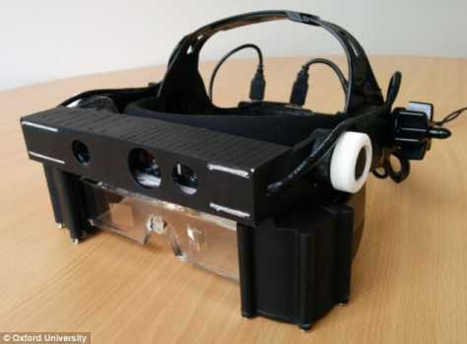
ASSISTED VISION SMART GLASS
It composed of sensors, GPS navigation, voice navigation, headphones, cameras,
Display of poor vision and some safety features

Slide 5
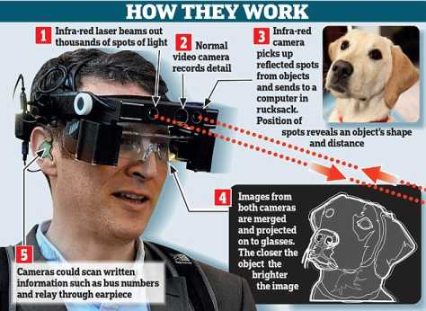
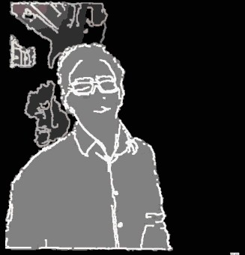

Slide 6
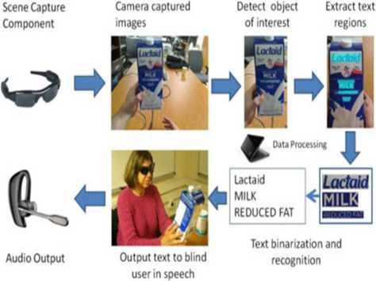

Slide 7
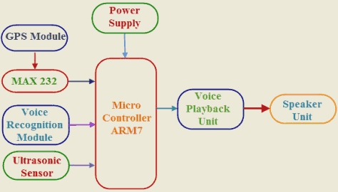
BLOCK DIAGRAM
The microcontroller used in this GPS and GSM based device with user input interface can be preferably ARM7TDMI based LPC2148 microcontroller
It composed of GPS, GSM and MAX232

Slide 8
.
ADVANTAGES
Accurate detection of obstacles in front, left and right direction
Less training time
Low power consumption
DISADVANTAGES
Due to presence of sensors and cameras makes it very costly device.
Any damage to device makes to high pay as it contains sophisticated parts

Slide 9
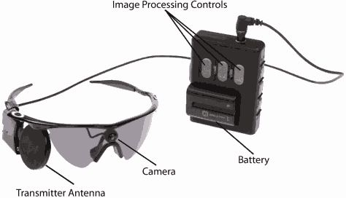
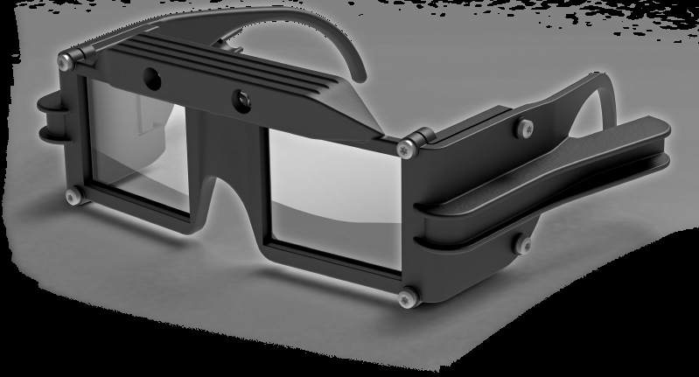
HISTORY

Slide 10
specification
32-bit ARM instruction set for maximum performance and flexibility
Unified bus interface, 32-bit data bus carries both instructions and data
Coprocessor interface

Slide 11
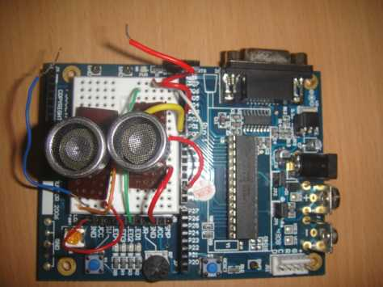

Slide 12
SOFTWARE DESIGN AND DEVELOPMENT
The software we use here is Keil μvision 4 IDE
(Integrated Development Environment) .This is a virtual
platform where we can execute code and check our desired results. For executing the code we have to choose the controller LPC 2148.

Slide 13
SUPPORT THEM STAND BY.
Thank you.

