Slide 1

Analysis on Retail Domain
Using Data Insights for the future
RAHUL GUPTA
DSC680 WEEK4
Jan 08, 2021

Slide 2
Why conduct retail data analysis?
Improve customer experience
Improve efficiency
Better Advertising
Forecast trends
The list goes on and on

Slide 3
What factors are important?
What data are we gathering?
Source of getting this information?
How are we Analysing it ?

Slide 4
Who are we perceiving?
Customers
Potential customers
Suppliers
Employees

Slide 5
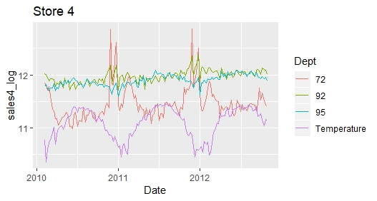
How the weather changes retail
Accessibility
Product need
Supply chain

Slide 6
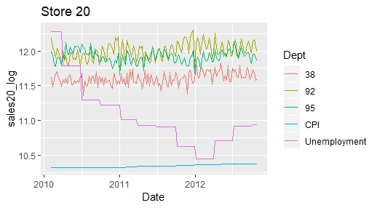
Unemployment’s effects on retail
Some effects
Based on need

Slide 7
Great, so what do we do with this?
Understand impacts
Plan accordingly
Prepare for the future

Slide 8
Any questions? Please email me at rgupta@my365.Bellevue.edu
https://github.com/rahulgupta271/DSC680_Project_1_Market_analytics_holiday_trend

