Slide 1

INDIAN INSTITUTE OF TECHNOLOGY, KHARAGPUR
Term project presentation of Information Retrieval
Topic : Offensive Query Detection on Tweets
Under the Supervision:
Dr. Somak Aditya
Dept. of Computer Science and Engineering
Mentored By :
Neeraj Saini
(Final Year PG Student)
Presented By:
Shubham Kumar Das (21CS60R28)
Rahul Mehta (21CS60R31)
Vamsikrishna Pilli (21CS60R51)
Sudharshan (21CS60R02)

Slide 2
OBJECTIVE
Proposing an approach that will automatically classifies the tweets in
three classes : Hateful , Offensive and Clean
Hateful
LEARNING
MODEL
Tweets
Offensive
INPUT
Clean
OUTPUT
Notes:
2

Slide 3
LITERATURE SURVEY
Research Papers-
https://arxiv.org/pdf/2010.12472.pdf
https://aclanthology.org/W18-5118.pdf
For RNN and LSTM –
http://colah.github.io/posts/2015-08-Understanding-LSTMs/
For CNN-
https://cs231n.github.io/convolutional-networks/
For attention mechanism –
http://www.adeveloperdiary.com/data-science/deep-learning/nlp/machine-translation-using-attention-with-pytorch/
For word embedding-
https://www.youtube.com/watch?v=pO_6Jk0QtKw&ab_channel=KrishNaik

Slide 4
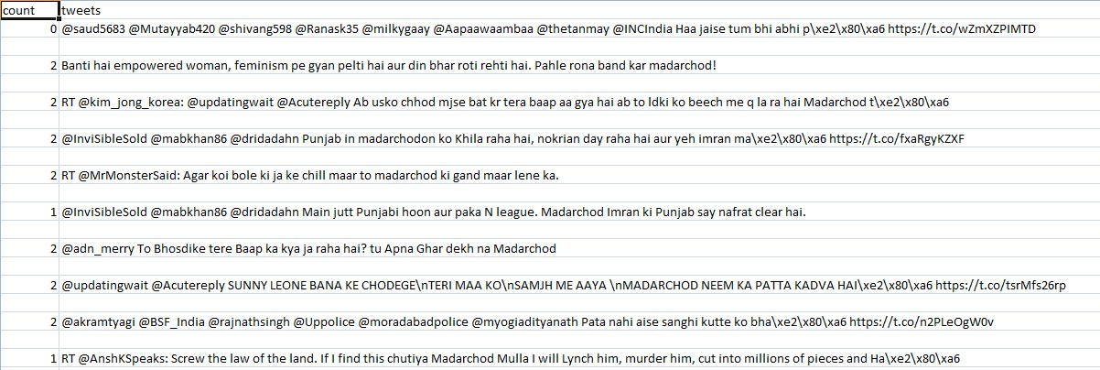
DATASET USED-
We use Hinglish Offensive Dataset that contains words spoken in Hindi (Indic) language but written in Roman script instead of the standard dev-nagari script.
0 : “Clean” 1 :” Offensive” 2 : “Hateful”

Slide 5
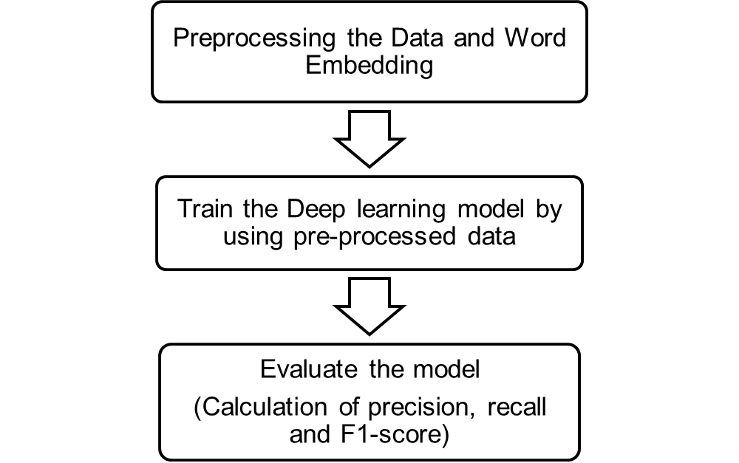
WORK FLOW

Slide 6
PREPROCESSING & WORD EMBEDDING
Remove punctuations, user-mentions (@) ,URLs, numbers (0-9).
Converting all tweets words into lowercase.
Remove all stop words.
Mapping from Hindi word to English with the help of “Hinglish_Profanity_List”.
Word to Vector representation is done by “GloVe”.
Website link for Hinglish_Profanity_List:
https://github.com/pmathur5k10/Hinglish-Offensive-Text-Classification/blob/master/Hinglish_Profanity_List.csv

Slide 7
LEARNING MODELS
Now we fed the vector representation of different words to our Learning Models. We mainly use following models for our classification-
Recurrent Neural Network (RNN)
Long Short Term Memory (LSTM)
Convolution Neural Network (CNN)
Combination of above.
We train these learning models with help of train data set.

Slide 8
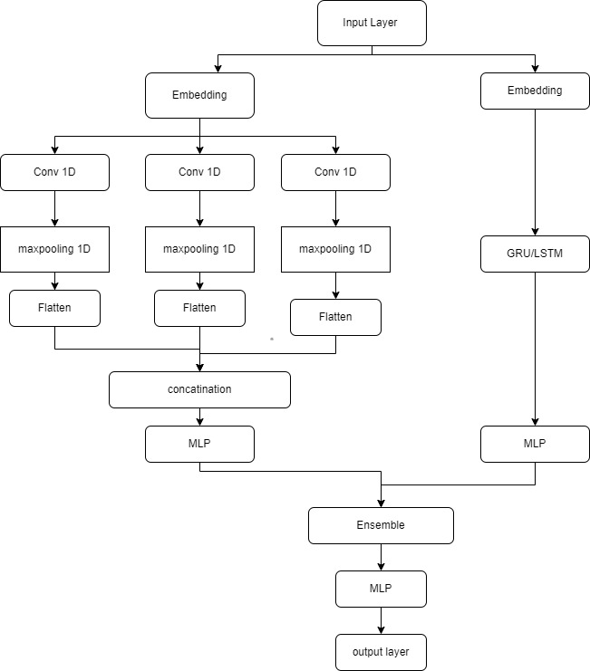
ARCHITECTURE OF CNN+LSTM
CNN –LSTM COMBINED ARCHITECTURE

Slide 9
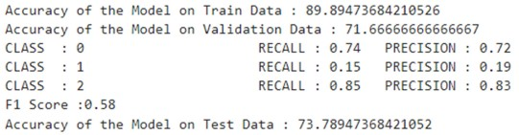
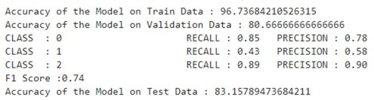
PERFORMANCE EVALUATION
LSTM Model
RNN Model

Slide 10
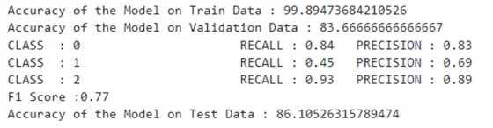
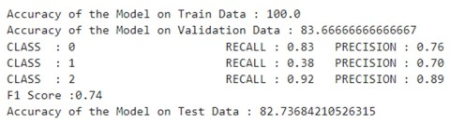
PERFORMANCE EVALUATION
CNN Model
RNN +CNN Model

Slide 11
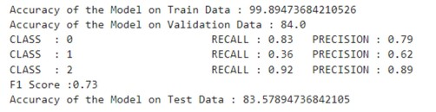
PERFORMANCE EVALUATION
LSTM+CNN Model

Slide 12
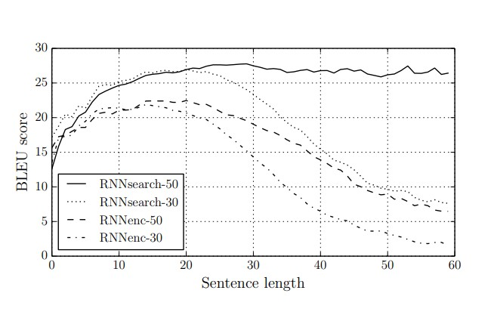
ATTENTION MECHANISM
Source:
https://arxiv.org/pdf/1409.0473.pdf

Slide 13
ADDING ATTENTION
e1
PREDICTION
LSTM 1
H1
SOFTMAX
e2
LSTM 2
H2
e3
LSTM 3
H3
LSTM 4
H4
e4
WORD EMBEDDING
LEARNING MODEL
ATTENTION
MECHANISM
LINEAR LAYER
CLASSIFICATION

Slide 14
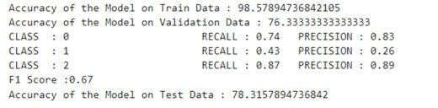
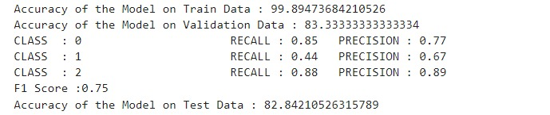
PERFORMANCE ON ATTENTION MECHANISM
LSTM with Attention
LSTM with Attention +CNN

Slide 15
FINAL OUTPUT
MODEL | TEST ACCURACY | F1 SCORE
LSTM Model | 73.78% | 0.58
RNN Model | 83.15% | 0.74
CNN Model | 86.11% | 0.77
RNN+CNN Model | 82.73% | 0.74
LSTM+CNN Model | 83.57% | 0.73
LSTM with Attention | 78.31% | 0.67
LSTM with Attention +CNN | 82.84% | 0.75

Slide 16
CONCLUSION
We considered multiclass labeling of offensive textual tweets in Hindienglish code switched language.
We propose the MIMCT model that uses multiple embeddings and secondary semantic features in a CNN-LSTM parallel channel architecture.

Slide 17
Future Work
We haven't focused on the kind of offensiveness and the target situation/person/purpose.
We can extend this model to multi-lingual setting.

Slide 18
THANK YOU

