Slide 1



Second International Conference on Advanced Computing and Systems
(AdComSys 2025)
26th – 27th June 2025
Organized by:
Department of Computer Science and Technology &
Computer Science and Information Technology
(CST & CSIT)
University of Engineering and Management, Kolkata
Paper ID: 20
Paper Title: Nucleus Instance Segmentation and Metastatic Tissue Identification Using Machine Learning
Author Names: Rahul Mehta, Ankita Chatterjee, Jayanta Mukherjee, & Sudipta Ghosh
Presented By: Rahul Mehta

Slide 2
CONTENTS
Introduction & Problem Statement
Technical Background
Model Architecture
Results
Conclusion
References

Slide 3
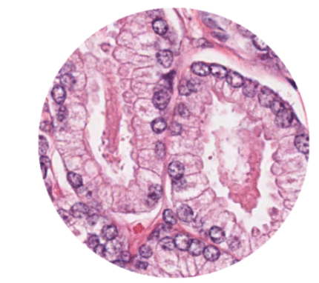
INTRODUCTION & PROBLEM STATEMENT
Images contains cluster of nuclei in which tumor is present.
Extraction of nuclei increase the potential of diagnosis.
Manual Assessments suffer from indistinct guidable observability.
Correctly segmentation of the nucleus present in the cluster will downstream analysis of tumor .
Inherent Symmetrical property.
Histopathological Image
Image Source: GitHub - basveeling/pcam: The PatchCamelyon (PCam) deep learning classification benchmark.

Slide 4
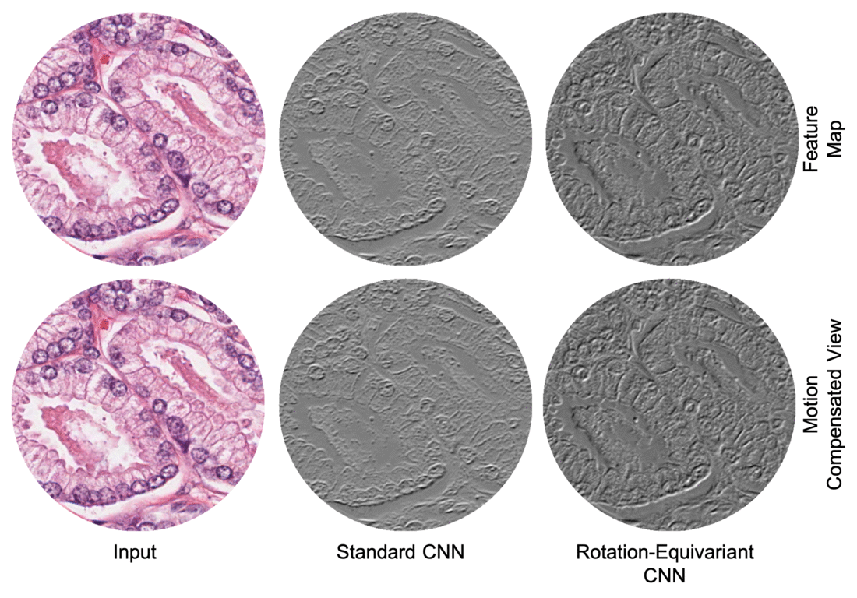

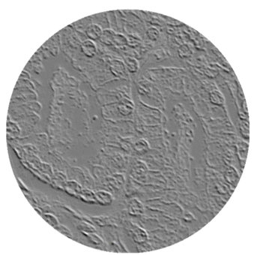
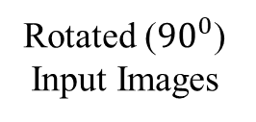
THEORETICAL BACKGROUND
Group Equivariant Convolution
Output Feature Maps
Rotationally Variant
CNN
Rotated (${90}^{0}$) Input Images
G-CNN
P4ConvZ2 layer
P4ConvP4 layer
Rotationally
Invariant
Group Equivariant Convolution layer

Slide 5
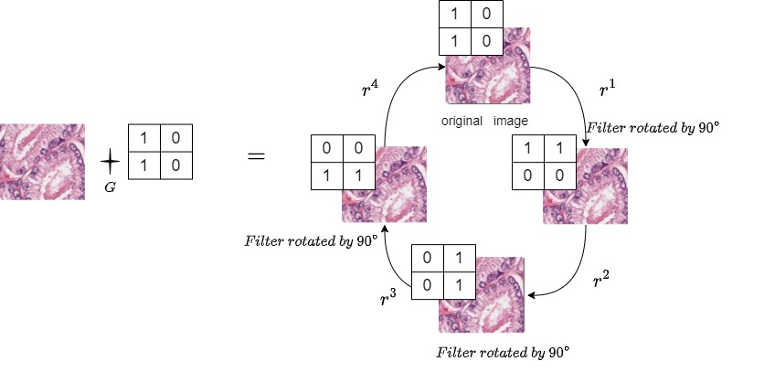
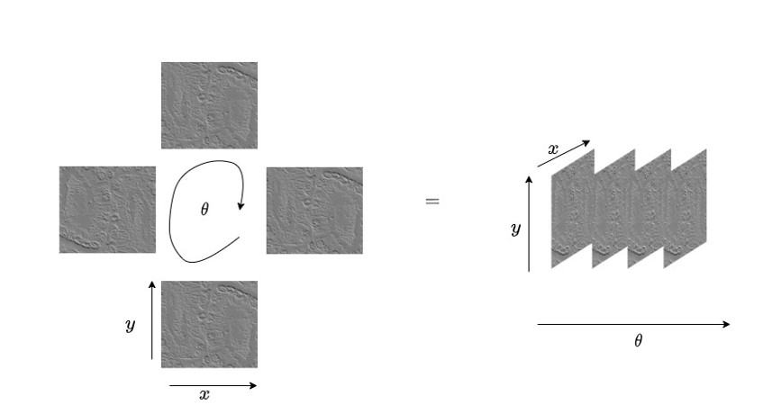
P4convZ2 Layer
THEORETICAL BACKGROUND
Creating structure of feature maps for next layer.
Rotation of filters instead image to reduce the computation overhead.
Addition of Extra Dimensionality.
Filter
Input Image
Located in different space
Convolution operation on group
Feature Maps
Second International Conference on Advanced Computing and Systems (AdComSys 2025)

Slide 6
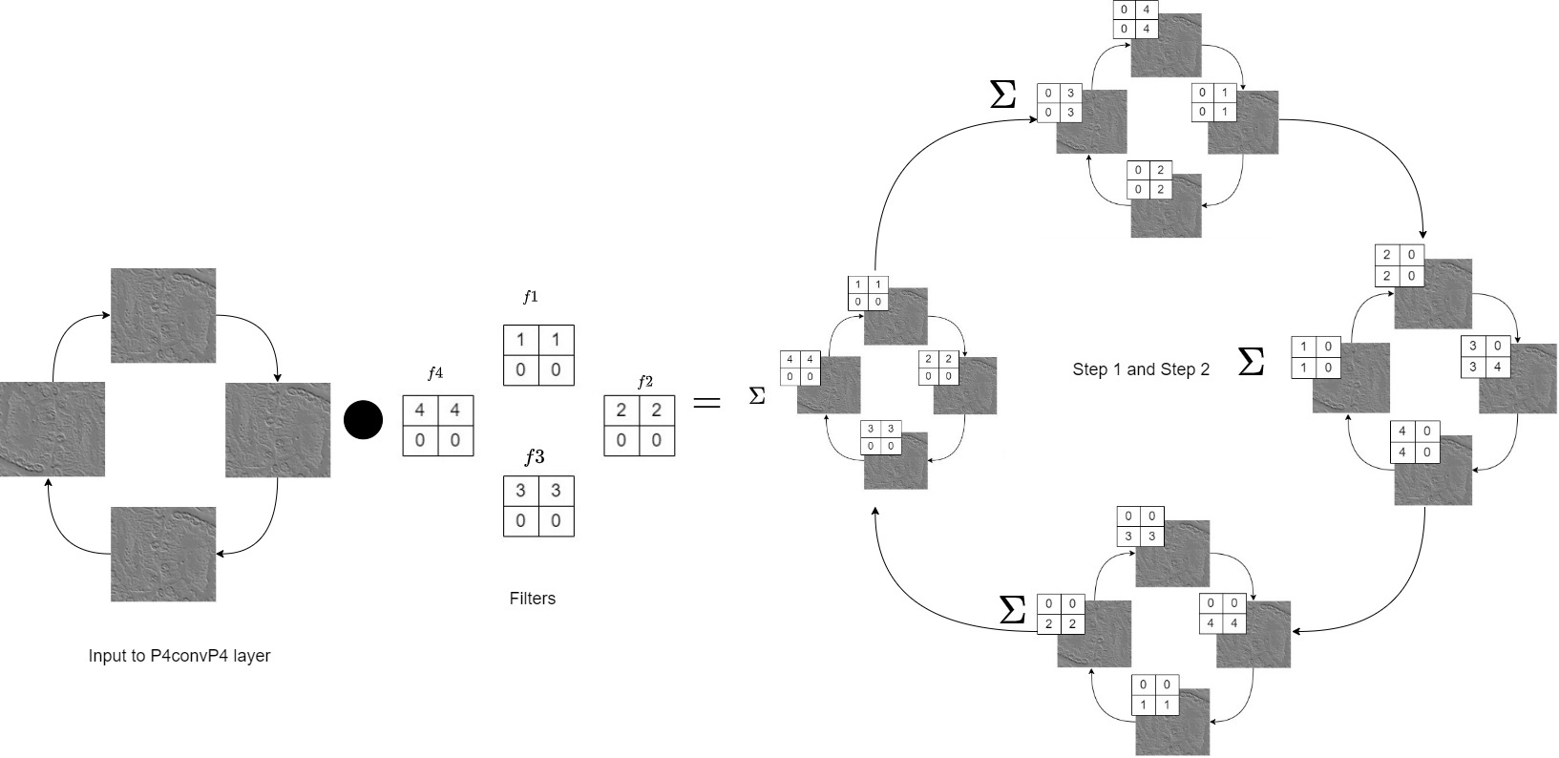
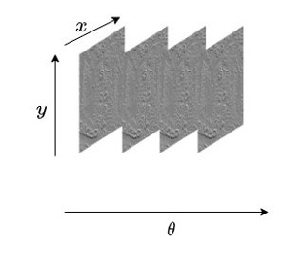

P4convP4 layer
THEORETICAL BACKGROUND
$$=$$
Output Feature Map
Input
Permutation step and Dot product with identical structures
Second International Conference on Advanced Computing and Systems (AdComSys 2025)

Slide 7
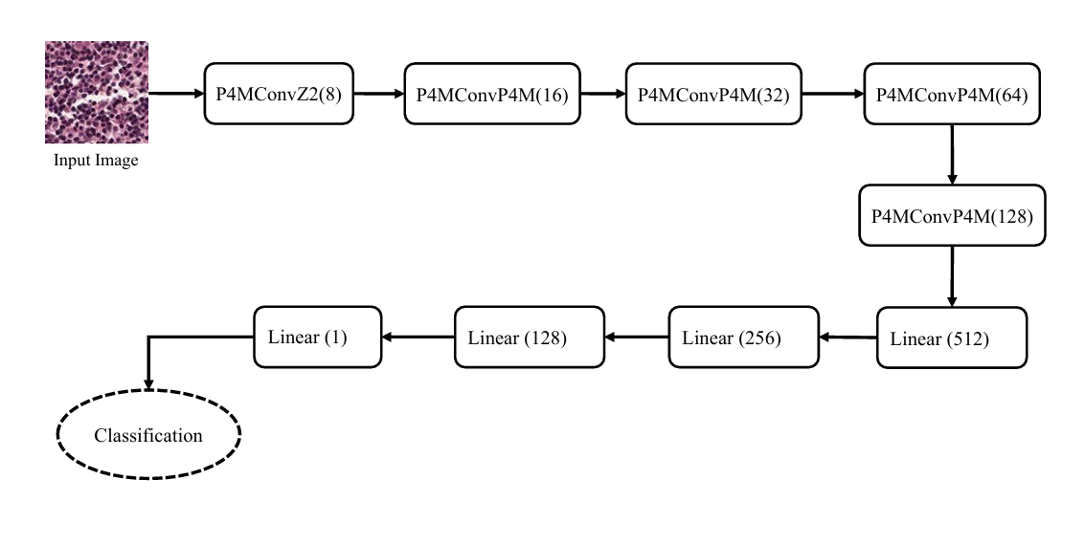
MODEL ARCHITECTURE
FOR CLASSIFICATION TASK

Slide 8
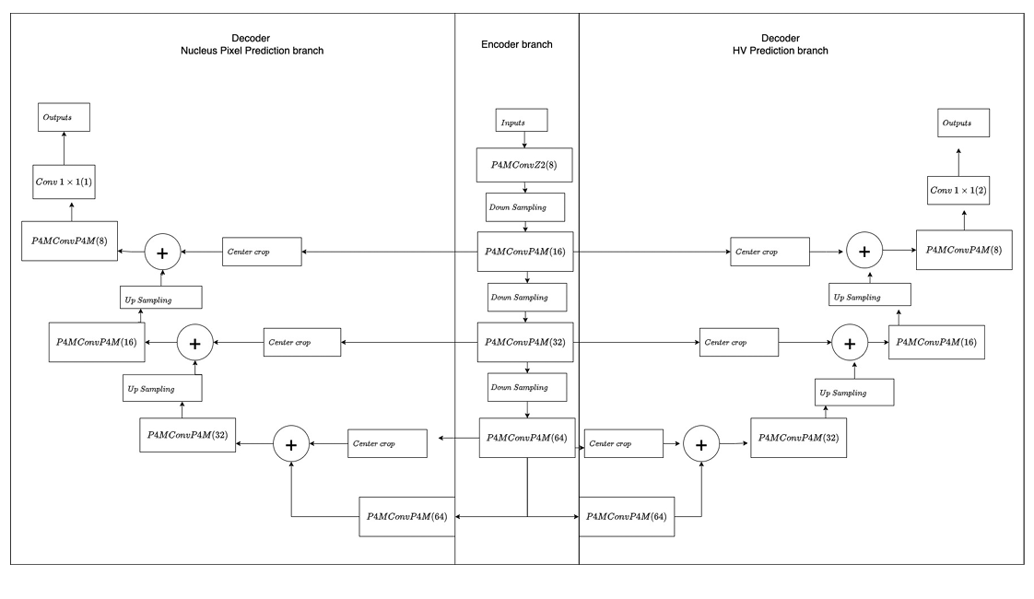
MODEL ARCHITECTURE
FOR SEGMENTATION TASK

Slide 9
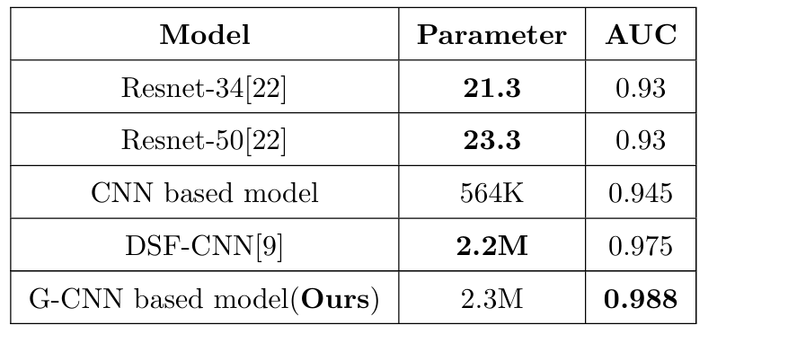
RESULTS
Classification results on the PCAM dataset with a similar parameter budget.

Slide 10
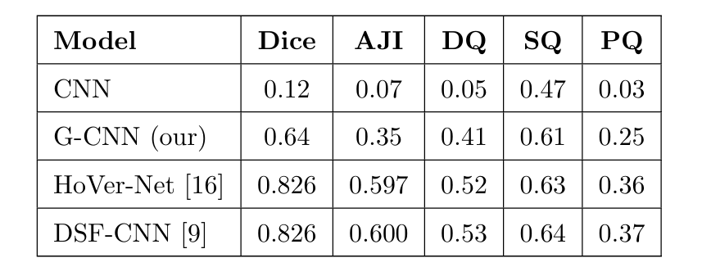
RESULTS
Nuclear Segmentation Results on the Kumar et al. Dataset.

Slide 11
CONCLUSIONS
Group equivariant convolutions aid in medical image tasks like nucleus segmentation and feature extraction.
Common methods (e.g., HoverNet) rely on dense, pre-trained models due to limited data.
Alternative: ResNet-style architecture with group equivariant layers.
Advantages:
  Efficient weight-sharing
  No pre-training needed
  Ideal for small datasets
A compact, adaptable solution for segmentation challenges.

Slide 12
REFERENCES
[1] Cancer Statistics, 2020: Report From National Cancer Registry Programme, India | JCO Global Oncology (ascopubs.org)
[2] Rotation Equivariant Convolutional Neural Network | by Anuj Ahuja | Intel Student Ambassadors | Medium
[3]Geometric Deep Learning: Group Equivariant Convolutional Networks | by Casper van Engelenburg | The Startup | Medium
[4] Thesis for modified convolution in all respects (uva.nl)
[5] Hover-net paper
[6] S. Graham, D. Epstein and N. Rajpoot, "Dense Steerable Filter CNNs for Exploiting Rotational Symmetry in Histology Images," in IEEE Transactions on Medical Imaging, vol. 39, no. 12, pp. 4124-4136, Dec. 2020, doi: 10.1109/TMI.2020.3013246.
Second International Conference on Advanced Computing and Systems (AdComSys 2025)

Slide 13
THANK YOU

