Slide 1
Case study Represented By : Rahul Mehta
Introduction
Description of Dataset:
"toughdata/quora-question-answer-dataset"
Extracted from Quora for human-like interactions
Contains 56k examples for training LLMs
Includes human response answers to questions
Training Set:80% of data (44k examples)
Validation Set:20% of data (11k examples)
Evaluating metrics like BLEU and ROUGE scores
Data Cleaning Steps:
Removal of duplicate records
Removal of URLs and linked text
Removal of emoji characters
Removal of bullet point characters
Removal of extra spaces

Slide 2
Literature Survey
Text-to-Text Generation
Clustered Approach:
Solves multitasking problems in text-to-text generation
Uses tokens to specify the training segment:
<summarise>
<QA>
<classification>
Benefits:
Allows different tasks to be trained simultaneously
Prevents interference between clusters during fine-tuning
Reference: 20-074.pdf (jmlr.org)
Measuring How Models Mimic Human Falsehoods
Usefulness for TruthfulQA Benchmark:
Evaluates the truthfulness of language models before deployment in critical applications
Development of Additional Training Techniques:
Emphasizes factual accuracy
Reduces the generation of falsehoods
Continuous Monitoring and Refinement:
Ensures models maintain high standards of truthfulness as they evolve
Reference: 20-074.pdf (jmlr.org)

Slide 3
Methodology
Use of Multitasking Pretrained Models:
Employ models like T5 to handle a wide range of queries and questions
Freezing Model Parameters:
Freeze certain parameters while fine-tuning to preserve contextual information
Warmup Steps:
Implement warmup steps to gradually adjust learning rates and stabilize training
Optimizer Configuration:
Configure optimizers for specific weights, e.g., ["bias", "LayerNorm.weight"], tailored to fine-tuning tasks

Slide 4
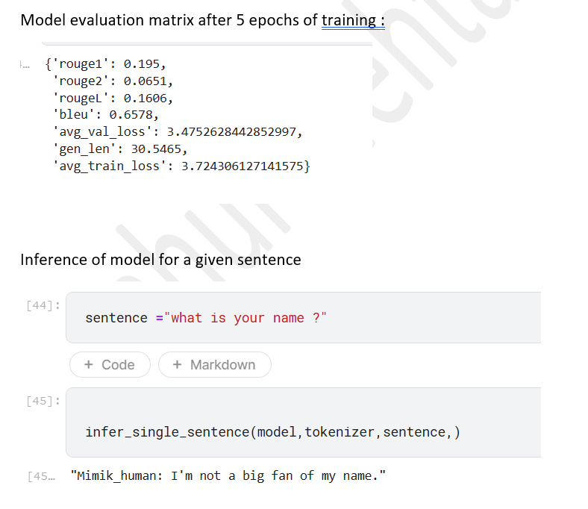
Model Results

Slide 5
Inclusion of Falsehood Measurement Systems: Implement systems to assess and quantify models' falsehoods mimicking human behavior Use of Combined Architecture Models: Integrate models like T5 and BERT to leverage their combined strengths Fine-Tuning Complex Models: Focus on fine-tuning high-parameter models to improve performance and accuracy
Conclusion/Insights and Recommendations

