Slide 1
Statistical Analysis of Major Air Pollutant Elements
Prepared By
Miao You
Sukanyaraj Govindaraaj
Rahul Bhosale

Slide 2
Project Overview
The purpose of this project is to perform a statistical analysis on US Air pollution and how the air pollutants trended over the last 15 years in various US states and counties.
Perform exploratory analysis on determine the overall trend of air pollutants emission over a period of 15 years.
ANOVA tests to determine
How the emission of certain air pollutant varies for different state/city.
How the emission of certain air pollutant varies for different season and identify any seasonality patterns.
Regression Models to forecast /predict each air pollutants Air Quality Index.

Slide 3
Data
Dataset is taken from U.S. EPA site which consists of pollutant levels collected from multiple weather stations across USA.
The dataset contains City locations, Pollutant index levels and statistics as given below.
Each pollutant has 5 specific columns, For instance, for NO2:
NO2 Units : The units measured for NO2.
NO2 Mean : The arithmetic mean of concentration of NO2 within a given day.
NO2 AQI : The calculated air quality index of NO2 within a given day.
NO2 1st Max Value : The maximum value obtained for NO2 concentration in a given day
NO2 1st Max Hour : The hour when the maximum NO2 concentration was recorded in a given day.

Slide 4
Preliminary Analysis
Data Cleansing
Eliminated effects of duplicate rows for each date by aggregating and taking mean over the date variable.
Removed rows with N/A values using na.omit().
Studied the structure of data using summary statistics to select the relevant data for the analysis.
Selected only specific column values for relevant to the analysis such as states, Date Local, Pollutant AQI’s and Pollutant Means.
Exploratory Analysis
Performed exploratory analysis on the data using ggplots to determine the variations/trends in data elements grouped by date and State variables.

Slide 5
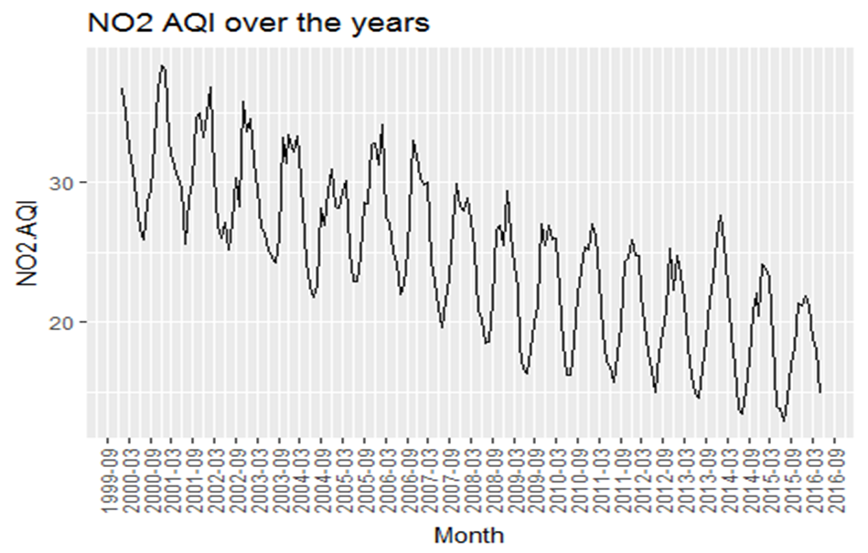
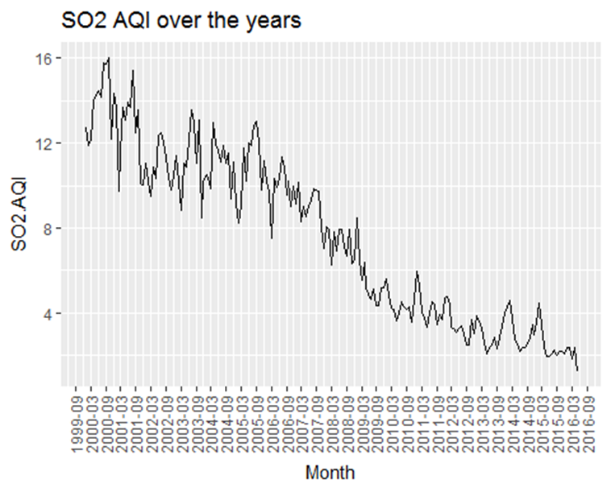
Data Exploration - Visualization
For exploratory analysis of the data, plotted the 4 pollutants AQI mean over the period of 15 years.
The below visualizations indicate that AQI index of NO2, SO2 and Co have decreased over the years from 1999-2016 but the level of O3 indicates only minimum variation (decrease).

Slide 6
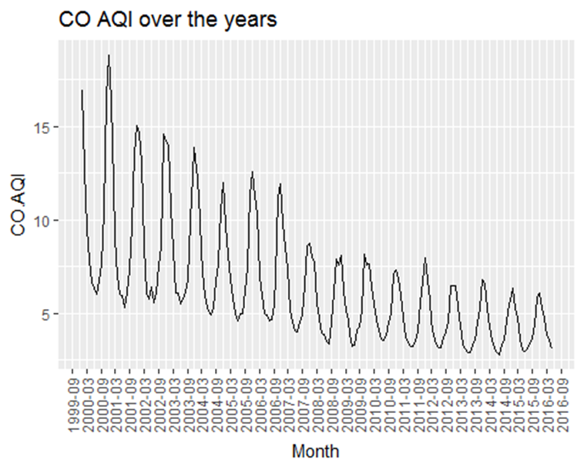
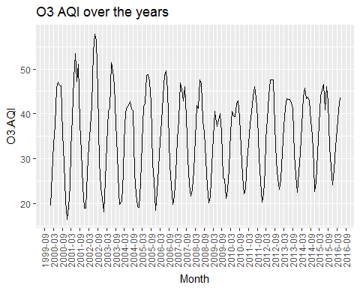
Data Exploration - Visualization

Slide 7
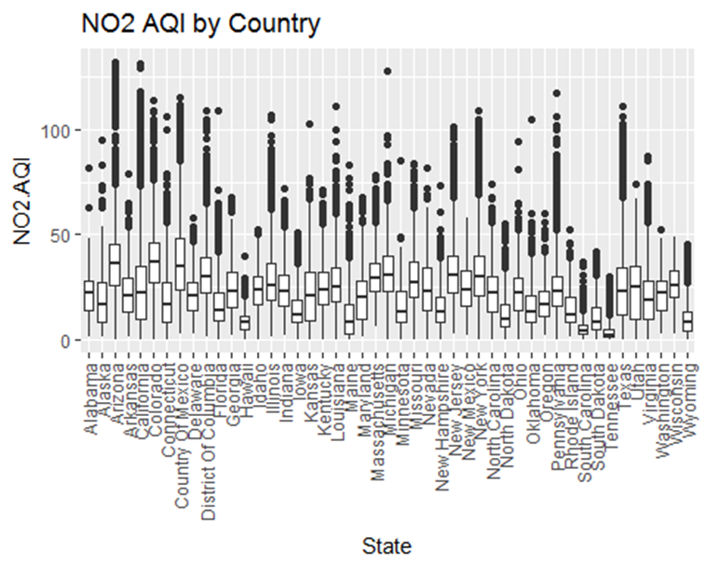
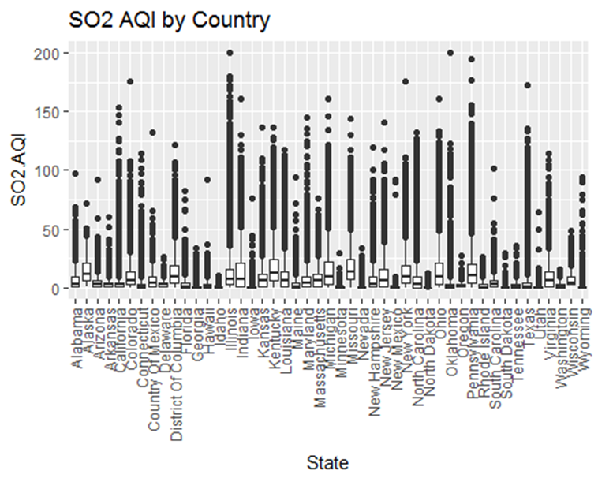
Data Exploration- Visualization
Plots of the pollutants AQI variation by states.
The boxplots shows larger values for NO2 and O3. While So2 has less AQI values for most of the states.
The plots also indicates greater number of outliers present in the data.

Slide 8
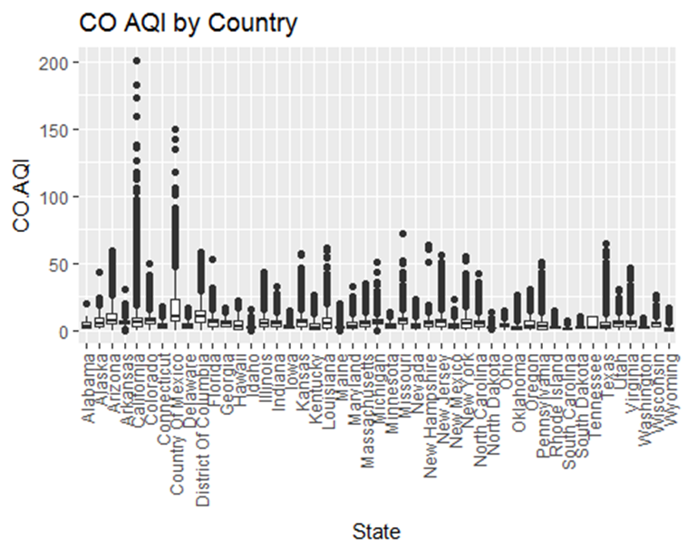
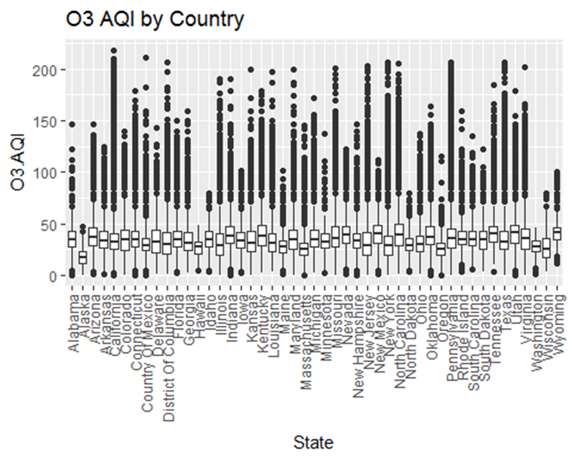
Data Exploration- Visualization

Slide 9
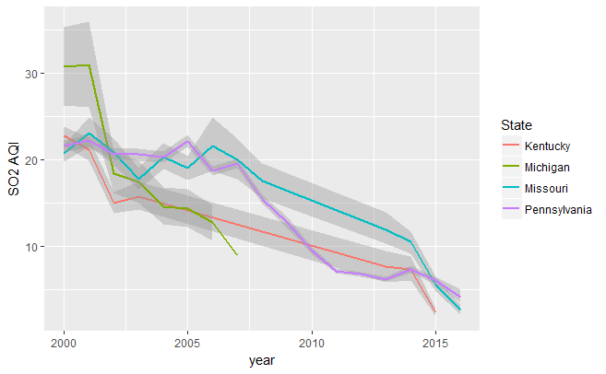
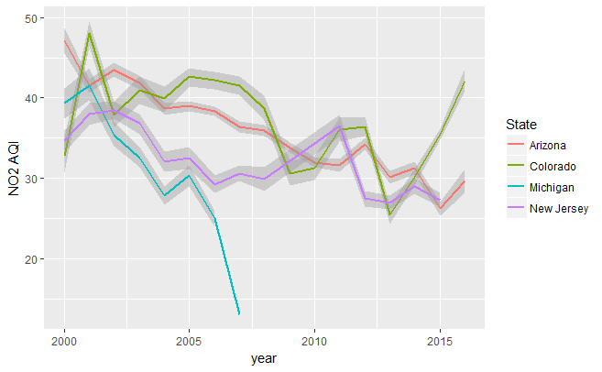
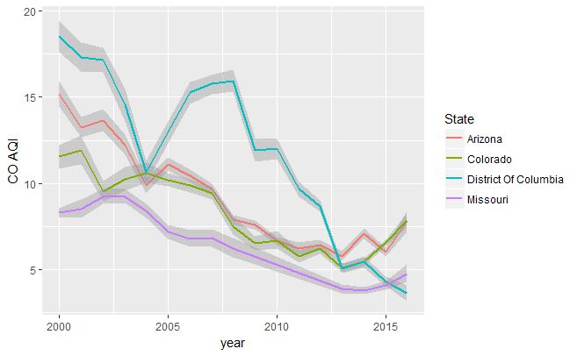
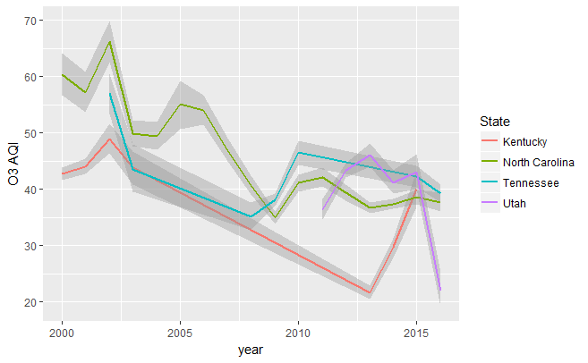
Plot of Top 4 States with MAX Mean AQIs for each Pollutant Type
Plot all 4 AQIs with the top 4 states that have the maximum mean AQI value over time. Took the monthly mean values as the representative values.

Slide 10
ANOVA –Determine Pollutant Emission Variation by States Location
Determine how the emission of Pollutants vary by geographical location of states – i.e. East Coast and West Coast.
Grouped states and selected top 4 states with the maximum mean AQI for the each Pollutant types.
Selected two states on the West cost and two on the east coast from the top 4.
Performed Fligner –test to check for differences in variances of Pollutants AQI Vs state location (East or West)
Performed Single Factor ANOVA to determine if there is difference in the man AQI’s for each pollutants type based on location.

Slide 11
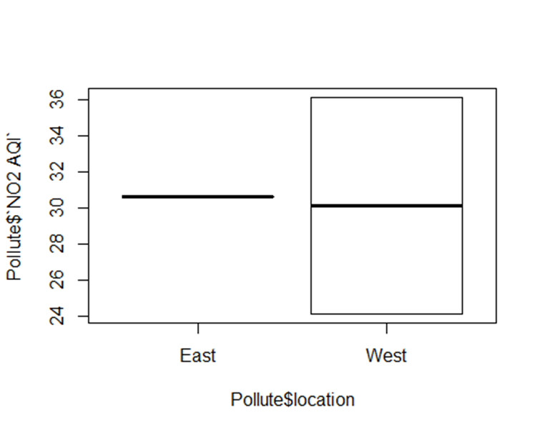
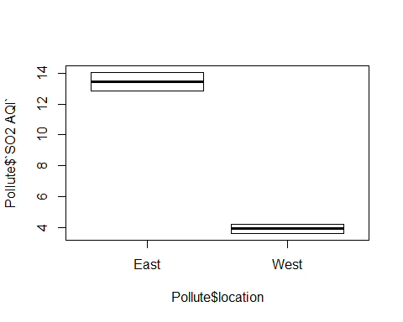
ANOVA –Determine Pollutant Emission Variation by States Location
The p-values > 0.05 in each of Fligner test for different pollutant types indicating homogeneity of Variances.

Slide 12
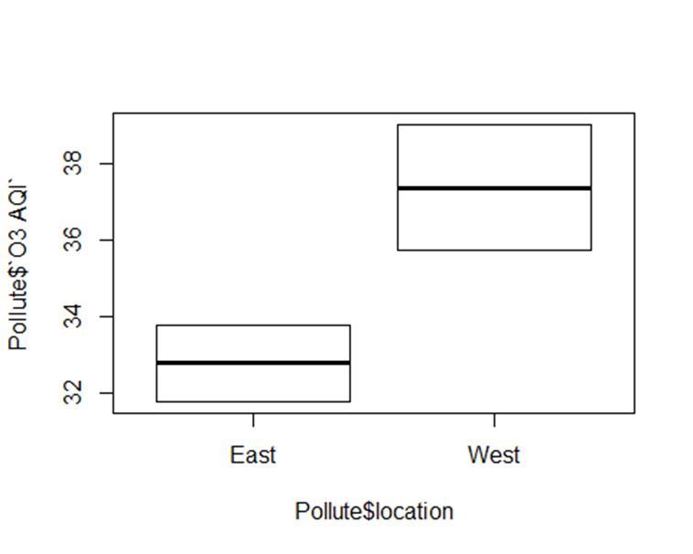
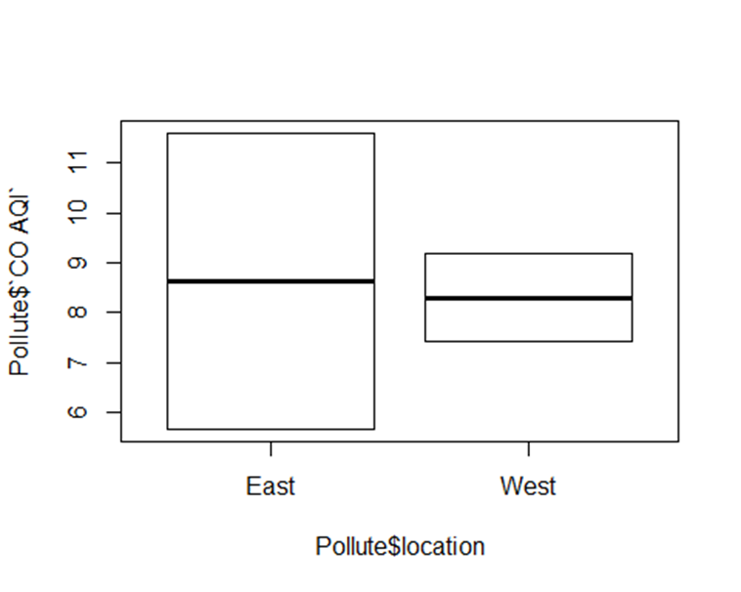
ANOVA –Determine Pollutant Emission Variation by Geographical Location

Slide 13
ANOVA –Determine Pollutant Emission Variation by States Location
The ANOVA on NO2, O3 and CO AQI have no significant p-vale indicating that there is no difference in the means.
The ANOVA on SO2 AQI indicates a significant difference in the means.
Thus the geographical location has an impact only on the emission of SO2.

Slide 14
Results

Slide 15
References
US EPA [2016], US Pollution Data, Reference taken from <Kaggle:https://www.kaggle.com/sogun3/uspollution/feed>

