Slide 1

27 May – 15 June

Slide 2
SESSION TOPIC: Farmer Empowerment
TravelClick Team - Alpha
Boby Yadav
Hakimuddin Noor
Kiran Darekar
Rahul Handay
Shantanu Nanwatkar
Farmer Empowerment
sashakt kisaan, safal kisaan
Date: 15 Jun 2019

Slide 3
Problem with existing system
Farmers yielding goes through chain of brokers and vendors before it gets to customer
Each layer add transportation cost and commission
Gives more control to brokers which leads to inflation
Wastage of crops in vegetable market/Mandi
Farmer
Broker 1
Broker 2
Vegetable Market
Vendors
Customer
Solution - what we are Proposing
Farmers can directly sell to customers
Empowering farmer by giving control in their hands
Farmer gets best price
Customer also gets vegetables/fruits at less price
Farmer
Customer

Slide 4
How its different from existing online vendors
Vendor’s App
Safal Kisaan App
Cost will be high based on commission amount
This platform is an online broker which adds cost based on demand
Can lead to cost inflation if products are stored
Cost will be lower as no commission added
No broker – direct supply from farmer
No direct impact on cost, as products are supplied on regular basis

Slide 5
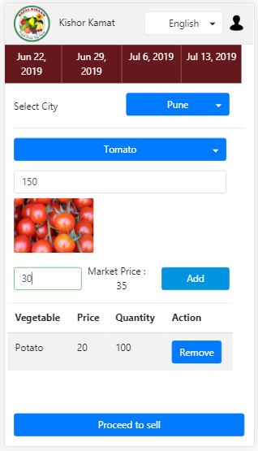
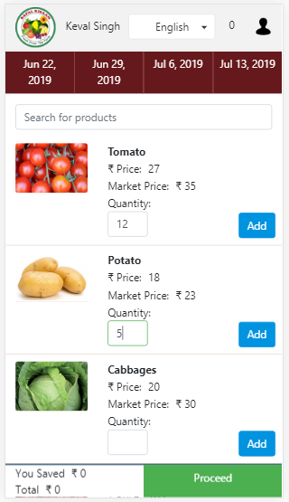
Screenshot Reference
Farmer Interface
User Interface

Slide 6
Challenges and solution
App usage - It might be difficult for farmers to use this app
Will be integrating e-learning videos in government portal (e-Kisaan) to educate farmer
Transportation – Managing request and shipment
Will be taking help from NGOs and CSR groups to help farmer at initial stage
Government laws
At the time of registration we will provide assistance to farmers to go through all clause and follow guide lines

Slide 7
Features in Alpha release
Grouping at both ends
Will provide farmer grouping feature to manage order and its shipment more effectively within a village
Giving bulk order option to customer group for better price
Live tracking
Allow both farmer and user to track their consignment and order resp.
Feedback and Rating
To help customer choose their option, will introduce feedback and rating mechanism
Business Intelligence
Based on previous records of order/consumption, we will suggest farmers to plan different products
Will pull weather reports to help plan for their cropping

Slide 8
Thank You

