Slide 1
Convolutional neural networks
Cnn architecture drawing
Basic cnn architecture theory
Convolutional layers
Strides and padding
Relu
Pooling layers
Fully connected layers
Usage and applications
Python libraries
syntax

Slide 2

FULL CONVOLUTIONAL NEURAL NETWORK ARCHITECTURE

Slide 3
Basic theory
CNN image classifications takes an input image, process it and classify it under certain categories (Eg., Dog, Cat, Tiger, Lion). Computers sees an input image as array of pixels and it depends on the image resolution. Based on the image resolution, it will see h x w x d( h = Height, w = Width, d = Dimension)
Technically, deep learning CNN models to train and test, each input image will pass it through a series of convolution layers with filters (Kernals), Pooling, fully connected layers (FC) and apply Softmax function to classify an object with probabilistic values between 0 and 1.

Slide 4
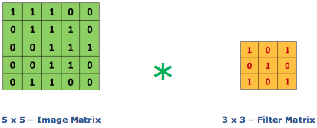

Convolutional layers
Convolution is the first layer to extract features from an input image. Convolution preserves the relationship between pixels by learning image features using small squares of input data. It is a mathematical operation that takes two inputs such as image matrix and a filter or kernel
Consider a 5 x 5 whose image pixel values are 0, 1 and filter matrix 3 x 3 as shown in figure in top right.
Then the convolution of 5 x 5 image matrix multiplies with 3 x 3 filter matrix which is called “Feature Map” as output shown in down below.
Convolution of an image with different filters can perform operations such as edge detection, blur and sharpen by applying filters.

Slide 5
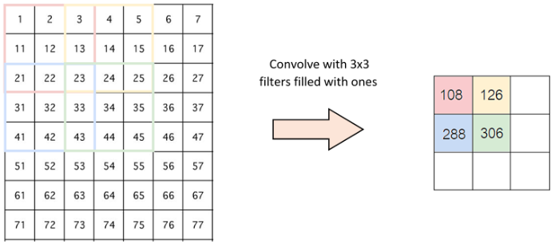
STRIDES
Stride is the number of pixels shifts over the input matrix. When the stride is 1 then we move the filters to 1 pixel at a time. When the stride is 2 then we move the filters to 2 pixels at a time and so on.
The below figure shows convolution would work with a stride of 2.
PADDING
Sometimes filter does not fit perfectly fit the input image. We have two options:
Pad the picture with zeros (zero-padding) so that it fits
Drop the part of the image where the filter did not fit.
This is called valid padding which keeps only valid part of the image.

Slide 6
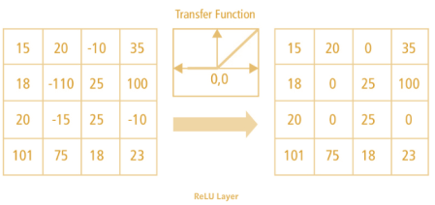
NON linearity (relu)
ReLU stands for Rectified Linear Unit for a non-linear operation. The output is ƒ(x) = max(0,x).
Why ReLU is important : ReLU’s purpose is to introduce non-linearity in our ConvNet. Since, the real world data would want our ConvNet to learn would be non-negative linear values.

Slide 7
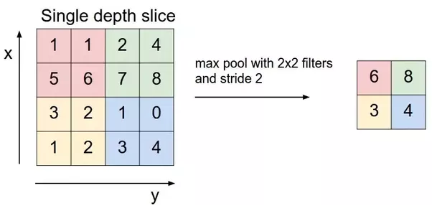
Pooling layer
Pooling layers section would reduce the number of parameters when the images are too large. Spatial pooling also called subsampling or downsampling which reduces the dimensionality of each map but retains the important information.
Max pooling take the largest element from the rectified feature map. Taking the largest element could also take the average pooling. Sum of all elements in the feature map call as sum pooling.

Slide 8
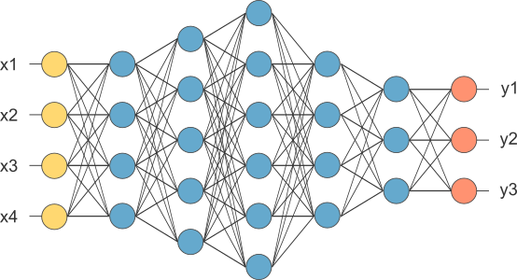
Fully connected layers
The layer we call as FC layer, we flattened our matrix into vector and feed it into a fully connected layer like neural network.
feature map matrix will be converted as vector (x1, x2, x3, …). With the fully connected layers, we combined these features together to create a model.

Slide 9
Usage and applications
IMAGE RECOGNITION
IMAGE CLASSIFICATION
OBJECT DETECTION
RECOGNITION FACES
APPLICATION OF FILTERS ON IMAGES

Slide 10
Python Libraries
Tensorflow
Keras
Keras.layers
Keras.models

Slide 11
Syntax
import tensorflow as tf
from tensorflow.keras import datasets, layers, models
(train_images, train_labels), (test_images, test_labels) = datasets.mnist.load_data()
train_images = train_images.reshape((60000, 28, 28, 1))
test_images = test_images.reshape((10000, 28, 28, 1))
model = models.Sequential()
model.add(layers.Conv2D(32, (3, 3), activation='relu', input_shape=(28, 28, 1)))
model.add(layers.MaxPooling2D((2, 2)))
model.add(layers.Flatten())
model.add(layers.Dense(64, activation='relu'))
model.add(layers.Dense(10, activation='softmax’))
model.compile(optimizer='adam', loss='sparse_categorical_crossentropy', metrics=['accuracy'])
model.fit(train_images, train_labels, epochs=5)

