Slide 1
OVERFITTING
Theory
Detecting overfitting
Preventing overfitting
Python libraries

Slide 2
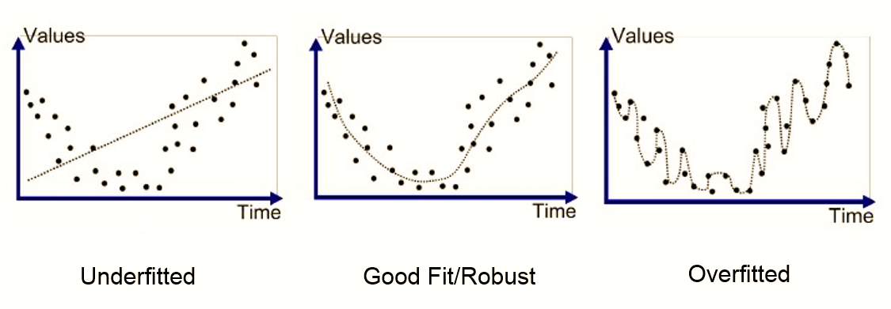
Theory
Overfitting is a modeling error which occurs when a function is too closely fit to a limited set of data points.
Overfitting the model generally takes the form of making an overly complex model to explain idiosyncrasies in the data under study

Slide 3
Detecting overfitting
we can’t know whether our model is fitted or not until we test it against some unknown test data.so we divide our dataset between train data and test data.
We train the model using the train data and then test the model performance using the test data.
If the accuracy of the model on the training model is not the same as the accuracy on the test data then model has been overfitted.

Slide 4
Preventing overfitting
Cross-validation - Use your initial training data to generate multiple mini train- test splits. Use these splits to tune your model.
Training with more data - It won’t work every time, but training with more data can help algorithms detect the signal better
Remove features -the idea to remove the useless features in the dataset and use only the important features.
Early stopping - the idea to stopping training as soon as the model starts overfitting. This can be found out it accuracy of validation data does not increase even after long training.

Slide 5
Python libraries and syntax
There are a lot of methods for controlling overfitting and each of them has a different method and syntax and python libraries.

