Slide 1
GIT
Distributed Version Control System

Slide 2

Version Control?
Version control is a system that records changes to a file or set of files over time so that you can recall specific versions later.

Slide 3
Why?
Git allows groups of people to work on the same
documents (often code) at the same time, and
without stepping on each other's toes

Slide 4
Repository
A directory where Git has been initialized to start
version controlling your files.

Slide 5
Git using the CLI

Slide 6
git init
"initialize", or create, a new repository in your current directory
Turning that directory into a git repository

Slide 7
Configure git
git config --global user.name "myname"
git config --global user.email “myname@abc.com"

Slide 8
git status
Check status of all files in the Repository

Slide 9
git add
Move files from ‘untracked’ to ‘staging’ area

Slide 10
git reset
Remove file(s) from the staging area to untracked state

Slide 11
git commit
git commit -m ‘commit message’
A "commit" is a snapshot of our repository. This way if we
ever need to look back at the changes we've made (or if
someone else does), we will see a nice timeline of all
changes.

Slide 12
git log
A ledger that has entries for all the changes we've
committed so far.

Slide 13
Remote Repository
GitHub: https://github.com
GitLab: https://gitlab.com
BitBucket: https://bitbucket.com

Slide 14
Connecting Remote Repo to the Native one
git remote add origin <url_to_remote_repo>

Slide 15
git push
Saving local changes to remote repo
git push -u origin master

Slide 16
git pull
Pulling changes made by others, from Remote
git pull origin master

Slide 17
What is branching?
Duplicating the code, to do experiment! Without affecting the working code

Slide 18
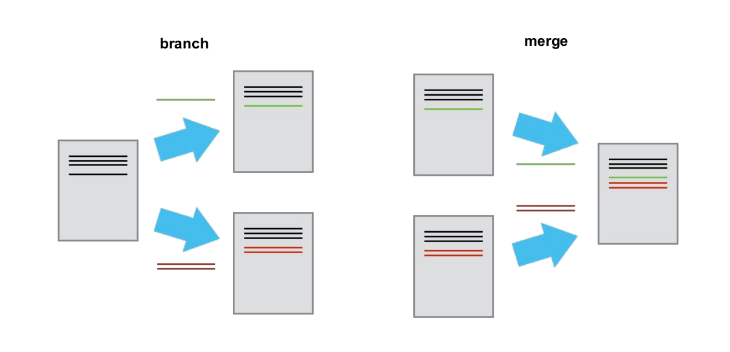
How Branching Works?

Slide 19
git branch
Explore Existing or Create a new branch
To Create: git branch my_exp_branch

Slide 20
git checkout
Changing from current branch to another branch
git checkout my_branch

Slide 21
git merge
merging your changes from other_branch into the
Current branch
git merge other_branch

Slide 22
git branch
Deleting a branch
git branch -d that_branch

Slide 23
git rm
Removing files from git
git rm <filename>

Slide 24
References
https://try.github.io
https://git-scm.com/

Slide 25
Questions?

Slide 26
rjain.rahul5@gmail.com
LinkedIn – Rahul Jain
Github/Gitlab – rahuljain5
Telegram - @rahuljain5
Rahul Jain

