Slide 1
Prescriptive Analytics
Submitted By:
Rahul Hanumanth Kambadur

Slide 2
Agenda
Brief about Bigazon
Business Objective
Data Understanding
Perform Descriptive Analytics
Perform Predictive Analytics
Perform Prescriptive Analytics

Slide 3
Brief about Bigazon
Bigazon is a leading online and physical store format for business to business distributor (selling to hotels, other retail outlets and institutions) selling products across different categories.
Bigazon distributes the products through online and in physical store formats across three southern states of Karnataka, Andhra Pradesh and Kerala.
Bigazon wanted to increase its sales revenue across different business customers for FY2018-2019 financial year to capture hyperlocal market and was mulling different strategies.

Slide 4
Business Objectives
Perform Descriptive Analytics on the sales dataset of 2017-18
Store segmentation based on sales data of 2017-18
Perform Prescriptive Analytics and provide recommendation to client to increase sales in 2018-19

Slide 5
Data Understanding

Slide 6
About Sales Dataset
2017-18 sales dataset contains sales record of 440 customers.
It contains data for both online and store sales.
It contains data for Andhra Pradesh, Kerala and Karnataka.
Channel Type | #of stores
Online | 298
Store | 142
Region | #of stores
Andhra Pradesh | 316
Kerala | 77
Karnataka | 47

Slide 7
Details about the columns
Channel : Whether the store sells via online or physical store mode.
Region: Which region the distribution happened.
Fresh Fruits: Sales in rupees for Fresh Fruits category
Milk: Sales in rupees for Fresh Milk category
Grocery: Sales in rupees for Grocery category
Frozen Foods: Sales in rupees for Frozen Foods category
Detergent/Washing Powder: Sales in rupees for Detergent/Washing Powder category
Delicatessen: Sales in rupees for Delicatessen category

Slide 8
Descriptive Analytics

Slide 9
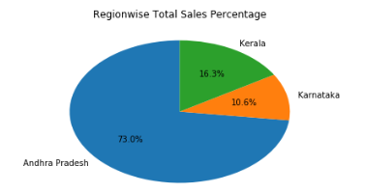
Region-wise sales distribution

Slide 10
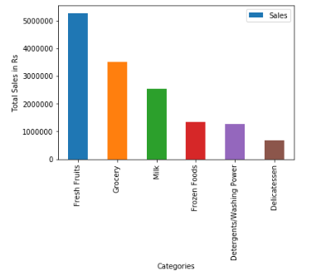
Category-wise sales

Slide 11
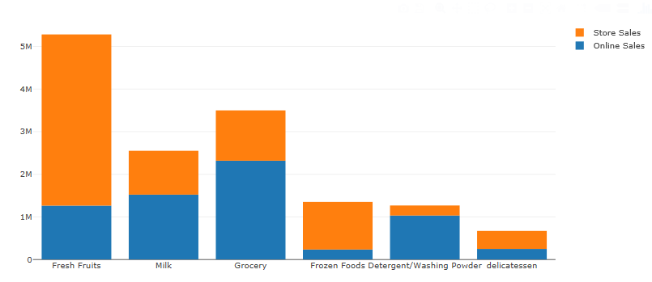
Individual category sales across Online and Store channels

Slide 12
Predictive Analytics

Slide 13
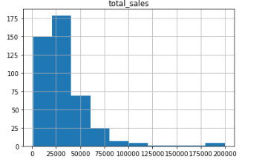
Customer segmentation based on sales
Histogram based on sales data is attached here:
Based on histogram data, stores are segmented
into 3 categories based on below condition:
a. Low Total Sales Segment :
total_sales <= 25000
b. Medium Total Sales Segment:
25000<total_sales<=75000
c. High Total Sales Segment:
total_sales > 75000

Slide 14
Sales Data across different segments
Customer Segment | Total Sales for each segment
Low Total Sales Segment | 2952711
Medium Total Sales Segment | 9216704
High Total Sales Segment | 2450085
From the above table, it is seen that that revenue from Medium Total Sales Segment is highest in 2017-18.

Slide 15
Prescriptive Analytics

Slide 16
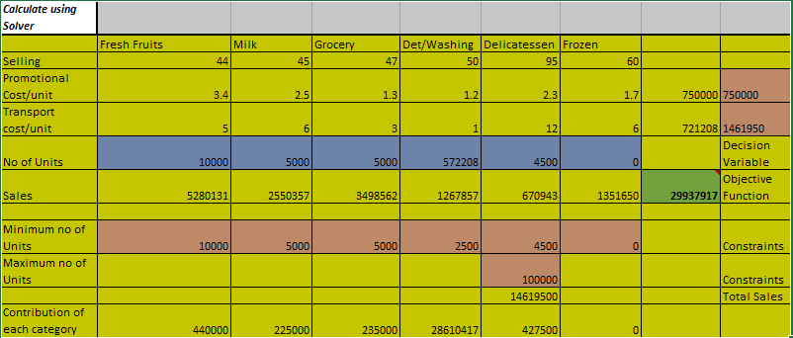
Use of Solver
The data is converted into Operation Research problem and we have used Solver to solve this OR problem
Snapshot of the solver is given below for reference:
Objective function is marked
as Green, as we are trying to
Maximize the sales
2. Decision variable is marked
as Blue, as we trying to change
No of units to maximize the sales
3. There are 4 Constraints,
which are marked as Pink:
Minimum no of units to be sold
Maximum no of units to be sold
Transport cost, as it has to be 10% of the sales
Promotional cost, as it has to be less than Rs 750000

Slide 17
Maximum Revenue and YoY growth
Maximum Revenue which can be achieved in 2018-19 considering constraints : Rs 29937916
Total Revenue in 2017-18: Rs 14619500
YoY Growth: 110%

Slide 18
Recommended Quantity of Milk and Fresh Fruits
Category | No of Units
Fresh Fruits | 10000
Milk | 5000

Slide 19
Most Revenue Generating Category
Category | Revenue (in Rs)
Fresh Fruits | 440000
Milk | 225000
Grocery | 235000
Detergent/Washing Powder | 28610417 (Most Revenue Generating Category)
Delicatessen | 427500
Frozen Foods | 0

Slide 20
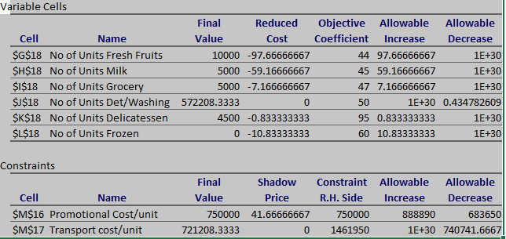
Sensitivity Report
From the sensitivity report,
it can be concluded that increasing
the promotional expenses will increase
Sales in 2018-19

Slide 21
Github Links
Github link of Python code is given below:
https://github.com/rahuljamadagni147/Prescriptive-Analytics/blob/master/BigazonAnalyticsUsingPython.ipynb
Github link of Solver used for prescriptive analytics is given below:
https://github.com/rahuljamadagni147/Prescriptive-Analytics/blob/master/Solver_Details.xlsx

Slide 22
Thank you

