Slide 1

Zomato Restaurant Analysis
By : Rahul Jha

Slide 2
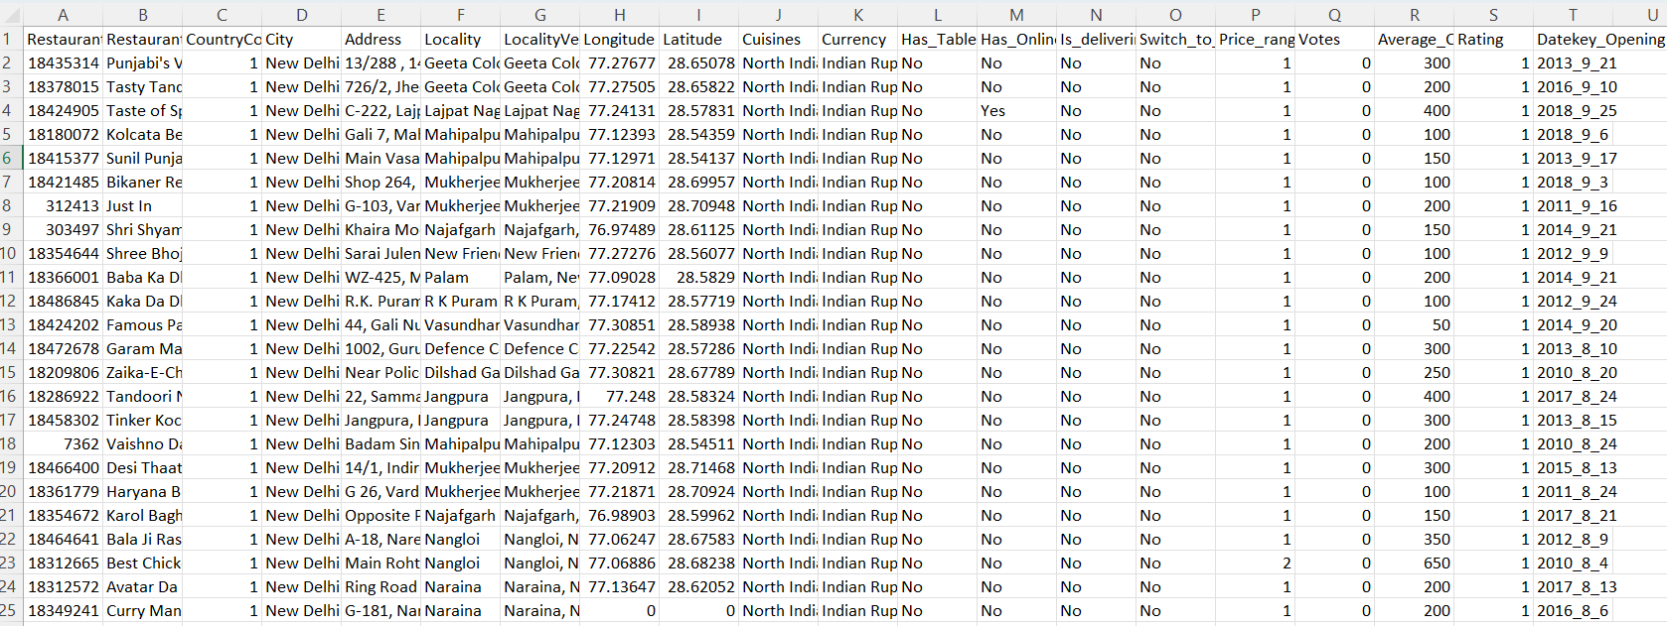
Aim of the project
Problem Statement
You are hired as a consultant data analyst by Zomato where the team is looking for expansion and opening restaurants. Your task is to come up with strategies/suggestions about opening newer restaurants.

Slide 3
Data overview
Restaurant ID: Unique identifier for each restaurant.
Restaurant Name: The name of the restaurant.
Country Code: Country code of the location where the restaurant is situated.
City: The city where the restaurant is located.
Address: The specific address of the restaurant.
Locality: The locality or neighborhood where the restaurant is situated.
Locality Verbose: Detailed information about the locality.
Longitude: The geographical longitude coordinate of the restaurant.
Latitude: The geographical latitude coordinate of the restaurant.
Cuisines: The type of cuisine offered by the restaurant.
Currency: The currency used for transactions in the restaurant.
Has-Table-booking: Indicates whether the restaurant has a table booking option (Yes/No).
Has-Online-delivery: Indicates whether the restaurant offers online delivery (Yes/No).
Is-delivering-now: Indicates whether the restaurant is currently delivering (Yes/No).
Switch-to-order-menu: Indicates whether users can switch to the order menu (Yes/No).
Price-range: A numeric value indicating the price range category of the restaurant.
Votes: The number of votes or ratings/(feedback) received by the restaurant.
Average-Cost-for-two: The average cost for two people dining at the restaurant.
Rating: The overall rating of the restaurant is based on user reviews.
Date-key-opening: The date when the restaurant was opened.

Slide 4
First I filled the missing values in the average cost of two column based on mode of the country’s average cost of two.
Then I filled the missing values in cuisines column by taking mode of countries most preferred cuisine.
Then I made the date column more presentable and easier to retrieve the data using =SUBSTITUTE(T2,”_”,”/”)
I made a new column for all the currencies converted into one currency INR for better comparison.
Number of restaurants by country and year.
Price range distribution.
Average number of votes per country.
Correlation between ratings and prices.
Data cleaning and preprocessing
Visualization

Slide 5
Attribute Creation
I created a column with combining the currency symbols with average cost of two prices with If and Concatenate formula.
I created a year column extracting year from the date that I have cleaned for creating a slicer for year in future.
Insights and Recommendations
Used pivot tables to analyze restaurant counts and ratings in various countries.
Recommended countries like Australia, Canada, Indonesia, Philippines and South Africa for new restaurant openings based on their lower competition and decent average ratings.
Analyzed the average number of voters for restaurants in each country to understand customer engagement levels

Slide 6

INDUSTRY ANALYSIS

Slide 7
Country wise restaurant count
Dominance of India: India stands out with a massive 90.6% share (8,652 restaurants out of 9,551).
Potential for Expansion in Medium Markets: Countries like the United States, the United Kingdom, and South Africa have a moderate number of restaurants (between 60-434), suggesting a balanced market with potential room for growth.
Smaller Markets: Countries like Qatar, Singapore, Sri Lanka, and Canada have fewer restaurants (ranging from 4-20).

Slide 8
Average rating of restaurants country wise
India has an overwhelming number of restaurants but suffers from a relatively low average rating (2.77). This suggests that though the market is large, there may be quality or service-related issues.
USA has a considerable number of restaurants (434) and a good rating (4.01). This suggests a well-established market with relatively stable feedback.
Philippines (4.47), Indonesia (4.29), and New Zealand (4.26) show promising ratings with low restaurant counts. These countries could be attractive opportunities for new restaurants, as customer satisfaction is high, and competition is less intense.

Slide 9
Year wise Count of restaurants
Steady Growth :
The number of restaurants remained fairly steady with slight ups and downs indicating consistent growth in the industry.
The overall trend is upward with 2018 showing the highest number of openings.
Slowdowns and Peaks :
In year 2012 there is a drop in restaurant openings (1022), which might suggest economic or industry-specific challenges during that period.
The peak in 2018 could indicate favourable market conditions or increased consumer demand at that time.

Slide 10
Online delivery and Table booking status
Out of 9551 restaurants only 2451 restaurants have facility for online delivery.
In the terms of percentage only 25.66% of the total restaurants has the online delivery available.
Countries which supports online delivery are United Arab Emirates and India.
In United Arab Emirates 28 out of 60 restaurants give facility of online delivery which is highest in percentage which is 46.66%.
In India 2423 out of 8652 restaurants have online delivery indicating that approximately 28% of restaurants provide this service.
Out of 9551 restaurants, only 1158 restaurants have facility of table booking.
In the terms of percentage only 12.12% of the total restaurants has the table booking.
Countries which supports table booking are India, Philippines, Qatar, South Africa,
United Arab Emirates and United Kingdom.
In Philippines 14 out of 22 restaurants give facility of table booking which is highest in percentage i.e. 63.63%.
In India 1110 out of 8652 restaurants have table booking, indicating that 12.84% of
restaurants provide this service.

Slide 11
Average cost of two as per country
High-Cost Countries:
Singapore (10,505 INR), United Kingdom (5,591 INR), Qatar
(5,314 INR) are at the top of the chart, suggesting that dining
in these countries is more expensive compared to others.
Mid-Cost Countries:
United Kingdom (5,591 INR), Qatar (5,314 INR), and United Arab
Emirates (3,927 INR) reflect moderate costs for dining,
representing a balance between affordability and luxury dining.
Low-Cost Countries:
Turkey (185 INR) and India (623 INR) show the lowest dining
costs, suggesting that dining is relatively affordable in these
regions.

Slide 12
Top 10 Cuisines Chart

Slide 13
Top Insights
India Dominates Restaurant Count:
With 8,652 restaurants, India holds a substantial majority, accounting for over 90% of the total restaurant count (9,551). This suggests that India’s
restaurant market is highly competitive, with numerous options for consumers, and likely shows a strong demand for dining services.
Average Ratings and High Performers:
Philippines (4.47), Indonesia (4.29), and Turkey (4.3) have the highest average ratings for restaurants. This indicates that these countries maintain high
standards for customer satisfaction and dining experiences, possibly reflecting good service quality, food standards, or cultural preferences for dining
out.
Significant Price Differences Across Countries:
The average cost for two in Singapore (10,505 INR) is nearly 60 times higher than that in Turkey (185 INR), reflecting massive regional disparities in the
cost of dining. This indicates that restaurant operators need to carefully consider the economic conditions and pricing strategies when entering
different markets.
Stable Growth in Restaurant Openings (2010-2018):
Over the years, there has been a consistent growth in the number of restaurants from 2010 to 2018, with 2018 recording the highest number of new
restaurants (1,102). This points to a steady increase in the dining-out culture and overall restaurant market growth globally during that period.

Slide 14

STRATEGIC RECOMMENDATIONS
Open restaurants in high-potential, low-competition countries.
Target markets with low restaurant density for easy entry.
Leverage density analysis to identify growth areas.
Expand strategically to boost profitability.
Study competitors to craft unique positioning.
Use customer sentiment to improve quality, pricing, and retention.
Enable online delivery & table booking to enhance satisfaction and ratings.

Slide 15
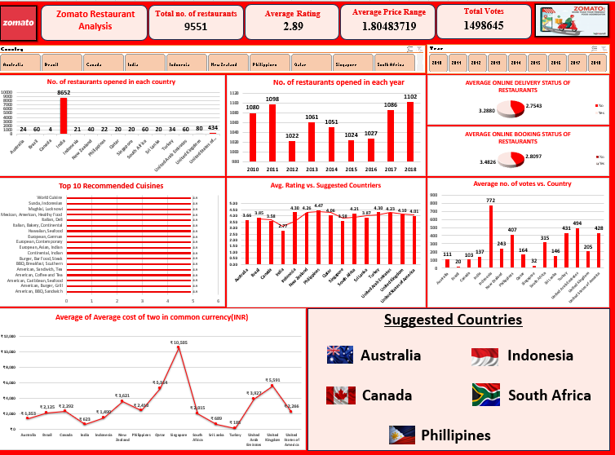
Dashboard

Slide 16


