Slide 1
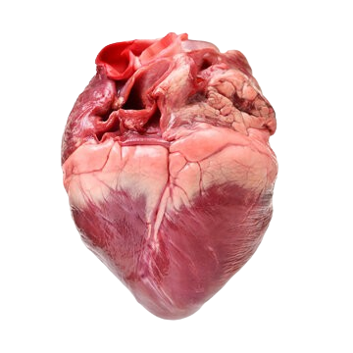
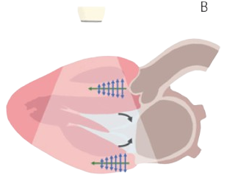
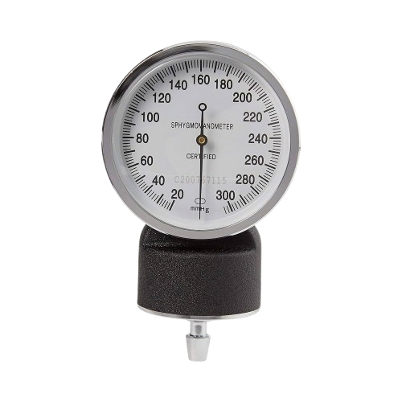
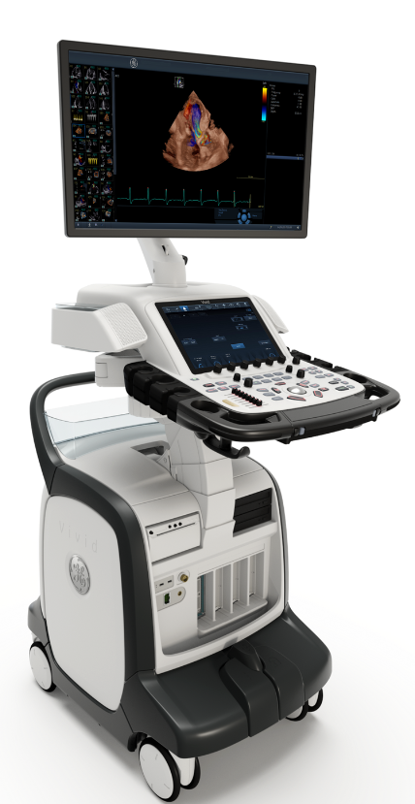
material
MODEL
functional
Shear Wave Elastography
Left Ventricle Filling Pressure
structural
Echocardiography
Notes:
We used tow of the available information – structural and material to figure out the shape of the missing piece in the puzzle

Slide 2
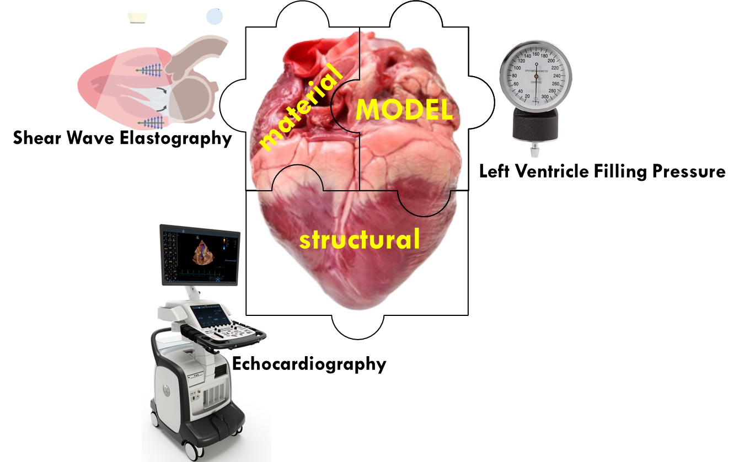

Slide 3
Notes:
We used tow of the available information – structural and material to figure out the shape of the missing piece in the puzzle

