Slide 1
India is 14% of installs but 2% of in-app revenue (reported); public signals show where to look
14%
of installs from India (reported)
2%
of in-app purchase revenue (reported)
0.143
revenue per install vs global (scenario)
• Reported by Sensor Tower via TechCrunch, Oct 2025 to Apr 2026; in-app purchases only.
• Scenario, not causal: revenue per install is 0.143 of the global rate; price alone implies 0.283.
• Ask: internal activation, retention and price-test data to replace these public proxies.
Sources: R-002 reported (techcrunch.com, 2026-05-09, read 2026-10-18); R-003 reported (techcrunch.com, 2026-05-09, read 2026-10-18); R-011 derived (derived in project); R-012 derived (derived in project) Data as of 2026-10-18.

Slide 2
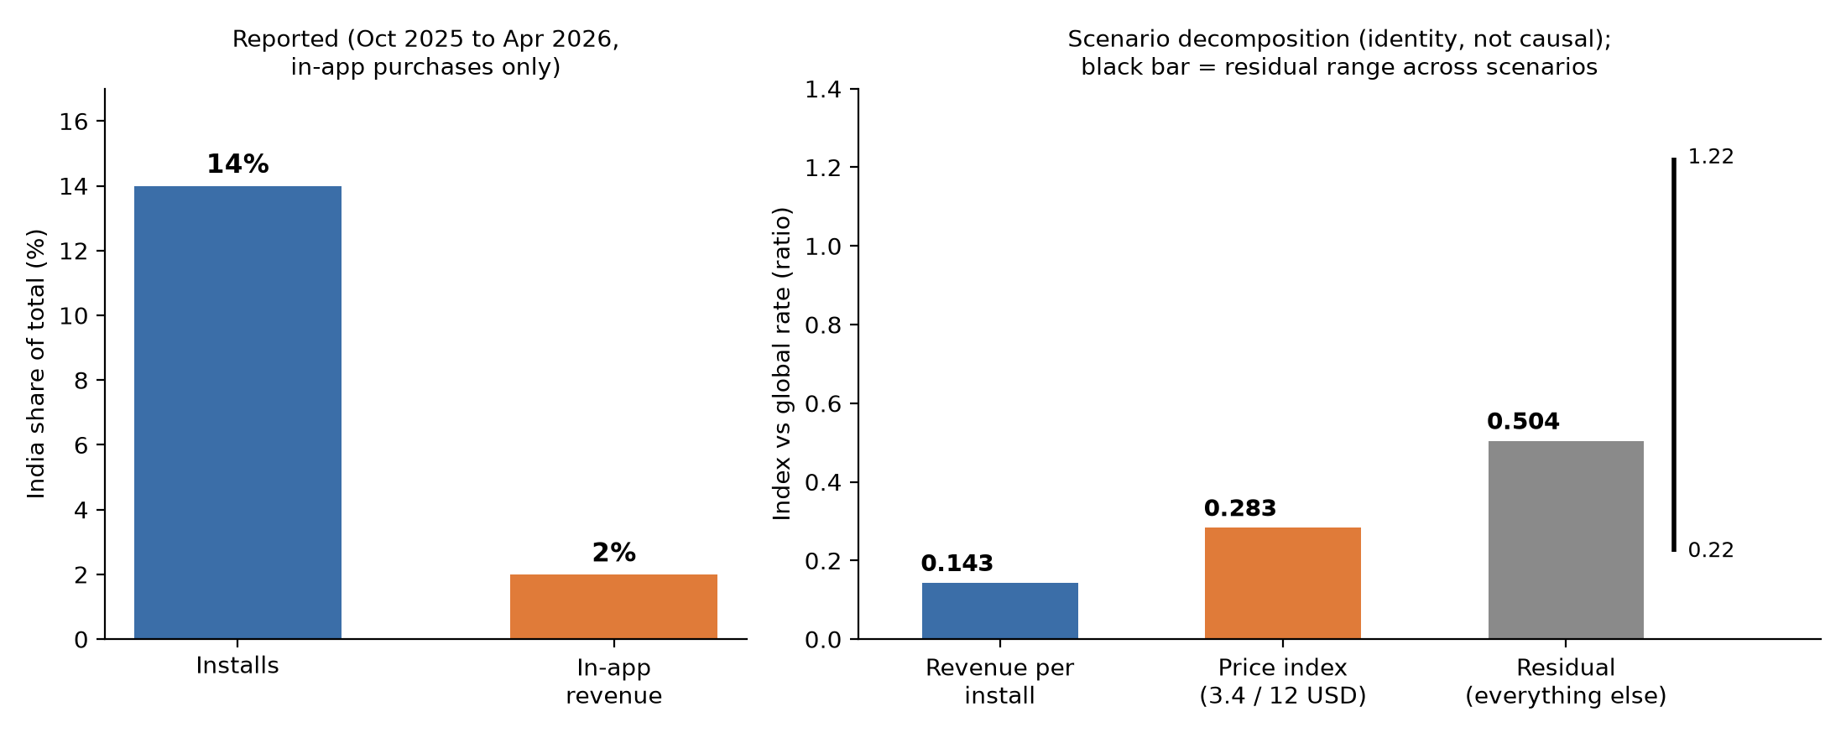
Price alone would imply 0.283 of the global revenue per install against 0.143 observed; the 0.504 residual cannot be apportioned (range 0.22 to 1.22)
• In-app purchases only. The company says India is its second-largest base by users and paying subscribers, yet web and desktop plans bill through Stripe, outside this measure (hypothesis: much India revenue sits outside the app stores).
• Index compares annual list prices at an implied FX; promotions, free tier and billing route are excluded.
• Install mix shifted inside the window (Android launch in February, India launch at the very end).
Sources: R-001 reported (techcrunch.com, 2026-05-09, read 2026-10-18); R-002 reported (techcrunch.com, 2026-05-09, read 2026-10-18); R-003 reported (techcrunch.com, 2026-05-09, read 2026-10-18); R-010 reported (techcrunch.com, 2026-05-09, read 2026-10-18); R-005 reported (wisprflow.ai, read 2026-10-18); R-011 derived (derived in project); R-012 derived (derived in project); R-013 derived (derived in project); R-014 derived (derived in project); R-085 reported (docs.wisprflow.ai, read 2026-10-18); R-119 reported (economictimes.indiatimes.com, 2026-04-28, read 2026-10-18)

Slide 3
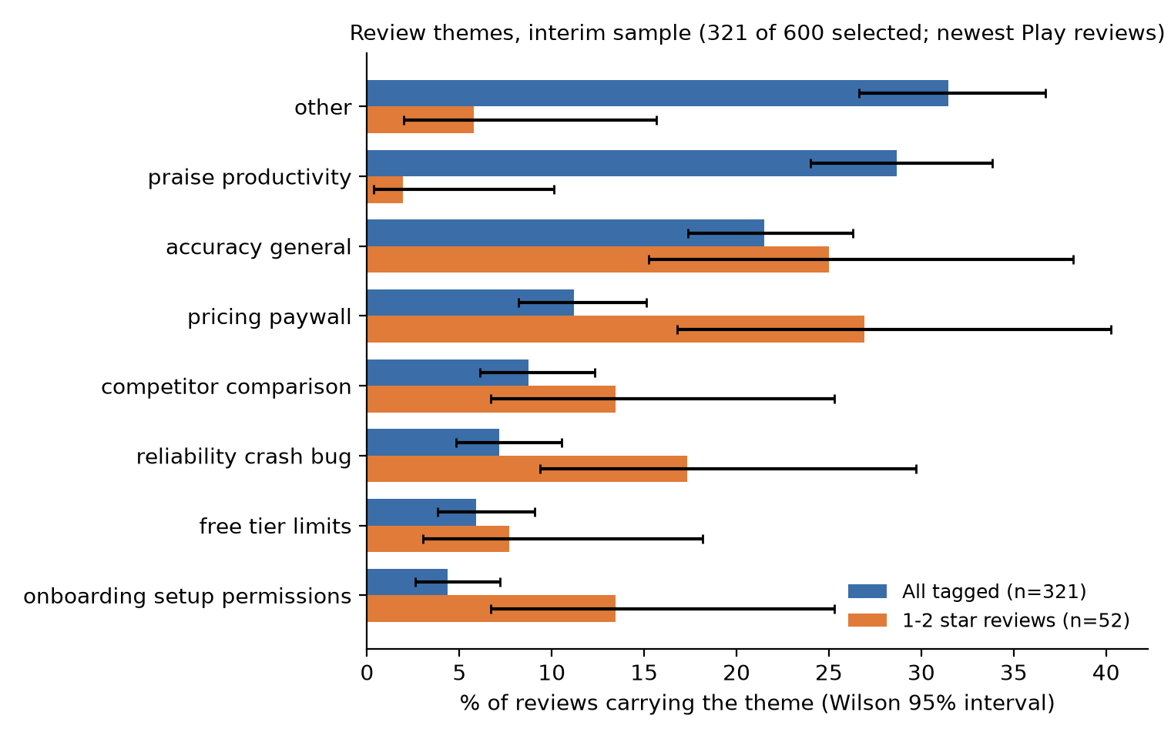
Most common review themes in an interim sample of 321 reviews: praise productivity, accuracy general, pricing paywall; India-versus-US is not estimable
• Pricing is higher and praise lower among the one- and two-star reviews (intervals do not overlap); other gaps are noise.
• Interim: 321 of 600 selected, newest Play reviews only; Play has no country split.
• 'Other' is the largest bucket; no tagged review is in the roman-Hindi/Devanagari proxy.
Sources: R-050 estimated (estimated from project data); R-057 estimated (estimated from project data); R-058 estimated (estimated from project data); R-051 estimated (estimated from project data); R-052 estimated (estimated from project data); R-053 estimated (estimated from project data); R-040 estimated (estimated from project data) Directional; tagger test results in appendix.

Slide 4
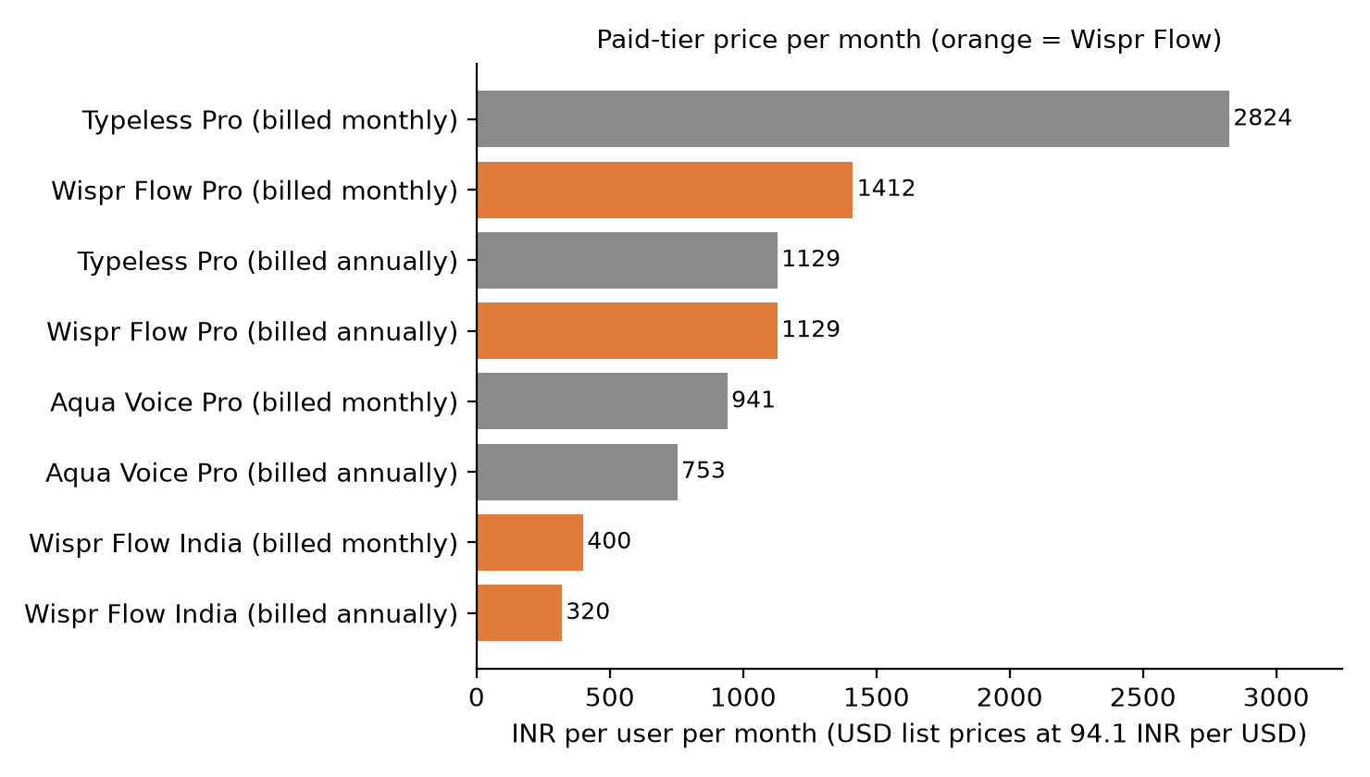
Gboard is the most dangerous free substitute; Superflow is the closest dedicated dictation rival (claims untested)
• Gboard leads the matrix at 13 of 15 with every criterion sourced: free voice typing, Hindi, 10B+ global installs.
• Superflow (Android, March 2026; Bengaluru developer) scores 11 on four known criteria, ahead of Typeless 9 and Aqua Voice 7; its price is unknown (11 to 14 possible).
• Install bands are global, claims advertised, Play item prices lack billing periods; Wispr's own Play items run 400 to 3849 INR.
Sources: R-070 reported (wisprflow.ai, read 2026-10-18); R-071 reported (wisprflow.ai, read 2026-10-18); R-114 derived (derived in project); R-115 reported (play.google.com, read 2026-10-19); R-116 reported (play.google.com, read 2026-10-19); R-117 reported (play.google.com, read 2026-10-19); R-118 reported (getsupernova.ai, read 2026-10-19); R-016 derived (derived in project) Rubric and full matrix: data/processed/competitor_matrix.csv and the dashboard. Superwhisper and Apple list prices are unknown and not charted; Play item ranges are not compared with Flow's price.

Slide 5
Checkout, free tier and offers: what is documented, and where the sources disagree
Item | What is documented or advertised | Status
India price | 320 INR a month billed annually (3840 a year, derived) or 400 INR monthly | Reported, India page
Payment | UPI and cards (Visa, Mastercard, American Express, Discover) plus one unnamed option; Wispr-specific UPI on Google Play and net banking are unverified | Advertised, not tested
Free plan | Weekly caps per docs: mobile soft 1000 / hard 1500 words, desktop 2000 / 5000; India page says unlimited | Docs vs marketing copy
Partner offers | Zepto 3 months, CRED 10 months of Pro (CRED length set per code); browser claim, individual plans, card at checkout, renews unless cancelled | Documented; redeemable today unknown
Students | 50% off Pro (India page); 3 months free for new Pro students (students page); help doc: terms set per account | Sources disagree
Android launch offer | Free with no cap during early access at launch; not in current docs | Launch only; current unknown
Sources: R-070 reported (wisprflow.ai, read 2026-10-18); R-071 reported (wisprflow.ai, read 2026-10-18); R-072 derived (derived in project); R-007 reported (wisprflow.ai, read 2026-10-18); R-008 reported (wisprflow.ai, read 2026-10-18); R-080 reported (docs.wisprflow.ai, read 2026-10-18); R-081 reported (docs.wisprflow.ai, read 2026-10-18); R-074 reported (docs.wisprflow.ai, read 2026-10-18); R-075 reported (docs.wisprflow.ai, read 2026-10-18); R-076 reported (wisprflow.ai, read 2026-10-18); R-077 reported (wisprflow.ai, read 2026-10-18); R-078 reported (docs.wisprflow.ai, read 2026-10-18) No payment method or offer was tested; nothing here is universal.

Slide 6
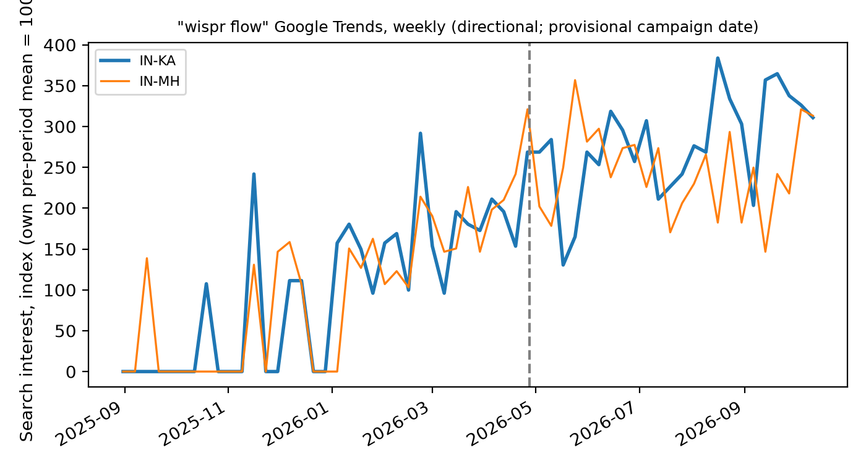
Search data cannot isolate the Bengaluru campaign (not estimable); a geo-split launch test could
• Only 2 of 5 states had enough pre-period search activity; a comparison needs at least 2 controls.
• Interest rose in every state after the provisional date, so a Karnataka-specific change is not separable.
• Better: geo-split launch with install attribution, or a holdout city.
Sources: R-107 derived (derived in project); R-091 reported (economictimes.indiatimes.com, 2026-04-28, read 2026-10-18) Directional Google Trends index; campaign date reported by Economic Times, exact start unverified.

Slide 7
Three experiments sized to India traffic (illustrative baselines); 1650 installs a day is a window average
Experiment | Primary metric | Baseline | MDE | n per arm | Days incl. follow-up | Decision rule
E1 Android permission-flow redesign | first completed dictation within one day of install | 0.3 | 0.05 | 1376 | 10.0-29.2 | Stop early on crash or D7-uninstall harm; roll out only if the lift's 95% interval excludes zero.
E2 Android free-tier weekly cap level | paid conversion by day 14 | 0.02 | 0.01 | 3788 | 22.2-75.2 | Stop early if D7 retention falls below a floor; roll out only if the day-14 conversion lift is above zero.
E3 Family and WhatsApp invite loop | invited users who complete a dictation | 0.2 | 0.04 | 1680 | 9.5-15.1 | Stop early on spam or opt-out spikes; scale only if the invite-to-dictation lift is above zero.
Sources: R-060 estimated (estimated from project data); R-061 estimated (estimated from project data); R-062 estimated (estimated from project data); R-100 derived (derived in project) Baselines and MDEs are assumptions; guardrail limits need internal baselines; E3 duration is a proxy; E2 tests a cap level, not unlimited. Grid: data/processed/experiment_sizing.csv.

Slide 8
First three months, and the internal data I would ask for to replace these proxies
Month one | Months two and three | Internal data to request
Activation funnel by platform Android permission drop-off Free-tier cap behaviour | Run E1 (permission flow) Then E3 (invite loop) E2 as a cap-level test | Cohort retention Price-test history Paid conversion by channel Web versus store billing

Slide 9
Appendix: data coverage and tagging evaluation
Topic | Facts
Play reviews | 3000 pulled, history from 2026-03; reviews are not split by country
App Store | RSS feed erratic and non-contiguous; India and US windows do not overlap
Trends | 5 states, weekly; 2 with enough pre-period data; one rate-limit retry resolved
Tagger, test | 60 reviews scored once: micro-F1 0.784 (95% interval 0.72-0.85), sentiment kappa 0.830 (0.68-0.95); only 7 of 17 themes had enough examples
Tagger, dev | 40 reviews after the label audit: micro-F1 0.752; the prompt was chosen on dev, so this is optimistic
Gold labels | One labeller; labels revised after the dev analysis; free-tier model processing
Sources: R-106 derived (derived in project); R-107 derived (derived in project); R-040 estimated (estimated from project data); R-041 estimated (estimated from project data); R-113 estimated (estimated from project data); R-103 estimated (estimated from project data); R-104 derived (derived in project); R-105 derived (derived in project)

Slide 10
Appendix: assumptions and limitations
Topic | Assumptions and limitations
Scenario parameters | Android share 30/50/70%, eligible 50/80%, exposed 50/100%; missed revenue 0 to 60%; baselines illustrative
Revenue | In-app purchases only, from one secondary article; FX implied by that article
Reviews | Not all users; Play has no country split; interim newest-reviews subset; small one-labeller gold set
Trends | Relative and state-level; sparse controls; campaign date reported, start unverified
Competitors | Scores rest on Play listings and developer claims; install bands are global, not India; Apple dictation and Eloquent unscored; competitor reviews not tagged
Payments and offers | Advertised or documented, not tested; no offer shown to be universal
Sources: R-108 assumption (assumption); R-109 assumption (assumption); R-110 assumption (assumption); R-111 assumption (assumption)

