Slide 1
Resume Screening and Ranking System
Presented by: Rahul Kumar

Slide 2
Content
• Introduction
• Tools Description
• Modules
• Data Flow Diagram (DFD)
• Use Case Diagram
• Limitation
• Future Scope
• Thank You

Slide 3
Introduction
It is a web-based tool that uses NLP to automate resume screening.
The system compares resumes with a job description to find the best match.
It calculates a relevance score based on content similarity.
Built using Python, Streamlit, and Scikit-learn.
Helps recruiters save time and make unbiased, accurate hiring decisions.

Slide 4
Tools Description
• Python - Core programming language
• Streamlit - Web app framework
• PDFMiner - For resume text extraction
• Scikit-learn - For TF-IDF and cosine similarity

Slide 5
Modules
• Resume Upload
• Job Description Input
• Text Extraction & Cleaning
• Similarity Score Calculation
• Resume Ranking
• CSV Export

Slide 6
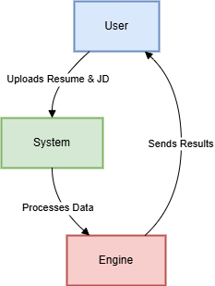
Data Flow Diagram (DFD)
• Level 0:

Slide 7
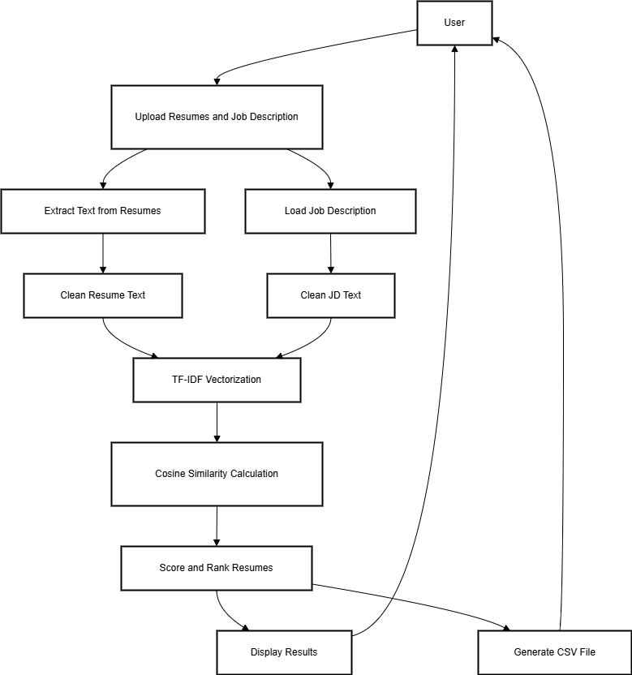
Data Flow Diagram (DFD)
• Level 1:

Slide 8
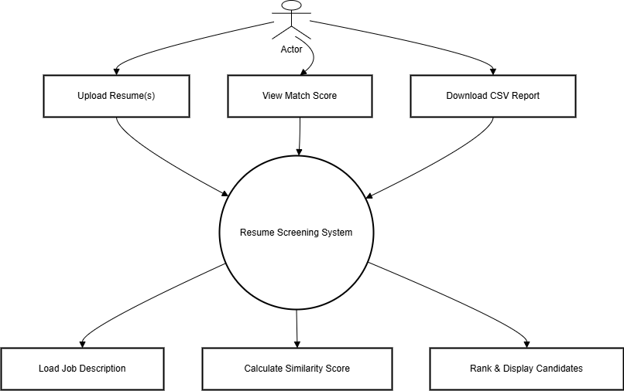
Use Case Diagram

Slide 9
Limitation
• Lacks deep semantic understanding
• Depends on quality of resume formatting
• Cannot replace human judgment entirely

Slide 10
Future Scope
• Use deep learning models (e.g., BERT)
• Score education and experience relevance
• Add dashboards and real-time analytics

Slide 11
Thank You
• Project by Rahul Kumar
• AI Resume Screener using NLP & Streamlit
• Thank you for your time!

