Slide 1


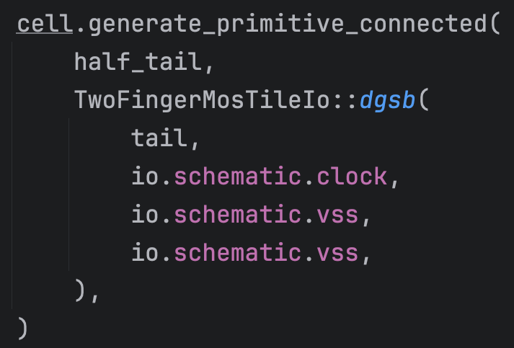
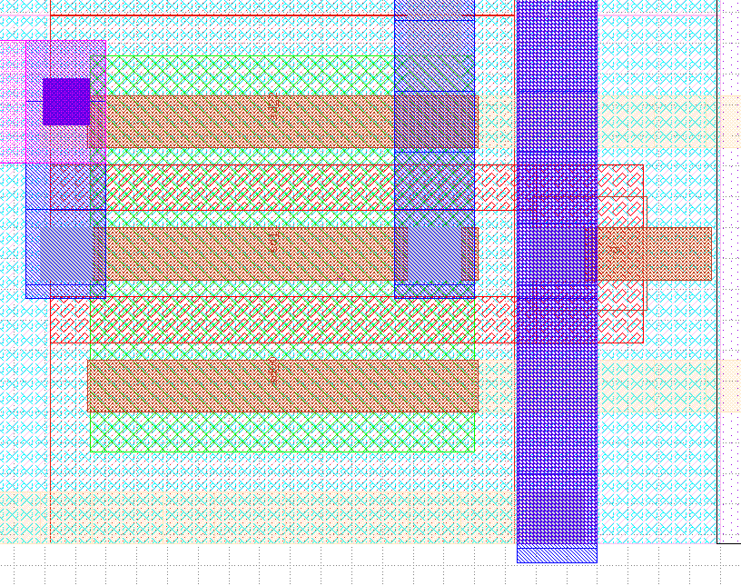
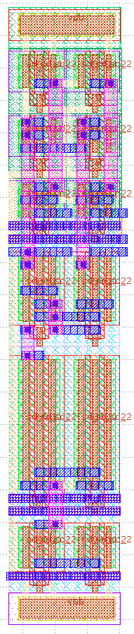
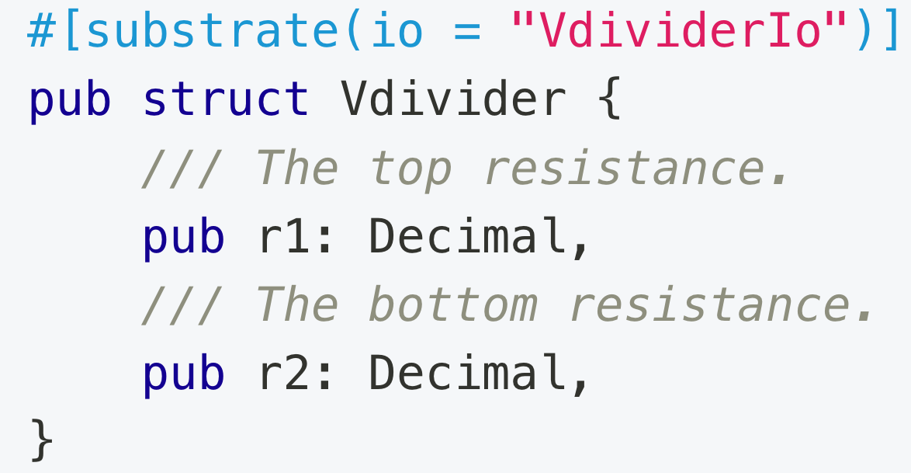
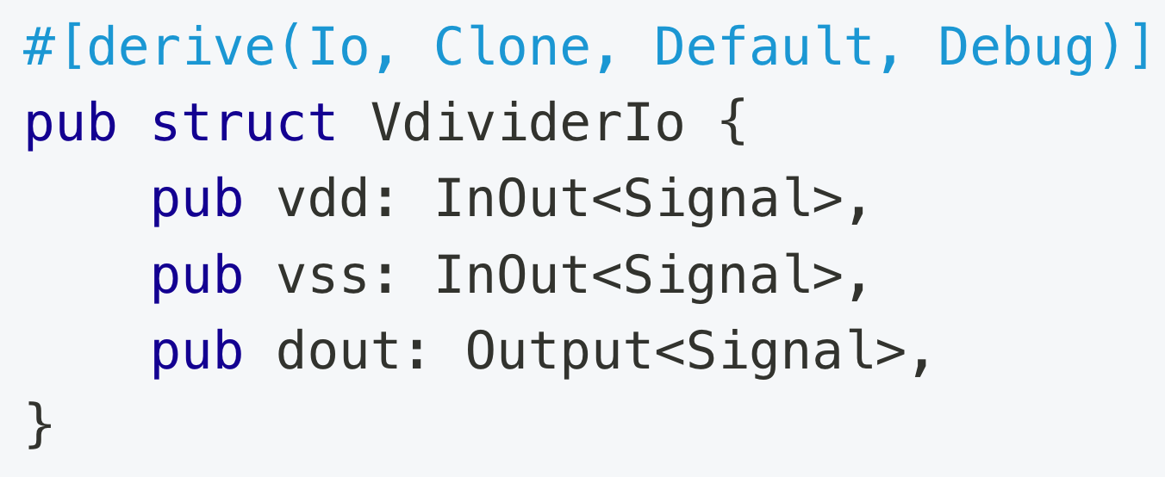
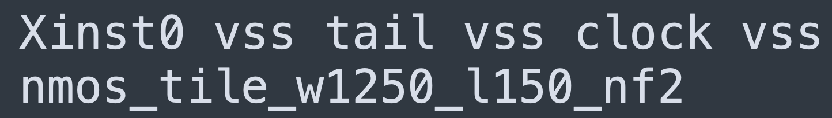
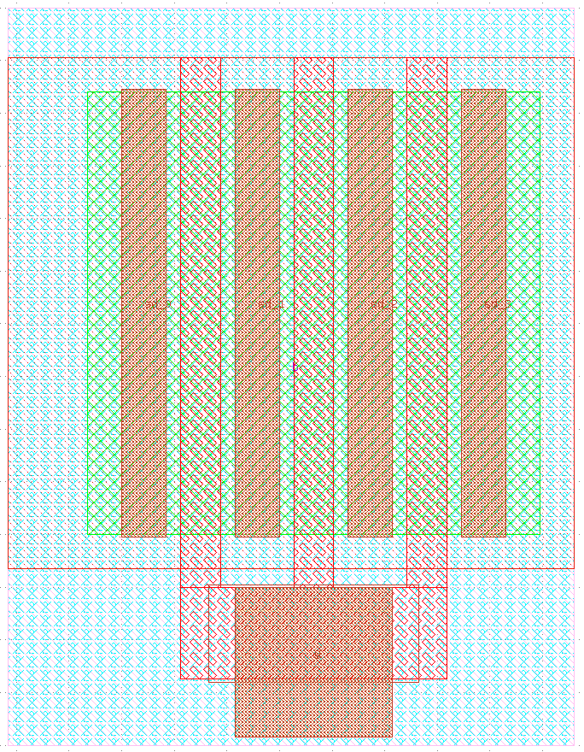
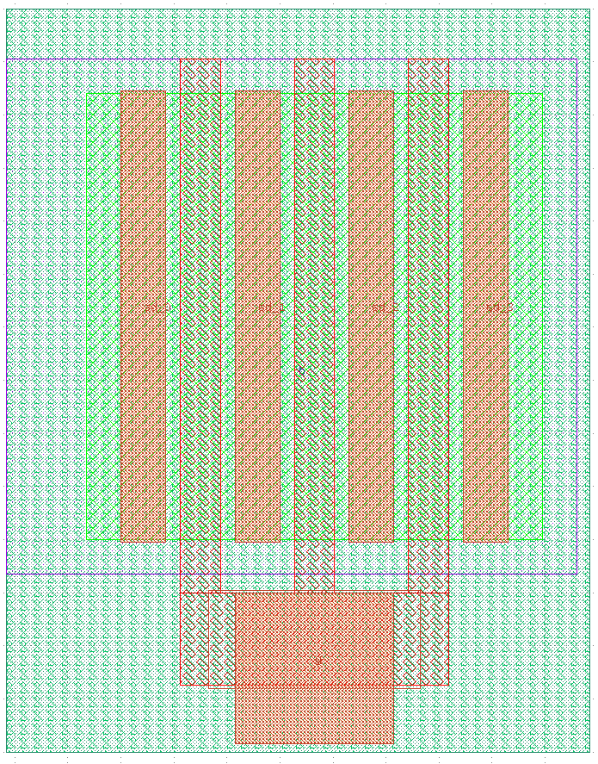
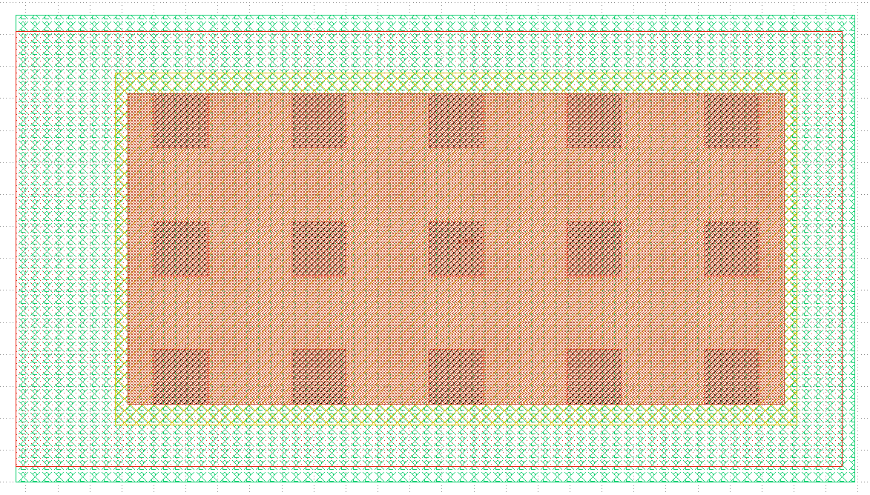
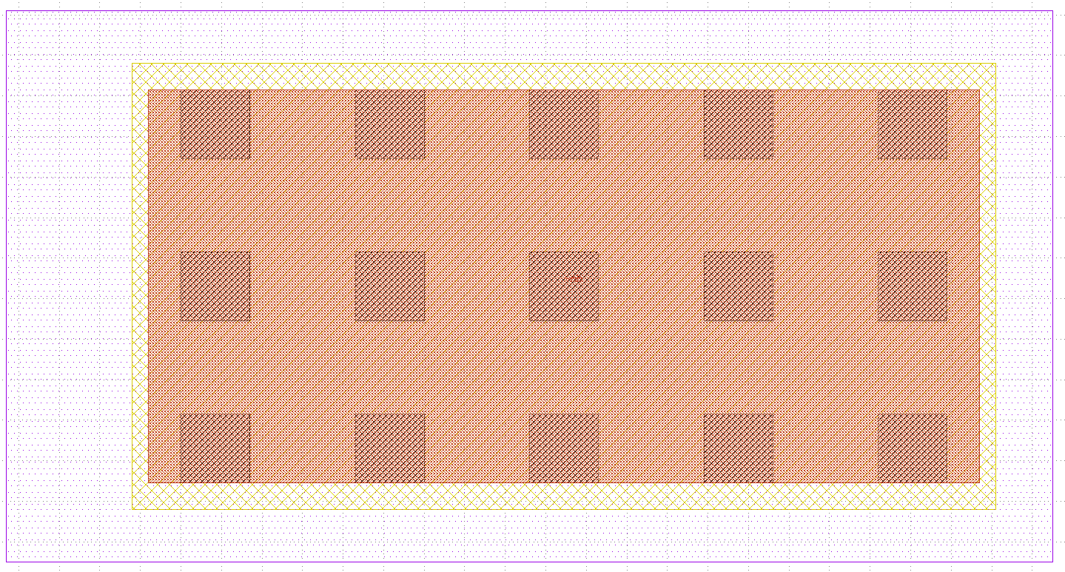
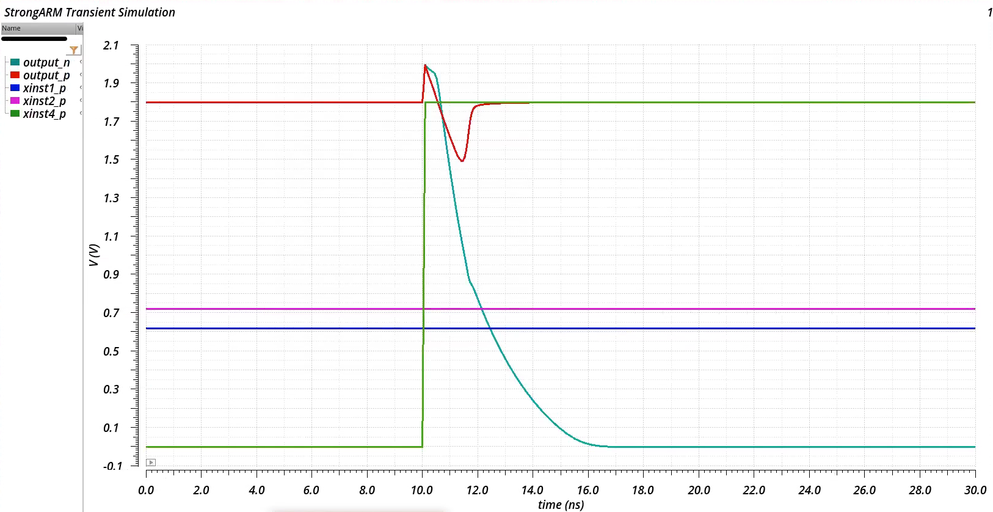
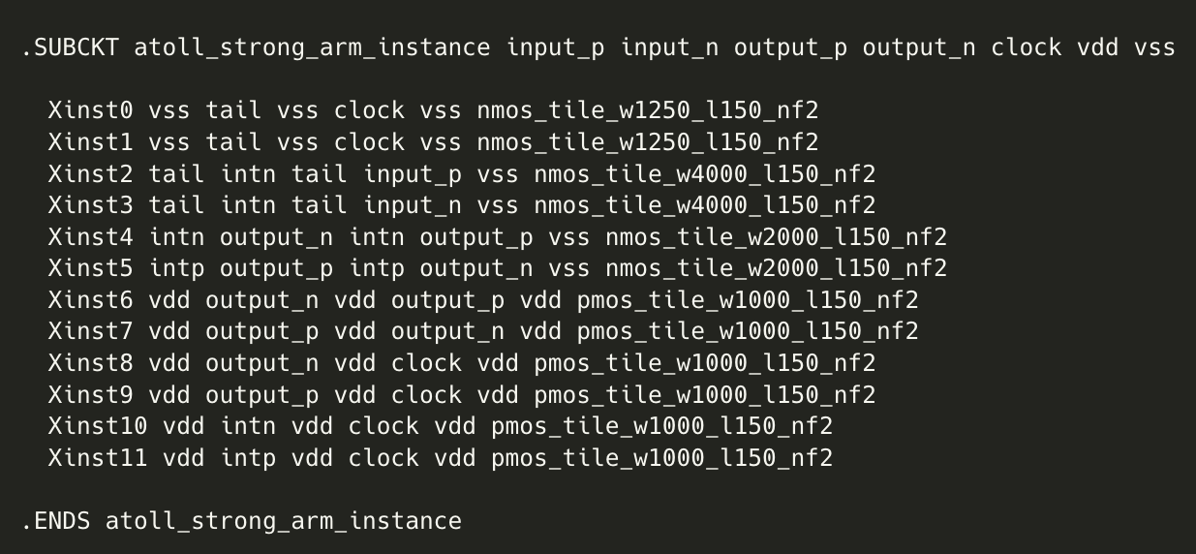
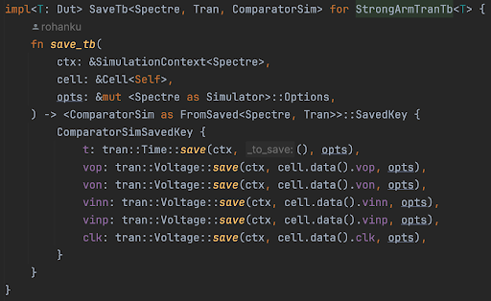
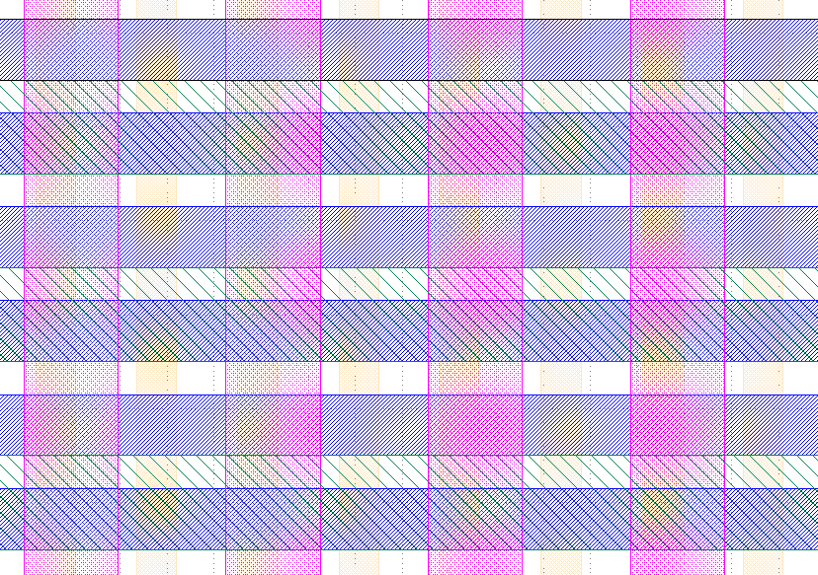
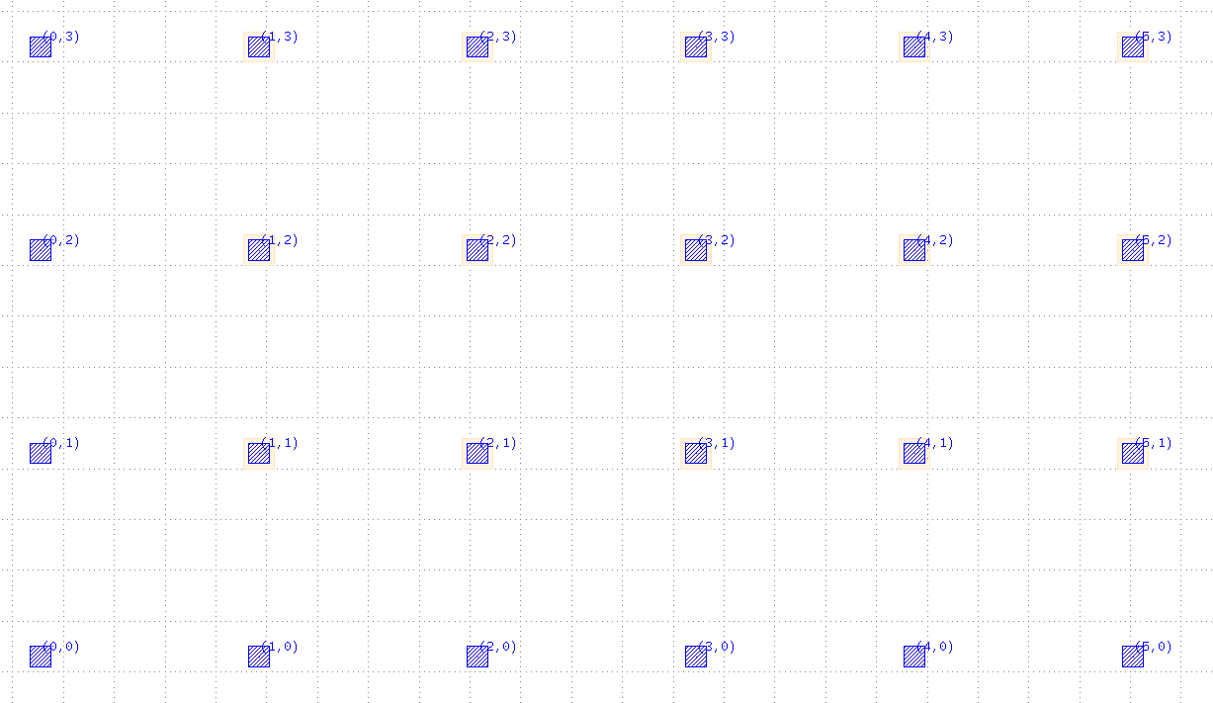
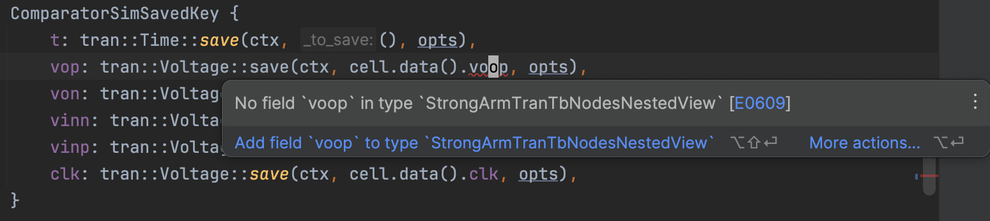
Strongly-typed APIs for analog generators
Rohan Kumar, Rahul Kumar Advisor: Borivoje Nikolic
Blocks and IOs
Schemas and Schematic Cell IR (SCIR)
Simultaneous layout and schematic
Blocks are composable generator units (think modules/cells). Blocks can be any type, but they are commonly structs that hold their parameters. All Blocks declare an IO type that specifies the input/output signals.
Blocks declare the set of views they support by implementing the appropriate traits (Schematic and/or Layout). The schematic and layout systems each support propagating nested views:
- Schematics can expose internal node voltages or terminal currents for probing in simulation
- Layouts can expose internal geometry to higher-level blocks
Schematics are logically embedded in a schema. A schema provides a set of primitives. For example, the SKY130 PDK is a schema: it provides 1.8V core NMOS/PMOS devices, 3.3V I/O devices, and more. Spice is also a schema: its primitives are raw subcircuit instantiations and generic resistor/capacitor/MOS devices. SCIR (pronounced “scur”) libraries are a collection of hierarchical cells in a schema. You can convert SCIR libraries between compatible schemas. For example, converting SKY130 to Spice requires mapping all Nfet01v8 instances to “X… sky130_fd_pr__nfet_01v8”. Netlist exporters consume SCIR libraries in their preferred schema, and export them to a file.
ATOLL leverages the flexibility of Substrate’s layout and schematic APIs to let you construct layout and schematic at the same time. When you instantiate ATOLL tiles, ATOLL tracks both their schematic and layout represenations. ATOLL then determines which schematic nodes must be connected and instructs a routing algorithm to connect them in layout.
T: Schematic
SCIR Library
(SKY130 PDK)
SCIR Library
(Spice)
Netlist file
(netlist.spice)
Simulator
(Ngspice)
The code on the left produces both a layout and the corresponding schematic.
Demo: StrongARM comparator
As an example, we created a StrongARM comparator in Sky130. You can adjust transistor sizes (within reason) and get a DRC/LVS clean layout in seconds.
Left: a definition of an example voltage divider block; Right: the voltage divider’s IO type definition.
The compilation flow for producing simulator-compatible netlists from a Substrate schematic generator.
Simulation and Testbenches
Global Grid Layout Methodology
Substrate-compatible simulators must provide a library that implements the Simulator trait. Analysis types (tran/AC/DC/etc.) implement the Analysis trait, which specifies the types of inputs and outputs. Testbench authors implement the FromSaved trait to extract quantities of interest from simulation output. Substrate uses your implementation of FromSaved to automatically insert save statements when generating simulator instructions. Mistakes such as typos in the names of signals to save are caught at compile time.
Automatic translation of logical layout (ATOLL) is a library that provides an opinionated set of abstractions for tileable layout. ATOLL requires that metal layers alternate preferred routing directions. ATOLL creates routing grids on each pair of layers: the M0 grid is formed by M0/M1, the M1 grid is formed by M0/M1, the M2 grid is formed by M1/M2, and so on. A tile using layers up to MN must encompass an integer number of grid points on M0, M1, …, MN.
To use ATOLL, users instantiate and place ATOLL tiles, do any “manual” layout (perhaps including routing), then invoke the ATOLL auto router. The autorouter draws tracks and vias to connect net fragments that aren’t already connected.
Users can create primitive ATOLL tiles using any type that implements Layout. ATOLL will extract an abstract view that indicates which grid points are blocked or available for routing.
Top: the comparator layout.
Left: the tiles from which the comparator is assembled.
Bottom-left: the generated netlist.
Code is available at
ucb-substrate/strongarm.
Future Work
Additional features we’d like to add:
- FinFET layout support
- PEX simulation with automatic node matching
- Automatic LEF/LIB generation
- Better support for other processes
- Demonstrate the use of Substrate for larger analog systems (eg. UCIe)
- Plugins for other layout styles, simulators, and DRC/LVS tools
Left: The global ATOLL routing grid for Sky130, showing M0, M1, M2, and M3. Above: the location of M0/M1 grid points.
Top: type-checked save statements are translated to simulator directives.
Bottom: Substrate catches a typo. Substrate’s API does not let you reference non-existent nodes.

