Slide 1


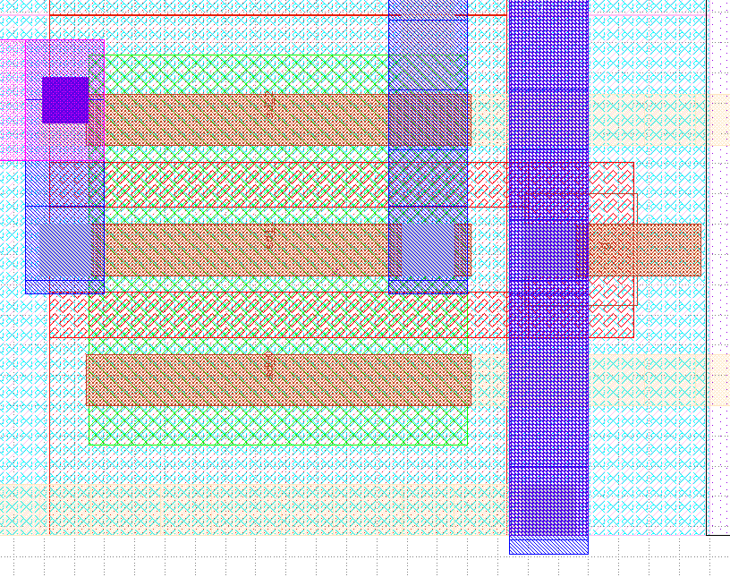
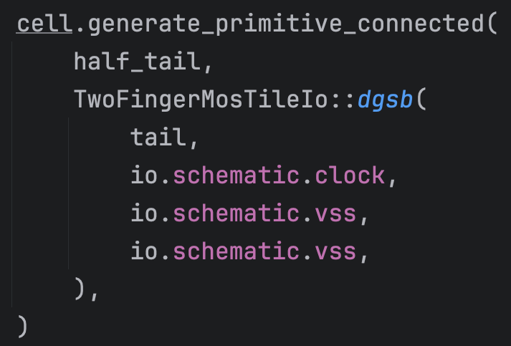
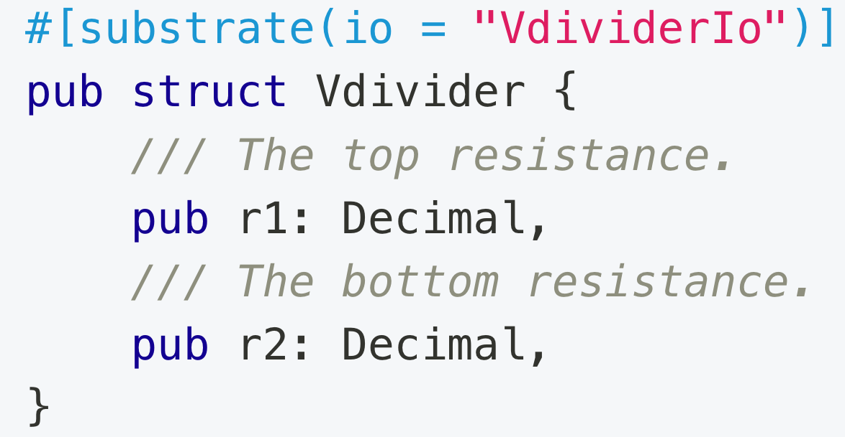
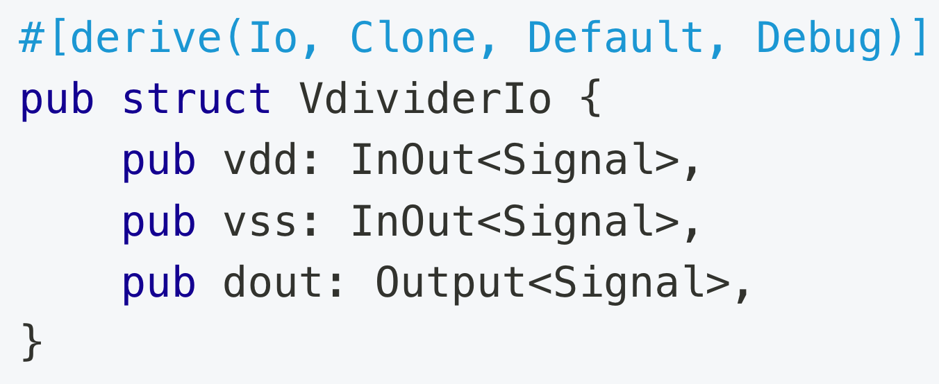
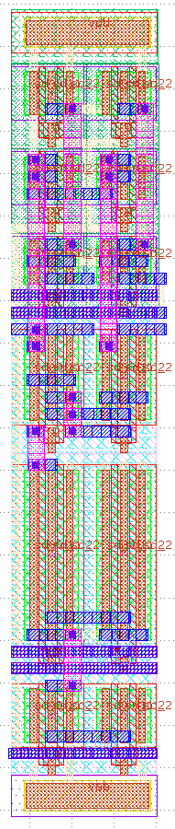
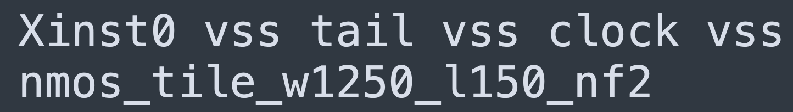
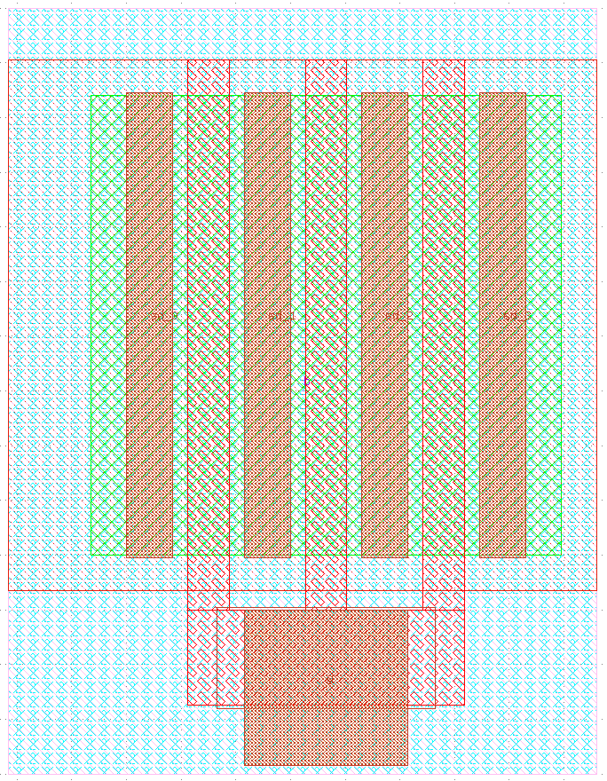
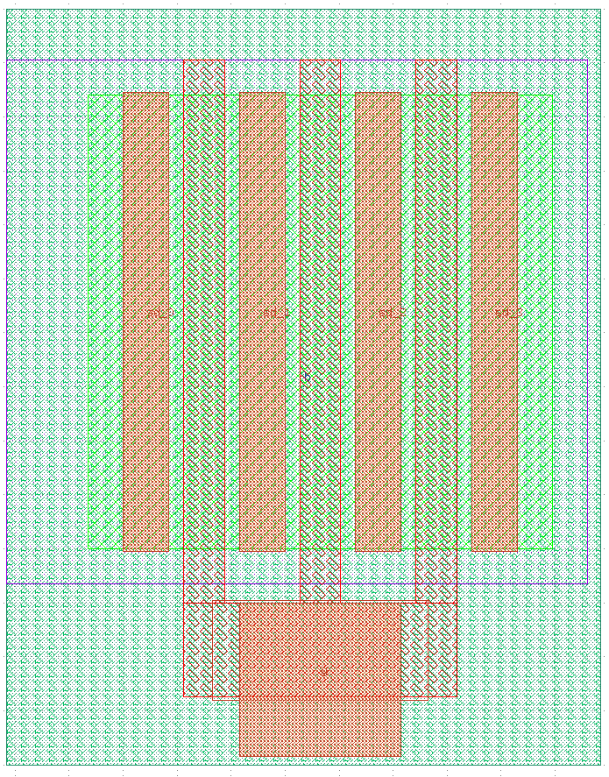
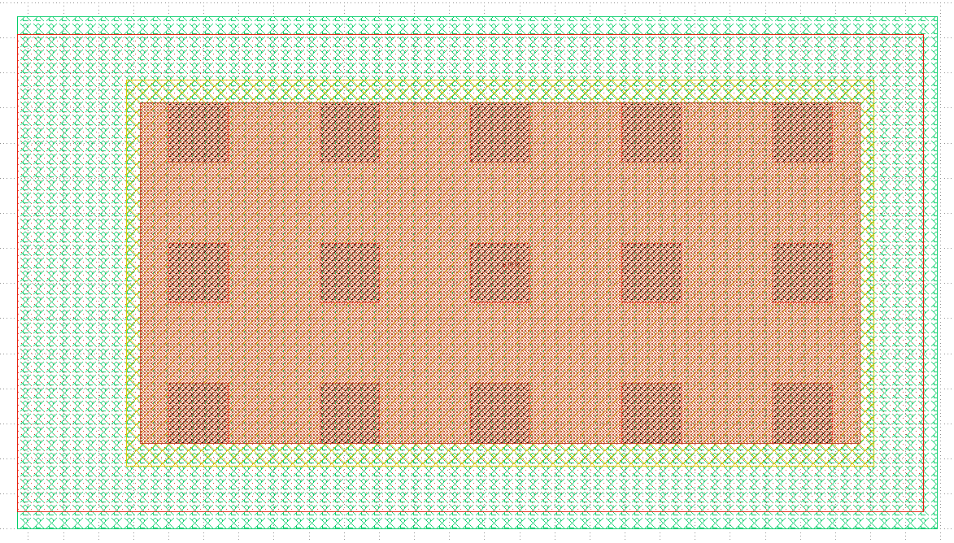
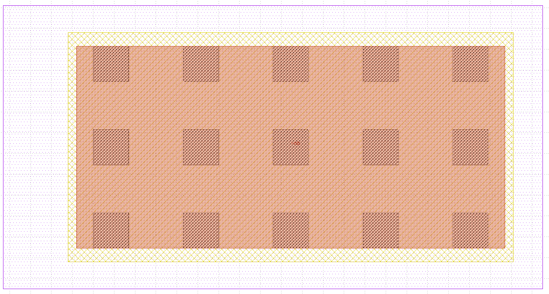
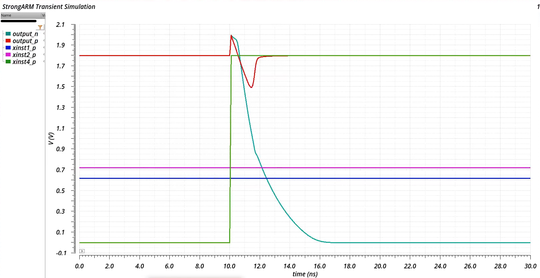
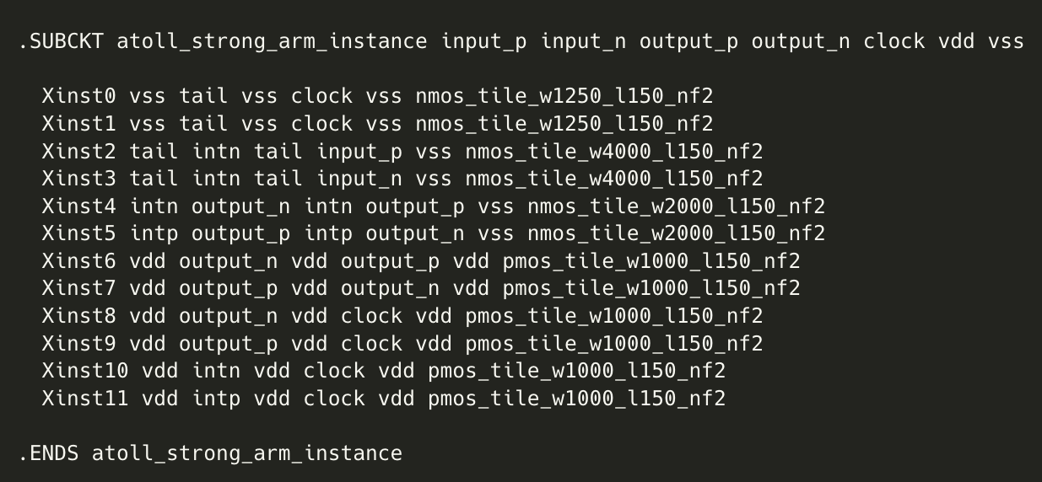
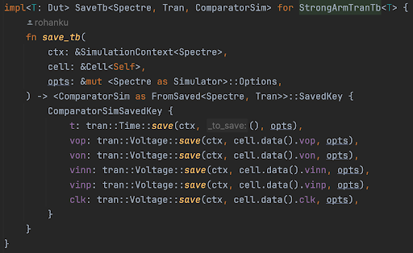
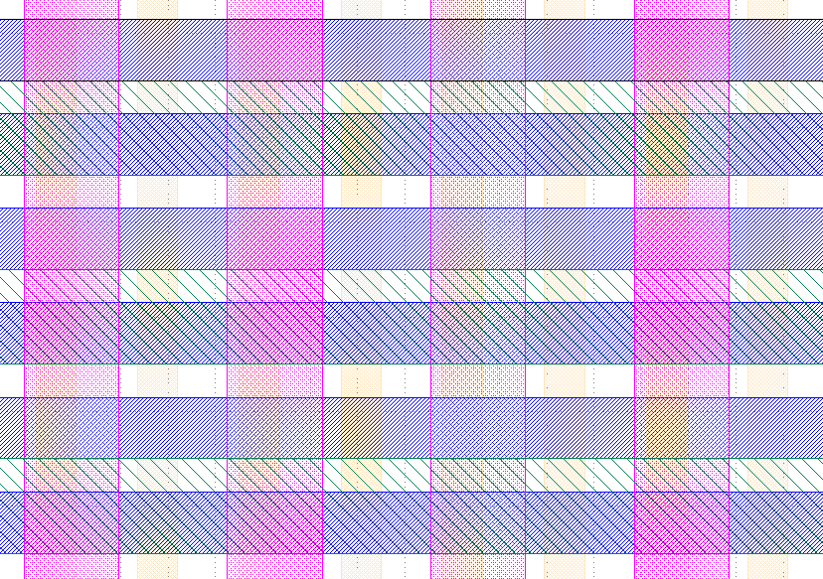
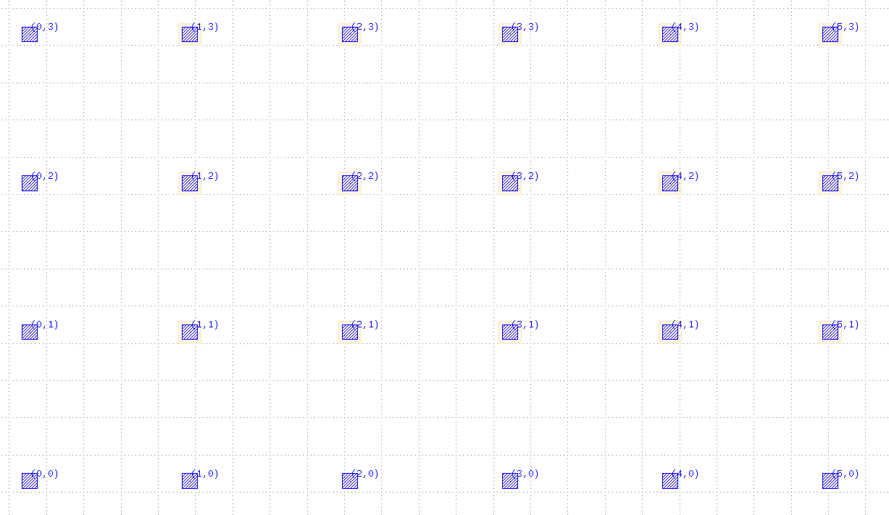
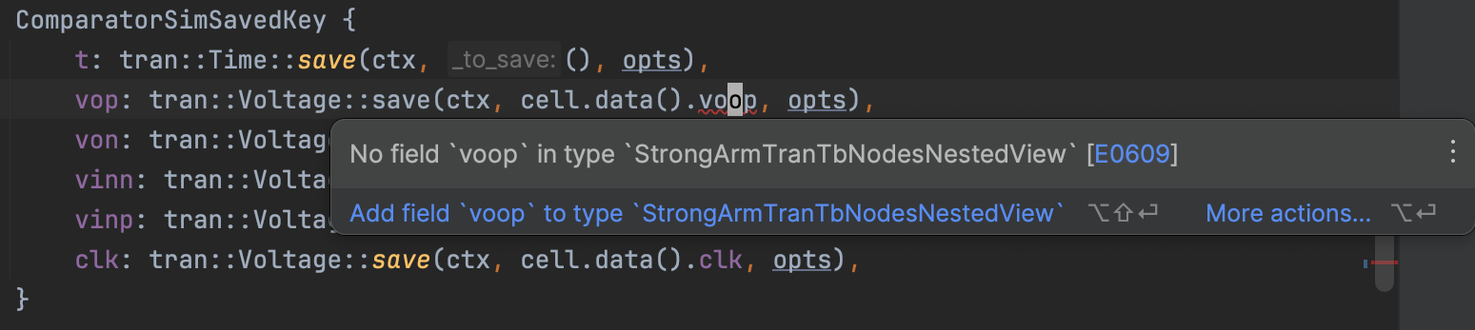
A strongly-typed AMS generator framework
Rohan Kumar, Rahul Kumar Advisor: Borivoje Nikolic
Blocks and IOs
Schemas and Schematic Cell IR (SCIR)
Simultaneous layout and schematic
Blocks are composable generator units (think modules/cells)
Blocks declare an IO type that specifies the input/output signals
Blocks declare the set of views they support by implementing the appropriate traits (Schematic and/or Layout)
Schematics/layouts can export nested views for making internal nodes/geometry accessible to other modules
Schemas provide a set of schematic primitives.
Ex: the SKY130 PDK provides core and IO devices
Ex: Spice provides raw subcircuits, resistors, capacitors, etc.
SCIR libraries are a collection of hierarchical cells in a schema
Can convert SCIR libraries between compatible schemas.
Netlist exporters consume SCIR libraries in their preferred schema and export them to a file.
ATOLL tracks schematic and layout state simultaneously
ATOLL determines which schematic nodes must be connected and instructs a routing algorithm to connect them in layout
T: Schematic
SCIR Library
(SKY130 PDK)
SCIR Library
(Spice)
Netlist file
(netlist.spice)
Simulator
(Ngspice)
The code on the left produces both a layout and the corresponding schematic.
Demo: StrongARM comparator
Example: StrongARM comparator in Sky130.
Can adjust transistor sizes and get a DRC/LVS clean layout
Left: a definition of an example voltage divider block; Right: the voltage divider’s IO type definition.
The compilation flow for producing simulator-compatible netlists from a Substrate schematic generator.
Simulation and Testbenches
Global Grid Layout Methodology
Simulators declare (at compile time) supported analyses
Testbench authors implement the FromSaved trait to extract quantities of interest from simulation output.
Substrate automatically uses FromSaved to insert save statements
Mistakes such as typos in the names of signals to save are caught at compile time.
ATOLL: Automatic translation of logical layout
An opinionated set of abstractions for tileable layout
Discrete, uniform routing grid on each routing layer
Users instantiate and place ATOLL tiles, do manual layout, then invoke auto router
The auto router connects net fragments that aren’t already connected
Can create primitive ATOLL tiles using any type that implements Layout
ATOLL extracts an abstract view that indicates the routing state of each grid point
Top: the comparator layout.
Left: the tiles from which the comparator is assembled.
Bottom-left: the generated netlist.
Code is available at
ucb-substrate/strongarm.
Future Work
Additional features we’d like to add:
FinFET layout support
PEX simulation with automatic node matching
Automatic LEF/LIB generation
Use Substrate for larger analog systems (eg. UCIe)
Plugins for other layout styles, simulators, and DRC/LVS tools
Left: The global ATOLL routing grid for Sky130, showing M0, M1, M2, and M3. Above: the location of M0/M1 grid points.
Top: type-checked save statements are translated to simulator directives.
Bottom: Substrate catches a typo. Substrate’s API does not let you reference non-existent nodes.

