Slide 1
PROPEL-V2, STAC-V1 Sierra Request for Quote
Contacts:
Felicia Guo: felicia_guo@berkeley.edu 917-520-6865
Rahul Kumar: rahulkumar@berkeley.edu 408-702-5845
&
Anita Flynn: aflynn@berkeley.edu 510-681-3931

Slide 2
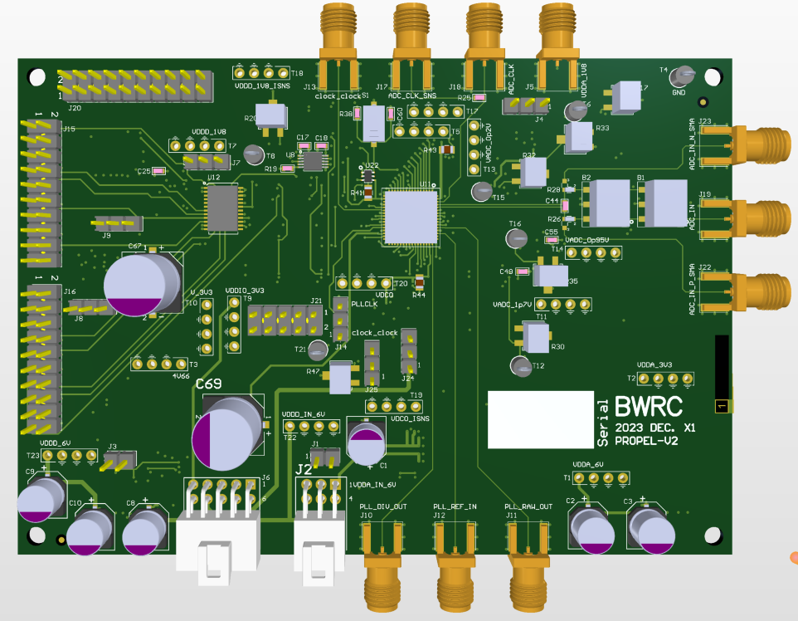
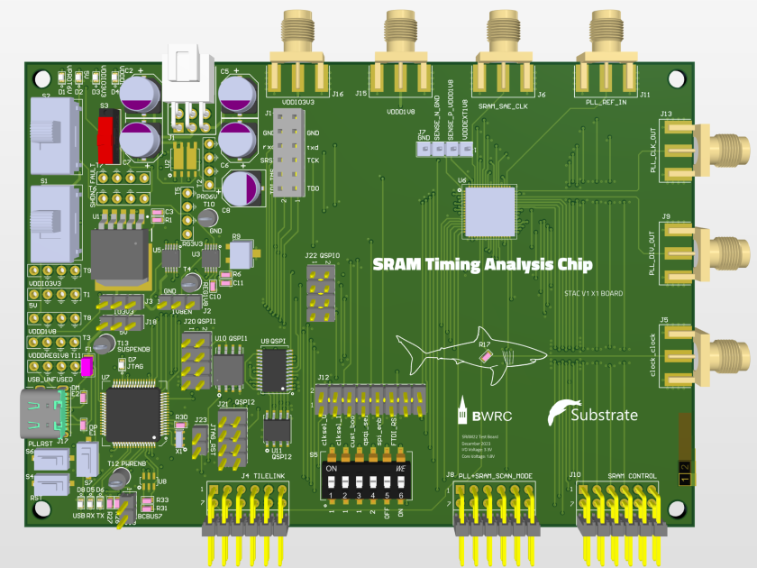
There are two board designs in this job with the same 6-layer stackup (i.e. the two designs can go on the same panel). They are named:
propel-v2 board
stac-v1 board
The stackup is 6-layers with a total board thickness of 55 mils (constrained by our use of edge-mount SMA connectors which require 60 mils). We are attaching the Sierra-proposed preliminary stackup which you sent us earlier (all dielectrics are FR4). We have controlled-impedance traces (on the top layer only 50 ohm microstrips single-ended).
Quantity of Boards:
We need 6 propel-v2 boards and 6 stac-v1 boards.
Please quote for 10-day delivery and for 5-day delivery.
The drawing is to scale
PROPEL-V2 (4.9in x 3.4in)
STAC-V1 (4.9in x 3.4in)

Slide 3
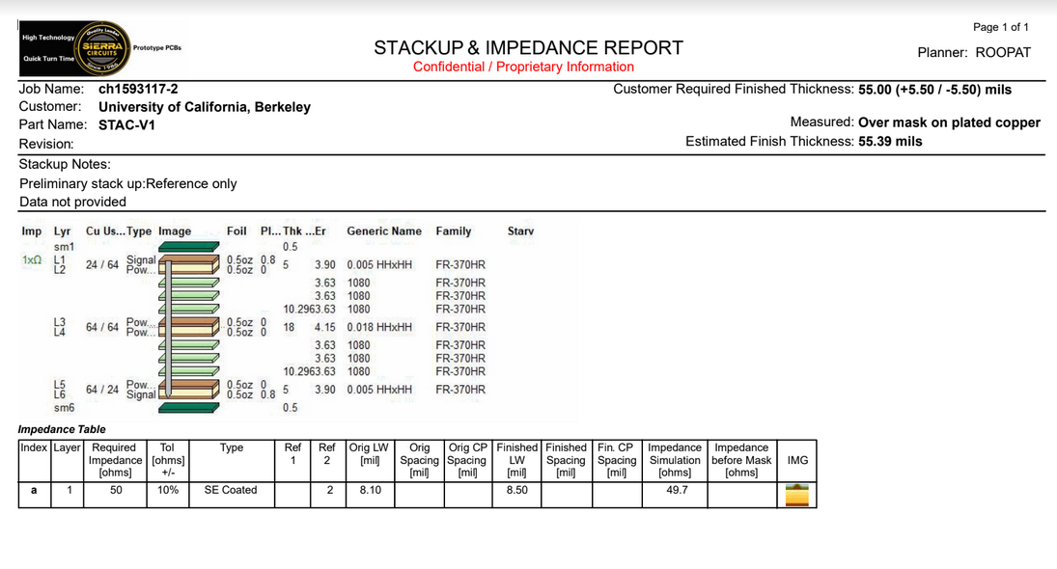
Stackup
Suggested_Stackup_Sierra.pdf (this file is attached, but a screenshot is also included here below)

Slide 4
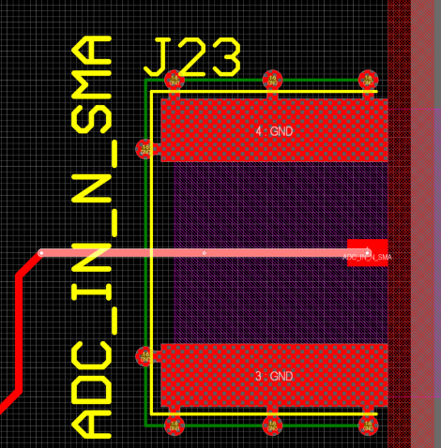
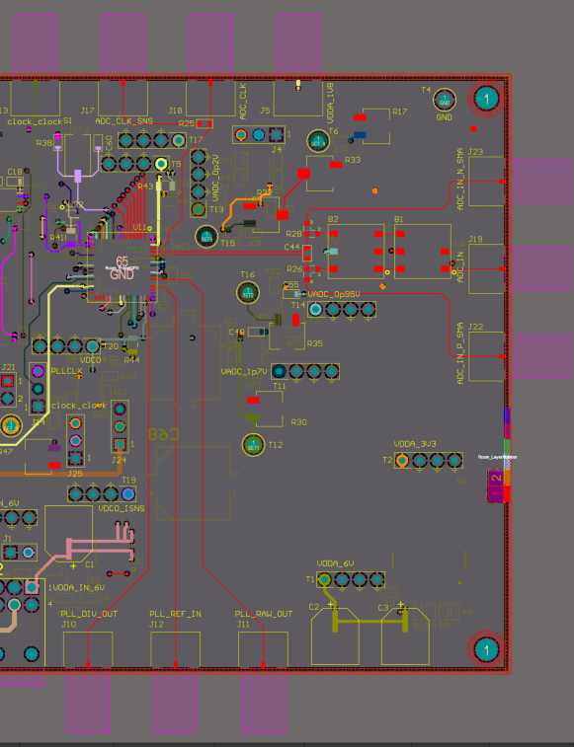
The impedance-controlled traces are
located on the top layer of the chip board as shown below.
microstrip single-ended coated on Propel-V2 board
Referenced to layer 2 ground
The impedance-controlled traces are denoted by these line widths of 8.501 mils:
This one is power test point, on bottom side. Does not need to be microstrip
8.501 mil

Slide 5
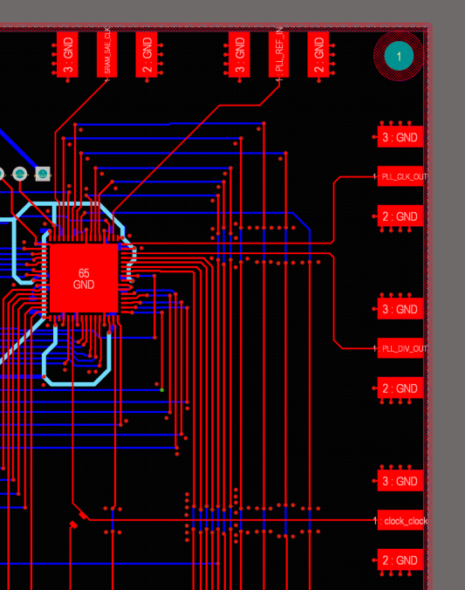
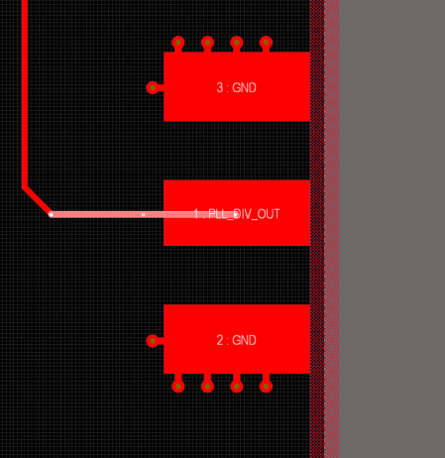
The impedance-controlled traces are
located on the top layer of the chip board as shown below.
microstrip single-ended coated on stac-v1 board
Referenced to layer 2 ground
The impedance-controlled traces are denoted by these line widths of 8.501 mils:
8.501 mil

Slide 6
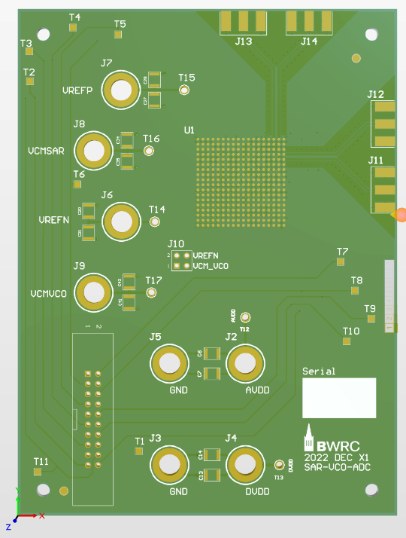
Two mounted cross-sections
Can you do a mounted cross-section
across each type of controlled impedance trace? Perhaps
something like this?
We only want these for educational purposes. You can cut them out from the extra “dummy” panel if you like (or perhaps you make them from “coupons”?)
Anyway, please don’t fabricate an entire extra panel for this request
(2700mil, 4189 mil)
(2400mil, 4089 mil)
2605mil, 4714mil
2530mil, 4639mil
2880mil, 4439mil
45 degree
2805mil, 4364mil

Slide 7
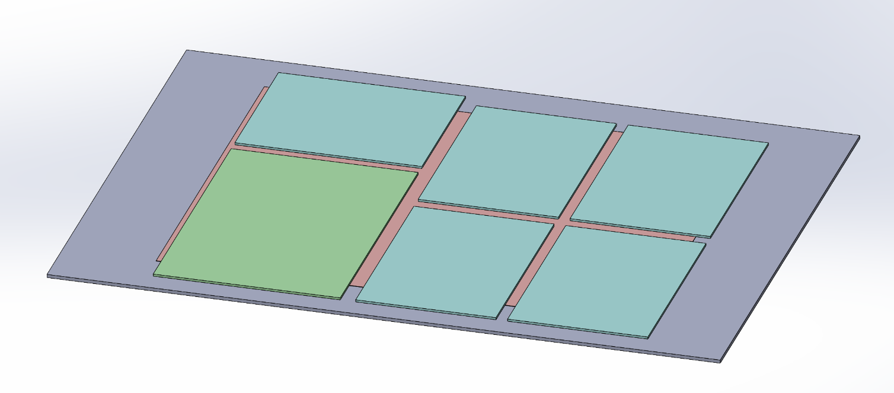
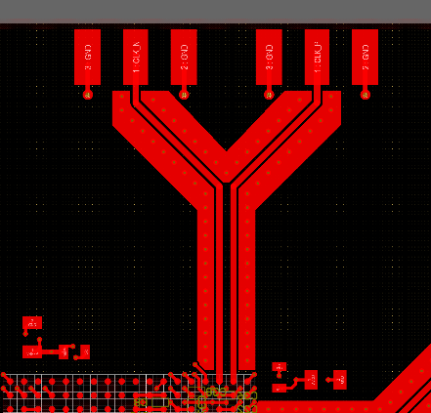

Appendix A
Out of curiosity, we’re wondering how you make mounted cross-sections? Is your process to use “coupons”? (We’re trying to write some documentation to explain mounted cross-sections to future students.)
Is it the case the Sierra’s CAM Shop would copy an area of the geometry from the ODB file, near where we want your cross-section, say this orange rectangle …
…and put it here on an edge as a “coupon”, then cut out the green rectangular area at the end of the process … and then mount it so the yellow dashed line is the cross-section at the surface that you look at under the microscope?

