Slide 1
10/31/23
Request for Layer Stackup from Sierra for PROPEL-V2
Felicia Guo felicia_guo@berkeley.edu (M) 917-520-6865
Anita Flynn aflynn@berkeley.edu (M) 510-681-3931

Slide 2
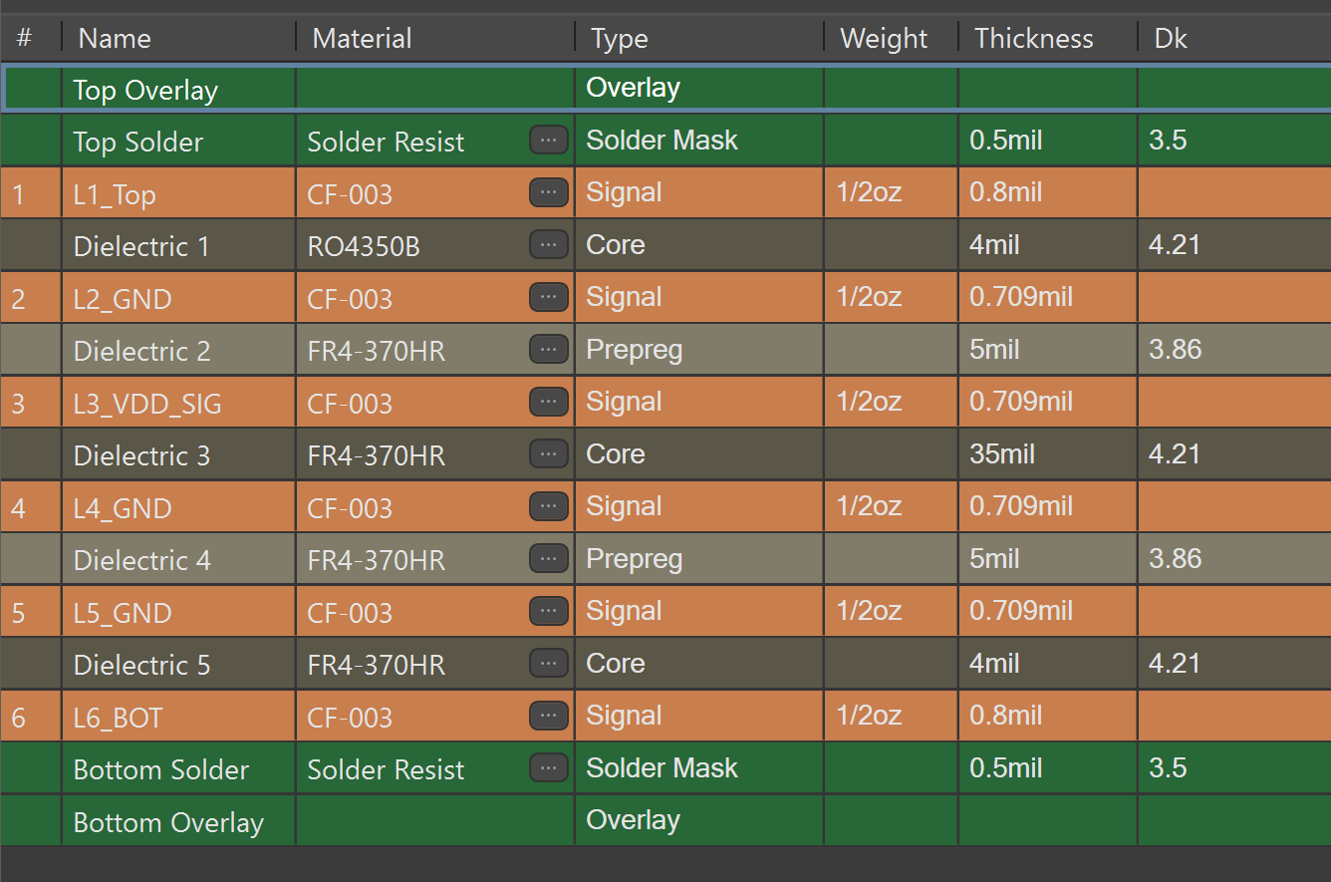
10/31/23
Justin,
Here is a screenshot of what we have typed into Altium for our proposed stackup. Can you give us something along these lines? We have controlled impedance traces only on the top layer, and we only have one class of those … single-ended 50 ohms +-10%. We would like a cap construction where the top layer of dielectric is core material of Rogers RO4350B. All other layers can be FR4. For overall thickness, see next slide …

Slide 3
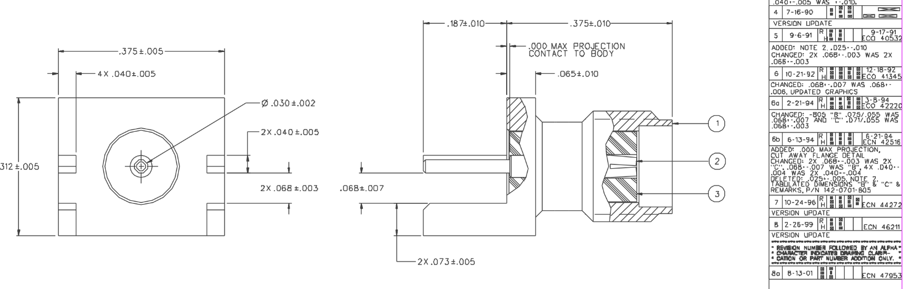
10/31/23 Our board thickness needs to accommodate these Cinch/Johnson end-launch SMA connectors (142-0701-801), which have a gap for accepting the board,of 68+-7 mils:
Worst case connector gap is 68mils – 7 mils = 61 mils.
I understand that Sierra’s standard board thickness tolerance is +-10%.
Therefore, we request a 55mil +-10% board thickness.

