Slide 1
Digicom Request for Quote
STAC v1 PCB Revision 1
Rahul Kumar (rahulkumar@berkeley.edu), Anita Flynn (aflynn@berkeley.edu)
November/December 2023

Slide 2
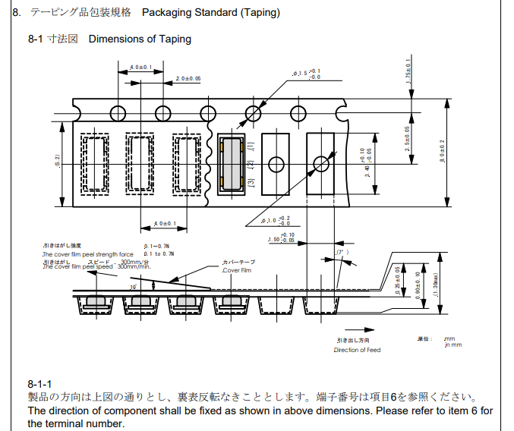
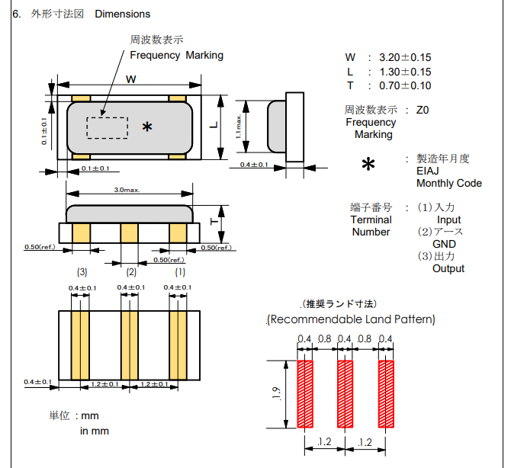

XTAL (Murata CSTNE12M0GH5L000R0)
The crystal looks symmetric, but according to the datasheet, pins 1 and 3 are not interchangeable. Need to make sure this gets assembled in the correct orientation.
The datasheet specifies the orientation of the crystal when it is packaged. Our PCB footprint indicates the pin numbers. Please make sure the crystal pins match the footprint pins when placed (ie. be careful not to rotate 180 degrees).
Links:
Digikey
Datasheet

Slide 3
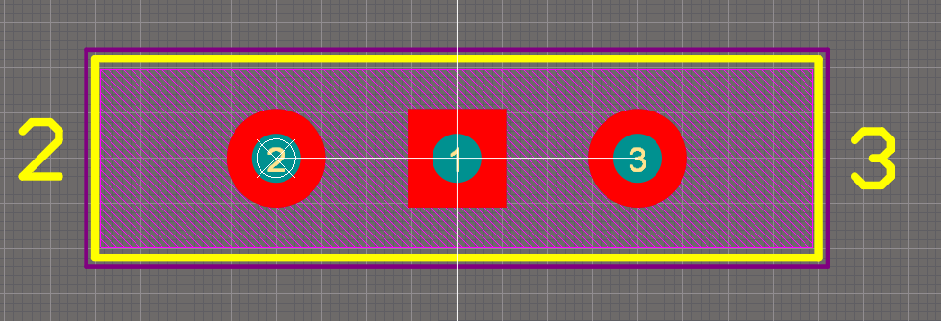
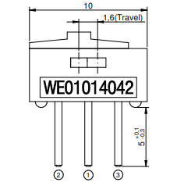
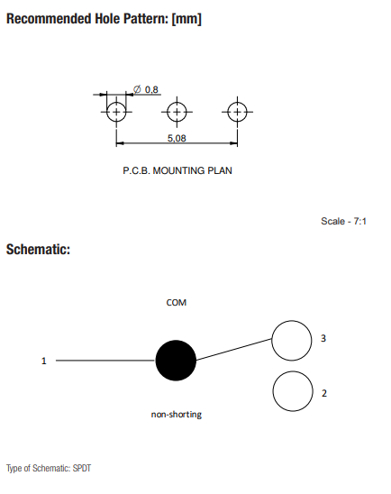
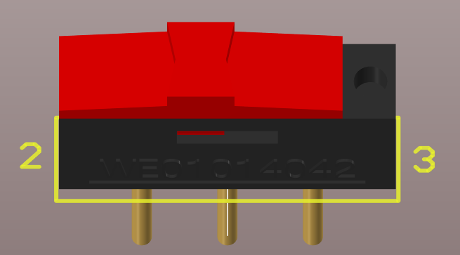
Power Switch (Wurth 450301014042)
This switch has an unconventional pin numbering: pin 1 is in the middle.
Our footprint indicates the locations of pins 2 and 3. Please make sure the switch is assembled matching the pin specification (ie. be careful not to rotate 180 degrees).
The switch has a circular dimple that indicates the location of pin 3 (see blue arrow).
Links:
Digikey
Datasheet

