Slide 1
Request for Quote: 6 boards
UC Berkeley, BWRC
12/14/2023
Rahul Kumar (rahulkumar@berkeley.edu, 408-702-5845)
Anita Flynn (aflynn@berkeley.edu, 510-681-3931)
Please don’t hesitate to contact us if you have any questions.

Slide 2
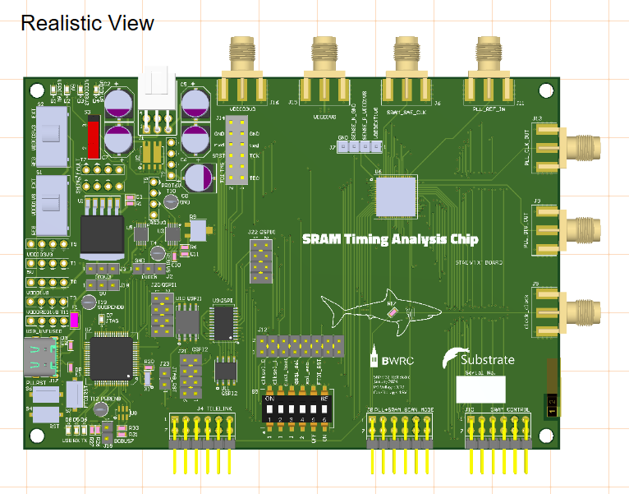
Request for quote
Could you please give us a quote to assemble:
6 of these STAC-V1-PCB boards
Lead-free solder paste
Please use heat sinks for soldering SMA connectors
We will provide the components/boards/spares/heatsinks/wrench
STAC-V1-PCB x 6

Slide 3
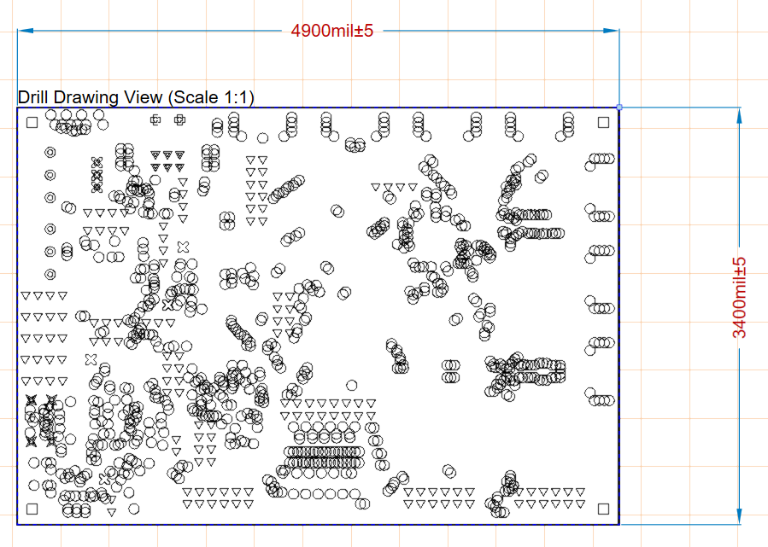
Drill Drawing with Dimensions

Slide 4
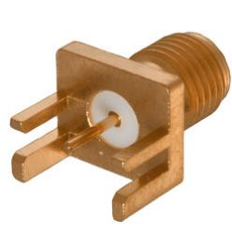
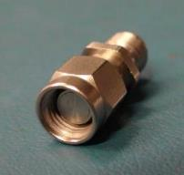
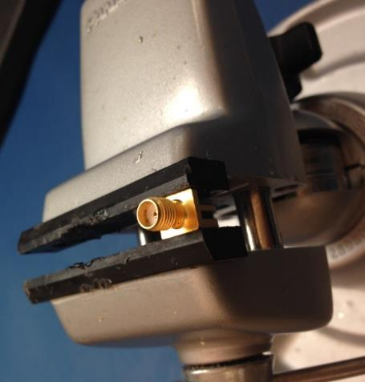
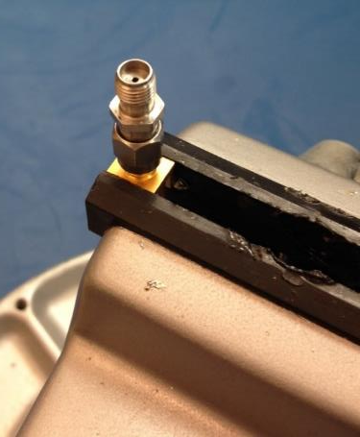
The 10 edge-mount SMA connectors on the chip board will need to be hand soldered. We will provide heat sinks. Please attach these heatsinks while hand soldering these SMA connectors to the chip board.
With hand soldering, and using these heat sinks, the heat sink will keep the face of the white plastic dielectric from melting/moving (and even if it does melt a little bit, the heat sink’s flat face should keep the face of the white plastic dielectric and the center pin at the correct level to remain within spec). After soldering, use the torque wrench to remove the heat sink.
female SMA connectors highlighted from previous side need to get assembled into edge of the board:
Please screw this heat sink into the female SMA which is held in a vise …

Slide 5
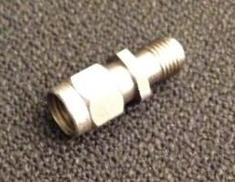
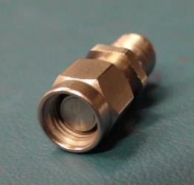
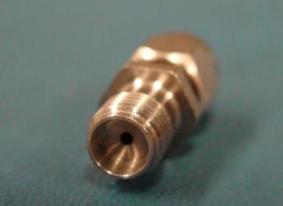
We will send along a number of these heat sinks:
Santron assembly tool #1209-03-P (basically, a heat sink)
This end looks like this:
This end looks like this:
This end is for screwing into SMA female connectors.
Ignore this end (this end is for screwing into SMA male connectors, which we don’t have on the boards).

Slide 6
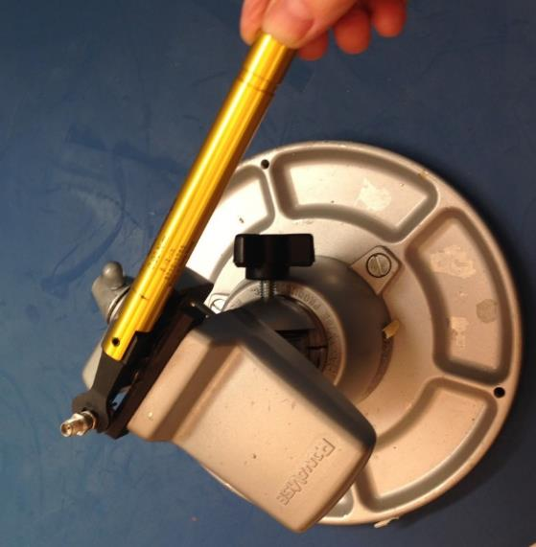
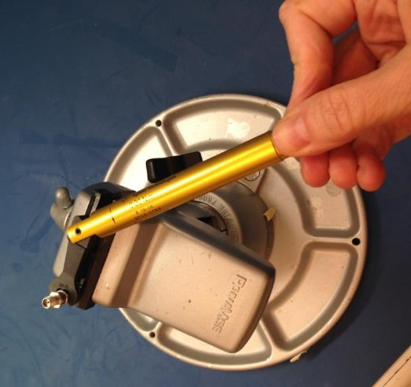
Then use the SMA torque wrench (hold it at the far end) to tighten the heat sink onto the SMA. Stop once the torque wrench “breaks” … that will ensure the heatsink is at the correct depth.
We will bring this torque wrench over to you.

Slide 7
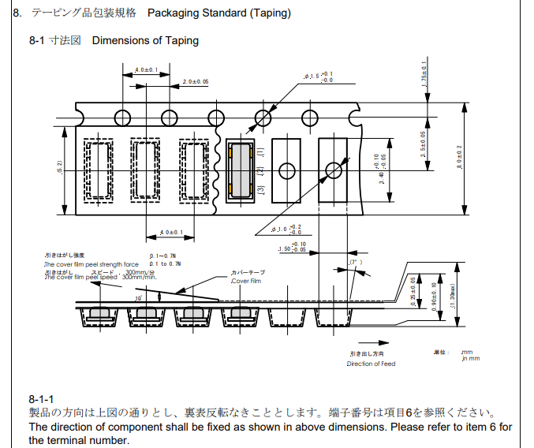
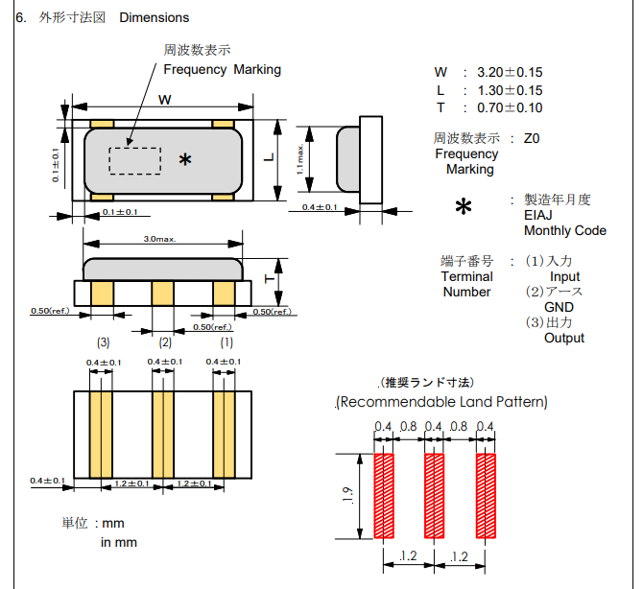

XTAL (Murata CSTNE12M0GH5L000R0)
Designator: X1
The crystal looks symmetric, but according to the datasheet, pins 1 and 3 are not interchangeable. Need to make sure this gets assembled in the correct orientation.
The datasheet specifies the orientation of the crystal when it is packaged. Our PCB footprint indicates the pin numbers. Please make sure the crystal pins match the footprint pins when placed (ie. be careful not to rotate 180 degrees).
Links:
Digikey
Datasheet

Slide 8
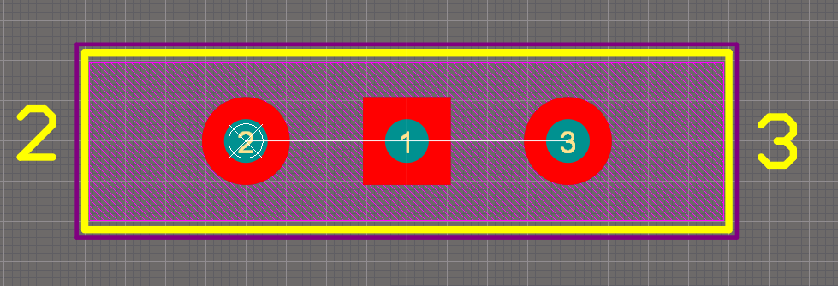
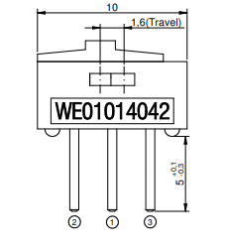
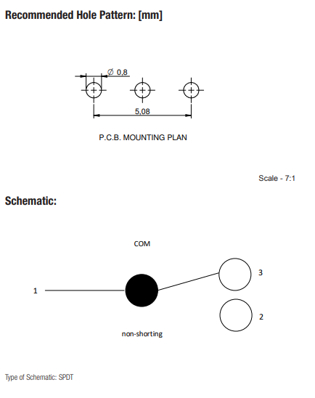
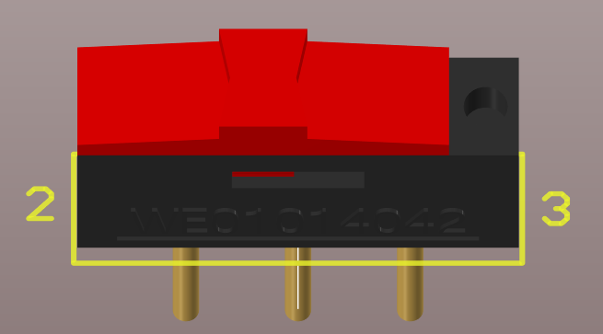
Power Switch (Wurth 450301014042)
Designator: S5
This switch has an unconventional pin numbering: pin 1 is in the middle.
Our footprint indicates the locations of pins 2 and 3. Please make sure the switch is assembled matching the pin specification (ie. be careful not to rotate 180 degrees).
The switch has a circular dimple that indicates the location of pin 3 (see blue arrow).
Links:
Digikey
Datasheet

