Slide 1
10/24/23
Board Physical Plan
STAC-v1

Slide 2
Fill in the following tables:
 | Name | Email | Cell Number
Chief: | Rahul Kumar | rahulkumar@berkeley.edu | 408-702-5845
Test Board name(s): | STAC Test Board v1
Board repo name in bwrcrepo.eecs.berkeley.edu “BWRC Boards” group | stac-pcb
Will there be more than 1 board design per panel? | no
Chip name: | STAC V1
Is the chip package a BGA? QFN? | QFN-64
Does the package have a corner mark? | Yes
Will a socket be used for the packaged die? Describe on a later page. | No
How many packaged die to be assembled onto the board? | 1
BGA ball or QFN pin pitch? | QFN (0.5mm)

Slide 3
How many boards to be fabricated? | 8
Do you want mounted cross-sections of your board? | yes
Surface finish required? ENIG, etc.? | ENIG
Preferred board house: | Sierra
How many boards do you want stuffed? | 7
Preferred assembly house: | Digicom
Do you want the assembly house to buy the parts? | No, purchase ourselves
Do you want the assembly house to buy the pastemask stencil? | Yes
Do you need a pastemask stencil for the BWRC custom jig? | No
Do you need any mechanical fixtures designed/machined? | No
Will you need to fit your test board on a probe station’s platen? | No

Slide 4
What dielectric laminate do you want for your board? | Rogers RO4350B on top, other layers FR4
Do you have edge-launch SMAs? What size fixed wrench? | Yes, 3/8”
Do you want the assembly house to use SMA heat sinks? | Yes
Do you have controlled impedance traces? SE? Diff pairs? | Yes, single-ended
Do you require vias-in-pads? | No
How many power domains? Please list: | 2 supplies on chip (VDDD1V8, VDDIO3V3)
For testing, do you require test pads for active scope probes? | yes
Do you require test pads for scope probe springy loops? | yes
Do you want test loops for attaching passive probes? | Test loops for ohming resistance
Do you need coax connectors to measure noise on power domains? | Yes

Slide 5
Please list/describe any other requirements for the test board:
Voltage Domains:
6V input
--> pass through power protection
-->pass through LDO (1st stage LDO, 4.66V output)
--> goes to 2 separate LDOs (2nd stage LDOs) , 1 for VDDD1V8, 1 for VDDIO3V3
Also have 2 points where we can bypass supplies directly to the chip (nets named *EXT*).
Switching controlled by jumper across two adjacent header pins.
No separate analog/digital supply voltages.

Slide 6
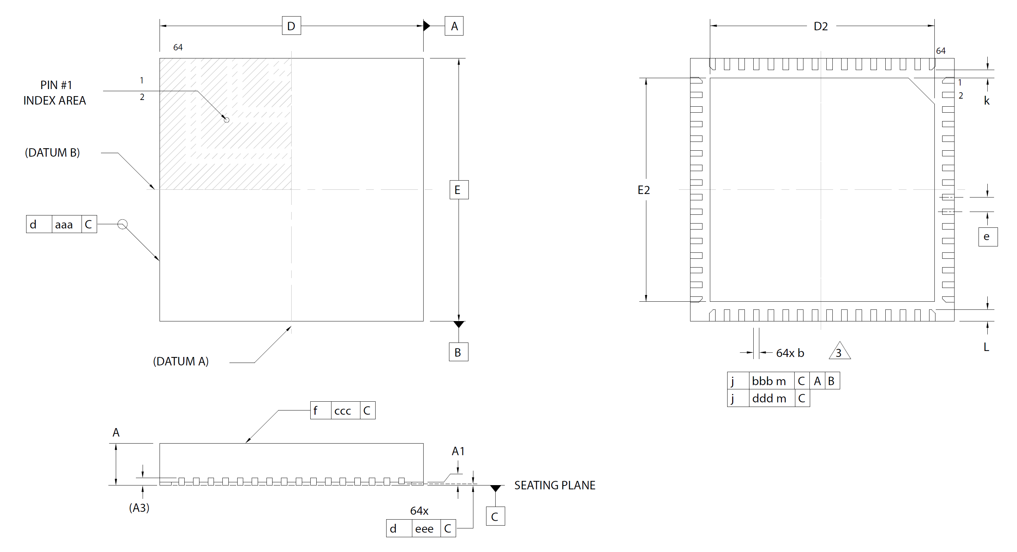
Drawing of package: QFN-64 w/exposed pad, 9mm x 9mm, 0.5mm pitch

Slide 7
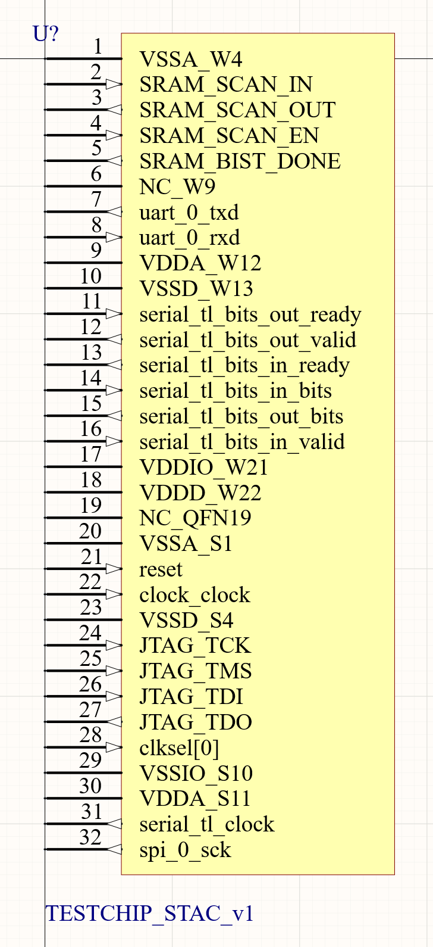
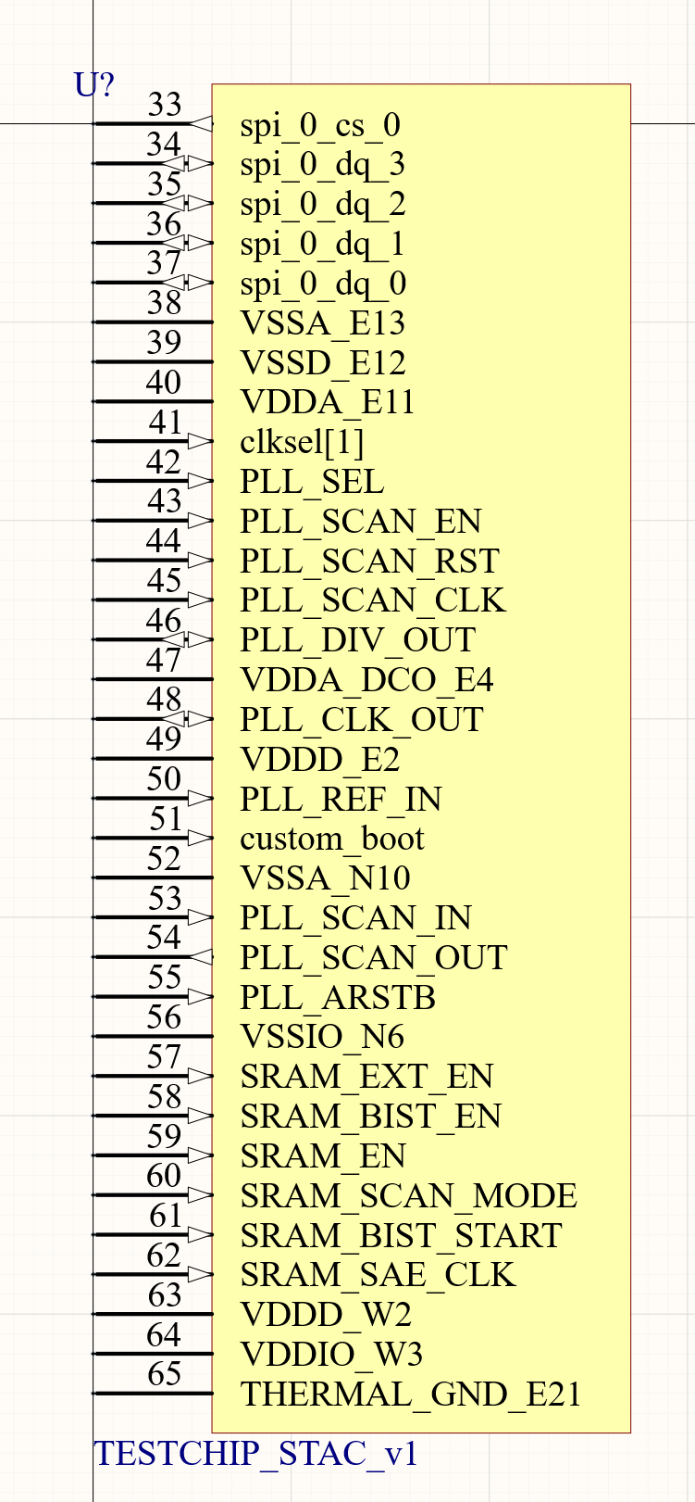
Please paste a screenshot of the Altium schematic symbol you created for you die and saved to BWRC.SchLib:

Slide 8
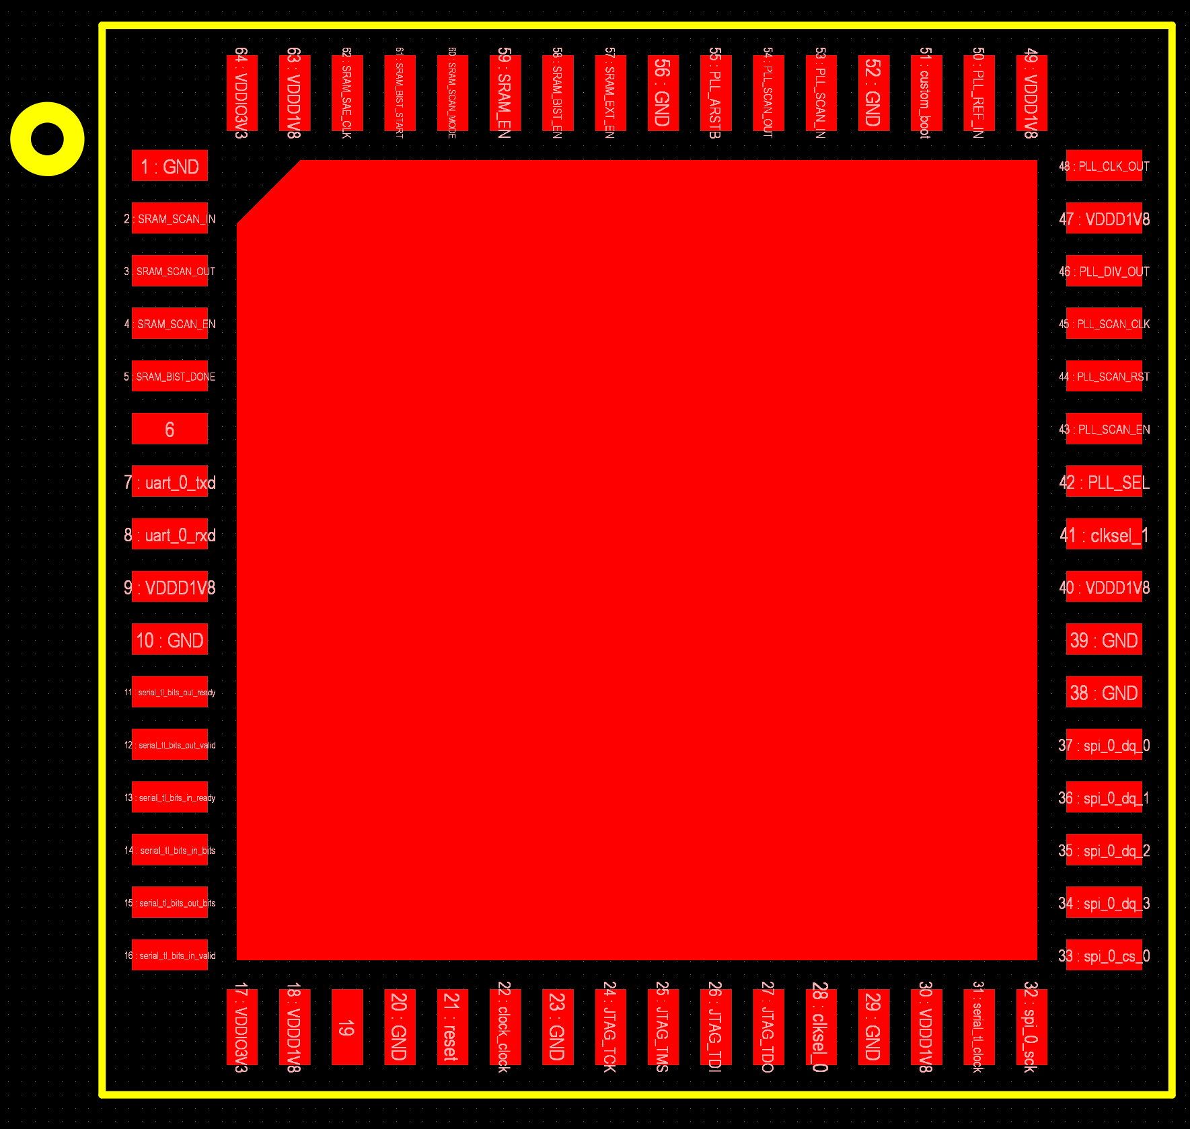
Pin 1
SRAM
PLL
Digital

Slide 9
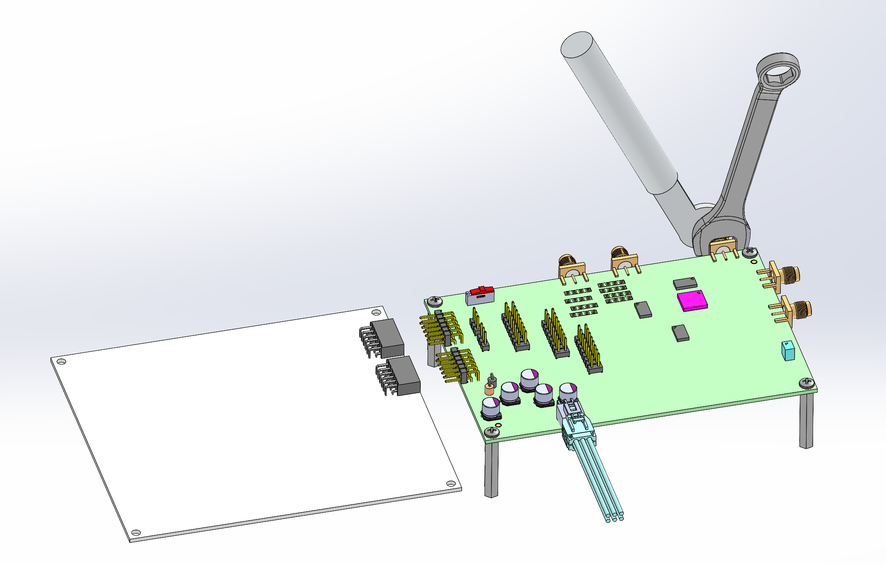
Physical constraints:
All controlled impedance traces can route on the top layer.
Main physical constraint: Have 2 PMOD headers (6x2 pins each) with a center-to-center pitch of 0.9”. These must be on one edge of the board and will directly plug in to an Arty A7-100T FPGA. First PMOD header is 9/16” from the Arty top edge.
Also have several SMA connectors.

