Slide 1
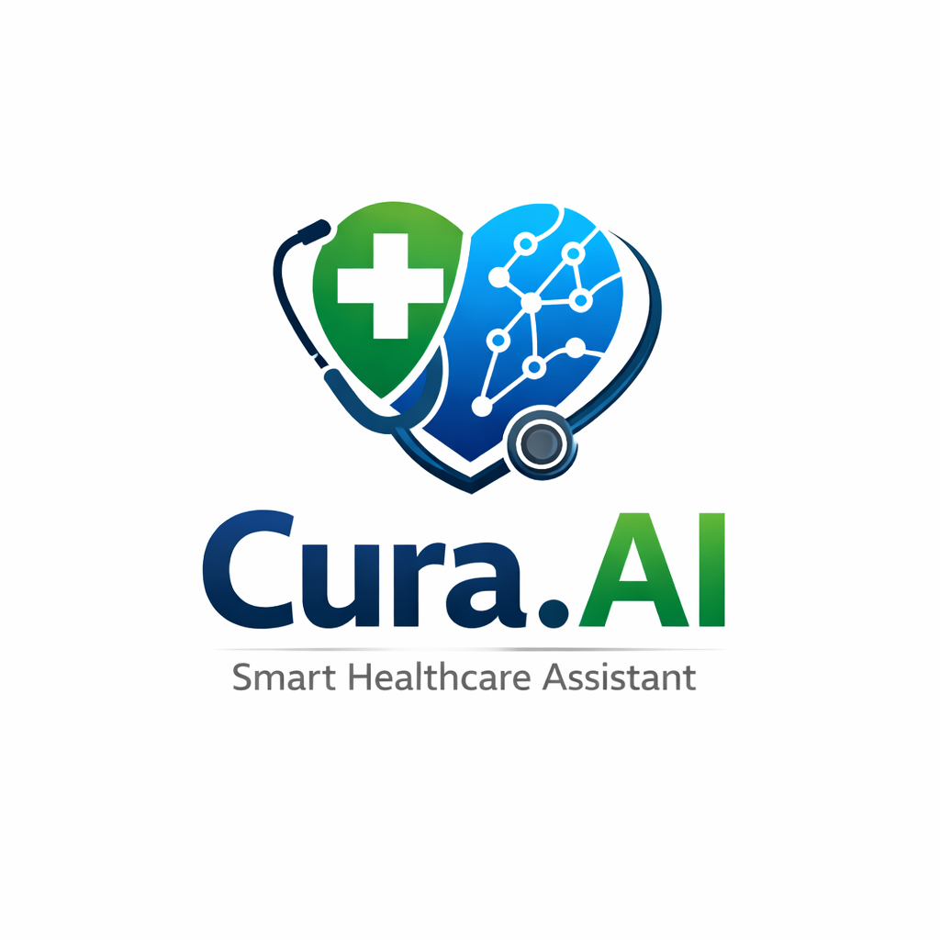

Cura AI
A Safety-Aware Multi-Agent Healthcare Assistant
Team Name: Aurix
Team Members: Rahul Kumar

Slide 2
THE PROBLEM
Healthcare Information Gap
Complex medical reports are difficult to interpret
Medication management errors cause thousands of hospitalizations annually
Drug interactions often go undetected until it's too late
Patients need accessible, intelligent health guidance
Patients struggle to understand medical terminology, track medications safely, and assess drug interactions

Slide 3



OUR SOLUTION
Intelligent Symptom Guidance
Smart Medication Management
Report Analysis
OCR-based medical report processing that converts complex medical jargon into simple, understandable summaries
AI-powered chat agent provides personalized health explanations using contextual memory
Automated reminders with built-in safety checks and drug interaction analysis

Slide 4
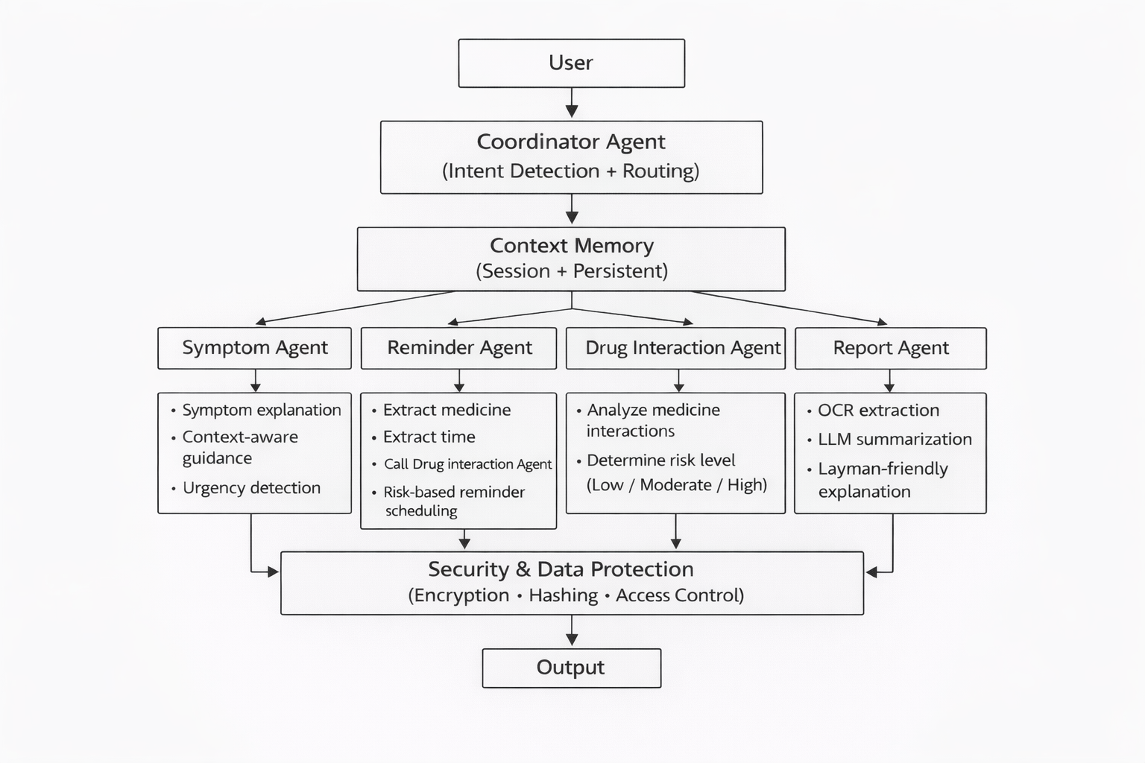
MULTI-AGENT ARCHITECTURE

Slide 5
Core Intelligent Agents
Coordinator Agent
Chat Agent
Reminder Agent
Drug Interaction Agent
Handles symptom-related queries and general health questions with contextual memory
Schedules medication reminders with risk-based gating and safety verification
Routes user requests based on detected intent to appropriate specialized agents
Analyzes medication combinations and classifies risk levels before scheduling
Report Agent
Uses Tesseract OCR to extract and simplify medical reports into layman-friendly explanations

Slide 6

Technology Stack
Backend
Frontend
Flask - REST API framework
SQLite - Persistent memory storage
Groq LLM API - Large language model inference
Gemini API - Large language model inference
Pytesseract - OCR for report analysis
Voice input - Web Speech API
Encryption - Fernet Symmetric Encryption
Hashing - SHA256
Access Control - Authentication
HTML/CSS/JavaScript - Modern chat UI
localStorage - Session management
Input - Voice and text input
Architecture
Custom multi-agent orchestration
Memory-augmented reasoning

Slide 7
Future Enhancements
Vector Database Integration
Enhanced semantic search and memory retrieval
PDF Report Support
Expand beyond image-based OCR
Clinical Evaluation Metrics
Structured testing and model comparison
Production Deployment
Docker containerization and scalable infrastructure

Slide 8

THANK YOU

