Slide 1
Advanced Machine Learning (STW7085CEM)
Coursework Project: Task 1 and Task 2
Task 1: Complaint Topic Discovery and Escalation-Risk Prediction (LDA + Gaussian Process)
Task 2: Fuzzy Logic Optimised Controller, GA Tuning and CEC'2005 Optimiser Comparison
Rahul Karn - Student ID 250163, CUID 16542734
Rashant Nayaju - Student ID 250117, CUID 16542767
Softwarica College of IT and E-Commerce (Coventry University), Kathmandu

Slide 2
OVERVIEW Project at a glance
- Two independent machine-learning studies for the module coursework.
- Task 1 (Python): unsupervised topic discovery and supervised escalation-risk prediction on consumer-finance complaints.
- Task 2 (MATLAB): a fuzzy logic controller for an assistive-care room, its genetic optimisation, and an optimiser comparison on benchmark functions.
- Both emphasise honest evaluation: calibration and a negative result in Task 1, and a reproducible 15-run protocol in Task 2.
- All work is reproducible from the linked repository.

Slide 3
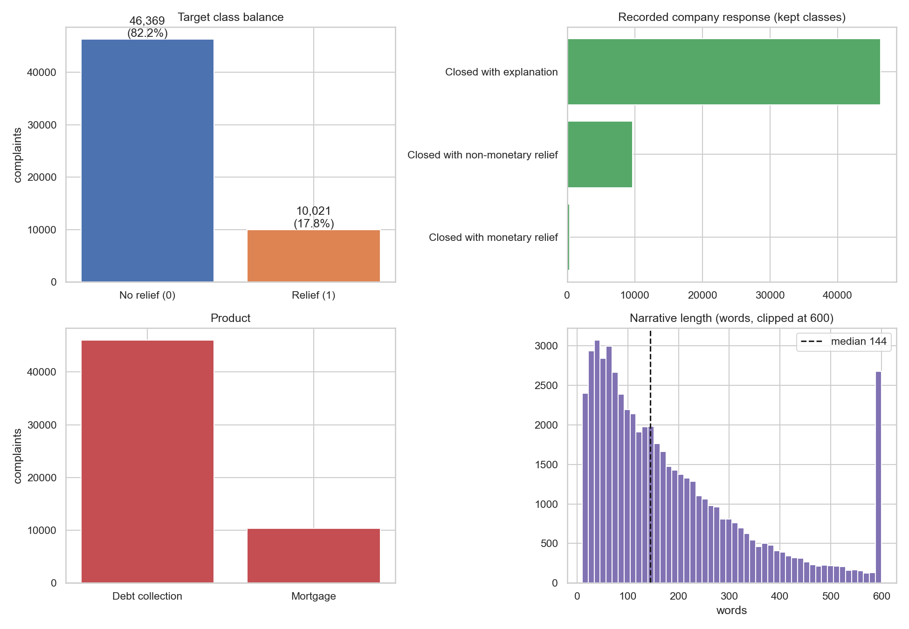
TASK 1 Problem and dataset
- Goal: find what people complain about, and predict which complaints win relief.
- Public consumer-finance complaints; 70,000 records cleaned to 56,390 narratives.
- Debt-collection and mortgage products, May 2023 to May 2026.
- Escalation label from the recorded company response (relief vs explanation).
- Class imbalance kept as-is: about 17.8 percent positive.

Slide 4
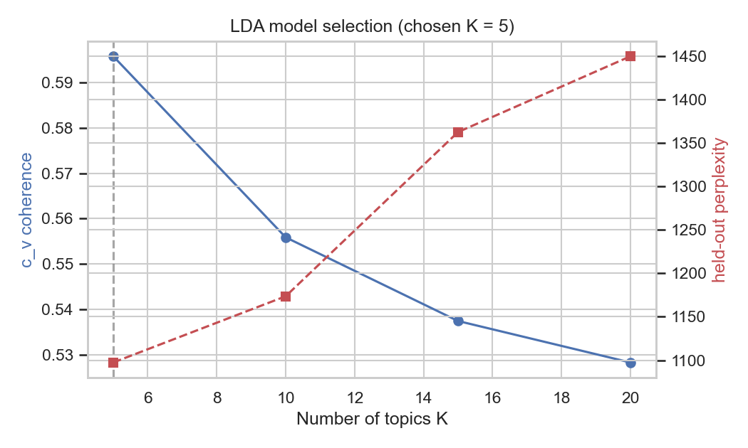
TASK 1 Methods
- Topic modelling: Latent Dirichlet Allocation, compared with LSA.
- Topic count chosen by c_v coherence; five clear themes.
- Escalation: Gaussian Process classifier by thresholding a GP regressor.
- RBF vs Matern kernel selected by marginal likelihood.
- SVM with Platt scaling as the baseline; five-fold cross-validation.
- Evaluation looks past accuracy to calibration, PR-AUC and uncertainty.

Slide 5
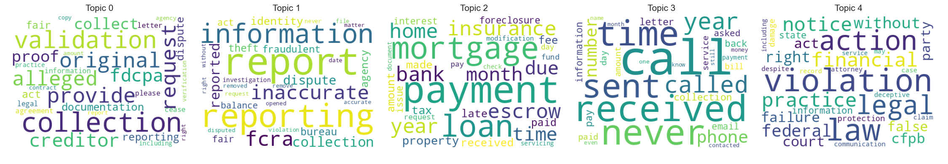
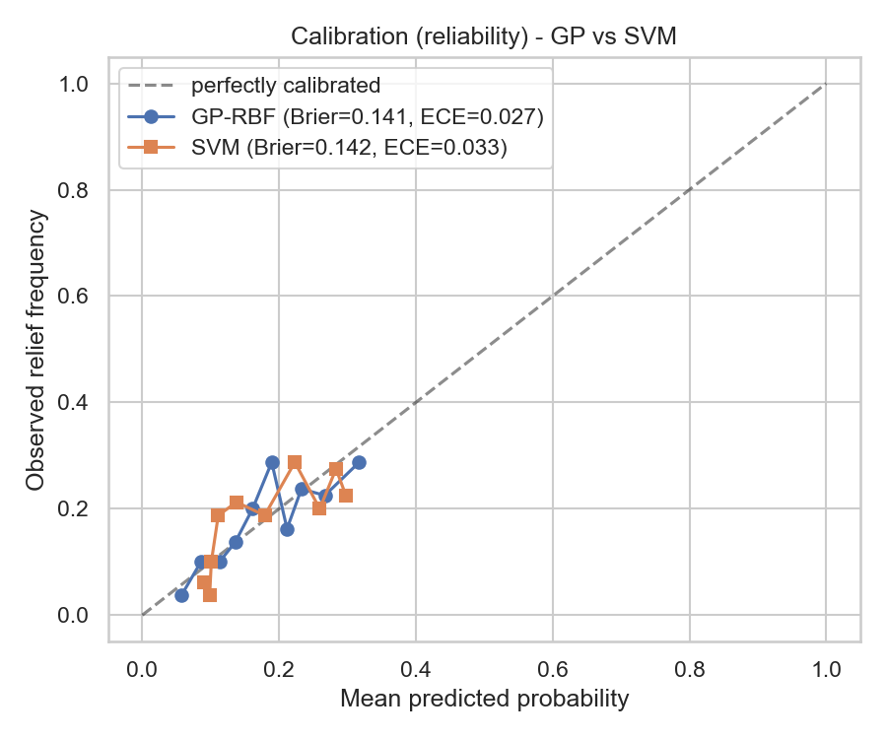
TASK 1 Key results
LDA gives clearer topics than LSA (coherence 0.65 vs 0.49)
GP slightly ahead of SVM; both well calibrated (Brier ~0.14)

Slide 6
TASK 1 Findings and honesty
- GP edges the SVM: macro-F1 0.57 vs 0.53, ROC-AUC 0.67 vs 0.65.
- Both models well calibrated; ECE about 0.02.
- Signal is weak: the narrative alone does not determine relief.
- Negative result reported honestly: GP uncertainty does not improve accuracy under selective prediction on this data.
- Topic-to-outcome link: credit-reporting complaints win relief most (0.27), mortgage servicing least (0.06).

Slide 7
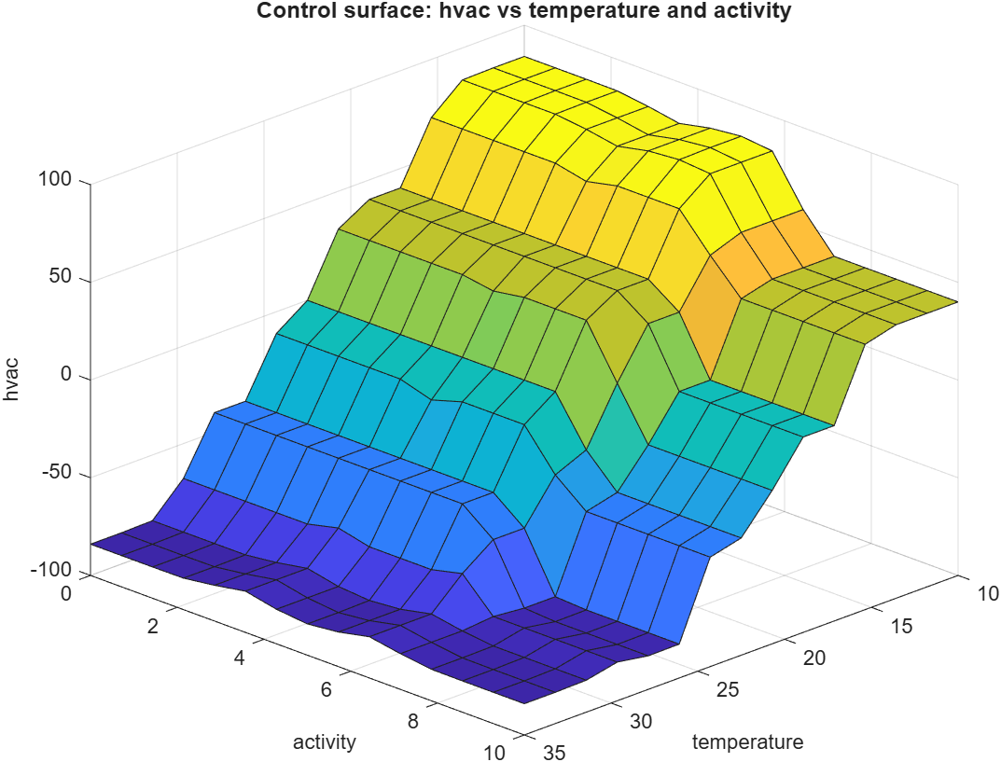
TASK 2 Fuzzy logic controller design
- Mamdani FLC for thermal comfort in one assistive-care room.
- Inputs: temperature (5 sets) and activity (3 sets).
- Output: a single signed HVAC command (-100 cooling to +100 heating).
- 15 rules, min/max inference, centroid defuzzification.
- Built and demonstrated in the MATLAB Fuzzy Logic Designer.

Slide 8
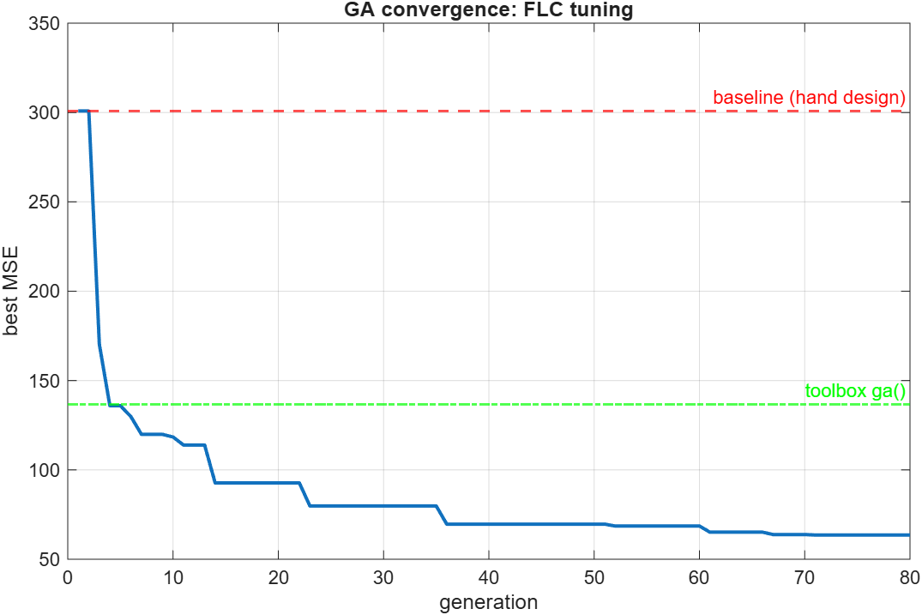
TASK 2 Genetic optimisation (Part 2)
- Real-coded GA tunes the membership-function breakpoints.
- Chromosome length L = 31; tournament selection, BLX-0.5 crossover, Gaussian mutation, elitism.
- Fitness: mean squared error against a target comfort dataset (286 examples).
- Result: MSE 300.9 -> 57.2, an 81 percent reduction.
- Our GA also beat the built-in solver (MSE 136.7) on the same budget.

Slide 9
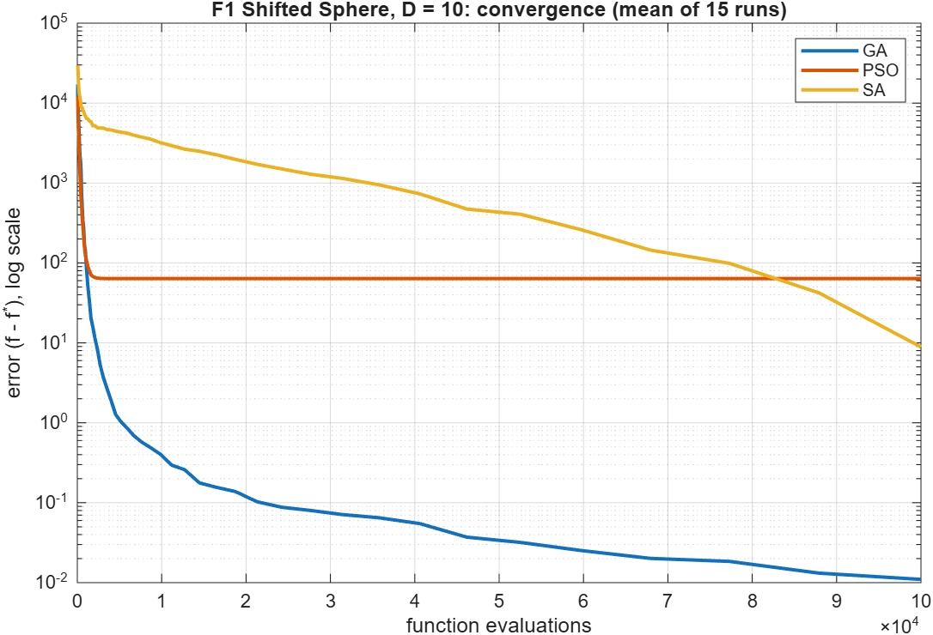
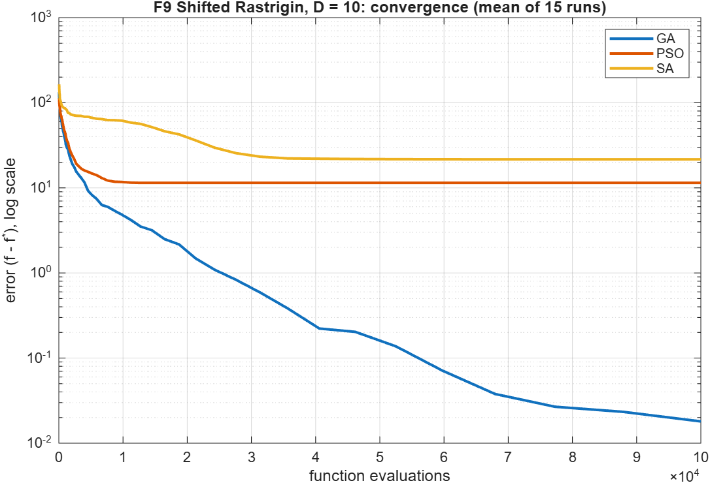
TASK 2 CEC'2005 optimiser comparison (Part 3)
Unimodal Sphere D=10: GA and PSO converge fastest
Multimodal Rastrigin D=10: GA is the most reliable

Slide 10
TASK 2 Comparison: what we found
- Two CEC'2005 functions: F1 Shifted Sphere and F9 Shifted Rastrigin.
- Three optimisers (GA, PSO, SA), dimensions D=2 and D=10, 15 runs each.
- Sphere: GA and PSO reach the optimum; SA weaker at high dimension.
- Rastrigin D=10: GA best (mean error 0.02), PSO ~11, SA ~22.
- Hand-coded results cross-checked against the Global Optimization Toolbox.

Slide 11
CONCLUSION Conclusions
- Task 1: LDA gives readable themes; GP matches the SVM and adds calibrated uncertainty, with limits reported honestly.
- Task 2: the GA improves the controller by 81 percent and is the most reliable optimiser on the hard multimodal benchmark.
- Both studies are fully reproducible from the repository.
- Author contributions and full methods are in each task report.

Slide 12
Thank you
Code, dataset, figures and reports:
https://github.com/rahulkarn250163/aml

