Slide 1

PowerPoint Slides
Computer Organisation and Architecture
Smruti Ranjan Sarangi, IIT Delhi
Chapter 7 Computer Arithmetic 2
PROPRIETARY MATERIAL. © 2014 The McGraw-Hill Companies, Inc. All rights reserved. No part of this PowerPoint slide may be displayed, reproduced or distributed in any form or by any means, without the prior written permission of the publisher, or used beyond the limited distribution to teachers and educators permitted by McGraw-Hill for their individual course preparation. PowerPoint Slides are being provided only to authorized professors and instructors for use in preparing for classes using the affiliated textbook. No other use or distribution of this PowerPoint slide is permitted. The PowerPoint slide may not be sold and may not be distributed or be used by any student or any other third party. No part of the slide may be reproduced, displayed or distributed in any form or by any means, electronic or otherwise, without the prior written permission of McGraw Hill Education (India) Private Limited.

Slide 2

These slides are meant to be used along with the book: Computer Organisation and Architecture, Smruti Ranjan Sarangi, McGrawHill 2015
Visit: http://www.cse.iitd.ernet.in/~srsarangi/archbooksoft.html

Slide 3

Outline
Addition
Multiplication
Division
Floating Point Addition
Floating Point Multiplication
Floating Point Division

Slide 4
Integer Division
Let us only consider positive numbers
N = DQ + R
N → Dividend
D → Divisor
Q → Quotient
R → Remainder
Properties
[Property 1:] R < D, R >= 0
[Property 2:] Q is the largest positive integer satisfying the equation (N = DQ +R) and Property 1

Slide 5
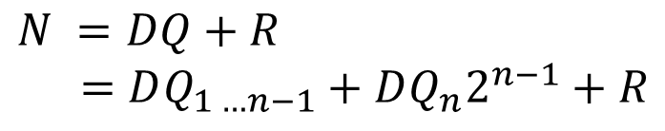
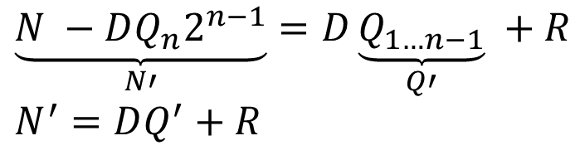
Reduction of the Divison Problem
$$N =DQ+R \\ =DQ_{1 …n−1}+DQ_{n}2^{n−1}+R$$
$$\underset{N′}{\underbrace{N −DQ_{n}2^{n−1}}}=D\underset{Q′}{\underbrace{Q_{1…n−1}}} +R \\ N^{′}=DQ^{′}+R$$
We have reduced the original problem to a smaller problem

Slide 6
How to Reduce the Problem
We need to find Q_{n}
We can try both values – 0 and 1
First try 1
If : N – D2^{n-1} >= 0, Q_{n} = 1 (maximize the quotient)
Otherwise it is 0
Once we have reduced the problem
We can proceed recursively

Slide 7
Iterative Divider
Divisor(D)
(U-D)
U
V
Initial: V holds the dividend (N), U = 0

Slide 8
Restoring Division
Algorithm 3: Restoring algorithm to divide two 32 bit numbers
Data: Divisor in D, Dividend in V, U = 0
Result: U contains the remainder (lower 32 bits), and V contains the quotient
i ← 0
for i < 32 do
i ← i + 1
/* Left shift UV by 1 position */
UV ← UV << 1
U ← U - D
if U ≥ 0 then
q ← 1
end
else
U ← U + D
q ← 0
end
/* Set the quotient bit */
LSB of V ← q
end

Slide 9
Example
Dividend (N)
00111
Divisor (D)
0011
U
V
beginning:
00000
0111
after shift:
00000
111X
1
end of
00000
1110
iteration:
after shift:
00001
110X
2
end of
00001
1100
iteration:
after shift:
00011
100X
3
end of
00000
1001
iteration:
4
after shift:
00001
001X
end of
00001
0010
iteration:
Quotient(Q)
0010
Remainder(R)
0001

Slide 10
Restoring Division
Consider each bit of the dividend
Try to subtract the divisor from the U register
If the subtraction is successful, set the relevant quotient bit to 1
Else, set the relevant quotient bit to 0
Left shift

Slide 11
Proof
Let us consider the value stored in UV (ignoring quotient bits)
After the shift (first iteration)
UV = 2N
After line 5, UV contains
UV – 2^{n}D = 2N – 2^{n}D = 2 * (N – 2^{n-1} D)
If (U – D) >= 0
N' = N – 2^{n-1}D.
Thus, UV contains 2N'

Slide 12
Proof - II
If (U – D) < 0
We know that (N = N')
Add D to U → Add 2^{n}D to UV
partial dividend = 2N = 2N'
In both cases
The partial dividend = 2N'
After 32 iterations
V will contain the entire quotient

Slide 13
Proof - III
At the end, UV = 2³² * N³² (N^{i} is the partial dividend after the i^{th} iteration)
N³¹ = DQ₁ + R
N³¹ – DQ₁ = N³² = R
Thus, U contains the remainder (R)

Slide 14
Time Complexity
n iterations
Each iteration takes log(n) time
Total time : n log(n)

Slide 15
Restoring vs Non-Restoring Division
We need to restore the value of register U
Requires an extra addition or a register move
Can we do without this ?
Non Restoring Division

Slide 16
Algorithm 4: Non-restoring algorithm to divide two 32 bit numbers
Data: Divisor in D, Dividend in V, U = 0
Result: U contains the remainder (lower 32 bits), and V contains the quotient
i ← 0
for i < 32 do
i ← i + 1
/* Left shift UV by 1 position */
UV ← UV << 1
if U ≥ 0 then
U ← U − D
end
else
U ← U + D
end
if U ≥ 0 then
q ← 1
end
else
q ← 0
end
/* Set the quotient bit */
lsb of V ← q
end
if U <0 then
U ← U + D
end

Slide 17
Dividend (N)
00111
Divisor (D)
0011
U
V
beginning:
00000
0111
after shift:
00000
111X
1
end of
11101
1110
iteration:
after shift:
11011
110X
2
end of
11110
1100
iteration:
after shift:
11101
100X
3
end of
00000
1001
iteration:
after shift:
00001
001X
4
end of
11110
0010
iteration:
U
V
end (U=U+D):
0001
0010
Quotient(Q)
0010
Remainder(R)
0001

Slide 18
Idea of the Proof
Start from the beginning : If (U – D) >= 0
Both the algorithms (restoring and non-restoring) produce the same result, and have the same state
If (U – D) < 0
We have a divergence
In the restoring algorithm
value(UV) = A
In the non-restoring algorithm
value(UV) = A - 2^{n}D

Slide 19
Proof - II
In the next iteration (just after the shift)
Restoring : value(UV) = 2A
Non - Restoring : value(UV) = 2A - 2^{n+1}D
If the quotient bit is 1 (end of iteration)
Restoring :
Subtract 2^{n}D
value(UV) = 2A - 2^{n}D
Non Restoring :
Add 2^{n}D
value(UV) = 2A – 2^{n+1}D + 2^{n}D = 2A - 2^{n}D

Slide 20
Proof - III
If the quotient bit is 0
Restoring
partial dividend = 2A
Non restoring
partial dividend = 2A – 2^{n}D
Next iteration (if quotient bit = 1) (after shift)
Restoring : partial dividend : 4A
Non restoring : partial dividend : 4A – 2^{n+1}D
Keep applying the same logic ….

Slide 21
Outline
Addition
Multiplication
Division
Floating Point Addition
Floating Point Multiplication
Floating Point Division

Slide 22
Adding Two Numbers (same sign)
Normalised form of a 32 bit (normal) floating point number.
A = (−1)^{S} × P × 2^{E−bias}, (1 ≤ P < 2, E ∈ Z, 1 ≤ E ≤ 254) (7.22)
Normalised form of a 32 bit (denormal) floating point number.
A = (−1)^{S} × P × 2⁻¹²⁶, (0 ≤ P < 1) (7.23)
Symbol
Meaning
S
Sign bit (0(+ve), 1(-ve))
P
Significand (form: 1.xxx(normal) or 0.xxx(denormal))
M
Mantissa (fractional part of significand)
E
(exponent + 127(bias))
Z
Set of integers
Recap : Floating Point Number System

Slide 23
Addition
Add : A + B
Unpack the E fields → E_{A} , E_{B}
Let the E field of the result be → E_{C}
Unpack the significand (P)
P contains → 1 bit before the decimal point, 23 mantissa bits (24 bits)
Unpack to a 25 bit number (unsigned)
W → Add a leading 0 bit, 24 bits of the signficand

Slide 24
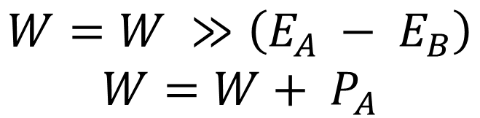
Addition - II
With no loss of generality
Assume E_{A} >= E_{B}
Let significands of A and B be P_{A} and P_{B}
Let us initially set W ← unpack (P_{B})
We make their exponents equal and shift W to the right by (E_{A} – E_{B}) positions
$$W=W ≫\left(E_{A} − E_{B}\right)$$
$$W=W+ P_{A}$$

Slide 25
Renormalisation
Let the significand represented by register, W, be P_{W}
There is a possibility that P_{W} >= 2
In this case, we need to renormalise
W ← W >> 1
E_{A} ← E_{A} + 1
The final result
Sign bit (same as sign of A or B)
Significand (P_{W}), exponent field (E_{A})

Slide 26
Example
Example: Add the numbers: 1.01₂ * 2³ + 1.11₂ * 2¹
Answer:
The decimal point in W is shown for enhancing readability. For simplicity, biased notation not used.
A = 1.01 * 2³ and B = 1.11 * 2¹
W = 01.11 (significand of B)
E = 3
W = 01.11 >> (3-1) = 00.0111
W + P_{A} = 00.0111 + 01.0100 = 01.1011
Result: C = 1.011 * 2³

Slide 27
Example - II
Example: Add : 1.01₂ * 2³ + 1.11₂ * 2²
Answer:
The decimal point in W is shown for enhancing readability. For simplicity, biased notation not used.
A = 1.01 * 2³ and B = 1.11 * 2²
W = 01.11 (significand of B)
E = 3
W = 01.11 >> (3-2) = 00.111
W + P_{A} = 00.111 + 01.0100 = 10.001
Normalisation: W = 10.001 >> 1 = 1.0001, E = 4
Result: C = 1.0001 * 2⁴

Slide 28
Rounding
Assume that we were allowed only two mantissa bits in the previous example
We need to perform rounding
Terminology :
Consider the sum(W) of the significands after we have normalised the result
W ← (P + R) * 2⁻²³ (R < 1)

Slide 29
Rounding - II
P represents the significand of the temporary result
R (is a residue)
Aim :
Modify P to take into account the value of R
Then, discard R
Process of rounding : P → P'

Slide 30
IEEE 754 Rounding Modes
Truncation
P' = P
Example in decimal : 9.5 → 9, 9.6 → 9
Round to +∞
P' = ⎡P +R⎤
Example in decimal : 9.5 → 10, -3.2 → -3

Slide 31
IEEE 754 Rounding - II
Round to -∞
P' = ⌊P+R⌋
Example in decimal : 9.5 → 9, -3.2 → -4
Round to nearest
P' = [P + R]
Example in decimal :
9.4 → 9 , 9.5 → 10 (even)
9.6 → 10 , -2.3 → -2
-3.5 → -4 (even)

Slide 32
Rounding Modes – Summary
Rounding Mode
Condition for incrementing the significand
Sign of the result (+ve)
Sign of the result (-ve)
Truncation
Round to +∞
Round to −∞
Round to Nearest
R > 0
(R > 0.5)||(R = 0.5 ∧ lsb(P) = 1)
R > 0
(R > 0.5)||(R = 0.5 ∧ lsb(P) = 1)
∧ (logical AND), R (residue)

Slide 33
Implementing Rounding
We need three bits
lsb(P)
msb of the residue (R) → r (round bit)
OR of the rest of the bits of the residue (R) → s (sticky bit)
Condition on Residue
Implementation
R > 0
R = 0.5
R > 0.5
r ∨ s = 1
r ∧ s = 1
r ∧ s = 1
r (round bit), s(sticky bit)

Slide 34
Renormalisation after Rounding
In rounding : we might increment the significand
We might need to renormalise
After renormalisation
Possible that E becomes equal to 255
In this, case declare an overflow

Slide 35
Addition of Numbers (Opposite Signs)
C = A + B
Same assumption E_{A} >= E_{B}
Steps
Load W with the significand of B (P_{B})
Take the 2's complement of W (W = -B)
W ← W >> (E_{A} – E_{B})
W ← W + P_{A}
If (W < 0) replace it with its 2's complement. Flip the sign of the result.

Slide 36
Addition of Numbers (Opposite Signs)-II
Normalise the result
Possible that W < 1
In this case, keep shifting W to the left till it is in normal form. (simultaneously decrement E_{A})
Round and Renormalise

Slide 37
C = A + B
A=0?
Y
C=B
N
W < 0?
N
B=0?
Y
C=A
Y
N
W
- W (2's complement)
Swap A and B
such that E <= E
A
B
S = S
W
P >> (E_{A} – E_{B})
B
Normalize W and
Overflow or
Y
E
E
A
, S
sign(A)
update E
underflow?
Report
Y
N
sign(A) = sign(B)?
Overflow or
Y
Construct C out
underflow?
of W, E, and S
N
N
Report
W
- W (2's complement)
Round W
C
W
W + P
A
Normalize W and
update E

Slide 38
Outline
Addition
Multiplication
Division
Floating Point Addition
Floating Point Multiplication
Floating Point Division

Slide 39
Multiplication of FP Numbers
Steps
E ← E_{A} + E_{B} - bias
W ← P_{A} * P_{B}
Normalise (shift left or shift right)
Round
Renormalise

Slide 40
C = A * B
A=0?
Y
C=0
N
Normalize W and
Y
update E
B=0?
C=0
N
Overflow or
Y
S
sign(A) sign(B)
underflow?
E
E + E - bias
N
Report
A
B
Round W
Construct C out
of W, E, and S
Normalize W and
Overflow or
Y
update E
C
underflow?
N
Report
Y
Overflow or
W
P
P
underflow?
A
*
B
Report
N

Slide 41
Outline
Addition
Multiplication
Division
Floating Point Addition
Floating Point Multiplication
Floating Point Division

Slide 42
Simple Division Algorithm
Divide A/B to produce C
There is no notion of a remainder in FP division
Algorithm
E ← E_{A} – E_{B} + bias
W ← P_{A} / P_{B}
normalise, round, renormalise
Complexity : O(n log(n))

Slide 43
Goldschmidt Division
Let us compute the reciprocal of B (1/B)
Then, we can use the standard floating point multiplication algorithm
Ignoring the exponent
Let us compute (1/P_{B})
If B is a normal floating point number
1 <= P_{B} < 2
P_{B} = 1 + X (X < 1)

Slide 44
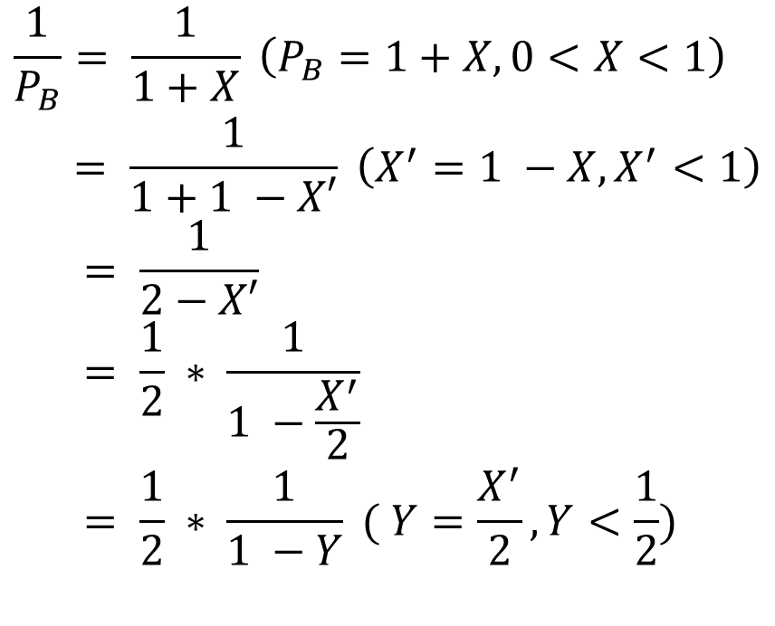
Goldschmidt Division - II
$$\frac{1}{P_{B}}= \frac{1}{1+X} \left(P_{B}=1+X, 0<X<1\right) \\ = \frac{1}{1+1 −X′} \left(X^{′}=1 −X, X^{′}<1\right) \\ = \frac{1}{2−X′} \\ = \frac{1}{2} ∗ \frac{1}{1 −\frac{X^{′}}{2}} \\ = \frac{1}{2} ∗ \frac{1}{1 −Y} ( Y=\frac{X^{′}}{2},Y<\frac{1}{2})$$

Slide 45
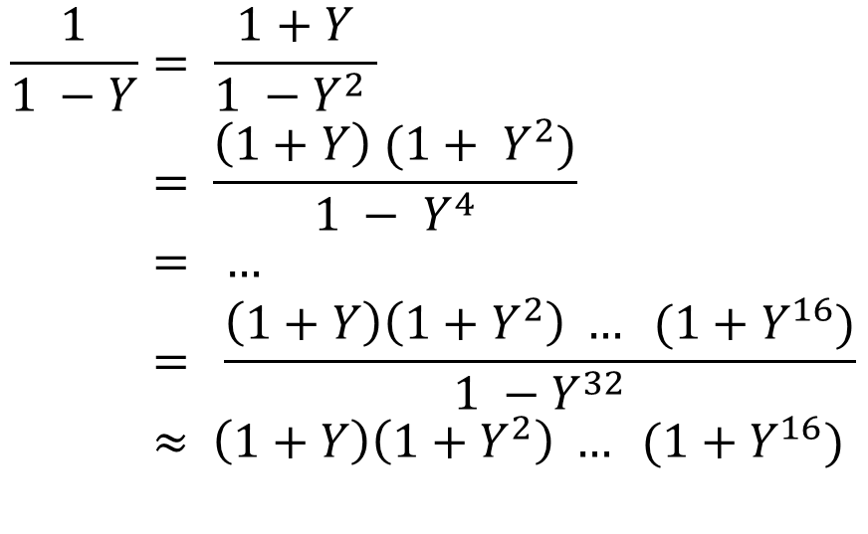
$$\frac{1}{1 −Y}= \frac{1+Y}{1 −Y^{2} } \\ = \frac{\left(1+Y\right) (1+ Y^{2})}{1 − Y^{4}} \\ = … \\ = \frac{\left(1+Y\right)\left(1+Y^{2}\right) … (1+Y^{16})}{1 −Y^{32}} \\ ≈ \left(1+Y\right)\left(1+Y^{2}\right) … (1+Y^{16})$$
No point considering Y³²
Cannot be represented in our format

Slide 46

Generating the 1/(1-Y)
$$\left(1+Y\right)\left(1+Y^{2}\right) … (1+Y^{16})$$
We can compute Y² using a FP multiplier.
Again square it to obtain Y⁴, Y⁸, and Y¹⁶
Takes 4 multiplications, and 5 additions, to generate all the terms
Need 4 more multiplications to generate the final result (1/1-Y)
Compute 1/P_{B} by a single right shift

Slide 47
GoldSchmidt Division Summary
Time complexity of finding the reciprocal
(log(n))²
Time required for all the multiplications and additions
(log(n))²
Total Time : (log(n))²

Slide 48
Division using the Newton Raphson Method
Let us focus on just finding the reciprocal of a number
Let us designate P_{B} as b (1 <= b < 2)
Aim is to compute 1/b
Let us create a function f(x) = 1/x – b
f(x) = 0, when x = 1/b
Problem of computing the reciprocal
same as computing the root of f(x)

Slide 49
Idea of the Method
Start with an arbitrary value of x → x₀
Locate x₀ on the graph of f(x)
Draw a tangent to f(x) at (x₀ , f(x₀))
Let the tangent intersect the x axis at x₁
Draw another tangent at (x₂, f(x₂))
Keep repeating
Ultimately, we will converge to the root

Slide 50
Newton Raphson Method
x₀,f(x₀)
f(x)
x₁,f(x₁)
root
x₂
x₁
x₀
x

Slide 51
Analysis
f(x) = 1/x – b
f’(x)= d f(x) / d(x) = -1 / x²
f'(x₀) = -1/x₀²
Equation of the tangent : y = mx + c
m = -1/x₀²
y = -x/x₀² + c
At x₀, y = 1/x₀ - b

Slide 52

Algebra
$$\frac{1}{x_{0}} −b=−\frac{x_{0}}{x_{0}^{2}}+c \\ ⇒ \frac{1}{x_{0}} −b=− \frac{1}{x_{0}}+c$$ $⇒c= \frac{2}{x_{0}}−b$
The equation of the tangent is :
y = -x/x₀² + 2/x₀ – b
Let this intersect the x axis at x₁

Slide 53
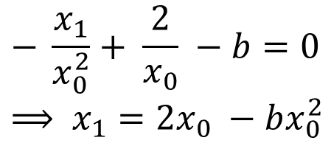
Intersection with the x-axis
$$− \frac{x_{1}}{x_{0}^{2}}+ \frac{2}{x_{0}} −b=0 \\ ⟹ x_{1}=2x_{0} −bx_{0}^{2}$$
Let us define : E(x) = bx – 1
E(x) = 0, when x = 1/b

Slide 54

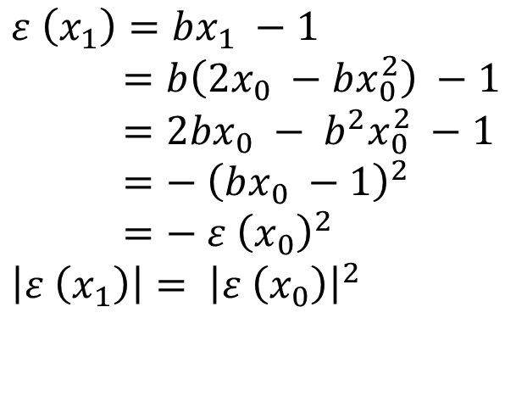
Evolution of the Error
$$ε \left(x_{0}\right)=bx_{0} −1$$
$$ε \left(x_{1}\right)=bx_{1} −1 \\ =b\left(2x_{0} −bx_{0}^{2}\right) −1 \\ =2bx_{0} − b^{2}x_{0}^{2} −1 \\ =− {\left(bx_{0} −1\right)}^{2} \\ =− {ε \left(x_{0}\right)}^{2} \\ \left|ε \left(x_{1}\right)\right|= {\left|ε \left(x_{0}\right)\right|}^{2}$$

Slide 55
Bounding the Error
1 <= b < 2 (significand of a normal floating point number)
Let x₀ = ½
The range of (bx₀ – 1) is [-1/2, 0]
Hence, |E(x₀)| <= ½
The error thus reduces by a power of 2 every iteration

Slide 56
Evolution of the Error - II
Iteration
max(ε (x)
0
1
2
1
1
2
2
2
1
2
4
3
1
2
8
4
1
2
16
5
1
2
32
E(x) = bx – 1 = b (x – 1/b)
x – 1/b is the difference between the ideal value and the actual estimate (x). This is near 2⁻³², which is too small to be considered.
No point considering beyond 5 iterations
Since, we are limited to 23 bit mantissas

Slide 57
Time Complexity
In every step, the operation that we need to perform is :
x_{n} = 2x_{n-1} – bx_{n-1}²
Requires a shift, multiply, and subtract operation
O(log(n)) time
Number of steps: O(log(n))
Total time : O( log (n)² )

Slide 58
THE END

