Slide 1
AI and Processors
Shashank Aital,
The Department of Computer Science and Engineering,
Indian Institute of Technology, Roorkee

Slide 2
The CPU
The “Central Processing Unit”
Sequentially execute instructions
Example: Multiplication
Fetch the current instruction with the help of Program Counter
Decode the instruction
Execute the instruction: Multiplication
Fetch the operands into ALU
Send a control signal to the ALU to perform multiplication
Store the answer in a register or memory as per the instruction
Then, fetch the next instruction
CPU design aims at reducing the Latency so that complex operations can be performed quickly.

Slide 3
AI - A challenge for processors?

Slide 4
Steps involved in making a model
Preprocess input data
Training the model
Storing the Trained Model
Deploy the model in production phase
Processor intensive tasks
Training the model
Inference

Slide 5
Training the Model
The forward pass
Multiply weights and add biases to the layer input
Feed the output of the previous layer to current layer
The Backward pass
In order to change weights and biases to get the desired output, we find the gradients of each parameter (may it be weights or biases) and use that to compute an optimized parameter.
Use chain rule.
Inference
Once the model is trained, we forward pass the new inputs and predict the output
Matrices?
The weights of each layer are stored in a matrix and biases are stored in a vector.
The output of that layer can be easily calculated by multiplying the weight matrix to the input vector and adding the bias vector to the product.

Slide 6
But what’s the problem?
Classical processor executes sequentially
Say we are multiplying 2 order “n” matrices.
The time complexity achieved is O(n³)
Not a problem for small values
Big Data
VGG16 - CNN with 16 layers has over 140 million parameters with very large matrices
Solution?
Parallel Processing

Slide 7
Parallel Processing
Two main operations executed over and over again
Multiply ‘n’ pairs of numbers
Add those products
Define an operation Multiply-Accumulate (MAC)
MAC can be used to calculate an element in the output of matrix multiplication
Different MAC operations are independent of one another
Execute the same MAC operation on the same operand simultaneously over different rows and columns.
Gives O(n) complexity
Need of large throughput.

Slide 8
AI Accelerators

Slide 9
The Graphics Processing Unit
Traditionally designed to process images
Unlike CPUs, which are designed for low latency, GPUs are designed for high throughput.
Have multiple small processing cores / clusters which facilitates parallel processing.
Each cluster has a dedicated L1 cache and a shared L2 cache between all the clusters.
Ex: NVIDIA Tesla V100

Slide 10
The Vision Processing Unit (VPU)
Facilitated Machine Vision Tasks
Designed to capture visual data and perform inference on it via parallel processing
Low power consumption
Ideal for CNNs, SIFTs and other similar computer vision algorithms
May include inbuilt camera buffers for enhanced performance
VPUs can be used in smartphones, IoT devices or Security Systems

Slide 11
Application Specific Integrated Circuit (ASIC)
Highly sophisticated processors designed by taking the work that is expected into consideration.
ASICs employ strategies such as optimised memory use, use of low precision arithmetic, etc. to increase the throughput of the computation.
Drawback: Cannot be used if the workflow changes (Has to be designed and produced again)
Ex: Google TPU - More on that later

Slide 12
Field Programmable Gate Array (FPGA)
An FPGA is an Integrated Circuit made to be configured by the end user to meet the requirements of the task in hand.
It has a range of programmable logic blocks and a range of reconfigurable interconnects.
FPGAs prove to be a lot more effective than GPUs in case of interface devices as they can be reprogrammed
They can include RAM blocks and logic hubs to enhance computation
They are similar to ASIC. But are a lot more flexible

Slide 13
Processors dedicated to AI

Slide 14
Intel - Habana

Slide 15
Intel - Habana
Habana Labs made 2 processors that gave a tough competition to the state of the art NVIDIA V100.
Intel bought out Habana Labs Ltd. for $2B
They achieved this by splitting the tasks of training and inference in two different chips
The processors are:
Habana Gaudi - A highly specialized neural network training chip
Habana Goya - An inference chip to be used in active deployment
Both run on 8 Habana TPC 2.0 cores but differ in the inbuilt libraries and memories

Slide 16
Intel Habana Gaudi
Fully Programmable Tensor Processing Core (TPC)
Tools, Libraries and Compiler
High Level Architecture:
8 x TPC 2.0
Each TPC 2.0 is a VLIW SIMD Processor with many features as:
GEMM (GEneral Matrix to Matrix Multiplication) operation acceleration
Tensor Addressing
Latency Hiding Capabilities
Random Number Generation
Advanced Implementation of Special Functions
Memory Architecture:
Local Memories on each TPC
4 HBMs providing a total of 32 GB space and 1 TB/s bandwidth

Slide 17
Intel Habana Gaudi - Training Strategies
Data Parallelism
Here, every core has a local copy of the Deep Learning Model.
Each core receives a different portion of data and the algorithm runs on all the cores independently
Finally, the results from all the cores are summed up in a hierarchical manner.
In the first reduction, half of the nodes contain the sum results of themselves and their neighbours and so on.
There is a Parameter Server to store the final summed and normalized value of all the parameters
Model Parallelism
Here, different machines are responsible for training different parts of the model.
We follow a pipelined sequential approach to train the model where every core performs its processing and sends the processed model to the next core and it in turn receives the next mini-batch for training from the previous core.

Slide 18
Intel Xeon - Skylake Microarchitecture

Slide 19
Intel Xeon Processors - Skylake microarchitecture
Xeon is a family of scalable processors manufactured by intel for non-consumer workstation, server and embedding system markets.
Skylake is the next microarchitecture succeeding Broadwell microarchitecture.
Some features of Skylake Mesh Architecture:
Till Broadwell, ring based architectures were used for inter-core and core-memory communications.
This version introduces the mesh architecture which makes it easier to move information around different cores preventing bottlenecks.
Comprises of an array of vertical and horizontal paths, allowing traversal along the shortest path.

Slide 20
Intel Xeon Processors - AVX-512 ISA
AVX-512 is a 512 bit SIMD instruction set implemented in Skylake-X
AVX-512 consists of multiple instructions that may be implemented independently, thus, allowing parallel processing
It consists of several separate sets having unique CPUIDs. Some of them are:
Foundation (F)
Exponential and Reciprocal Instructions (ER)
Prefetch Instructions (PF)
Intel introduced three more sets with the Skylake Microarchitecture:
Vector Length Instructions (VL)
Double Word and Quadword Instructions (DQ)
Byte and Word Instructions (BW)
It has vector instructions where the operands are vectors. These instructions are executed in parallel across different cores.

Slide 21
NVIDIA DGX - 2 (AI Server)

Slide 22
NVIDIA DGX-2 (AI Server)
Made by integrating 16 NVIDIA V100 Tensor Core GPUs and powered by NVIDIA DGX software, this workstation gives a performance of 2 petaFLOPS.
Total GPU memory of 512 GB (32 x 16)
CPU: Dual Intel Xeon Platinum 8186 @ 2.7 GHz, 24 cores
OS: Ubuntu (Linux)

Slide 23
NVIDIA Tesla V100 (GPU)
Transistor count: 21.1B
GPU Architecture: NVIDIA Volta. Some of its features are:
Integrations with APIs:
Volta uses CUDA 9 for organizing groups of communicating threads
Pascal and Volta include support for new cooperative launch APIs that support synchronization amongst CUDA thread blocks.
Second Generation NVIDIA NVLink:
Delivers high speed interconnect, higher bandwidth, more links, and improved scalability for multi-GPU system configurations
Volta GV100 supports up to 6 NVLink links and a total bandwidth of 300 GB/sec.
Memory
HBM2 Memory: Faster, Higher Efficiency
16 GB HBM2 memory subsystem delivers 900 GB/sec peak memory bandwidth.

Slide 24
Google TPU

Slide 25
Google TPU
CPUs are sequential machines. Hence, they are called scalar machines.
GPUs take 1D array of operands. Hence, they are vector machines.
ML / DL algorithms contain many matrix multiplications calculations.
So, we make such a hardware architecture such that MACs perform complete matrix multiplication.
TPUs achieve a high level of performance using systolic arrays.

Slide 26
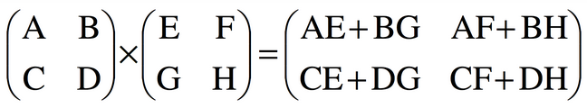

Systolic arrays
They are grids of processors interconnected to simulate a matrix.
We perform matrix multiplication by storing the operands in this grid.
In reality, these arrays can be as big as 128 x 128. But, let’s simulate a 2 x 2 systolic array.
Consider the first matrix as matrix containing activations of the previous layer and the second matrix as the weight matrix.
Initially, we load weights into the systolic array:

Slide 27
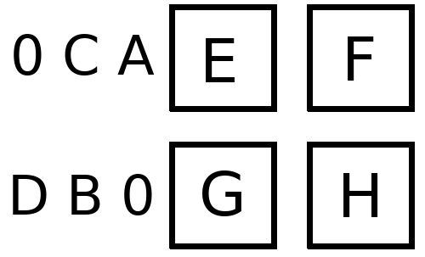
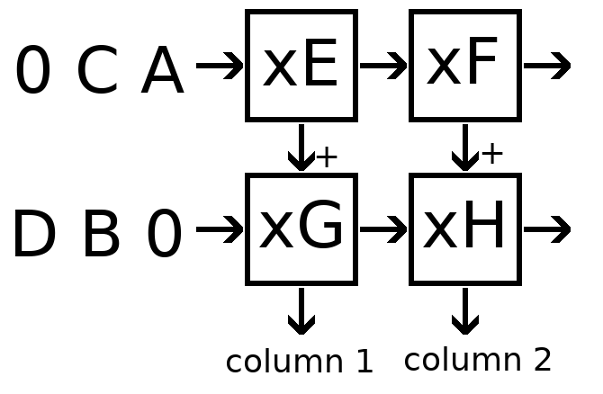
Systolic arrays
Then, we load activations in input queue as follows:
We perform the following steps in each cycle:
Multiply the weight in that cell to the activation coming from the left. If there is no cell to the left, take the input activation from the input queue.
Add the product to the partial sum obtained from the cell directly above. If there is no cell above, use partial sum equals 0.
Pass the activation to the cell to the right. If there is no cell to the right, discard the activation
Pass the activation to the cell at the bottom. If there is no cell at the bottom, store the partial sum as output.
Example: For 2 x 2 :

Slide 28
Systolic arrays
Input queues are appended with zeros in order to ensure that they enter the correct cell at the correct moment.
While a regular sequential processor requires n³ cycles, systolic arrays perform the same operation in (3n-2) cycles.
The core advantage of TPU is its MXU - a systolic array matrix multiplication unit.

Slide 29
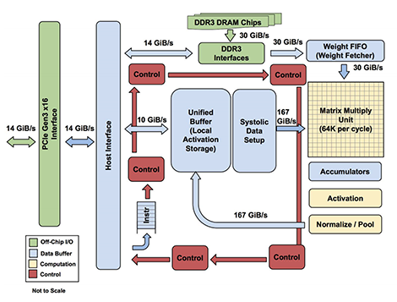
TPU - Inner Working

Slide 30
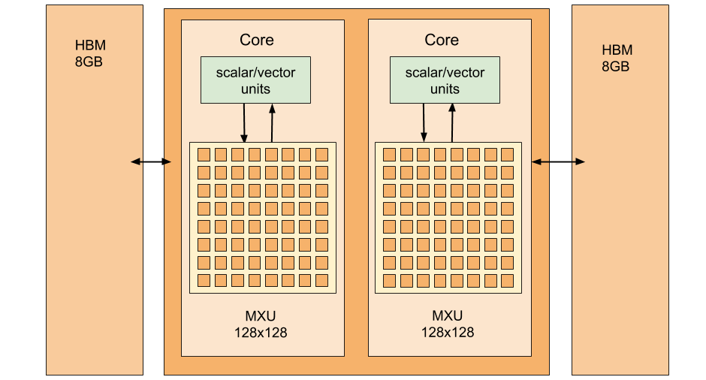
TPU v2
TPU v2 has some new features on TPU v1 such as:
8 GiB of HBM for each TPU Core
One MXU for each TPU Core
Upto total 512 TPU cores and 4 TiB of total memory in a TPU Pod

Slide 31
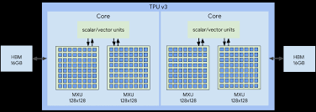
TPU v3
TPU v3 has higher features built on TPU v2 such as:
16 GiB of HBM for each core
Two MXUs for each TPU Core
Upto 2048 total TPU Cores and 32 TiB of total memory in a TPU Pod

Slide 32
THANK YOU

