Slide 1
Processor Design for ML/AI
CSN-221 CAM Autumn 2020-21: Project 1
Shreyas Dodamani
19114079

Slide 2
About Processors...
I5
Control Unit (CU)
I4
I3
Central Processing Unit
F - Fetch
D - Decode
A - ALU
W - Register Write
CPU
Arithmetic and Logic Unit (ALU)
I2
I1

Slide 3
ML in Brief
Neural Network
a_{i} = w_{i}^{T} x_{i-1} + b_{i}
Input
Output
Hidden Layers

Slide 4

Why is ML Heavy Duty?
Ideally, compute bound limitations exist
Matrix multiplication takes
O( n² ) memory
O( n³ ) computation time
Practically, it can be memory bound too
Unit
a_{ik}* b_{kj}
n² computations in
O( n² ) time
Unit
n
n² computations in
O( 1 ) time
n

Slide 5
The Solution
Parallel Processing
Throughput > Latency

Slide 6
AI Accelerators
Graphics Processing Unit - GPU
Array of CPUs connected to a central control unit
CPU
GPU

Slide 7
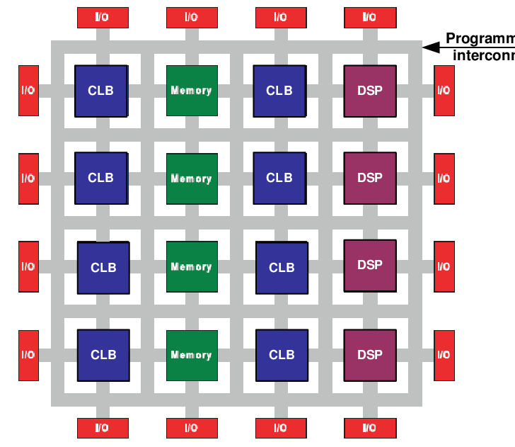
AI Accelerators
Field Programming Gate Array - FPGA
Integrated circuits with flexible logic
Users can modify logic to their convenience
Source: ResearchGate

Slide 8
AI Accelerators
Application Specific Integrated Circuit - ASIC
Integrated circuit chip customized for a particular use, rather than intended for general-purpose use.

Slide 9



Vendors
Google Cloud TPU v1, v2, v3
Huawei Ascend
310, 910
NVIDIA Volta v100

Slide 10
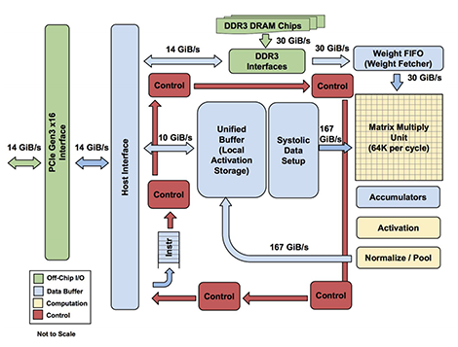
Google TPU v1 - ASIC
Source: arxiv.org

Slide 11
Huawei Ascend
Ascend 310 | Ascend 910
16 TOPS@INT8 8 TOPS@FP16 | 512 TOPS@INT8 256 TFLOPS@FP16
Power consumption: 8W | Max power consumption: 350W
Built on Huawei’s Da Vinci Architecture
Ascend 910 is a System-on-Chip Processor

Slide 12
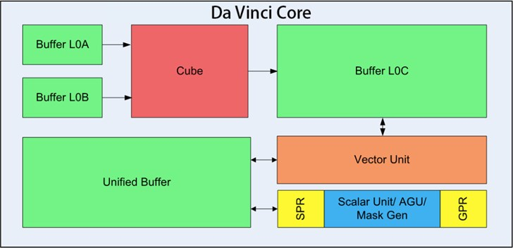
Huawei Ascend - Da Vinci Architecture
Source: fonow.com

Slide 13
NVIDIA Volta v100 - GPU
Streaming Multiprocessors (SM)
One SM is divided into quadrants
Data caches
L1 Cache - Localised
L2 Cache - Common
Instruction caches
Increase efficiency
NVLINK
Interconnection between processors that allow 128-bit one word instructions
Extremely high throughput
300 GB / second

Slide 14

?

Slide 15
Comparing Vendors
Chip | Google TPU v1 | Huawei Ascend 910 | Nvidia Volta v100
TDP (W) | 75 | 350 | 300
On-Chip RAM (MB) | 28 | 64 | 21.1
Peak FP32 (TFLOPs) | unknown | unknown | 15.7
Peak FP16 (TFLOPs) | 23 (INT6) | 256 | 125
Memory bandwidth (GB/s) | 30 (DDR3) | 1200 (HBM2) | 900 (HBM2)
I/O bandwidth (GB/s) | 14 | 115 | 300

Slide 16
THANK YOU

