Slide 1

LIBRARY MANAGEMENT SYSTEM

Slide 2
INTRODUCTION
This project is about managing library books and users digitally.
Uses Advanced Object-Oriented Programming (OOP) to make the system easy to update and expand.

Slide 3
OBJECTIVE
Simplify managing library resources such as books and user accounts.
Increase efficiency by automating repetitive tasks.
Use design patterns to demonstrate better coding practices and problem-solving techniques.

Slide 4
SURVEY OF EXISTING LIBRARY SYSTEMS
1. Koha (Open-Source Library System)
Features:
Manages books, users, and transactions.
Supports book issuing, returning, and fines.
Provides reports and search functionality.
Limitations:
Difficult to set up and requires technical expertise.
Not very user-friendly for beginners.

Slide 5
SURVEY OF EXISTING LIBRARY SYSTEMS
2. Libib
Features:
Allows book cataloging and barcode scanning.
Helps track lending history.
Stores data in the cloud for easy access.
Limitations:
Does not have advanced library management features.
No proper role-based access (Admin, Librarian, Member).

Slide 6
TECHNOLOGY STACK
Programming Language:
Java → For backend logic & OOP concepts.
Frameworks & Libraries:
JavaFX / Swing → For building the user interface.
JUnit → For testing code.
Database:
MySQL → Stores books, users, and transactions.

Slide 7
SYSTEM DESIGN (MVC PATTERN)
Our system follows the Model-View-Controller (MVC) design:
Model:
Handles data (Books, Users, Transactions).
View:
User interface (Screens for Admin, Librarian, and Member).
Controller:
Connects the UI with the database and logic.

Slide 8
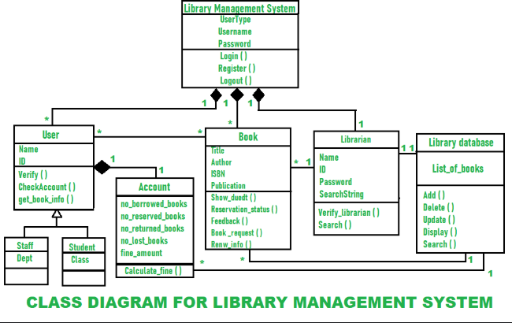

Slide 9
FEATURES OF OUR SYSTEM
1. Admin:
Adds & removes users and books.
Views reports and system logs.
2. Librarian:
Issues & returns books.
Manages the book catalog.
3. Member:
Searches and borrows books.
Checks due dates and borrowing history.

Slide 10
FEATURES OF OUR SYSTEM
Late Fee System (Using Decorator Pattern).
User Account Creation (Using Factory Pattern).
Secure Database (Using Encapsulation in Java).

Slide 11
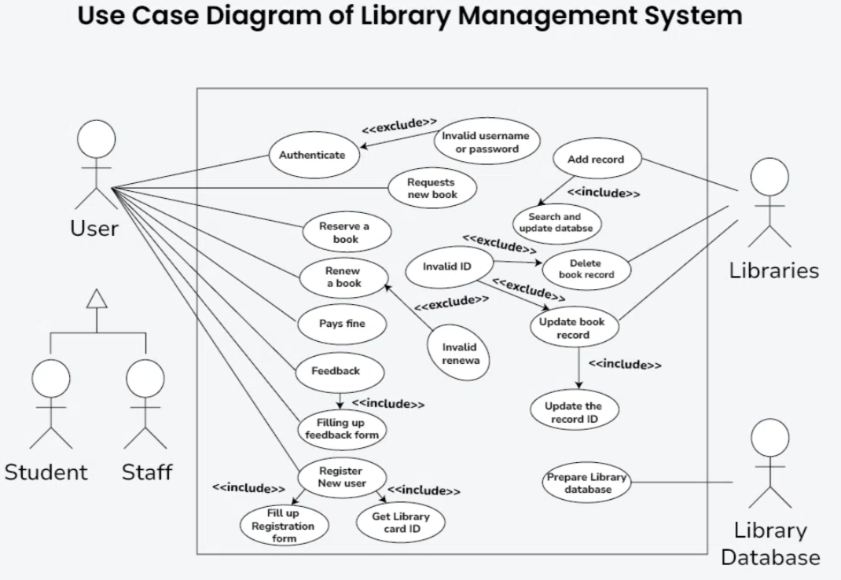

Slide 12
TEAM ROLES & RESPONSIBILITIES
Team Leader:
2310030411-manage the project timeline and assign tasks.
Backend Developer:
124,247:Will develop the core logic using Java.
Frontend Developer:
411,129Will design the UI and connect it to the backend.
Tester & Debugger:
125: Will test the system and fix errors.

Slide 13
CONCLUSION
What We Aim to Achieve:
Apply OOP concepts and design patterns effectively.
Develop a well-organized and user-friendly library system.

Slide 14
THANK YOU

