Slide 1
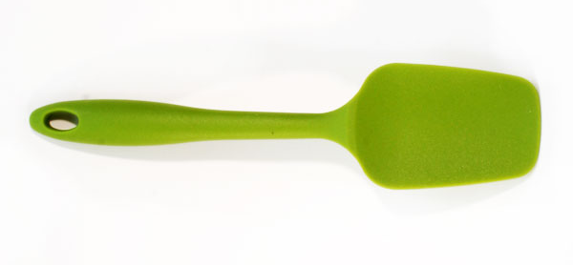
Spatula
Find Recipes and Cook Them
#Yolo
Rahul Gupta, Samantha Dove, Sean Dadashi

Slide 2

Audience: Cooks

Slide 3
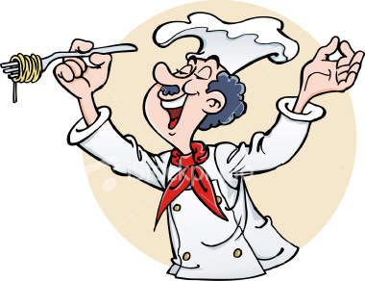

Twofold Problem
1. Find a Meal to Cook
2. Cook that Meal

Slide 4
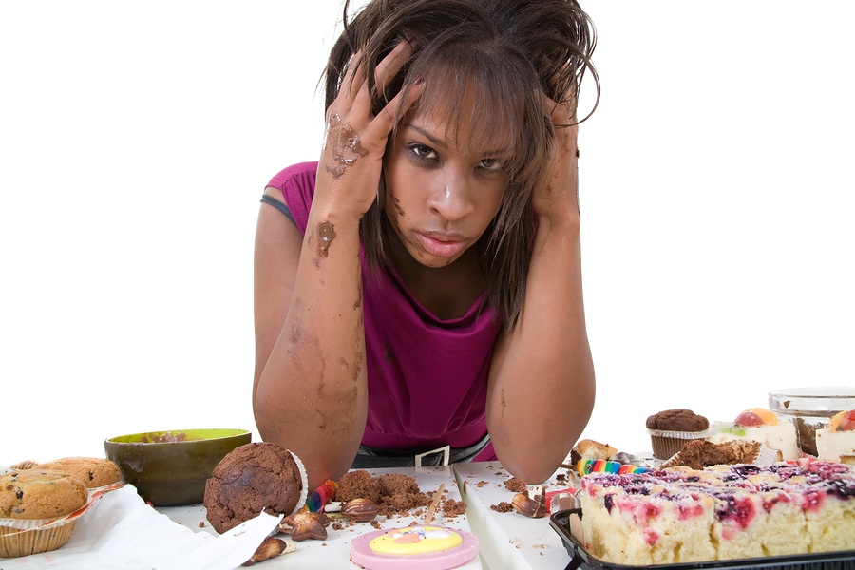
1. Find a Meal to Cook

Slide 5

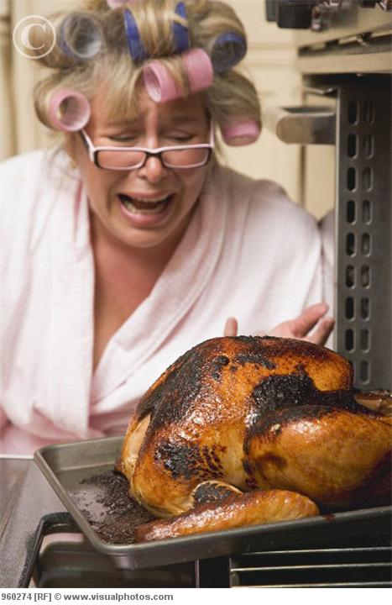
2. Cook a Meal
Rolls
Broccolli
Stuffing
Turkey
Pie
Another Pie

Slide 6
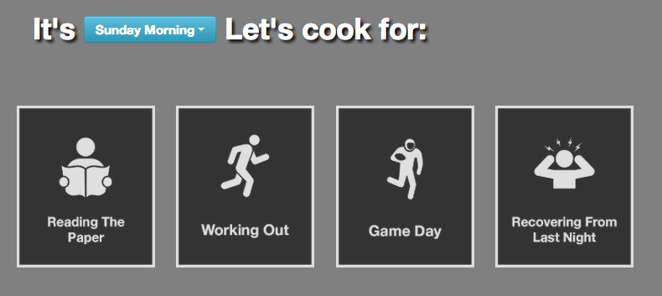
Solutions
Problem 1: Find a Meal to Cook
Solution: Suggest meals based on mood and time of day

Slide 7
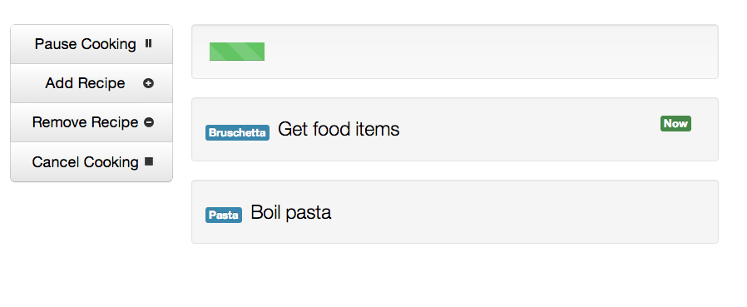
Solutions
Problem 2: Cook a Meal to Perfection
Solution: Step by Step Timeline

Slide 8
Tasks
Find a meal you feel like cooking. (M)
Find and add a single recipe to cook. (E)
After you’ve started cooking, find and add an additional recipe to your meal. (H)
1
2
3

