Slide 1

Smart Searchify
AI-Enabled Semantic Search for eSankhyiki
Rahul Khichar

Slide 2
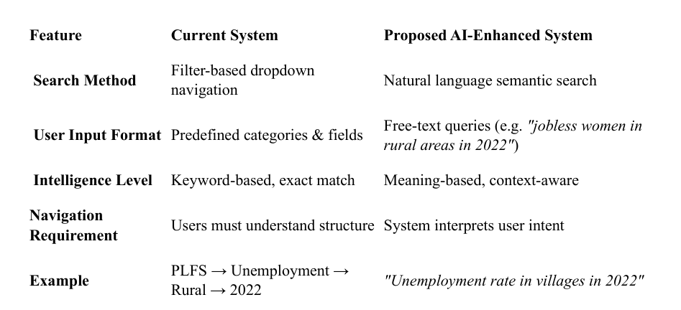
Problem Statement
The eSankhyiki Portal serves as a one-stop platform for accessing India’s official statistics through a structured, filter-based search. Our project aims to elevate this experience by integrating AI-powered semantic search, utilizing word embeddings and natural language understanding to enable more user friendly and intelligent data discovery.

Slide 3
Extracting Datasets using Web Scraping
To automate the extraction of datasets from HTML files and save them in a structured format (CSV).
The eSankhyiki portal provides data mainly in HTML format. APIs or structured data files (CSV, Excel) are unavailable or difficult to access.
For web scraping, several third-party Python libraries are commonly used:
Requests – fetches HTML content from web pages
BeautifulSoup – to parse and extract HTML content
Crome Extension: Single file (easlily extracts HTML file where request doesn’t work
Process:
- Fetch HTML data using requests or Selenium.
- Parse and clean the data using BeautifulSoup.
- Extract specific dataset information (e.g., title, category, release date).
- Save extracted data to CSV for easy access and analysis

Slide 4

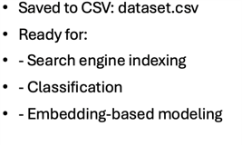
Data Preproccessing
For Loading and concatenation we used Used os.listdir() to list folders/files​
Read each CSV using pandas.read_csv()​
Concatenated using pd.concat()​
Result: Single unified DataFrame​
​
As the part of data cleaning​
Converted 'Release Date' to datetime format​
Removed duplicate entries​
Sorted by release date​
Removed duplicates based on 'Title’​
Defined clean_search_text() to:​
- Remove HTML tags, URLs, special characters​
- Lowercase text and normalize dashes​
- Optionally remove stopwords​
Applied cleaning on 'search_text'​

Slide 5
Classification (Model Selection and Performence)
I experimented with several classification models to identify the best approach for predicting the most relevant product categories. The following table summarizes the performance of various models based on accuracy, model size, and inference time:
Model Accuracy Model Size (KB) Avg Inference Time (ms)
LogisticRegression 1.00 30.98 1.68
LinearSVC 1.00 30.85 1.33
RandomForest 1.00 4342.70 30.63
KNN 1.00 8584.83 38.09
XGBoost 0.9993 880.94 2.17
Both Logistic Regression and LinearSVC achieved perfect accuracy with minimal model size and fast inference times, making them ideal candidates for real-time query classification.

Slide 6
Vectorisation
Transforming textual data into numerical vectors so that machine learning models can process and compare meanings.
Used sentence embeddings from sentence-transformers (all-MiniLM-L6-v2) and transformedsearch_text into 384-dimensional dense vectors​
Benefits: semantic similarity captured​
Semantic Search
Cosine Similarity Search
Cosine similarity measures the angle between two vectors, identifying how similar the query is to document embeddings in high-dimensional space.
Deep Semantic Search (CrossEncoder)
CrossEncoder refines relevance scoring by analyzing query-document pairs with a transformer model, ensuring better semantic understanding for accurate results.

Slide 7
Algorithm: Semantic Search Engine – Accuracy Meets Speed
User Query Input
User enters a natural language search query.
2. Query Embedding (Bi-Encoder)
Generate vector representation using a lightweight model (MiniLM).
Enables fast initial similarity search.
3. Query Classification
Predict top 3 relevant product categories (e.g., CPI, PLFS) using a trained classifier(Linear SVC).
Helps narrow down the search space to improve relevance.
4. First-Stage Filtering (Cosine Similarity)
For each product (or full dataset), compute cosine similarity between query and document embeddings.
Select the top 50 most similar rows per category.
This dramatically reduces the number of candidates for deep analysis.

Slide 8
Deep Semantic Ranking & Result Delivery
5. Second-Stage Re-Ranking (CrossEncoder)
- Apply a deep semantic model (CrossEncoder) to top 50 candidates.
- Score pairs of (query, document text) for nuanced semantic matching.
- Select top N most relevant documents per product.
6. Parallel Overall Search
- Independently apply the same 2-stage process on the entire dataset.
- Return top 10 global matches for broad semantic relevance.
7. Result Presentation
- Show two panels:
- Product-Specific Top Matches (based on predicted categories)
- Overall Top Semantic Matches
- Each result card displays:
- Title, category, metadata, download link, and description.

Slide 9
Optimized For:
Speed via cosine pre-filtering
Accuracy via CrossEncoder semantic re-ranking
Relevance through product classification
Scalability with precomputed embeddings

Slide 10
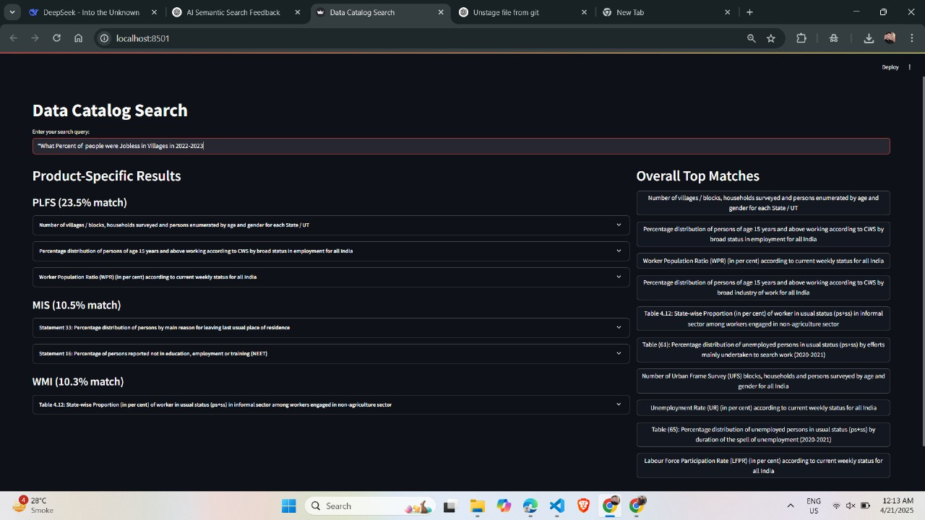
https://github.com/rahulkhichar7/SmartSearchify-AI-Enabled-Semantic-Search-for-eSankhyiki-Portal.git

Slide 11
References
https://huggingface.co/
https://scikit-learn.org/stable/modules/generated/sklearn.svm.LinearSVC.html
https://www.sbert.net/ ( sentence transformer)
https://www.esankhyiki.gov.in/
Thank you

